Slide 1
Chapter 1
Introduction to Digital systems

Slide 2
Signal
A signal is an electromagnetic or electrical current that carries data from one system or network to another.
In electronics, a signal is often a time-varying voltage that is also an electromagnetic wave carrying information, though it can take on other forms, such as current.
There are two main types of signals used in electronics: analog and digital signals.

Slide 3
Analog Signal
An analog signal is time-varying and generally bound to a range (e.g. +12V to -12V), but there is an infinite number of values within that continuous range.
An analog signal uses a given property of the medium to convey the signal’s information, such as electricity moving through a wire.
In an electrical signal, the voltage, current, or frequency of the signal may be varied to represent the information.
Analog signals are often calculated responses to changes in light, sound, temperature, position, pressure, or other physical phenomena.

Slide 4
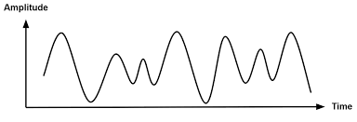
Cont’d
When plotted on a voltage vs. time graph, an analog signal should produce a smooth and continuous curve. There should not be any discrete value changes.

Slide 5
Cont’d
Most of the fundamental electronic components; resistors, capacitors, inductors, diodes, transistors, and operational amplifiers (op amps) are all inherently analog components. Circuits built with a combination of these components are analog circuits.
Analog circuits can be complex designs with multiple components, or they can be simple.

Slide 6
Cont’d
Analog circuits are usually more susceptible to noise, with “noise” being any small, undesired variations in voltage. Small changes in the voltage level of an analog signal can produce significant errors when being processed.
Analog signals are commonly used in communication systems that convey voice, data, image signal, or video information using a continuous signal.

Slide 7
Cont’d
There are two basic kinds of analog transmission, which are both based on how they adapt data to combine an input signal with a carrier signal.
The two techniques are amplitude modulation and frequency modulation.
Amplitude modulation (AM) adjusts the amplitude of the carrier signal.
Frequency modulation (FM) adjusts the frequency of the carrier signal.

Slide 8
Cont’d
Analog transmission may be achieved via many methods:
Through a twisted pair or coaxial cable
Through an optical fiber cable
Through radio
Through water

Slide 9
Digital Signal
A digital signal is a signal that represents data as a sequence of discrete values. A digital signal can only take on one value from a finite set of possible values at a given time.
Digital signals are used in all digital electronics, including computing equipment and data transmission devices. When plotted on a voltage vs. time graph, digital signals are one of two values, and are usually between 0V and VCC.

Slide 10
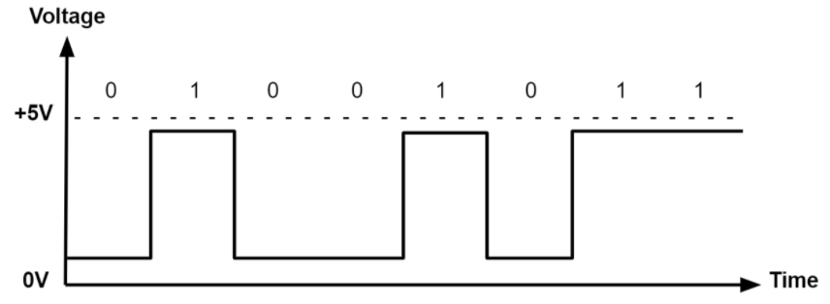
Cont’d
Digital circuits implement components such as logic gates or more complex digital Ics.

Slide 11
Cont’d
Digital circuits commonly use a binary scheme. Although data values are represented by just two states (0s and 1s), larger values can be represented by groups of binary bits.
For example, in a 1-bit system, a 0 represents a data value of 0, and a 1 represents a data value of 1. However, in a 2-bit system, a 00 represents a 0, a 01 represents a 1, a 10 represents a 2, and a 11 represents a 3. In a 16-bit system, the largest number that can be represented is 2¹⁶, or 65,536. These groups of bits can be captured either as a sequence of successive bits or a parallel bus. This allows large streams of data to be processed easily.

Slide 12
Cont’d
Most useful digital circuits are synchronous, meaning there is a reference clock to coordinate the operation of the circuit blocks, so they operate in a predictable manner.
Analog electronics operate asynchronously, meaning they process the signal as it arrives at the input.

Slide 13
Digital Signals vs. Analog Signals
Advantages to using digital signals include the following:
Digital signals can convey information with less noise, distortion, and interference.
Digital circuits can be reproduced easily in mass quantities at comparatively low costs.
Digital signal processing is more flexible because DSP operations can be altered using digitally programmable systems.
Digital signal processing is more secure because digital information can be easily encrypted and compressed.
Digital systems are more accurate, and the probability of error occurrence can be reduced by employing error detection and correction codes.
Digital signals can be easily stored on any magnetic media or optical media using semiconductor chips.
Digital signals can be transmitted over long distances.

Slide 14
Cont’d
Disadvantages to using digital signals include the following:
A higher bandwidth is required for digital communication when compared to analog transmission of the same information.
DSP processes the signal at high speeds, and comprises more top internal hardware resources. This results in higher power dissipation compared to analog signal processing, which includes passive components that consume less energy.
Digital systems and processing are typically more complex.

Slide 15
Cont’d
Advantages to using analog signals include the following:
Analog signals are easier to process.
Analog signals best suited for audio and video transmission.
Analog signals are much higher density, and can present more refined information.
Analog signals use less bandwidth than digital signals.
Analog signals provide a more accurate representation of changes in physical phenomena, such as sound, light, temperature, position, or pressure.
Analog communication systems are less sensitive in terms of electrical tolerance.

Slide 16
Cont’d
Disadvantages to using analog signals include the following:
Data transmission at long distances may result in undesirable signal disturbances.
Analog signals are prone to generation loss.
Analog signals are subject to noise and distortion, as opposed to digital signals which have much higher immunity.
Analog signals are generally lower quality signals than digital signals.

Slide 17
Analog and Digital Signals: Systems and Applications
A few analog signal applications include:
Audio recording and reproduction
Temperature sensors
Image sensors
Radio signals
A few digital signal applications include:
Communication systems (broadband, cellular)
Networking and data communications
Digital interfaces for programmability

