Slide 1
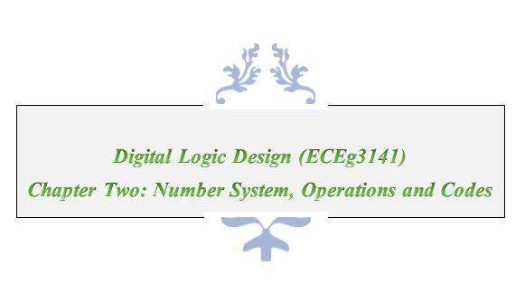
Digital Electronics

Slide 2
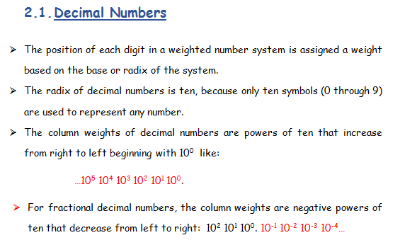

Slide 3
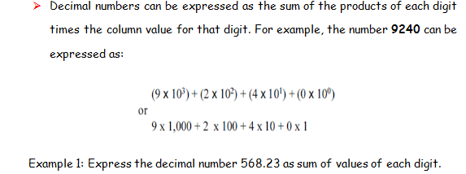
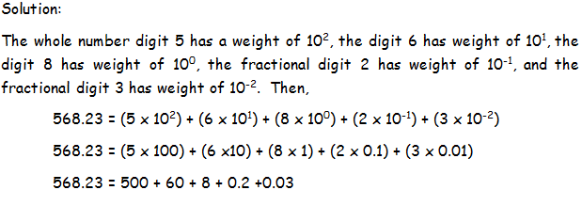
Cont’d…

Slide 4
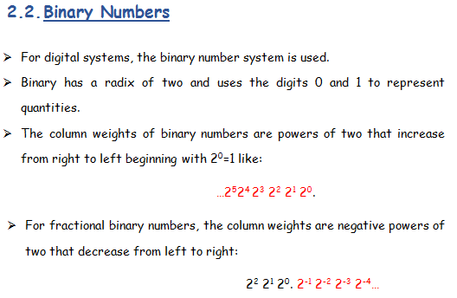

Slide 5
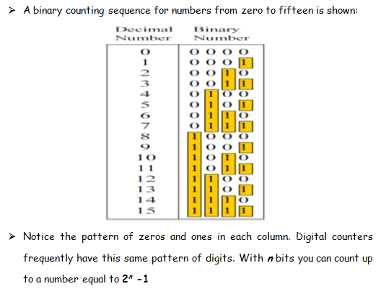
Cont’d…
Decimal Number
Binary Number

Slide 6

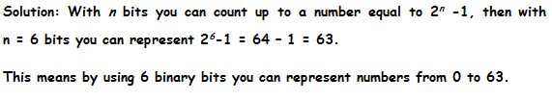
Cont’d…
7

Slide 7
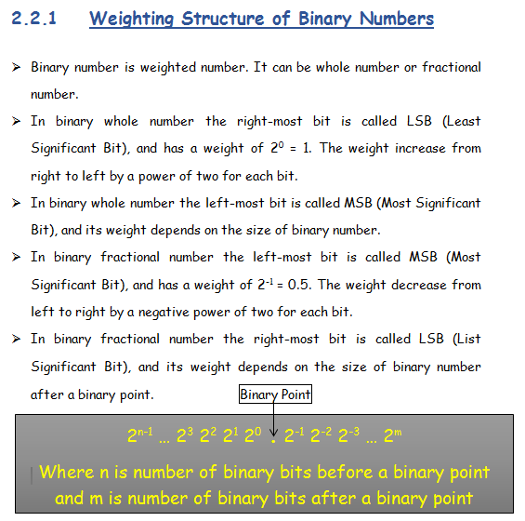

Slide 8
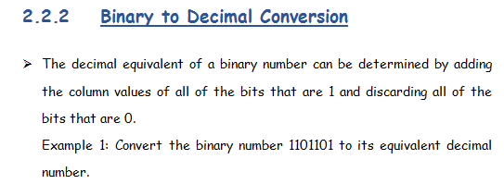
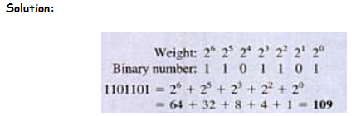
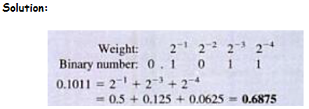

Slide 9
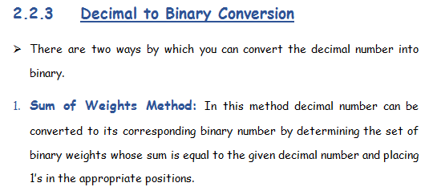

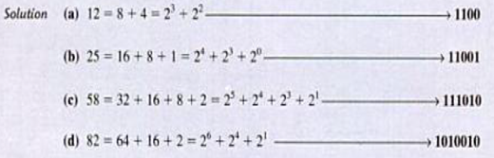

Slide 10
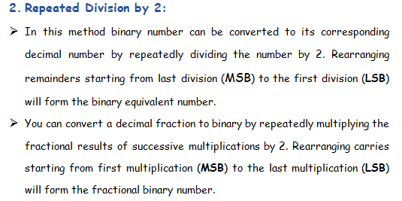
Cont’d…

Slide 11

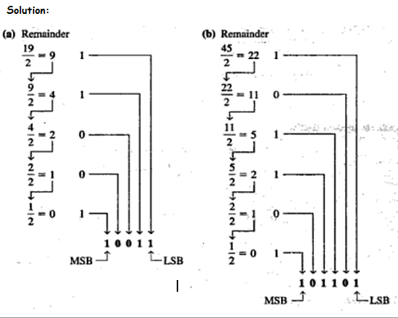
Cont’d…

Slide 12

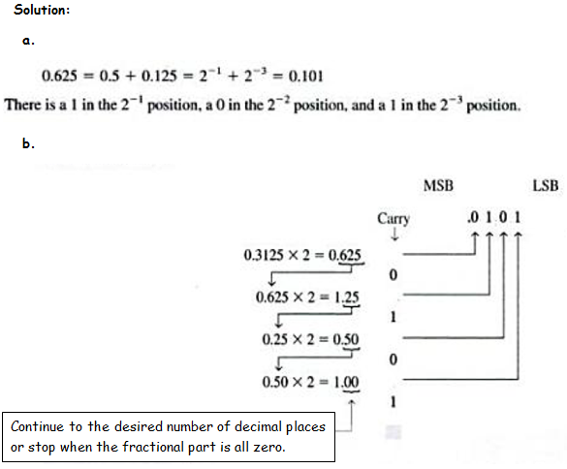
Cont’d…

Slide 13
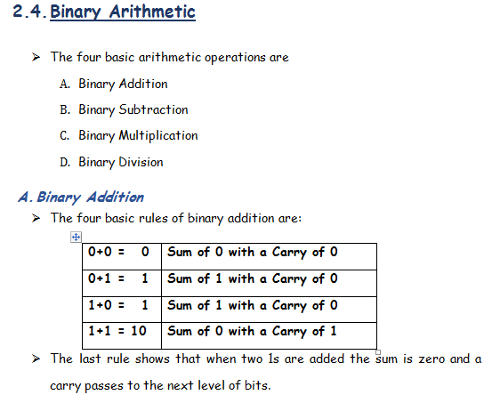

Slide 14

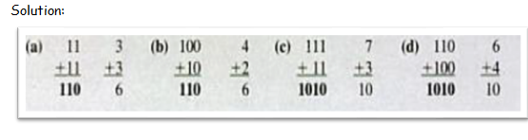

Cont’d…

Slide 15
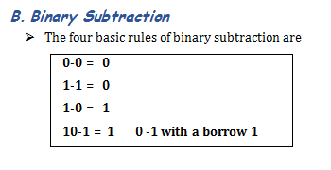

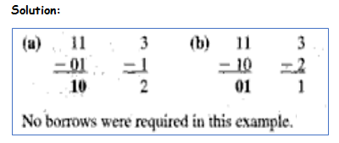
Cont’d…
No borrows were required in this example.

Slide 16

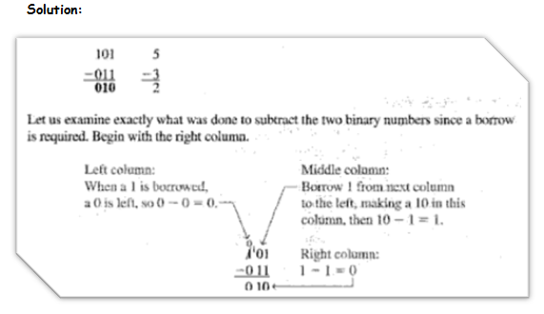
Cont’d…
See the following illustration since a borrow is required in this example.

Slide 17
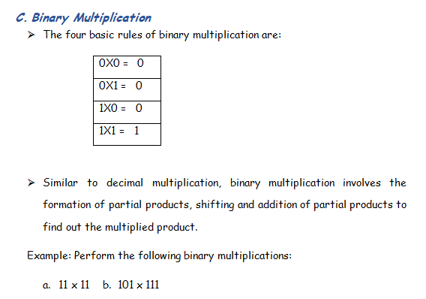
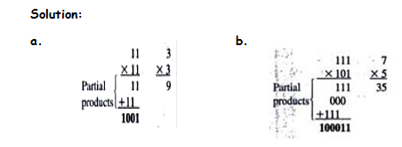
Cont’d…
Partial Products
Partial Products

Slide 18
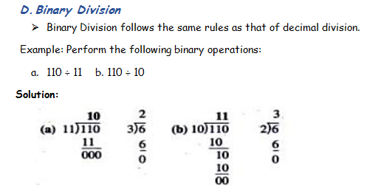
Cont’d…

Slide 19
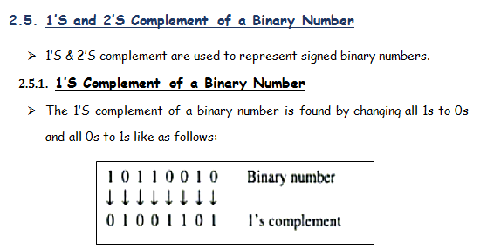
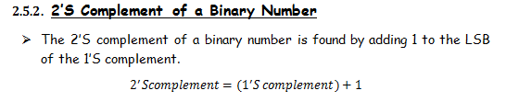

Slide 20
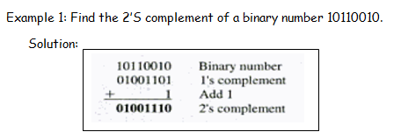
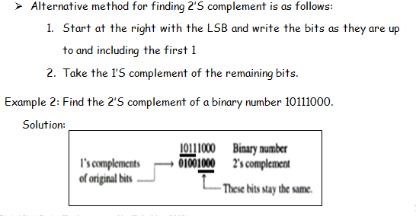
Cont’d…

Slide 21
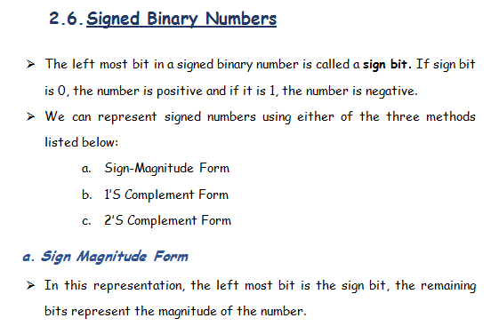

Slide 22
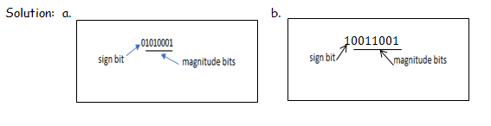
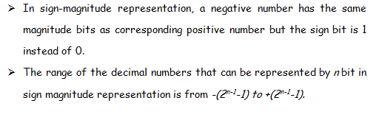
Cont’d…

Slide 23
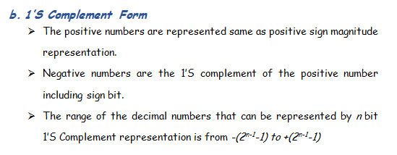
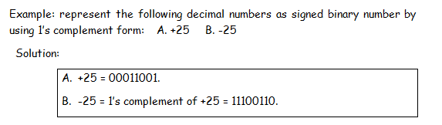
Cont’d…

Slide 24
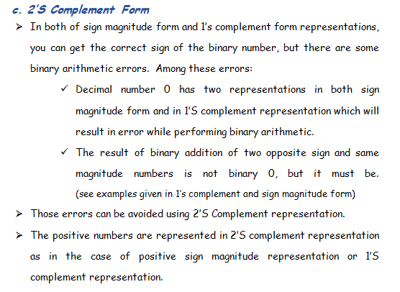
Cont’d…

Slide 25
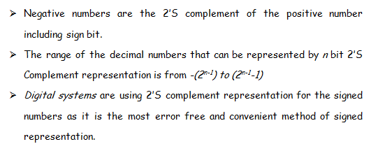
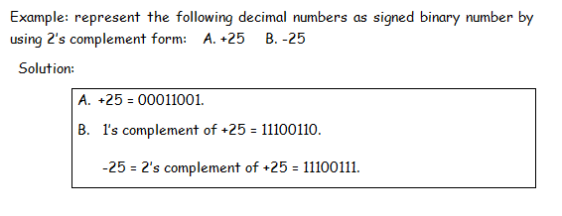
Cont’d…

Slide 26
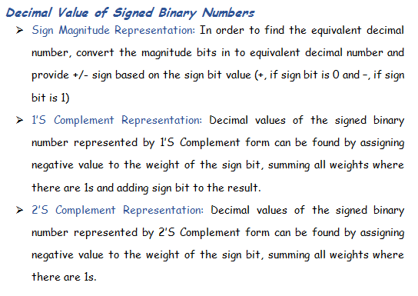
Cont’d…

Slide 27
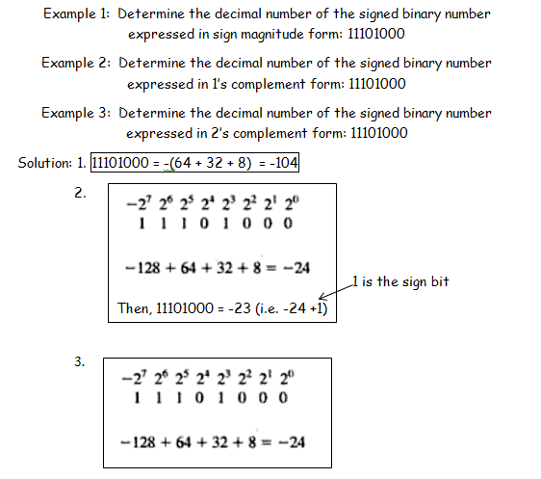
Cont’d…

Slide 28
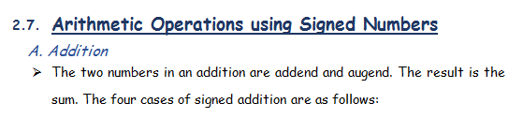
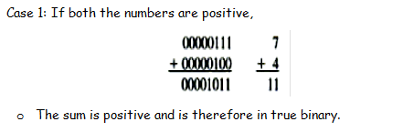
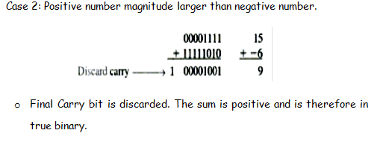

Slide 29
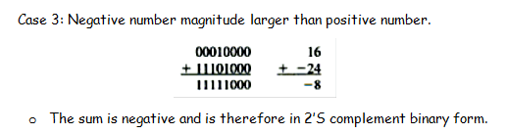
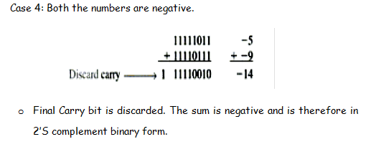
Cont’d…

Slide 30
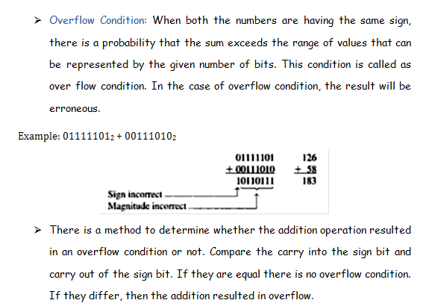
Cont’d…

Slide 31
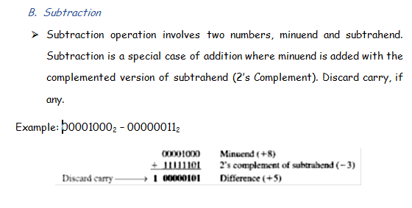

Cont’d…

Slide 32
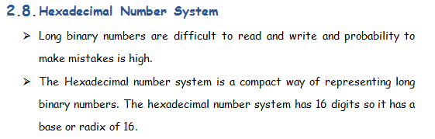
Cont’d…

Slide 33
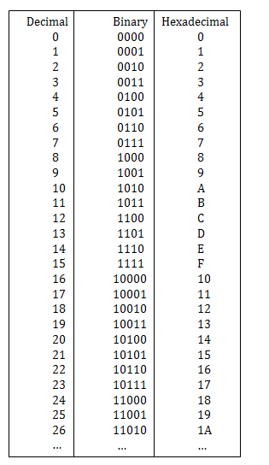
Cont’d…

Slide 34
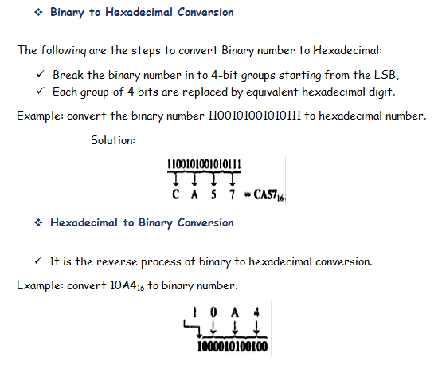
Cont’d…

Slide 35
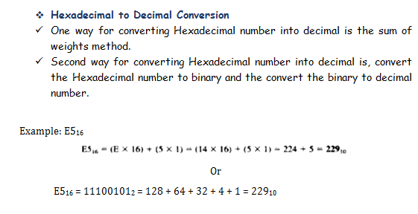
Cont’d…

Slide 36
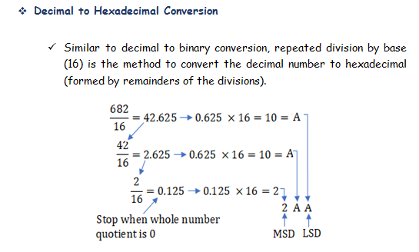
Cont’d…

Slide 37


Slide 38


Cont’d…

Slide 39

Cont’d…

Slide 40

Cont’d…

Slide 41

Cont’d…

Slide 42
Binary Coded Decimal (BCD)
BCD is a way to express each of the decimal digits with a binary code.
There are only 10 code groups in the BCD system
Ex : 35₁₀ = 0011 0101
0 | 1 | 2 | 3 | 4 | 5 | 6 | 7 | 8 | 9
0000 | 0001 | 0010 | 0011 | 0100 | 0101 | 0110 | 0111 | 1000 | 1001

Slide 43
Digital Codes
There are other specialized codes used in digital systems ➔ e.g. Gray code, ASCII code
Some codes are
strictly numeric : e.g. BCD
Alphanumeric – to represent numbers, letters, symbols, instructions : e.g. ASCII

Slide 44
Gray Code
is not an arithmetic code
Only one bit changes from one code to the next in the sequence
Gray code can be any amounts of bits.
Below is example from Gray Code-to-Binary
Eg : 1110 (Gray Code)
= 1011₂

Slide 45
Gray Code
Below is example from Binary-to-Gray Code
Eg : 1110₂
= 1001 (Kod Gray)

Slide 46
DECIMAL | BINARY | GRAY CODE
0 | 0000 | 0000
1 | 0001 | 0001
2 | 0010 | 0011
3 | 0011 | 0010
4 | 0100 | 0110
5 | 0101 | 0111
6 | 0110 | 0101
7 | 0111 | 0100
8 | 1000 | 1100
9 | 1001 | 1101
10 | 1010 | 1111
11 | 1011 | 1110
12 | 1100 | 1010
13 | 1101 | 1011
14 | 1110 | 1001
15 | 1111 | 1000

Slide 47
ASCII
American Standard Code for Information Interchange (ASCII)
It has 128 characters and symbols represented in 7-bit binary code
Example :
A = 1000001₂;
a = 1100001₂

Slide 48
ASCII Table
Kos ASCII : 1000001₂
 | 000 | 001 | 010 | 011 | 100 | 101 | 110 | 111
0000 | NUL | DLE | SP | 0 | @ | P | ` | p
0001 | SOH | DCI | ! | 1 | A | Q | a | q
0010 | STX | DC2 | " | 2 | B | R | b | r
0011 | ETX | DC3 | # | 3 | C | S | c | s
0100 | EOT | DC4 | $ | 4 | D | T | d | t
0101 | ENQ | NAK | % | 5 | E | U | e | u
0110 | ACK | SYN | & | 6 | F | V | f | v
0111 | BEL | ETB | ' | 7 | G | W | g | w
1000 | BS | CAN | ( | 8 | H | X | h | x
1001 | HT | EM | ) | 9 | I | Y | i | y
1010 | LF | SUB | * | : | J | Z | j | z
1011 | VT | ESC | + | ; | K | [ | k | {
1100 | FF | FS | , | < | L | \ | l | |
1101 | CR | GS | - | = | M | ] | m | }
1110 | SO | RS | . | > | N | ^ | n | ~
1111 | SI | US | / | ? | O | _ | o | DEL

Slide 49
ASCII example: 20 PRINT A=“X”;
Symbol | Binary | Hexadecimal
2 | 0110010 | 32
0 | 0110000 | 30
Space | 0100000 | 20
P | 1010000 | 50
R | 1010010 | 52
I | 1001001 | 49
N | 1001110 | 4E
T | 1010100 | 54
Space | 0100000 | 20
A | 1000001 | 41
= | 0111101 | 3D
“ | 0100010 | 22
X | 1011000 | 3B
“ | 0100010 | 22
; | 0111011 | 3B
1000001₂ = 0100 0001₂
4 1₈

