Slide 1
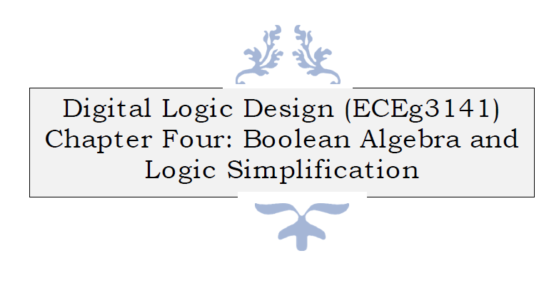

Slide 2

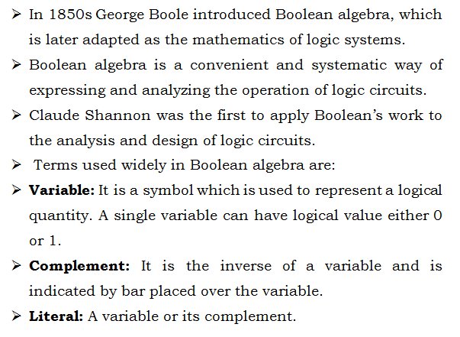

Slide 3

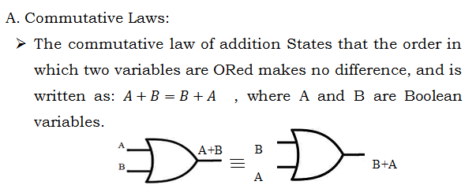
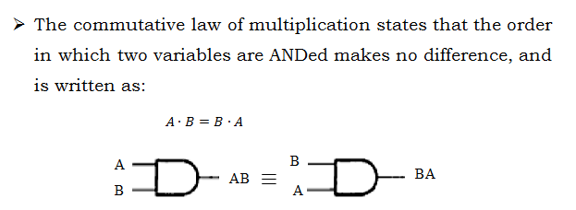

Slide 4
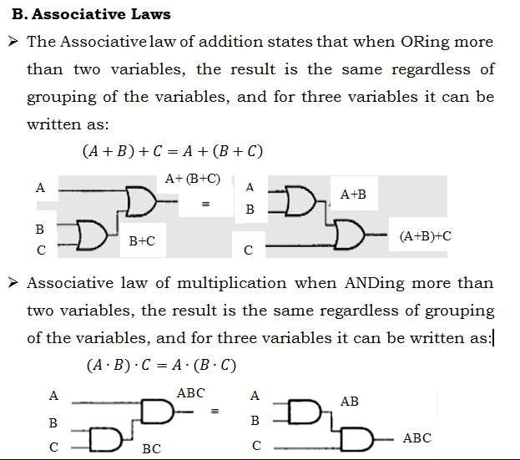
Cont’d…

Slide 5
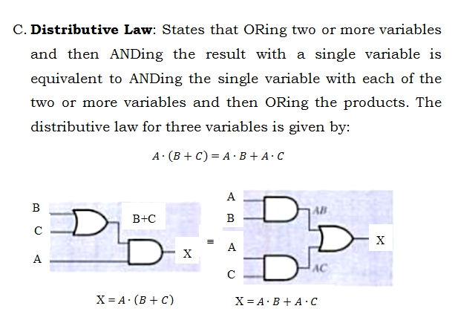
Cont’d…

Slide 6

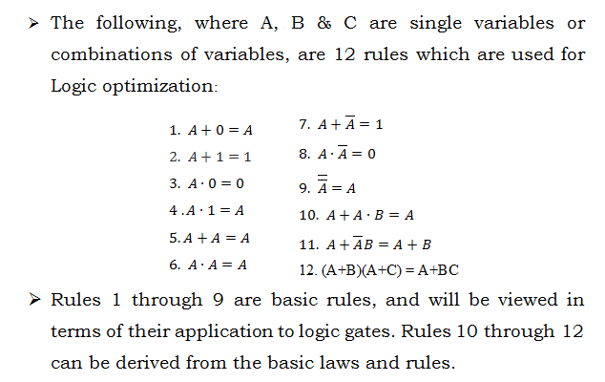

Slide 7

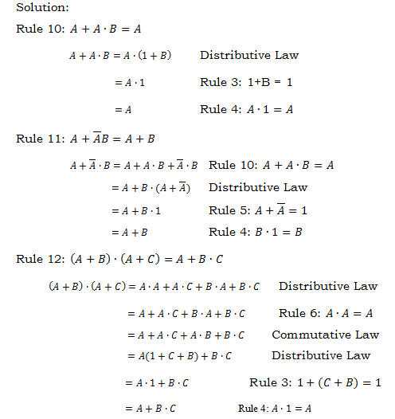
Cont’d…

Slide 8

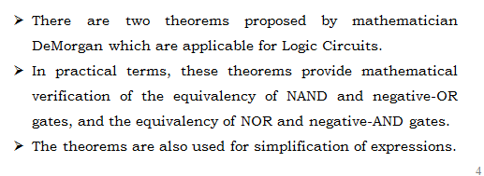

Slide 9
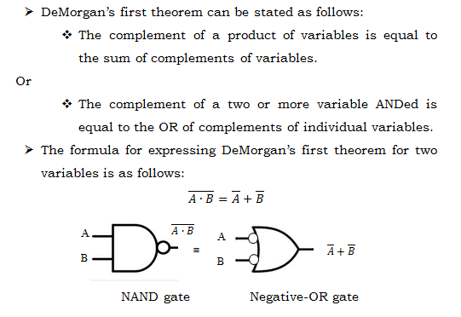
Cont’d…

Slide 10
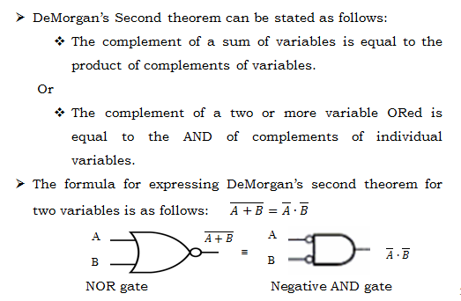
Cont’d…

Slide 11



Cont’d…

Slide 12
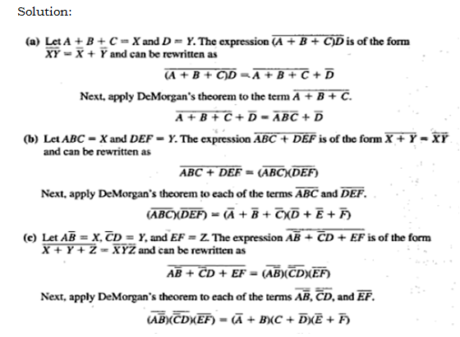
Cont’d…

Slide 13
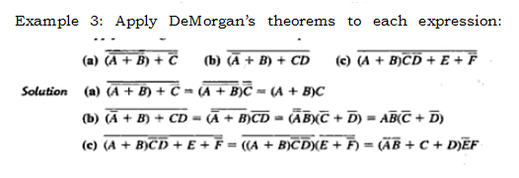
Cont’d…

Slide 14
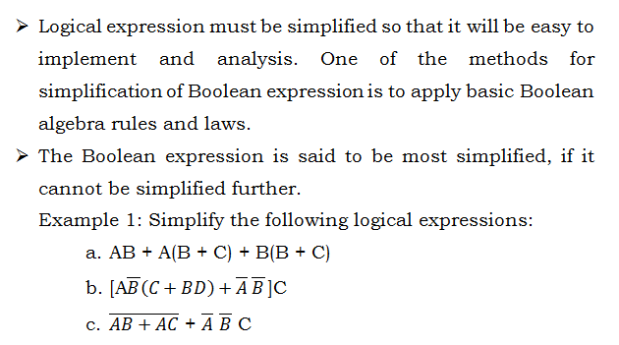

Slide 15
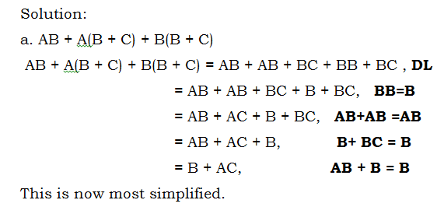
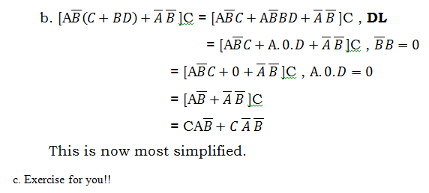
Cont’d…

Slide 16
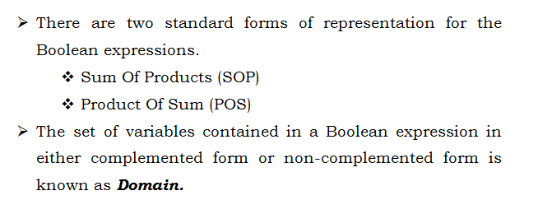

Slide 17

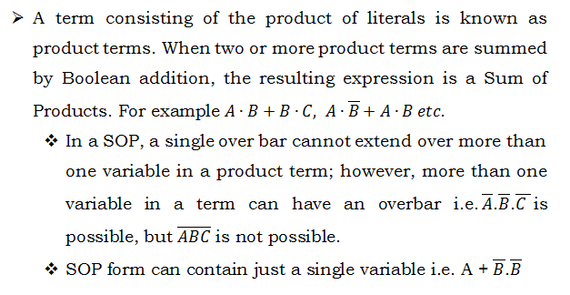
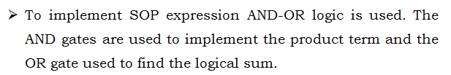

Slide 18
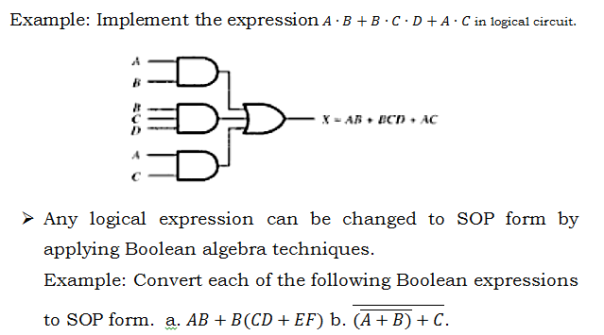

Cont’d…

Slide 19
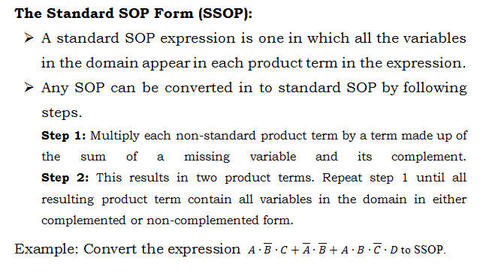
Cont’d…

Slide 20
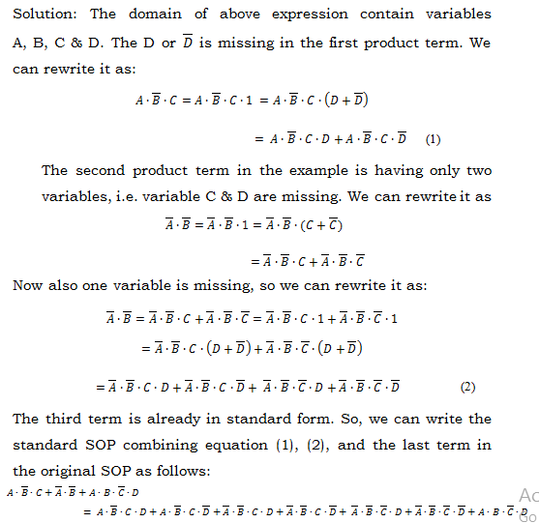
Cont’d…

Slide 21
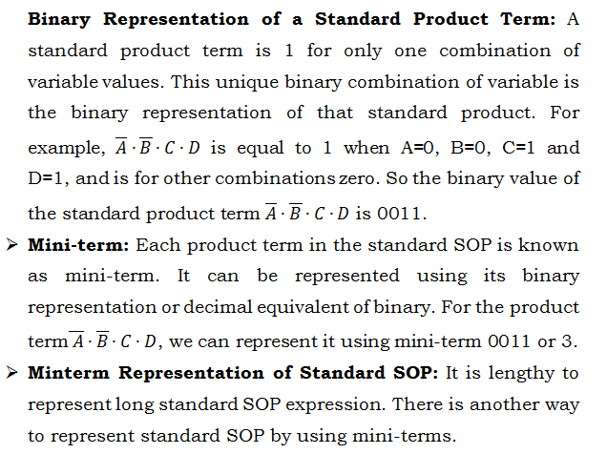
Cont’d…

Slide 22
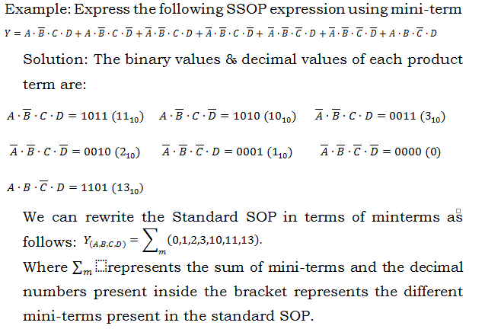
Cont’d…

Slide 23

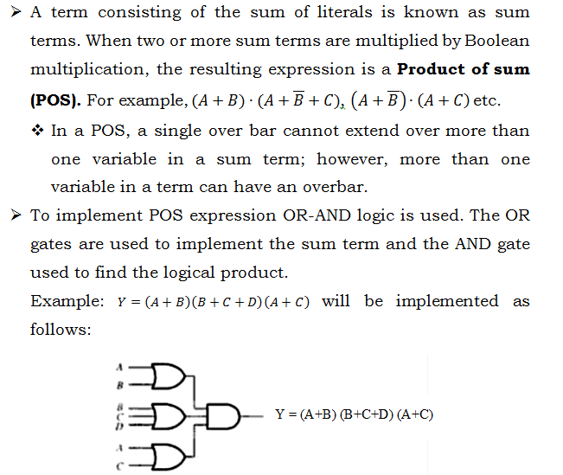

Slide 24
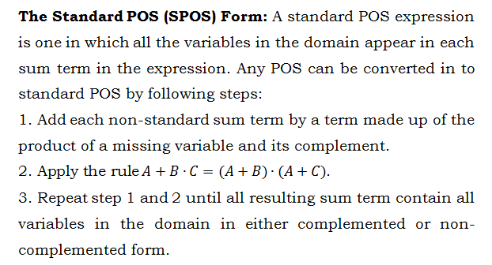
Cont’d…

Slide 25
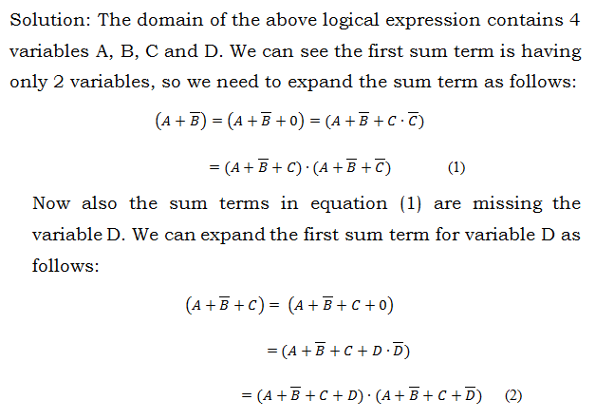
Cont’d…

Slide 26
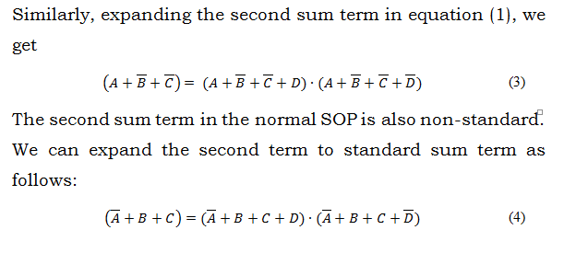
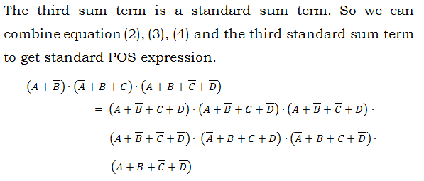
Cont’d…

Slide 27
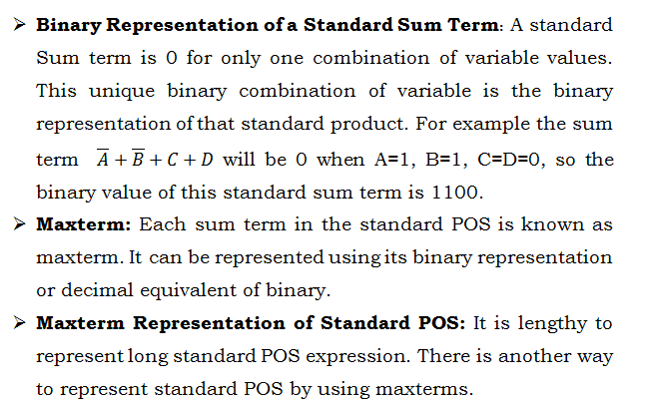
Cont’d…

Slide 28
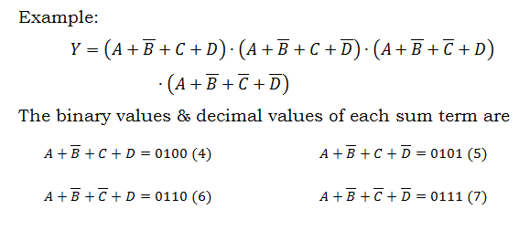
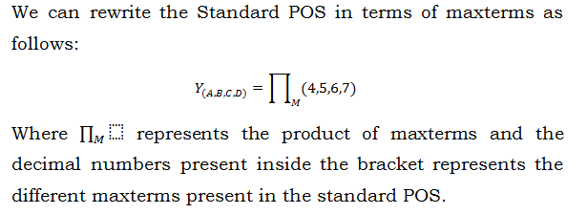
Cont’d…

Slide 29
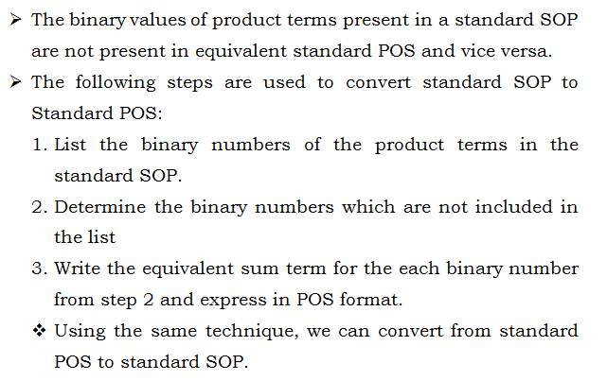

Slide 30

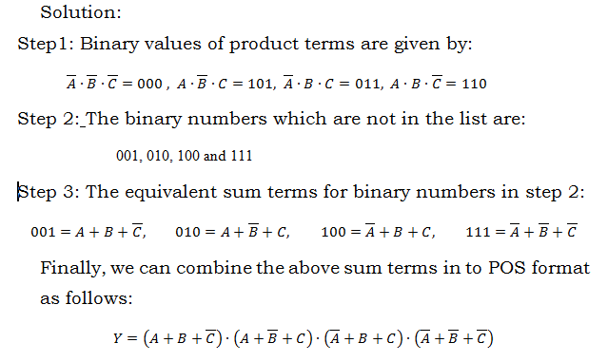
Cont’d…

Slide 31
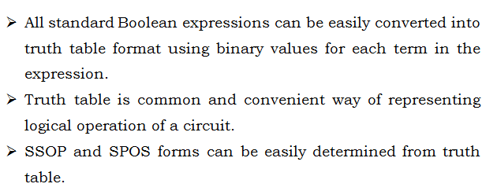


Slide 32
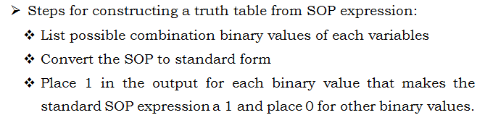

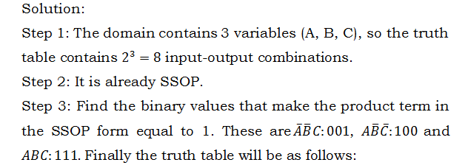
Cont’d…

Slide 33
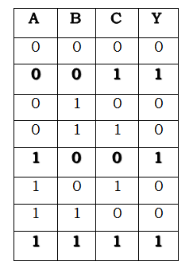
Cont’d…

Slide 34
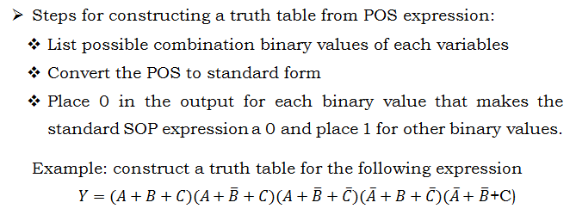

Slide 35
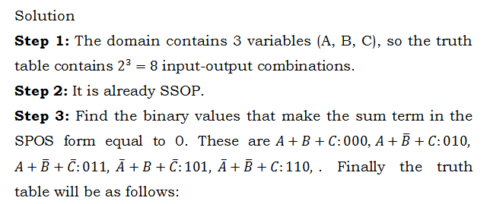
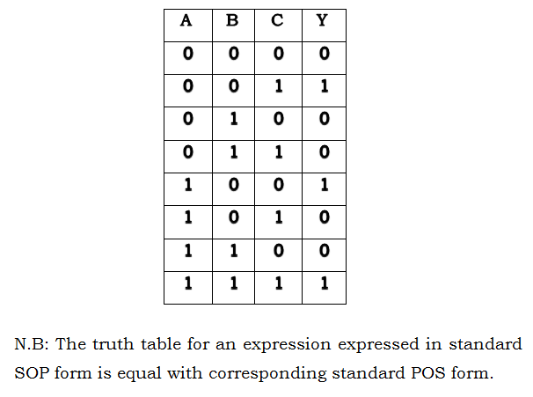
Cont’d…

Slide 36
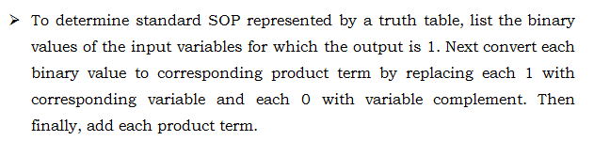
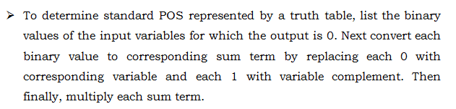

Slide 37
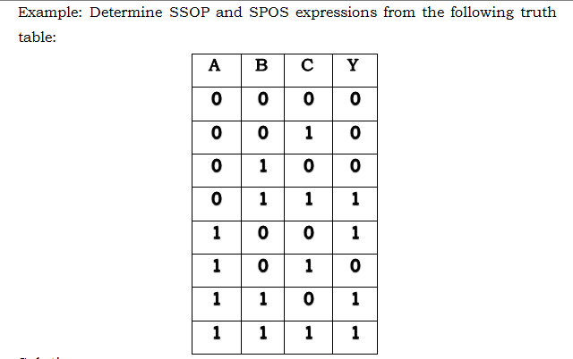
Cont’d…

Slide 38
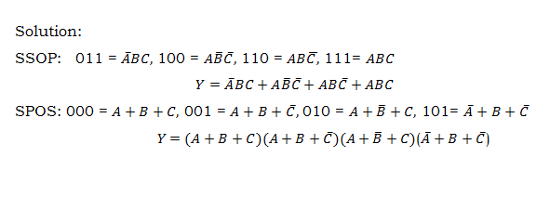
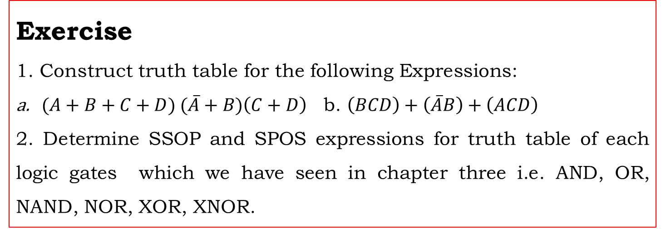
Cont’d…
Exercise
1. Construct truth table for the following Expressions:
$(A+B+C+D) (\overline{A}+B)\left(C+D\right)$b. $\left(BCD\right)+\left(\overline{A}B\right)+\left(ACD\right)$
2. Determine SSOP and SPOS expressions for truth table of each logic gates which we have seen in chapter three i.e. AND, OR, NAND, NOR, XOR, XNOR.

Slide 39

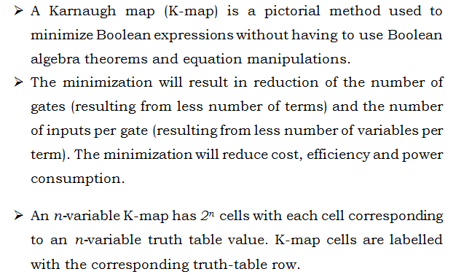

Slide 40
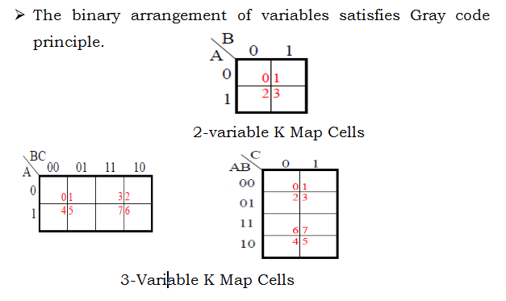
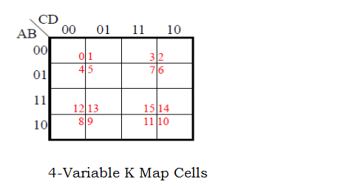
Cont’d…

Slide 41
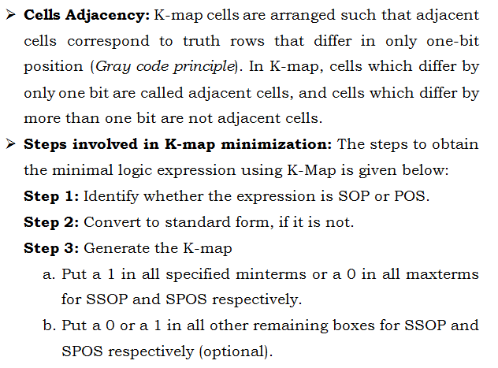
Cont’d…

Slide 42


Cont’d…

Slide 43

Cont’d…

Slide 44


Cont’d…

Slide 45

Cont’d…

Slide 46


Cont’d…

Slide 47

Cont’d…

Slide 48


Cont’d…

Slide 49

Cont’d…

Slide 50

Cont’d…

Slide 51


Cont’d…

Slide 52

Cont’d…

Slide 53

Cont’d…

Slide 54

Cont’d…

Slide 55

Cont’d…

Slide 56

Cont’d…

