Slide 1

Automating the Build Process
Chapter six
using ANT

Slide 2
Definition
In the context of software development, build refers to the process that converts files and other assets under the developers' responsibility into a software product in its final or consumable form. The build may include:
compiling source files
packaging compiled files into compressed formats (such as jar, zip)
producing installers
creating or updating of database schema or data
The build is automated when these steps are repeatable, require no direct human intervention, and can be performed at any time with no information other than what is stored in the source code control repository.

Slide 3
Expected Benefits
Build automation is a prerequisite to effective use of
continuous integration.
However, it brings benefits of its own:
eliminating a source of variation, and thus of defects; a manual build process containing a large number of necessary steps offers as many opportunities to make mistakes.
requiring thorough documentation of assumptions about the target environment, and of dependencies on third party products.

Slide 4
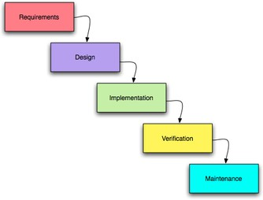
ANT is used in the Verification phases of the SW lifecycle
The stages of developing a software application
Requirements Analysis
High-level Design
Plan
Low-level Design
Implementation
Unit Test
Integration
System Test
Deploy
Maintain

Slide 5
What is ANT?
ANT (Another Neat Tool) is a utility that automates the process of compiling and building (jarring) Java project files
It can be run independently of Eclipse, NetBeans, or any other Java development environment
ANT only depends on the JDK utilities (Java compiler, JAR utility, etc.)

Slide 6
Why ANT?
Typically, large projects need to be built and tested frequently during the Verification phase
Builds are done daily, or even more frequently
Usually by the people doing the verification
ANT can completely automate the tasks of
retrieving code from a Repository
Completely recompiling all source (.java) files
JAR’ing rebuilt class (.java) files
Copying built files to a distribution directory for access by testers

Slide 7
Why ANT?
Dedicated PCs are usually used to perform the compile and build
The OS is at a known fixed revision level
The build PC is kept “unpolluted” except for the tools needed to build the target application
The JDK and other tools are at a known fixed revision level

Slide 8
The idea behind ANT and other similar build automation tools
ANT is based on executing build scripts that describe
1. Targets: the end result – usually file(s) that need to be
created as the end “product”
E.g. a JAR file
There may be one or more targets defined
The dependencies of the target on other files or targets
E.g. JAR file depends on .class files (and maybe Javadoc .html
files) that need to be built first
.class files depend on .java files
.html files depend on .java files
There is typically a hierarchy of dependencies; the final target depends on intermediate targets
The rules for creating the target(s):
Use jar.exe utility to create a JAR file from .class files
Use javac.exe is use to compile .java files into .class files
Use javadoc.exe to process comments in .java files into .html files
8

Slide 9
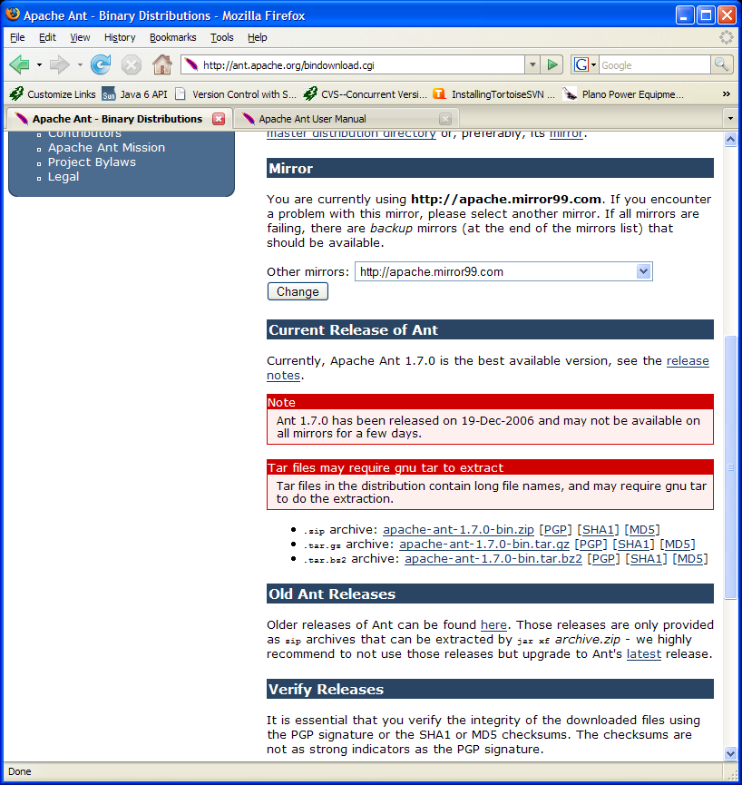
For a standalone ANT engine, you can Install ANT from www.apache.org
Eclipse comes with its own
ANT “engine”, so you don’t need to install a standalone version
of ANT unless you want to run
ANT outside of Eclipse

Slide 10
Anatomy of a simple ANT
script
<?xml version="1.0"?>
Every script starts with an xml statement similar to this which identifies
this file as containing xml statements
Properties are name/value pairs that can be declared for
subsequent symbolic access within the Ant script.
<property name=“output" value="Hello SE2030!"/>
Targets contain statements and rules that the Ant engine executes
in order to perform some task or achieve some goal.
<target name=“printMessage" description="Prints a message.">
<echo message="The message is ${output}"/>
The project element names the Ant project, and optionally
specifies the default target, base directory, etc.
script" default=“printMessage" basedir=".">
<project name="Ant demo
</target>
Echo is a very simple task. See the Ant manual for a list of
other tasks at ant.apache.org/manual in the section “Overview of Ant Tasks”
</project>

Slide 11
<?xml version="1.0"?> Since Ant build files are XML files the document begins with an XML declaration which specifies which version of XML is in use, this is to allow for the possibility of automatic version recognition should it become necessary.
<project name="test" default="compile" basedir="."> The root element of an Ant build file is the project element, it has three attributes.
name: The name of the project, it can be any combination of alphanumeric characters that constitute valid XML.
default: The default target to use when no target is specified, out of these three attributes default is the only required attribute.
basedir: The base directory from which any relative directories used within the Ant build file are referenced from. If this is omitted the parent directory of the build file will be used.

Slide 12
<property name="src" value="."/> <property name="build" value="build"/>
The property element allows the declaration of properties which are like user- definable variables available for use within an Ant build file. The name attribute specifies the name of the property and the value attribute specifies the desired value of the property. The name and value values are subject to standard XML constraints. In the markup shown above src has been assigned the value ".".
In order to reference a property defined in this manner one specifies the name between ${ and }, for example, to reference the value of src one uses ${ src }. In the example, src is used later on to specify the location of the .java files to be processed.

Slide 13
Creating an ANT script to compile (build) your project
Demonstration
Look for the file ant_tutorial.pdf

