Slide 1
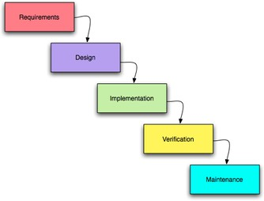
What is the Software Life Cycle?
The stages of developing a software application
Requirements Analysis
High-level Design
Plan (SE2800)
Low-level Design
Implementation
Unit Test (SE2832)
Integration
System Test (SE3800)
Deploy (SE3800)
Maintain
1

Slide 2
Requirements Analysis via Use Cases

Slide 3

What is Requirements Analysis?
And why do we do it?
“Beware of the guy in the room”
- Steve McConnell

Slide 4
We perform Requirements Analysis to…
Help the customer/client establish specific requirements
and expectations
Help the customer/client determine what the cost will be
Provide our managers with information they need to
plan the project
Primarily effort/time
Help colleagues (team members or programmers) understand the requirements and potential limitations
Produce a solution that best satisfies the given problem

Slide 5


A Requirement is a specific thing your system must satisfy in order to work correctly
A Requirement is usually a single thing that can be verified (validated) to make sure you’ve actually satisfied it
When all Requirements are met, your application is complete!
Software Quality is determined in part as successful conformance to Requirements

Slide 6
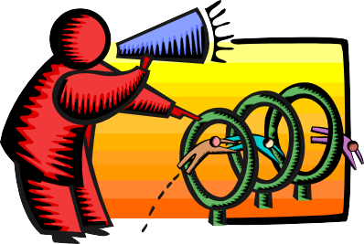

What is meant by
Requirements?
Statements that qualify what the program does…
Or should do
Sometimes requirements specify what a program must not or cannot do
Or should not do

Slide 7

User Stories are a common way of expressing a Requirement of what the system must do:
User Story format: “As a <specific type of user>, I would like to <achieve some goal> [in order to <justification>]”
As a Student, I would like to view open courses in order to create a schedule
As a Faculty, I would like to view the students
registered for the course sections I am teaching
As the Registrar, I would like to create courses and
course sections
A complete set of User Stories describe everything a system can do.
They are however frequently incomplete at the start.

Slide 8
An Actor is a external agent that interacts with the system
The Actors for some systems are just the conventional
“users”
The Blackboard system incorporates the concept of different types of Actor/users
What are they? <group activity>
How many Actors does WordCounter have?
What are they? <group activity>
An Actor does not have to be a person
Some systems interact with other (external) systems
Examples? <group activity>

Slide 9
The Blackboard system incorporates the concept of “Student”, “Faculty”, and “Registrar” Actors, and each can achieve different Goals
As a Student, you can
View the courses you are enrolled in
Submit your assignments
Retrieve your grades
As a Faculty, I can
View the courses I am teaching
View the students in each course
Create assignments
Grade assignments
The Registrar can
Create courses
Each of these is a Goal, and each distinct Goal is the end result of a separate Use Case
Assign me to a course as the Faculty
Assign you to a course as a Student

Slide 10
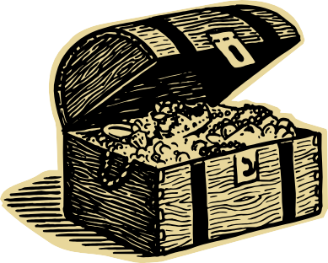

A Goal is a specific thing accomplished as a result of executing a Use Case
Achieving the Goal is the reason for the User Story
it has some value
A system may be capable of achieving multiple Goals
How many Goals does the WordCounter achieve?
How many Goals does Blackboard achieve?

Slide 11

Use Cases are an effective technique for narrating how a system works in fulfilling a User Story/Requirement
Use Cases explain what actually happens when someone uses the system to (try to) achieve a goal - to help us understand how it should work in detail
Use Cases were introduced by Ivar Jacobson in the 1980’s (see reading assignment)

Slide 12
ATM Login Demo

Slide 13


Each Use Case explains one or more Scenarios that describe how the system should interact with an Actor to achieve a specific Goal
A Scenario is a narrative that describes what happens within a specific Use Case
An Actor is an external agent that interacts with the system
sd UML Sequence ...
Actor
A Goal is the specific thing accomplished as a result of executing a Use Case.

Slide 14

A Use Case can contain more than a single Scenario
Every Use Case contains a basic Scenario that describes what
happens in the “normal” case
This is called the Main Path, Normal Flow, Basic Flow, or “Sunny Day” Scenario
The Goal is always achieved in the basic Scenario

Slide 15

Most people will expect your programs to work even when problems occur
A good solution goes beyond the obvious things a customer tells you and makes sure your system works even in unusual or unexpected circumstances
Plan for things to go wrong!
”Thinking and writing about failure handling saves the design team a lot of money
over the course of the project.”
from Use cases, ten years later – Alistair Cockburn

Slide 16
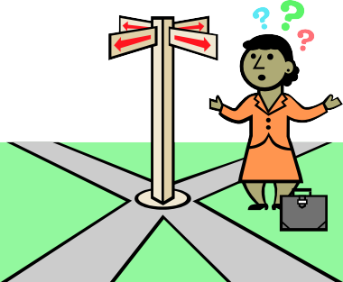

Alternate Scenarios of a Use Case describe atypical or exceptional situations (“Rainy day scenarios”)
Alternate Scenarios can have
Different steps from those of the Main Path
Additional steps added to the Main Path
recovery steps to get back on the Main Path
All Scenarios in a Use Case target a common Goal, although
in some Alternate Scenarios the Use Case may terminate abnormally
(without achieving the intended Goal)
Dr. Mark L. Hornick
SE-2030

Slide 17

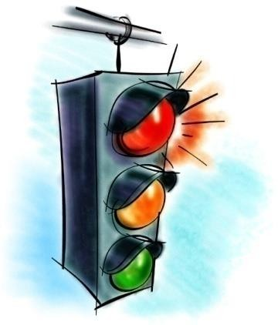
Use Cases have clear boundaries
Every Use Case must have a definite Starting and Stopping point
Every Use Case is started off by an external initiator (an Actor)
Every Scenario must have a condition that indicates that is complete
goal achieved or not
SE-2030
Dr. Mark L. Hornick
17

Slide 18

Often, one Use Case must first be satisfied before another Use Case can proceed
This is called a Precondition
What Precondition(s) must exist before a Customer can withdraw cash from an ATM?

Slide 19
Achieving a Goal may result in the creation of artifacts
These are called Postconditions
The system may have changed state
Data may have changed
Files may have been created or destroyed
Other output may have been generated

Slide 20
Meeting Goals of User Stories and their associated Use Cases
To verify that a Goal has been achieved, we usually talk about Acceptance Criteria
These take the form of:
Evidence of tests passing
Approval of observed functionality

Slide 21


Writing Use Cases can be an iterative process
In reviewing Use Cases, you nearly always uncover requirements that the Customer expects
…but didn’t think about on their own
…sometimes you need to think beyond what the Customer asks for in order to
determine the complete Requirements (more User Stories may need to be written)

Slide 22
Use Case Templates are used to provide a degree of standardization to related Use Cases
Use Case Title or User Story
Brief Description including Goal
Identification of Actor(s)
Pre-conditions
Scenarios
Basic/Normal Flow
Alternate Flows
See the course website for a link
to the Use Case template you’ll use in SE2030
Post-conditions/Acceptance Criteria
Additional Notes

Slide 23

Group Exercise
User Story/Requirement: As a Customer, I would like to retrieve cash from my Checking Account so that I have some spending money.
Write down the steps in the Main Path required to achieve the Goal
Each step should be described as an action/response
i.e. an action initiated by an Actor and the subsequent response
by the system
Each step should be numbered
23

Slide 24
High Level Design
Use Case Textual Analysis

Slide 25

Once Use Cases are completed, we have to design the system that solves the problem before we can build it
Software Engineers can infer a lot of information about how the system should be designed from the Use Case narratives

Slide 26

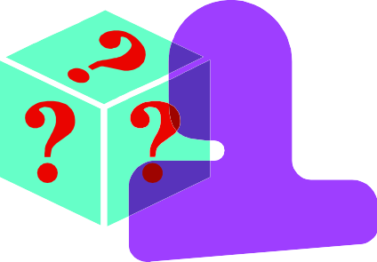
Textual Analysis of Use Case scenarios is used to create high-level designs
Prerequisite: Use Cases should be complete, so that all capabilities of the system are described, and all requirements met.
Textual Analysis is a quick and easy way to make a “first guess” at the classes that will comprise the system
SE-2030
Dr. Mark L. Hornick

Slide 27

Textual Analysis is looking at the nouns and verbs in your Use Cases to figure out the classes and their methods
Nouns in the Use Cases are candidates for the classes you need to write
Grammar 101: nouns are things
Verbs in the Use Cases are usually the methods that the classes implement
Verbs are actions

Slide 28


Approach: Read through each Use Case, picking out the nouns appearing in the scenario descriptions
You’re actually discovering objects, which are instances of classes that abstract the problem domain entities

Slide 29
After identifying nouns, eliminate redundancies
“list of names”
“name collection”
“array of names”
“Welcome message”
“Welcome dialog”
“Welcome screen”
“Names”
“Welcome Screen”
Note: Do not identify individual Buttons, Checkboxes, Menus, etc as individual nouns; these would all be part of a parent screen.

Slide 30
The following nouns are not
candidates for classes:
When you implement the code, you’ll only need classes for the parts of the system you need to represent, but not for things outside the system
“user retrieves cash from ATM”
“user inserts envelope into ATM”
Experience and common sense help here.

Slide 31

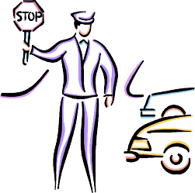

There are three classifications of objects
discovered via Textual Analysis
Boundary Objects
Model the system boundary (often multiple)
User Interface elements (entire screens, but not individual ui elements)
Interfaces to external actors (e.g. databases)
Control Objects
Represents an entity or manager that makes decisions (e.g. figures out what to do when a button is pressed)
In simple systems, this is usually the application itself, and
there is typically only a single Control Object
Entity Objects
A data store or persistence element that captures or represents information (often multiple objects)
The precise/permanent classification of objects is not always possible upon first review – iteration is often necessary!

Slide 32




For each Use Case, draw a UML high- level Sequence Diagram showing the
interaction between objects
The purpose of this diagram is to begin to identify the fundamental classes
and their behaviors
and attributes

Slide 33
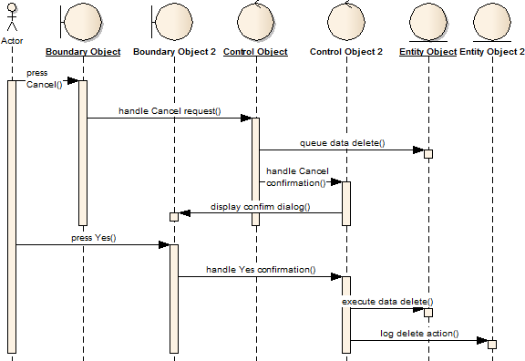
Boundary, Entity, and Control elements must obey the following relationships
Actors can only talk to
boundary objects.
Boundary objects can usually only talk to controllers and actors.
Entity objects can usually only talk to controllers and boundary objects.
Controllers can talk to boundary objects and entity objects, and to other controllers, but not to actors

Slide 34
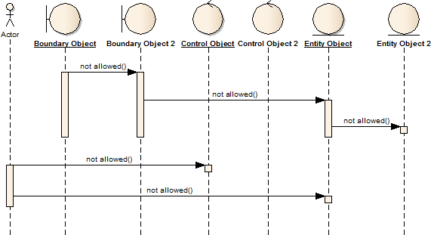
The following relationships are generally restricted or not permitted
1. Actors can only talk to boundary
objects.
2. Entity objects can communicate with an another Entity that it “owns” (e.g. an Collection owns Items in the Collection)
Allowed with reservations
Allowed with reservations
Allowed with reservations
3. Boundary objects can talk to certain Entity objects (UI gets Items from a Collection to display), and other Boundary objects it “owns” (e.g. a popup dialog).
4. Controllers can talk to boundary objects and entity objects, and to other controllers, but not to actors

