Slide 1
Chapter 3 Introduction to Database Transactions

Slide 2
Introduction to Transaction Processing
Based on the number of users who can use the system concurrently, database systems can be classified as:
Single-User System:
At most one user at a time can use the database management system.
Eg. Personal computer system
Multiuser System:
Many users can access the DBMS concurrently.
Eg. Air line reservation, Bank and the like system are operated by many users who submit transaction concurrently to the system
This is achieved by multiprogramming , which allows the computer to execute multiple programs/processes at the same time.

Slide 3
Introduction…
Concurrency
Interleaved processing:
A single central processing unit (CPU) executes at most one process at a time.
However, multiprogramming operating systems execute some commands from one process, then suspend that process and execute some commands from the next process, and so on.
Therefore, concurrent execution of processes in a single CPU is interleaved.
Advantages:
keeps the CPU busy when the process requires I/O by switching to execute another process rather than remaining idle during I/O time
prevents long process from delaying other processes.
Parallel processing:
If the computer system has multiple hardware processors (CPUs), parallel processing of multiple processes is possible.
If Processes are concurrently executed in multiple CPUs.

Slide 4
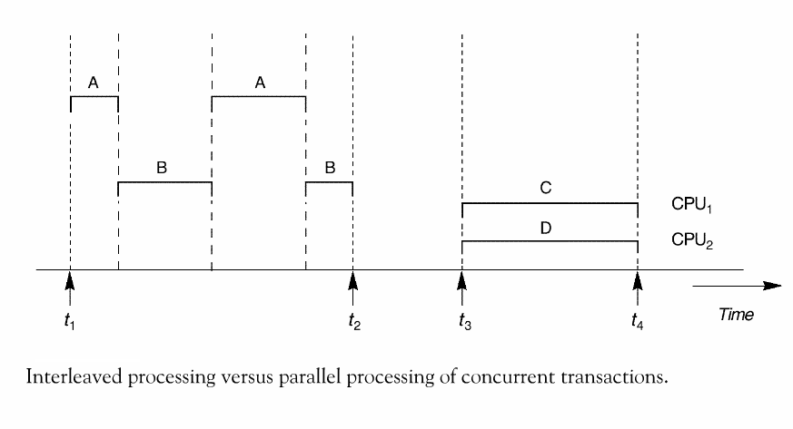
Introduction…

Slide 5
Introduction…
A Transaction:
Logical unit of database processing that includes one or more access operations (read -retrieval, write - insert or update, delete).
Examples include ATM transactions, credit card approvals, flight reservations, hotel check-in, phone calls, supermarket canning, academic registration and billing.
Database before transaction and after transaction must be in consistent state.
Transaction boundaries:
Any single transaction in an application program is bounded with Begin and End statements.
An application program may contain several transactions separated by the Begin and End transaction boundaries.

Slide 6
Introduction…
SIMPLE MODEL OF A DATABASE :
A database is a collection of named data items
The size of a data item is called its Granularity – It may be a field, a record , or a whole disk block that measure the size of the data item
Basic operations that a transaction can perform are read and write
read_item(X): Reads a database item named X into a program variable. To simplify our notation, we assume that the program variable is also named X.
write_item(X): Writes the value of program variable X into the database item named X.

Slide 7
Introduction…
Basic unit of data transfer from the disk to the computer main memory is one block.
In general, a data item (what is read or written) will be the field of some record in the database, although it may be a larger unit such as a record or even a whole block.
read_item(X) command includes the following steps:
Find the address of the disk block that contains item X.
Copy that disk block into a buffer in main memory (if that disk block is not already in some main memory buffer).
Copy item X from the buffer to the program variable named X.

Slide 8
Introduction…
write_item(X) command includes the following steps:
Find the address of the disk block that contains item X.
Copy that disk block into a buffer in main memory (if that disk block is not already in some main memory buffer).
Copy item X from the program variable named X into its correct location in the buffer.
Store the updated block from the buffer back to disk (either immediately or at some later point in time).

Slide 9
The DBMS maintains a number of buffers in the main memory that holds data base disk blocks which contains the database items being processed.
When these buffers are all occupied and
if there is a need for additional database block to be copied to the main memory ; some buffer management policy is used to choose for replacement but if the chosen buffer has been modified, it must be written back to disk before it is used.

Slide 10
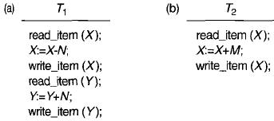
Introduction…
Two sample transactions
(a) Transaction T1
(b) Transaction T2
A=300 B=400
Assume we want to transfer from acount1 to account 2
T1 T2
Read(A) Read(B)
A=A-100 B=B+100
Write(A) Write(B) B=500
A=200 B=500
Before Transaction=300+400 =700
After Transaction =200+500=700 which consistent state

Slide 11
Introduction…
Transactions submitted by various users may execute concurrently and may access and update the same database items.
If this concurrent execution is uncontrolled, it may lead to problems, such as an inconsistent database.
Concurrency control and recovery mechanisms are mainly concerned with the database access commands in a transaction to address such problems.

Slide 12
Transaction Properties
To ensure data integrity, DBMS should maintain the following ACID properties:
Atomicity: A transaction is an atomic unit of processing; it is either performed all transaction or not performed at all.
Abort :- changes made to database is not visible(not saved)
Commit :-changes made to database is visible
Consistency (correctness): A correct execution of the transaction must take the database from one consistent state to another.
Isolation: A transaction should not make its updates visible to other transactions until it is committed; this property, when enforced strictly, solves the temporary update problem and makes cascading rollbacks of transactions unnecessary.
When there is no interaction between different transaction
Durability or permanency: Once a transaction changes the database and the changes are committed, these changes must never be lost because of subsequent failure.
Consistency in values of transactions

Slide 13
Example:
Properties…
Suppose that Ti is a transaction that transfer 2000 birr from account CA2090( which is 5000 Birr) to SB2359(which is 3500 birr) as follows
Read(CA2090)
CA2090= CA2090-2000
Write(CA2090)
Read(SB2359)
SB2359= SB2359+2000
Atomicity- either all or none of the above operation will be done – this is materialized by transaction management component of DBMS
Consistency-the sum of CA2090 and SB2359 be unchanged by the execution of Ti i.e 8500- this is the responsibility of application programmer who codes the transaction
Isolation- when several transaction are being processed concurrently on a data item they may create many inconsistent problems. So handling such case is the responsibility of Concurrency control component of the DBMS
Durability - once Ti writes its update this will remain there when the database restarted from failure . This is the responsibility of recovery management components of the DBMS

Slide 14
Transaction States
A transaction is an atomic unit of work that is either completed in its entirety or not done at all.
For recovery purposes, the system needs to keep track of when the transaction starts, terminates, and commits or aborts.
Transaction states:
Active state -indicates the beginning of a transaction execution
Partially committed state -shows the end of read/write operation but this will not ensure permanent modification on the database
Committed state -ensures that all the changes done on a record by a transaction were done persistently
Failed state happens when a transaction is aborted during its active state or if one of the rechecking is fails
Terminated State -corresponds to the transaction leaving the system

Slide 15
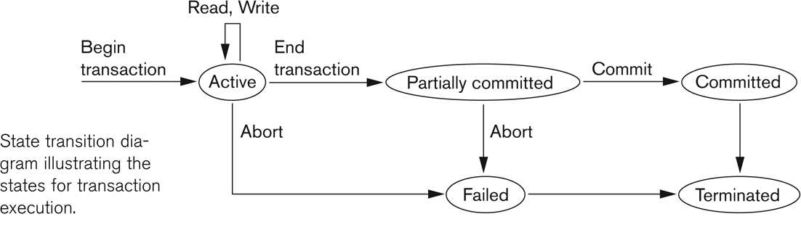
State transition diagram illustrating the states for transaction execution
States …

Slide 16
Why Concurrency Control is needed:
Concurrency :- executing multiple transaction at a time.
Simultaneous execution of transaction over shared database can create several data integrity and consistency problems
Advantages:-
Waiting time decrease
Response time decrease
Resource utilization increase
Efficiency increase
But there are 3 main problems

Slide 17
CON’T…
1. Reading uncommitted data(WR conflict “dirty read )
This occurs when one transaction updates a database item and then the transaction fails for some reason
A=5 assume A+1
T1 | T2
R(A) = 5 W(A) = 6 R(B) W(B) Abort | R(A) = 6 committed but reads value stored in local buffer.(dirty read) It reads before transaction completes.

Slide 18
CON’T…
2. Unrepeatable read (Rw conflict )
An unrepeatable read, also known as a "non-repeatable read," is a phenomenon that can occur in database transactions when a piece of data is read by a transaction and, when the same transaction attempts to read the same data again, it finds that the data has been modified or deleted by another concurrent transaction in the meantime. This inconsistency can lead to unexpected and incorrect results
A=10 assume A+5
T1 | T2
R(A) = 10 A+5 W(A) =15 | R(A) =10 Confusion R(A) = 15

Slide 19
CON’T…
2. The Lost Update Problem (WW conflict ) The Lost Update Problem, also known as a Write-Write (WW) conflict, is a concurrency issue that can occur in a multi-user database environment when two transactions update the same data concurrently, resulting in the loss of one of the updates.
In this scenario, if both transactions A and B are operating concurrently, there is a possibility that the update made by Transaction B will overwrite the changes made by Transaction A

Slide 20
Schedules
Schedule – a schedule refers to the sequential or chronological order in which instructions of concurrent transactions are executed
a schedule for a set of transactions must consist of all instructions of those transactions
must preserve the order in which the instructions appear in each individual transaction.
Types of schedule
Serial Schedule
Schedule where operations of each transaction are executed consecutively without any interleaved operations from other transactions.
Inconsistency not present here
S1:- t1,t2 or
S2:- t2,t1

Slide 21
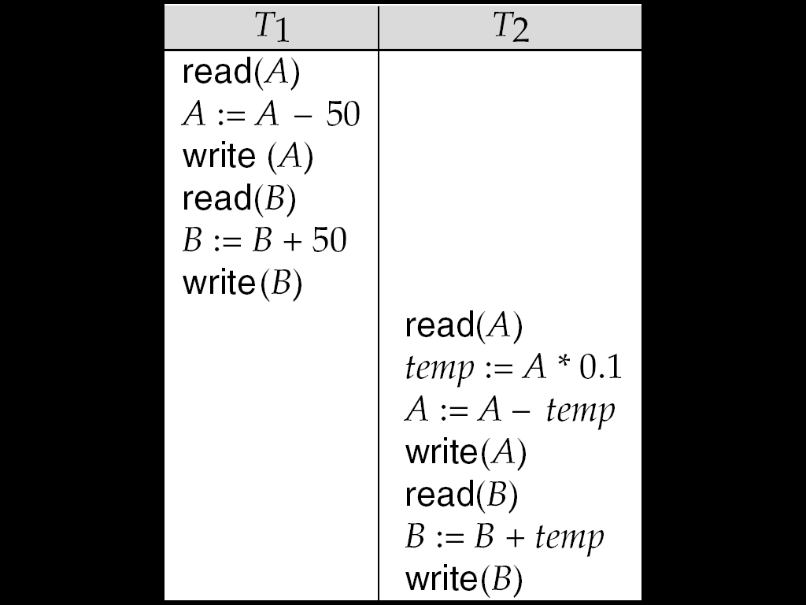
Schedule 1
Let :
T1 transfer $50 from A to B, and
T2 transfer 10% of the balance from A to B.
A serial schedule in which T1 is followed by T2:

Slide 22
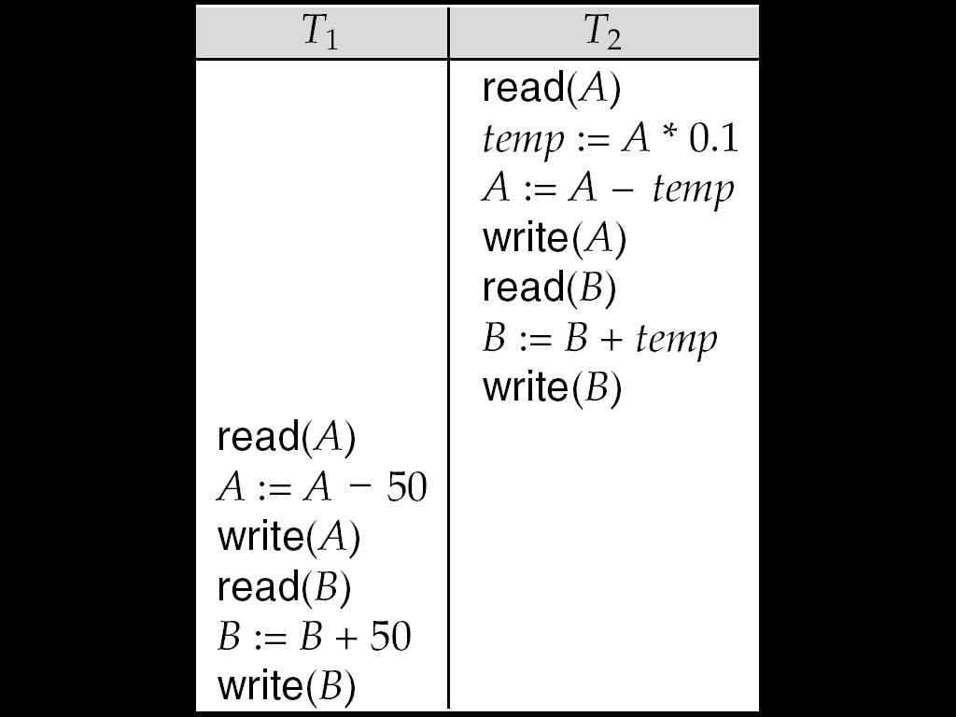
Schedule 2
A serial schedule where T₂ is followed by T₁

Slide 23
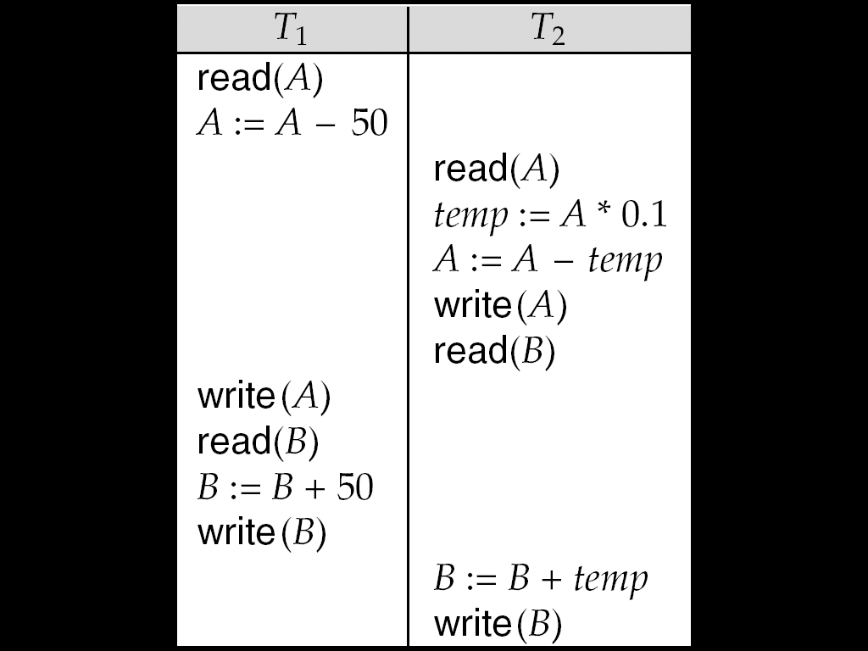
Schedule 3
The following concurrent schedule
serializable schedule (conflict serilizable and view serializable)
Non-serilizable shedule (revocable and non revocable)
Using context switch
does not preserve the value of (A + B). Not in consistent state

Slide 24
Serializability
Serializability is a property of a database transaction that ensures that the final state of the database, after executing a set of transactions concurrently,
Objective of a concurrency control is to schedule transactions in such a way as to avoid any interference.
Serializability identifies whether concurrent schedule is produce consistence result or not
A serializable schedule over a set S of committed transactions is a schedule whose effect on any consistent database instance is guaranteed to be identical to that of some complete serial schedule over S.
Serializable schedule: A schedule S is serializable if it is equivalent to some serial schedule of the same transactions

Slide 25
Serializability
Conflict serializablilty: if conccurent schedule converted to serial schedule by swaping non-conflicting operation then its called conflict serializable schedule.

Slide 26
Con;t
Non Conflict serializable:
Conflict serializable
T1 | T2
R(A) | R(B)
W(A) | W(B)
R(B) | W(A)
R(A) | W(B)
T1 | T2
R(A) | W(A)
W(A) | R(A)
W(A) | W(A)

Slide 27
Con;t
Equivalent Schedule(since Schedule S is converted to S’ by serial swaps of non conflicting instruction)
The following operation are conflicting schedule
S S'
T1 | T2
R(A)
W(A)
 | R(A)
R(B)
 | W(A)
W(B)
 | R(B)
 | W(B)
T1 | T2
R(A)
W(A)
R(B)
 | R(A)
W(B)
 | W(A)
 | R(B)
 | W(B)
T1 | T2
R(A)
W(A)
R(B)
W(B)
 | R(A)
 | W(A)
 | R(B)
 | W(B)
T1 | T2
R(A)
W(A)
 | R(A)
 | W(A)
R(B)
W(B)
 | R(B)
 | W(B)

Slide 28
Con;t
Non Conflict Schedule
We can not convert to S dash
S S’
Its not conflict serializable
It may produce or not produce consistence result
T1 | T2
R(A)
W(A)
 | R(A)
 | W(A)
R(A)
W(A)
T1 | T2
R(A)
W(A)
R(A)
W(A)
 | R(A)
 | W(A)

Slide 29
Con;t
T1 | T2
R(A)
A=A+100
W(A)
 | R(B)
 | B=B-200
 | W(B)
R(B)
B=B-100
W(B)
 | R(A)
 | A=A+250
 | W(A)
Example:
A=500
B=300
A+B=800
Its not conflict
Serializable
Produce consistence
result

Slide 30
Precedence Graph
Checking Conflict serializable or not?
If cycle is there its non conflicting
T1 | T2
R(A)
W(A)
 | R(B)
 | W(B)
R(B)
W(B)
 | R(A)
 | W(A)
T1
T2

Slide 31
Precedence Graph
Checking Conflict serializable or not?
Not conflict serializable
T1 | T2 | T3
R(A)
 | W(A)
 |  | W(A)
W(A)
T1
T2
T3

Slide 32
Precedence Graph
Checking Conflict serializable or not?
No cycle is here so its conflicting serializable
T1 | T2 | T3
R(A)
 |  | R(C)
 |  | W(C)
 | R(B)
R(B)
 | W(B)
 |  | W(A)
 | W(C)
T1
T2
T3

Slide 33
View serializability:
A schedule is view serializable if it is view equivalent to a serial schedule.
If the following three condition are met its view serializable
1.If transaction Ti reads the initial value of Q in schedule S the transaction Ti must in schedule S’ also read initial Value of Q.
2.For each data item Q, the transaction(if any) that perform the final write(Q)operation in schedule S must perform the final; write (Q) operation in schedule S’.
3.If transaction Ti excute reads (Q) in schedule S and that value waas produced by transaction Tj (if any) then transaction Ti must in schedulue S’ also read the vallue of Q that was produced by transaction Tj

Slide 34
View serializable
1.check conflict serializable
2.Blind write
3.check the initial read ,final write and intermediate read
its not conflict serializable(cycle is there in graph)
IR (a) – T1 – S and T1 – S’
Fw(a) T3 – S and T3 – S’
No intermidiate
So its view serializable
Blind Write
T1 | T2 | T3
R(A)
 | W(A)
W(A)
 |  | W(A)
T1 | T2 | T3
R(A)
W(A)
 | W(A)
 |  | W(A)

Slide 35
View serializable
its not conflict serializable(cycle is there in graph)
IR (a) – T1 – S and T1 – S’
Fw(a) T2 – S and T2 – S’
Intermidite Read T2-T1 for S and T1-T2 for S’ (not same)
So its not view serializable
T1 | T2
R(A)
W(A)
 | W(A)
R(A)
W(A)
 | R(A)
 | W(A)
T1 | T2
R(A)
W(A)
R(A)
W(A)
 | W(A)
 | R(A)
 | W(A)

Slide 36
Concurrency Control

Slide 37
Introduction
Transaction Processor is divided into:
A concurrency-control manager (scheduler)- responsible for assuring isolation of transactions
A logging and recovery manager- responsible for the durability of transactions.
The scheduler (concurrency-control manager) must assure that the individual actions of multiple transactions are executed in such an order that the net effect is the same as if the transactions had in fact executed one-at-a-time.
Requests from transactions
Lock
Table
Scheduler
Read and Writes
Buffers

Slide 38
Introduction…
The Purpose of Concurrency Control is:
To enforce Isolation (through mutual exclusion) among conflicting transactions.
To preserve database consistency through consistency preserving execution of transactions.
To resolve read-write and write-write conflicts.
A typical scheduler does its work by maintaining locks on certain pieces of the database. These locks prevent two transactions from accessing the same piece of data at the same time. Example:
In concurrent execution environment if T1 conflicts with T2 over a data item A, then the existing concurrency control decides if T1 or T2 should get the data item A and if the other transaction is rolled-back or waits.

Slide 39
Introduction…
Example:
Bank database: 3 Accounts
A = 500
Account Balances
B = 500
C = 500
Property: A + B + C = 1500
Money does not leave the system

Slide 40
Introduction …
Example
Transaction T1: Transfer 100 from A to B
Transaction T2: Transfer 100 from A to C
Read (A, t)
Read (A, s)
t = t - 100
s = s - 100
Write (A, t)
Write (A, s)
Read (B, t)
Read (C, s)
t = t + 100
s = s + 100
Write (B, t)
Write (C, s)

Slide 41
Transaction T1
Transaction T2
A
B
C
500
500
500
Read (A, t)
t = t - 100
Read (A, s)
s = s - 100
Write (A, s)
400
500
500
Write (A, t)
400
500
500
Read (B, t)
t = t + 100
Write (B, t)
400
600
500
Read (C, s)
s = s + 100
Write (C, s)
400
600
600
Schedule
400 + 600 + 600 = 1600

Slide 42
Transaction T1
Transaction T2
A
B
C
500
500
500
Read (A, t)
t = t - 100
Write (A, t)
400
500
500
Read (A, s)
s = s - 100
Write (A, s)
300
500
500
Read (B, t)
t = t + 100
Write (B, t)
300
600
500
Read (C, s)
s = s + 100
Alternative
Schedule
Write (C, s)
300
600
600
300 + 600 + 600 = 1500
So What ?

Slide 43
Concurrency Control Techniques
Concurrency control techniques are used to ensure the noninterference or isolation property of concurrently executing transactions.
Basic concurrency control techniques are:
Locking
Timestamping
Multiversion
Optimistic methods(Validation or Certification)
Lock Granularity

Slide 44
Locking
Lock is a variable associated with a data item that describes the status of the data item with respect to the possible operations that can be applied.
Lock based protocol insure conflict serialazblity.
It insure consisitency
Locking is an operation which secures
(a) permission to Read
(b) permission to Write a data item for a transaction.
Example:
Lock (X). Data item X is locked in behalf of the requesting transaction.
Unlocking is an operation which removes these permissions from the data item.
Example:
Unlock (X): Data item X is made available to all other transactions.
Lock and Unlock are Atomic operations.

Slide 45
Locking …
Two lock modes:
(a) shared (read) (b) exclusive (write).
Shared mode: shared lock (X)
More than one transaction can apply share lock on X for reading its value but no write lock can be applied on X by any other transaction.
read
Exclusive mode: Write lock (X)
Only one write lock on X can exist at any time and no shared lock can be applied by any other transaction on X.
Read and write
Conflict matrix

Slide 46
Locking …
Locking - Basic Rules
It has two oprerations : Lock_item(X) and unLock_item(X)
A transaction request access to an item X by first issuing a lock_Item(x) opreation .
If lock (x)=1, the transaction is forced to wait.
If lock (X)= 0; it is set to 1 and the transaction is allowed to access x
When a transaction finished operation on X it issues an Unlock_Item operation which set lock(x) to 0 so that X may be accessed by another transaction
If transaction has shared lock on item, it can read but not update item.
If transaction has exclusive lock on item, it can both read and update item.
Reads cannot conflict, so more than one transaction can hold shared locks simultaneously on same item.
Exclusive lock gives transaction exclusive access to that item.

Slide 47
Locking …
1.Lock based Protocol
T1
A
T2
If T1 locks Transaction (A) no one can use it unless unlockes. T2 must wait

Slide 48
Locking …
S1 S2
T1 | T2
Lock-x(a) R(A) W(A)
 | Lock-x(b) R(B) W(B)
T1 | T2
Lock-s(a) R(A) Unlock(a)
 | R(A) W(A)
S1 : If T1 asks for lock-S(A) it can not write so T1 must ask for lock-X(A). T2 also must asks for lock-S(B).
S2: since both T1 and T2 uses same variable T2 can not ask lock operation it must wait until T1 unlocks.
Note: if T1 and T2 is compatible no need to wait other transaction (if both t1 and t2 is shared mode lock ) no need to wait each other

Slide 49
Limitation of Lock based Protocol
Deadlock and Starvation
Deadlock:
T1 ------>T2
T2 ------>T1
If both T1&T2 waiting each other then deadlock occur
To solve this deadlock problem we have to kill(roll back)one of the two transaction.
T1 | T2
Lock-x(A) R(A) A=A+100 W(A)
 | Lock-S(B) R(B) Lock-x(A) R(A) W(A)
Lock-x(B) R(B) W(B)

Slide 50
Limitation of Lock based Protocol
2. Starvation:
T2 must wait all the Transaction till unlockes. So now T2 is starved.
T1 | T2 | T3 | T4
Lock-x(A) R(A)
 | Lock-x(A) R(A) W(A)
 |  | Lock-s(A) R(A)
 |  |  | Lock-s(A) R(A)

Slide 51
Dealing with Deadlock and Starvation
Deadlock
It is a state that may result when two or more transactions are each waiting for locks held by the other to be released
Example :
T1 T2
read_lock (Y);
read_item (Y);
read_lock (X);
read_item (X);
write_lock (X);
write_lock (Y);
T1 is in the waiting queue for X which is locked by T2
T2 is on the waiting queue for Y which is locked by T1
No transaction can continue until the other transaction completes
T1 and T2 did follow two-phase policy but they are deadlock
So the DBMS must either prevent or detect and resolve such deadlock situations

Slide 52
Two-Phase Locking Techniques: The algorithm
Every transaction can be divided into Two Phases: Locking (Growing) & Unlocking (Shrinking)
Locking (Growing) Phase:
A transaction applies locks (read or write) on desired data items one at a time.
Acquires all locks but cannot release any locks.
Unlocking (Shrinking) Phase:
A transaction unlocks its locked data items one at a time.
Releases locks but cannot acquire any new locks.
Requirement:
For a transaction, these two phases must be mutually exclusive, that is, during locking phase unlocking phase must not start and during unlocking phase locking phase must not begin.
# locks
held by
Ti
Growing Phase
Shrinking Phase
Time
Transaction follows 2PL protocol if all locking operations precede the first unlock operation in the transaction.

Slide 53
Two-Phase Locking Techniques
Example
Example
Its not Two Phase Locking becouse it will ask for lock After Unlock .
In two phase protocol after release locks no lock request in(Shrinking phase)
T1 | T2
Lock-S(A) R(A) Unlock A
 | Lock-S(B) R(B) Unlock(B)
Lock-X(B) R(B) W(B) Unlock(B)

Slide 54
Two-Phase Locking Techniques
Example
Example
Its Two Phase Locking.
Growing Phase
Shrinking Phase
Growing Phase
Shrinking Phase
T1 | T2
Lock-S(A) R(A) Lock-X(B) R(B) W(B) Unlock(A) Unlock(B)
 | Lock-S(B) R(B) Unlock(B)

Slide 55
Refinement of two phase locking protocol
Locking Conversion:
Upgrade Lock (S to X)-→(Growing phase)
Downgrade Lock (X to S)→(Shrinking phase)
T1 | T2
Lock-S(a1) R(a)
 | Lock-S(a1) R(a1)
Lock-S(a2) R(a2)
 | Lock-S(a2) R(a2)
Upgrade(a) W(a)
T1 | T2
Lock-S(a) R(a) W(a) Downgrade(a)
 | Lock-S(a) R(a)
R(a) Unlock(a)
 | Upgrade(a) W(a)

Slide 56
Types of Two Phase Locking
Simple Two phase lock:
Strict Two phase locking:- A transaction doesn’t release any of its write lock until it commits or aborts.
It may release shared mode lock but hold exclusive mode till commit operation
Rigorous two phase locking:- • A transaction doesn't release any of its lock (exclusive and shared) until it commit or aborts

Slide 57
Two phase locking protocol
T1 | T2
Lock-S(a) R(a) Lock-x(b) R(b) W(b) Unlock(a) Unlock(b) commit | (Rigorous-two phase lock)
 | Lock-S(a) R(a) Lock-x(b) R(a) W(b) Unlock(a) Unlock(b) commit
T1 | T2
Lock-s(a) R(a)
 | Lock-S(a) R(a1)
Lock-x(b) R(b) Unlock(b) R(a) | (Simple-two phase)
 | Lock-x(b) R(b) W(b) Unlock(b) commit
Unlock(a) commit
T1 | T2
Lock-S(a) R(a) W(a) Lock-x(b) R(b) W(b) Unlock(a) | It unlock shared mode lock (Strict-two phase)
 | Lock-S(a) R(a)
Lock-s(b) Unlock(a) Unlock(b) commit | commit

Slide 58
Deadlock and Starvation …
There are possible solutions : Deadlock prevention, deadlock detection and avoidance, and lock timeouts
Deadlock prevention protocol: two possibilities
The conservative two-phase locking
A transaction locks all data items it refers to before it begins execution.
This way of locking prevents deadlock since a transaction never waits for a data item.
Limitation : It restricts concurrency
Transaction Timestamp( TS(T) )
We can prevent deadlocks by giving each transaction a priority and ensuring that lower priority transactions are not allowed to wait for higher priority transactions.
One way to assign priorities is to give each transaction a timestamp when it starts up.
it is a unique identifier given to each transaction based on time in which it is started. i.e if T1 starts before T2 , TS(T1)<TS(T2)
The lower the timestamp, the higher the transaction's priority, that is, the oldest transaction has the highest priority.

Slide 59
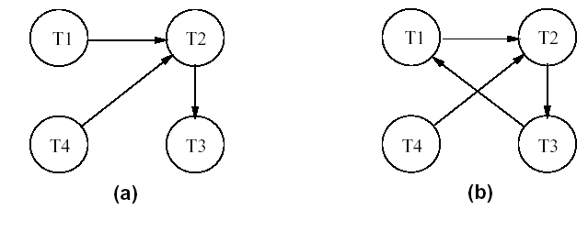
Deadlock and Starvation …
Deadlock Detection and resolution
In this approach, deadlocks are allowed to happen
The scheduler maintains a wait-for-graph for detecting cycle.
When a chain like: Ti waits for Tj waits for Tk waits for Ti or Tj occurs, then this creates a cycle.
When the system is in the state of deadlock , some of the transaction should be aborted by selected (victim) and rolled-back
This can be done by aborting those transaction: that have made the least work, the one with the lowest locks, and that have the least # of abortion and so on
Example:

Slide 60
Deadlock and Starvation …
Timeouts
It uses the period of time that several transaction have been waiting to lock items
It has lower overhead cost and it is simple
If the transaction wait for a longer time than the predefined time out period, the system assume that may be deadlocked and aborted it
Starvation
Starvation occurs when a particular transaction consistently waits or restarted and never gets a chance to proceed further while other transaction continue normally
This may occur , if the waiting method for item locking:
Gave priority for some transaction over others
Problem in Victim selection algorithm- it is possible that the same transaction may consistently be selected as victim and rolled-back.
Solution
FIFO
Allow for transaction that wait for a longer time
Give higher priority for transaction that have been aborted for many time

Slide 61
Timestamp based concurrency control algorithm
Timestamp
In lock based concurrency control , conflicting actions of different transactions are ordered by the order in which locks are obtained.
But here, Timestamp values are assigned based on time in which the transaction are submitted to the system using the current date & time of the system
A monotonically increasing variable (integer) indicating the age of an operation or a transaction.
A larger timestamp value indicates a more recent event or operation.
Timestamp based algorithm uses timestamp to serialize the execution of concurrent transactions.
It doesn’t use lock, thus deadlock cannot be occurred
In the timestamp ordering, conflicting operation in the schedule shouldn’t violate serilazable ordering
This can be achieved by associating timestamp value (TS) to each database item which is denoted as follow:
Read_Ts(x): the read timestamp of x – this is the largest time among all the time stamps of transaction that have successfully read item X
Write_TS(X): the largest of all the timestamps of transaction that have successfully written item X

Slide 62
Multiversion Concurrency Control Techniques
This approach maintains a number of versions of a data item and allocates the right version to a read operation of a transaction.
Thus unlike other mechanisms a read operation in this mechanism is never rejected.
This algorithm uses the concept of view serilazability than conflict serialiazability
Side effect:
Significantly more storage (RAM and disk) is required to maintain multiple versions. To check unlimited growth of versions, a garbage collection is run when some criteria is satisfied.

Slide 63
Validation (Optimistic) Concurrency Control Schemes
This technique allow transaction to proceed asynchronously and only at the time of commit, serializability is checked &
transactions are aborted in case of non-serializable schedules.
Good if there is little interference among transaction
It has three phases: Read, Validation , and Write phase
i. Read phase:
A transaction can read values of committed data items. However, updates are applied only to local copies (versions) of the data items (in database cache).
ii. Validation phase:.
If the transaction Ti decides that it wants to commit, the DBMS checks whether the transaction could possibly have conflicted with any other concurrently executing transaction.
While one transaction ,Ti, is being validated , no other transaction can be allowed to commit
This phase for Ti checks that, for each transaction Tj that is either committed or is in its validation phase, one of the following conditions holds:

Slide 64
Validation (Optimistic) …
Tj completes its write phase before Ti starts its read phase.
Ti starts its write phase after Tj completes its write phase and the read set of Ti has no item in common with the write set of Tj
Both the read_set and write_set of Ti have no items in common with the write_set of Tj, and Tj completes its read phase before Ti completes its read phase.
When validating Ti, the first condition is checked first for each transaction Tj, since (1) is the simplest condition to check. If (1) is false then (2) is checked and if (2) is false then (3 ) is checked.
If none of these conditions holds, the validation fails and Ti is aborted.
iii. Write phase:
On a successful validation, transactions’ updates are applied to the database; otherwise, transactions are restarted.

Slide 65
Multiple Granularity Locking
A lockable unit of data defines its granularity
Granularity can be coarse (entire database) or it can be fine (an attribute of a relation).
Example of data item granularity:
A field of a database record
A database record
A disk block/ page
An entire file
The entire database
Data item granularity significantly affects concurrency control performance.
Thus, the degree of concurrency is low for coarse granularity and high for fine granularity.
Example:
A transaction that expects to access most of the pages in a file should probably set a lock on the entire file , rather than locking individual pages or records
If a transaction that requires to access relatively few pages of the file , it is better to lock those pages
Similarly , if a transaction access several records on a page , it should lock the entire page and if it access just a few records , it should lock some those records.
This example will hold true , if a lock on the node locks that node and implicitly all its descendants

