Slide 1
Chapter 5
Distributed Databases

Slide 2
Distributed Database Concepts
A distributed computing system is a system which consists of a number of processing elements, not necessarily homogeneous, that are interconnected by a computer network, and that cooperate in performing certain assigned tasks.
A distributed database (DDB) is a collection of multiple logically interrelated databases distributed over a computer network.
A distributed database management system (DDBMS) is a software system that manages a distributed database while making the distribution transparent to the user.

Slide 3
Advantages of Distributed Databases
Management of distributed data with different levels of transparency:
Data Transparency: refers to the ability of a user to access data as if it were stored in a single location, regardless of its physical location within the network.
Location Transparency: refers to the ability of the system to hide the physical location of data, and the user can access data without knowing its exact location.
Replication Transparency: refers to the ability of the system to manage the replication of data across multiple nodes automatically and transparently to the user.

Slide 4
Distributed Databases
Failure Transparency: refers to the ability of the system to transparently handle node failures, allowing users to continue accessing the data, even if one or more nodes have failed.
Scalability Transparency: refers to the ability of the system to transparently handle increasing amounts of data and user load, allowing the system to scale out as needed.
These levels of transparency are important in ensuring that a distributed database operates seamlessly, effectively and transparently to the user.

Slide 5
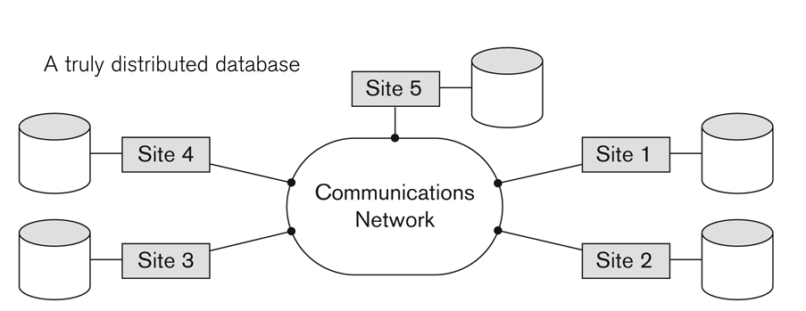
Advantages of Distributed Databases
Management of distributed data with different levels of transparency:
  A DBMS should be distribution transparent in the sense of hiding the details of where each file (table, relation) is physically stored within the system.
  The physical placement of data (files, relations, etc.) which is not known to the user (distribution transparency).

Slide 6
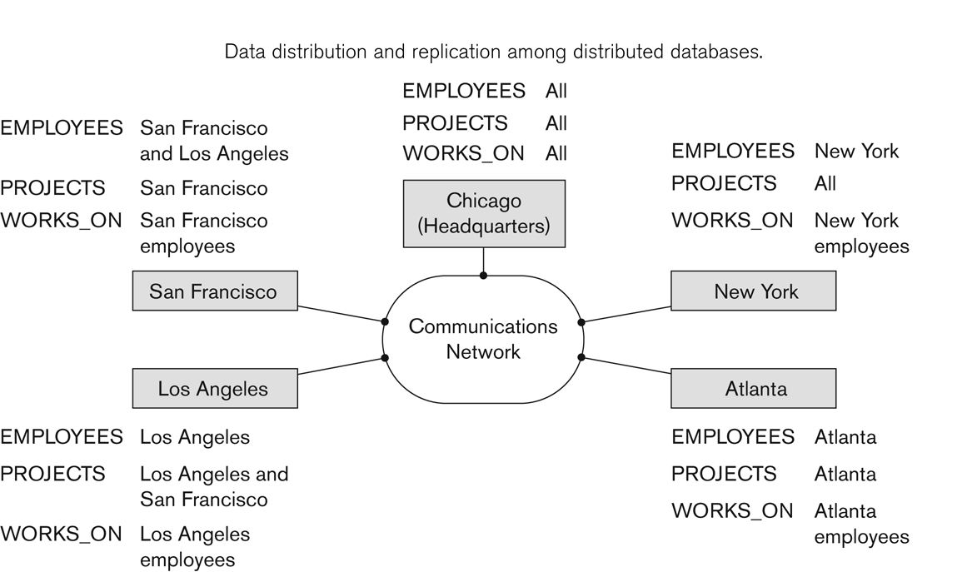
Advantages…..
The EMPLOYEE, PROJECT, and WORKS_ON tables may be fragmented horizontally and stored with possible replication as shown below.

Slide 7
Advantages …..
Types of transparencies
  Distribution or network transparency: users do not have to worry about operational details of the network.
    There is Location transparency, which refers to freedom of issuing command from any location without affecting its working.
    Then there is Naming transparency, which allows access to any names object (files, relations, etc.) from any location.
  Replication transparency:
    It allows to store copies of a data at multiple sites.
    This is done to minimize access time to the required data.
    It makes the user unaware of the existence of copies.
  Fragmentation transparency:
    Allows to fragment a relation horizontally (create a subset of tuples of a relation) or vertically (create a subset of columns of a relation).
    Makes the user unaware of the existence of fragments.

Slide 8
Advantages …..
2. Increased reliability and availability:
  Reliability is the probability that a system is running (not down) at a certain time point.
  Availability is the probability that the system is continuously available (usable or accessible) during a time interval.
  A distributed database system has multiple nodes (computers) and if one fails then others are available to do the job.
3. Improved performance:
  A distributed DBMS fragments the database to keep data closer to where it is needed most.
  This reduces data management (access and modification) time significantly
4. Easier expansion (scalability):
  Allows new nodes (computers) to be added anytime without chaining the entire configuration.

Slide 9
Functions of DDBMS
Keeping track of data: The ability to keep track of the data distribution, fragmentation, and replication by expanding the DDBMS catalog.
Distributed query processing: The ability to access remote sites and transmit queries and data among the various sites via a communication network.
Distributed transaction management: The ability to devise execution strategies for queries and transactions that access data from more than one site and to synchronize the access to distributed data and maintain integrity of the overall database.
Replicated data management: The ability to decide which copy of a replicated data item to access and to maintain the consistency of copies of a replicated data item.

Slide 10
Functions …..
Distributed database recovery: The ability to recover from individual site crashes and from new types of failures such as the failure of a communication links.
Security: Distributed transactions must be executed with the proper management of the security of the data and the authorization/access privileges of users.
Distributed directory (catalog) management: A directory contains information (metadata) about data in the database. The directory may be global for the entire DDB, or local for each site. The placement and distribution of the directory are design and policy issues.
At the physical hardware level, the following main factors distinguish a DDBMS from a centralized system:
    There are multiple computers, called sites or nodes.
    These sites must be connected by some type of communication network to transmit data and commands among sites,

Slide 11
Disadvantages of Distributed Databases
Complexity- The data replication, failure recovery, network management …make the system more complex than the central DBMSs.
Cost- Since DDBMS needs more people and more hardware, maintaining and running the system can be more expensive than the centralized system .
Problem of connecting Dissimilar Machine- Additional layers of operating system software are needed to translate and coordinate the flow of data between machines.
Data integrity and security problem- Because data maintained by distributed systems can be accessed at any locations in the network, controlling the integrity of a database can be difficult.

Slide 12
Data Fragmentation
There are two approaches to store the relation in the distributed database: Replication and Fragmentation
Data Fragmentation: is a technique used to break up the database into logically related units called fragments.
  A database can be fragmented as:
    Horizontal Fragmentation
    Vertical Fragmentation
    Mixed (Hybrid) Fragmentation
The main reasons for fragmenting a relation are
    Efficiency- data that is not needed by the local applications is not stored
    Parallelism- a transaction can be divided into several subqueries that operate on fragments which will increase the degree of concurrency.

Slide 13
Data Fragmentation …..
Horizontal Fragmentation: divides a relation "horizontally" by grouping rows to create subsets of tuples, where each subset has a certain logical meaning.
    It is a horizontal subset of a relation which contain those of tuples which satisfy selection conditions.
    Eg: Consider the EMPLOYEE relation with selection condition (DNO = 5). All tuples satisfy this condition will create a subset which will be a horizontal fragment of EMPLOYEE relation.
    A selection condition may be composed of several conditions connected by AND or OR.

Slide 14
Data Fragmentation …..
Vertical Fragmentation: divides a relation "vertically" by columns.
  It is a subset of a relation which is created by a subset of columns. Thus a vertical fragment of a relation will contain values of selected columns.
  A vertical fragment can be created by keeping the values of some attributes.
  Each fragment must include the primary key attribute of the parent relation for each fragment to be connected.
Mixed(Hybrid) Fragmentation: the combination of vertical and horizontal fragmentation.
      This is achieved by SELECT-PROJECT operations which is represented by Π_{Li}(σ_{Ci} (R)).

Slide 15
Data Fragmentation …..
Representation
  There are three rules that must be followed during fragmentation
    Completeness: if a relation r is decomposed into fragments r1, r2… rn , each data item that can be found in r must appear in at least one fragment.
    Reconstruction: it must be possible to define a relation operation that will reconstruct the relation r from fragments.
    Disjointness: if a data item di appears in fragment ri , then it shouldn’t appear in any other fragment

Slide 16
Data Replication
Database is replicated to all sites.
In full replication the entire database is replicated and in partial replication some selected part is replicated to some of the sites.
Full replication is useful in improving the availability of data, because the system can continue to operate as long as at least one site is up.

Slide 17
Data Replication…..
It also improves performance of retrieval for global queries, because the result of such a query can be obtained locally from anyone site.
The disadvantage of full replication is that it can slow down update operations.
Each fragment(or each copy of a fragment) must be assigned to a particular site in the distributed system. This process is called data distribution (or data allocation).

Slide 18
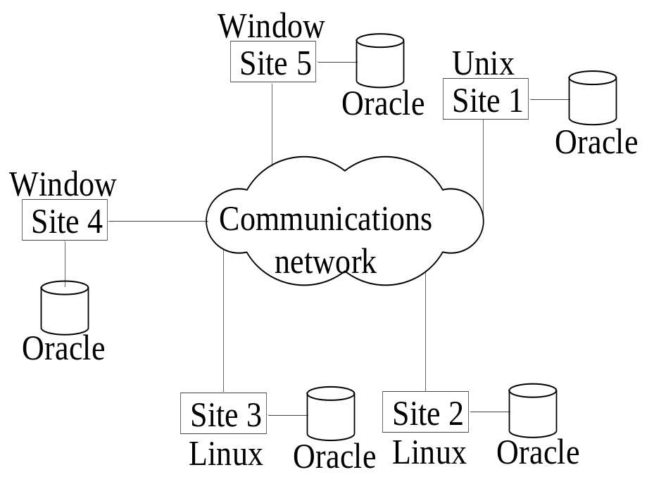
Types of Distributed Systems
Homogeneous
  All sites of the database system have identical setup, i.e., same database system software.
  The system may have little or no local autonomy(not standalone)
  The underlying operating systems can be a mixture of Linux, Window, Unix, etc.

Slide 19
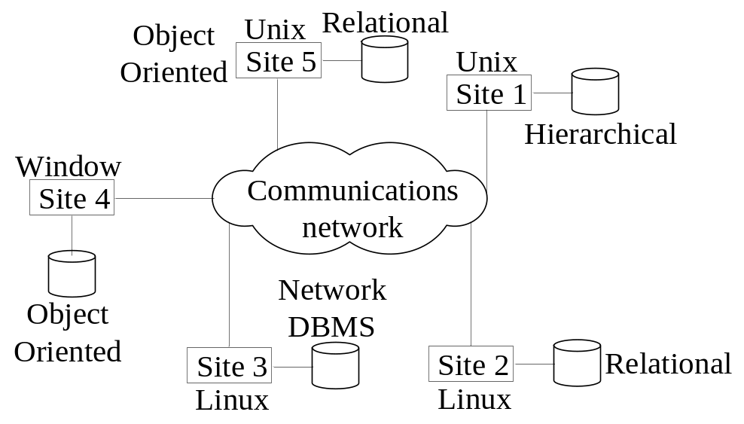
Types…..
Heterogeneous
  Federated: Each site may run different database system but the data access is managed through a single conceptual schema.
    This implies that the degree of local autonomy is minimum. Each site must adhere to a centralized access policy. There may be a global schema.
    Each server is an independent and autonomous centralized DBMS that has its own local users, local transactions, and DBA and
      hence has a very high degree of local autonomy.
  Multidatabase: There is no one conceptual global schema. For data access a schema is constructed dynamically as needed by the application software.

Slide 20
Types…..
Federated Database Management Systems Issues
  Differences in data models:
    Relational, Objected oriented, hierarchical, network, etc.
  Differences in constraints:
    Each site may have their own data accessing and processing constraints.
  Differences in query language:
    Some site may use SQL, some may use SQL-89, some may use SQL-92, and so on.

Slide 21
Query Processing in Distributed Databases
Issues
  Cost of transferring data (files and results) over the network.
    This cost is usually high, so some optimization is necessary.
    Example: relations Employee at site1 and Department at Site2
      Employee at site 1. 10,000 rows. Row size = 100 bytes. Table size = 10⁶ bytes.
      Department at Site 2. 100 rows. Row size = 35 bytes.
      Table size = 3,500 bytes.
    Q: For each employee, retrieve employee name and department name Where the employee works.
    Q: π_{Fname,Lname,Dname} (Employee _{Dno = Dnumber} Department)
Fname | Minit | Lname | SSN | Bdate | Address | Sex | Salary | Superssn | Dno
Dname | Dnumber | Mgrssn | Mgrstartdate

Slide 22
Query Processing…..
Result
  The result of this query will have 10,000 rows, assuming that every employee is related to a department.
  Suppose each result row 40 bytes long. The query is submitted at site 3 and the result is sent to this site.
  Problem: Employee and Department relations are not present at site 3.

Slide 23
Query Processing…..
Strategies:
  Transfer Employee and Department to site 3.
    Total transfer bytes = 1,000,000 + 3500 = 1,003,500 bytes.
  Transfer Employee to site 2, execute join at site 2 and send the result to site 3.
    Query result size = 40 * 10,000 = 400,000 bytes. Total transfer size = 400,000 + 1,000,000 = 1,400,000 bytes.
  Transfer Department relation to site 1, execute the join at site 1, and send the result to site 3.
    Total bytes transferred = 400,000 + 3500 = 403,500 bytes.
Optimization criteria: minimizing data transfer(Communication cost).
  Preferred approach: strategy 3.

Slide 24
Query Processing…..
Consider the query
  Q’: For each department, retrieve the department name and the name of the department manager
Relational Algebra expression:
  π _{Fname,Lname,Dname} (Employee _{Mgrssn = SSN} Department)
The result of this query will have 100 tuples, assuming that every department has a manager, the execution strategies are:
  Transfer Employee and Department to the result site and perform the join at site 3.
    Total bytes transferred = 1,000,000 + 3500 = 1,003,500 bytes.
  Transfer Employee to site 2, execute join at site 2 and send the result to site 3. Query result size = 40 * 100 = 4000 bytes.
    Total transfer size = 4000 + 1,000,000 = 1,004,000 bytes.
  Transfer Department relation to site 1, execute join at site 1 and send the result to site 3.
    Total transfer size = 4000 + 3500 = 7500 bytes.
  Preferred strategy: Choose strategy 3.

Slide 25
Query Processing…..
Now suppose the result site is 2. Possible strategies :
  Transfer Employee relation to site 2, execute the query and present the result to the user at site 2.
    Total transfer size = 1,000,000 bytes for both queries Q and Q’.
  Transfer Department relation to site1, execute join at site1 and send the result back to site 2.
    Total transfer size for Q = 400,000 + 3500 = 403,500 bytes and for Q’ = 4000 + 3500 = 7500 bytes.

Slide 26
Concurrency Control and Recovery
Distributed Databases encounter a number of concurrency control and recovery problems which are not present in centralized databases. Some of them are:
  Dealing with multiple copies of data items
  Failure of individual sites
  Communication link failure
  Distributed commit
  Distributed deadlock

Slide 27
Concurrency Control …..
Dealing with multiple copies of data items:
  The concurrency control must maintain global consistency. Likewise, the recovery mechanism must recover all copies and maintain consistency after recovery.
  Global consistency refers to the state in which all nodes in a distributed system have the same view of the data. It is a property of a distributed system that ensures that all operations and updates are performed in a consistent and coordinated manner across all nodes, regardless of their location.
Failure of individual sites:
  Database availability must not be affected due to the failure of one or two sites and the recovery scheme must recover them before they are available for use.

Slide 28
Concurrency Control …..
Communication link failure:
Communication link failure refers to the inability of two devices to communicate with each other due to a problem with the communication channel connecting them.
  This failure may create network partition which would affect database availability even though all database sites may be running.
Distributed commit:
Distributed commit is a mechanism for ensuring that a transaction in a distributed system is either fully committed or fully rolled back, ensuring the consistency of data across the system. In a distributed commit,
  A transaction may be fragmented and they may be executed by a number of sites. This require a two or three-phase commit approach for transaction commit.
Distributed deadlock:
  Since transactions are processed at multiple sites, two or more sites may get involved in deadlock. This must be resolved in a distributed manner.

Slide 29
Concurrency Control …..
The process of distributed commit typically involves the following steps:
All nodes participating in the transaction begin by preparing to commit.
The coordinator node sends a commit request to all participants.
Each participant acknowledges its readiness to commit.
If all participants have acknowledged, the coordinator sends a final commit message to all participants.
Each participant then performs the necessary updates and sends a final confirmation message to the coordinator.
The coordinator, upon receiving final confirmation messages from all participants, sends a "commit done" message to all participants.
Each participant performs any necessary clean up and the transaction is considered complete.
Distributed deadlock:
  Since transactions are processed at multiple sites, two or more sites may get involved in deadlock. This must be resolved in a distributed manner.

Slide 30
Concurrency Control …..
Distributed deadlock:
  Since transactions are processed at multiple sites, two or more sites may get involved in deadlock. This must be resolved in a distributed manner.
A distributed deadlock occurs when multiple processes in a distributed system are each waiting for resources held by the other processes. This creates a circular dependency that prevents any of the processes from continuing, resulting in a deadlock situation.
In a distributed system, deadlocks can occur across multiple nodes and can be more difficult to detect and resolve than in a single-node system. This is because each node may have its own view of the resources it holds and the resources it is waiting for, and the coordinator node responsible for detecting and resolving deadlocks may not have complete information about the state of the system.

Slide 31
Concurrency Control …..
There are several methods for detecting and resolving distributed deadlocks, including:
Centralized Deadlock Detection: In this approach, a central coordinator node periodically examines the state of the system to detect deadlocks.
Distributed Deadlock Detection: In this approach, each node in the system periodically exchanges information with its neighbors to detect deadlocks.
Timeouts: In this approach, each process waits for a specified amount of time before assuming that a deadlock has occurred and taking appropriate action.

Slide 32
Concurrency Control …..
Once a deadlock is detected, there are several strategies for resolving it, including:
Abort one or more of the processes involved in the deadlock.
Preempt one or more resources held by a process involved in the deadlock and allocate them to another process.
Rollback one or more of the transactions involved in the deadlock.

Slide 33
Concurrency Control…..
Distributed Concurrency Control Based on a Distinguished Copy of a Data Item
A distinguished copy of a data item is a specific instance of a data item that is designated as the authoritative or primary copy of that data item in a distributed system.
In a distributed system, multiple copies of a data item may exist across different nodes. When updates are made to the data item, it is important to ensure that all copies of the data item are updated consistently and correctly. The distinguished copy of the data item serves as the source of truth for the data item, and all updates to the data item are made to this copy first. The updates are then propagated to all other copies of the data item

Slide 34
Concurrency Control…..
Distributed Concurrency Control Based on a Distinguished Copy of a Data Item
  site that contains this distinguished copy. The idea is to designate a particular copy of each data item as a distinguished copy.
The distinction of a copy of a data item as the distinguished copy can be based on various factors, such as the location of the data item, the processing capabilities of the node where the data item is stored, or the availability of the data item. The choice of the distinguished copy of a data item can have significant impact on the performance, scalability, and reliability of a distributed system, so it is important to choose an appropriate approach based on the specific requirements of the system.

Slide 35
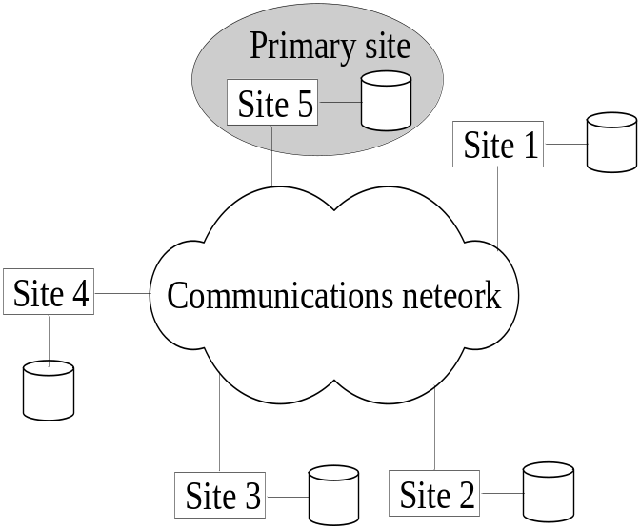
Concurrency Control…..
Primary site technique:
Primary site technique is a method used in distributed systems to maintain a single authoritative copy of a data item.
  All distinguished copies are kept at the same site.
  A single site is designated as a primary site which serves as a coordinator for transaction management.
  Concurrency control and commit are managed by this site.
  In two phase locking, this site manages locking and releasing data items.

Slide 36
Concurrency Control…..
Primary site technique:
in a distributed system, multiple copies of a data item may exist across different nodes. The primary site technique designates one node, the primary site, as the authoritative source for the data item. All updates to the data item are made to the primary site first, and then propagated to all other nodes in the system that store a copy of the data item.
The primary site technique is used to ensure consistency and accuracy of the data item across the system, and to prevent conflicting updates from multiple nodes. It also allows for efficient updates, as only the primary site needs to be updated directly, rather than updating multiple copies individually.

Slide 37
Concurrency Control…..
Primary site technique:
The choice of the primary site can be based on various factors, such as the location of the data item, the processing capabilities of the node where the data item is stored, or the availability of the data item. The primary site can be designated statically, for example by configuring the system to always use a specific node as the primary site, or dynamically, for example by using an algorithm to choose the most appropriate node based on the current state of the system.

Slide 38
Concurrency Control…..
Primary site technique:
In the primary site technique, the primary site is responsible for executing transactions and maintaining the authoritative copy of the data. To implement two-phase locking at the primary site, the following steps can be performed:
Lock acquisition: When a transaction requests access to a data item, it first acquires a lock on that data item. This lock can be a shared lock for read-only access, or an exclusive lock for write access. The lock is acquired at the primary site, which is responsible for maintaining the lock table.
Lock propagation: Once the lock has been acquired at the primary site, it is propagated to all other nodes in the system that have a copy of the data item. This ensures that all nodes have a consistent view of the locks held on the data item.

Slide 39
Concurrency Control…..
Lock release: When a transaction has completed its access to a data item, it releases the lock. The lock is released at the primary site, and then propagated to all other nodes.
Deadlock detection: To avoid deadlocks, a deadlock detection algorithm can be used at the primary site. If a deadlock is detected, one of the transactions involved in the deadlock is rolled back to release its locks, allowing the other transactions to proceed

Slide 40
Concurrency Control…..
Primary site technique…..
  Advantages:
    An extension to the centralized two phase locking so implementation and management is simple.
    Data items are locked only at one site but they can be accessed at any site.
  Disadvantages
    All transaction management activities go to primary site which is likely to overload the site.
    If the primary site fails, the entire system is inaccessible.
    This can limit system reliability and availability.
  To aid recovery, a backup site is designated which behaves as a shadow of primary site. In case of primary site failure, backup site can act as primary site.

Slide 41
Concurrency Control…..
The Primary Copy Technique is a method used in distributed systems to manage data consistency across multiple nodes. The technique designates one node as the primary node, and all updates to the data are made on the primary node first. This node holds the authoritative copy of the data, and all other nodes in the system have replicas of the data.
The primary copy technique is used to ensure that all updates to the data are made in a consistent and orderly manner, and that all nodes in the system have the same view of the data. When a transaction wants to update the data, it first sends a request to the primary node. The primary node executes the transaction and updates the authoritative copy of the data. Then the updated data is propagated to the replica nodes.

Slide 42
Concurrency Control…..
In the primary copy technique, conflicts between updates made by different transactions can be resolved by the primary node, which has the complete information about the state of the data. The primary copy technique can be used in various types of distributed systems, including database systems, cloud computing systems, and file systems. It is an important aspect of distributed data management and should be carefully designed and implemented to ensure the correct functioning of the syste

Slide 43
Concurrency Control…..
Primary Copy Technique:
    In this approach, instead of a site, a data item partition is designated as primary copy. To lock a data item just the primary copy of the data item is locked.
  Advantages:
    Since primary copies are distributed at various sites, a single site is not overloaded with locking and unlocking requests.
  Disadvantages:
    Identification of a primary copy is complex. A distributed directory must be maintained, possibly at all sites.

Slide 44
Concurrency Control…..
Recovery from a coordinator failure
Recovery from a coordinator failure in a distributed system refers to the process of restoring normal functioning of the system after a failure of the coordinator node. The coordinator is a special node in a distributed system that is responsible for coordinating the execution of transactions and ensuring data consistency across the nodes.
The recovery process can vary depending on the design of the system and the type of coordinator failure. In some cases, the recovery process may involve the selection of a new coordinator node, which takes over the responsibilities of the failed node. In other cases, the recovery process may involve rolling back any transactions that were executed by the failed coordinator but not yet committed, and then resuming normal processing.
.

Slide 45
RECOVARY…..
The recovery process should be designed to minimize the impact of the coordinator failure on the system, and to ensure that the data remains consistent and available to users. This can involve implementing robust data backup and recovery strategies, and monitoring the system for potential failures and taking corrective actions as needed.
In addition, the recovery process should be efficient and fast, to minimize the downtime of the system and to allow normal processing to resume as soon as possible. This can involve the use of check pointing, which is the process of periodically saving the state of the system so that it can be quickly restored in case of a failure.
Overall, recovery from a coordinator failure is a critical aspect of the design and implementation of a distributed system, and should be carefully planned and tested to ensure its reliability and efficiency.

Slide 46
RECOVARY…..
Primary site approach with no backup site:
  Aborts and restarts all active transactions at all sites.
The primary site approach with no backup site refers to a distributed system architecture where there is only one node designated as the primary site, and no secondary or backup site. This means that all updates to the data are made at the primary site, and there is no fallback option in case of failure of the primary site.
In this architecture, the primary site holds the authoritative copy of the data and is responsible for executing transactions and maintaining data consistency. All other nodes in the system have replicas of the data, but they do not have the ability to make updates.

Slide 47
RECOVARY…..
Primary site approach with backup site:
  Suspends all active transactions, designates the backup site as the primary site and identifies a new back up site. Primary site receives all transaction management information to resume processing.
  The primary site approach with a backup site refers to a distributed system architecture where there is a primary site and a secondary or backup site. The primary site is responsible for executing transactions and maintaining the authoritative copy of the data, while the backup site acts as a secondary repository of the data.

Slide 48
RECOVARY…..
Primary site approach with backup site:
In this architecture, if the primary site fails, the backup site takes over as the new primary site and continues to execute transactions and maintain the data. This provides a high degree of reliability, as the system can continue to function even if the primary site fails.
The primary site and the backup site communicate with each other regularly to keep their copies of the data synchronized. This can be achieved through techniques such as database replication, in which changes made at the primary site are automatically reflected at the backup site.

Slide 49
RECOVARY…..
Recovery from a coordinator failure
  In both approaches a coordinator site or copy may become unavailable. This will require the selection of a new coordinator.
Recovery from a coordinator failure in a distributed system refers to the process of restoring normal functioning of the system after a failure of the coordinator node. The coordinator is a special node in a distributed system that is responsible for coordinating the execution of transactions and ensuring data consistency across the nodes.
The recovery process can vary depending on the design of the system and the type of coordinator failure. In some cases, the recovery process may involve the selection of a new coordinator node, which takes over the responsibilities of the failed node. In other cases, the recovery process may involve rolling back any transactions that were executed by the failed coordinator but not yet committed, and then resuming normal processing.

Slide 50
RECOVARY…..
Recovery from a coordinator failure
The recovery process should be designed to minimize the impact of the coordinator failure on the system, and to ensure that the data remains consistent and available to users. This can involve implementing robust data backup and recovery strategies, and monitoring the system for potential failures and taking corrective actions as needed.
In addition, the recovery process should be efficient and fast, to minimize the downtime of the system and to allow normal processing to resume as soon as possible. This can involve the use of check pointing, which is the process of periodically saving the state of the system so that it can be quickly restored in case of a failure.

Slide 51
Concurrency Control…..
Primary and backup sites fail or no backup site:
  Use election process to select a new coordinator site.
  Any processY, that attempts to communicate with the coordinator site repeatedly and fails to do so can assume that the coordinator is down and can start the election process by sending a message to all running sites proposing that Y become the new coordinator. As soon as Y receives a majority of yes votes, Y can declare that it is the new coordinator.

Slide 52
Concurrency Control…..
Primary and backup sites fail or no backup site:
The statement describes an election process for selecting a new coordinator site in a distributed system. The process is triggered when a site, process Y, fails to communicate with the existing coordinator and assumes that the coordinator is down.
Process Y then sends a message to all running sites proposing that it become the new coordinator. The message contains a request for a majority of yes votes from the other sites. As soon as process Y receives a majority of yes votes, it can declare itself to be the new coordinator.
This election process is used to dynamically select a new coordinator in case of a failure of the existing coordinator. The process ensures that there is a new coordinator in place as soon as possible, and that the new coordinator is selected in a democratic and consensus-based manner.

Slide 53
Concurrency Control…..
Primary and backup sites fail or no backup site:
The election process is a critical component of the design of a distributed system, as it ensures that the system can continue to function even in the event of a failure of the coordinator. The process should be carefully designed to ensure that it is efficient, reliable, and fair.

Slide 54
Concurrency Control…..
Distributed Concurrency control based on voting:
Distributed concurrency control based on voting is a technique for managing concurrent access to shared resources in a distributed system. In this technique, the coordinator site collects voting information from all participating sites before deciding to execute a transaction.
The voting process ensures that all participating sites agree on the order of transactions, and that transactions are executed in a consistent manner across all sites. This helps to ensure that the data remains consistent and up-to-date, even in the presence of concurrent access to the shared resources.

Slide 55
Concurrency Control…..
Distributed Concurrency control based on voting:
The coordinator site acts as the central authority, collecting voting information from all sites, and making the final decision on the execution of transactions. The coordinator site also ensures that transactions are executed in a serializable order, preventing inconsistencies that can result from concurrent access to shared resources.
Overall, distributed concurrency control based on voting is a useful technique for managing concurrent access to shared resources in a distributed system. It ensures that the data remains consistent and up-to-date, even in the presence of concurrent access to shared resources, and that transactions are executed in a consistent manner across all sites.

Slide 56
Concurrency Control…..
Distributed Concurrency control based on voting:
  There is no primary copy of coordinator.
  Each copy maintains its own lock and can grant or deny the request for it.
  If a transaction wants to lock a data item, it sends lock request to all the sites that have the data item.
  If majority of sites grant lock, then the requesting transaction gets the data item.
  To avoid unacceptably long wait, a time-out period is defined. If the requesting transaction does not get any vote information then the transaction is aborted.
  Locking information (grant or denied) is sent to all these sites.

Slide 57
Distributed Recovery
There are two major problems with regard to distributed recovery.
  It is difficult to determine a site is down without exchanging numerous messages with other sites.
  Suppose that site X sends a message to site Y and expects a response from Y but does not receive it. There are several possible explanations for this:
    The message was not delivered to Y because of communication failure.
    Site Y is down and could not respond.
    Site Y is running and sent a response, but the response was not delivered.
  Distributed commit.
    When a transaction is updating data at several sites, it cannot commit until it is sure that the effect of the transaction on every site cannot be lost.

Slide 58
Thank You
Any Question???

