Slide 1
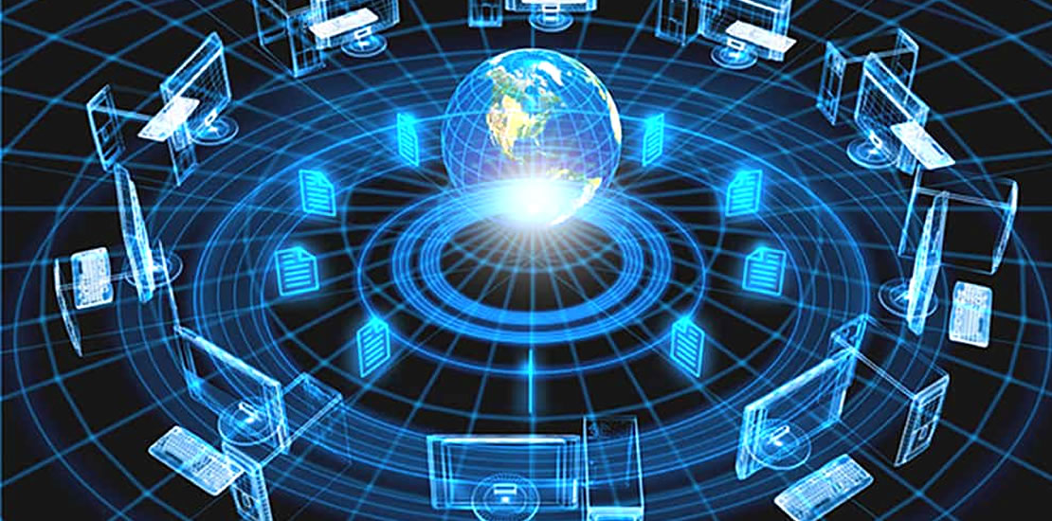
CHAPTER 1
INTRODUCTION

Slide 2
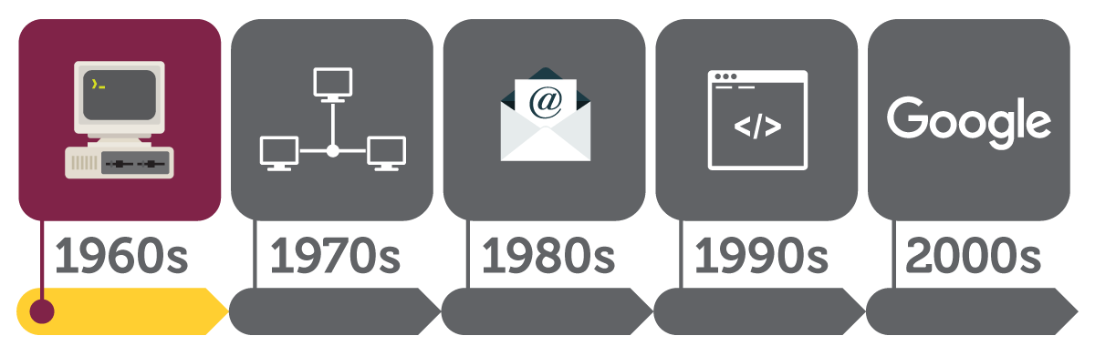
1. History and Overview of Networks

Slide 3
What is Communication?
Exchange of information through the use of speech, signs or symbols is called communication.
Communicating with people over a distance is known as telecommunication.
The first forms of telecommunication were smoke signals, drums or fire torches.
The major disadvantage with these communication systems was that only a set of pre-determined messages could be transmitted.

Slide 4
cont’d
However, the real telecommunication was born in 1870s during the invention of telephone.
The International Telecommunication Union (ITU) defines telecommunication as transmission, emission and reception of any signs, signals or messages by electromagnetic systems.
Telephones slowly gave way to television, videophone, satellite and finally computer networks.

Slide 5
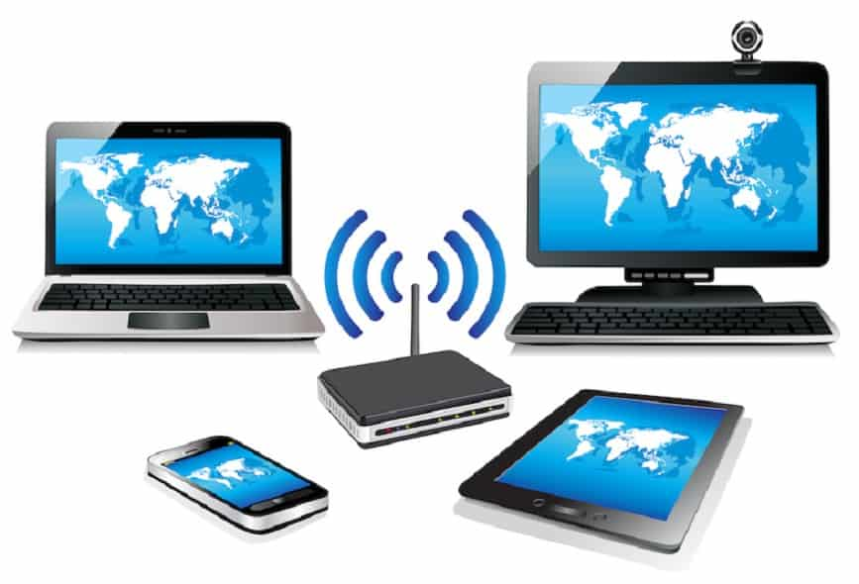
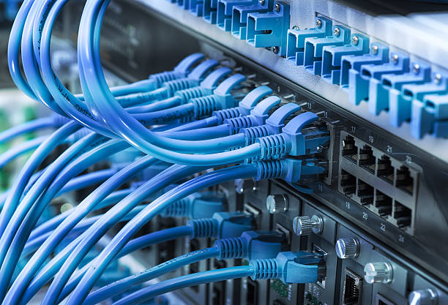
What is Computer Network?
A network set up by connecting two or more computers and other supporting hardware devices through communication channels is called a computer network.
Two or more computers are said to be interconnected if they are able to exchange information.
A network connection can be set up with the help of either cable or wireless media.

Slide 6
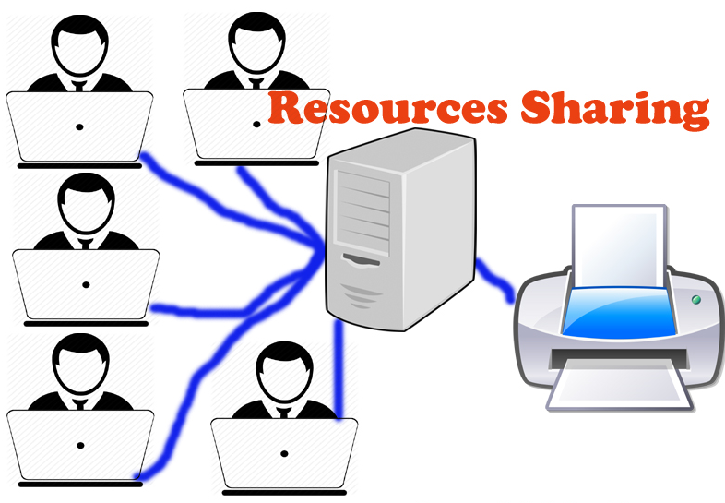
Uses of Computer Network
Resource sharing: It allows us to share resources such hardware, software and data among the users on the network.

Slide 7
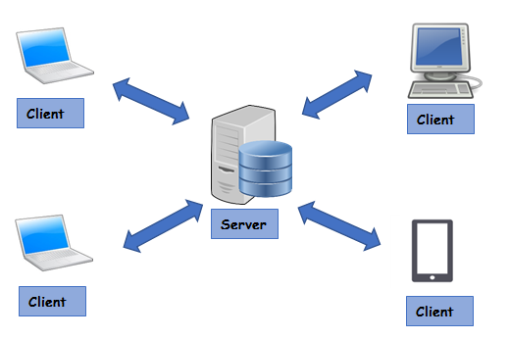
Uses of Computer Network
Client-Server model: A Client-Server based network infrastructure consists two (2) components:
A server is a central computer used to store the information and maintained by the system administrator.
Always receives clients request and provide services.
Clients are the machines used to access the information stored in the server remotely.
Always send a request and receive information or data from the server.
Example, accessing
Google’s web-server

Slide 8
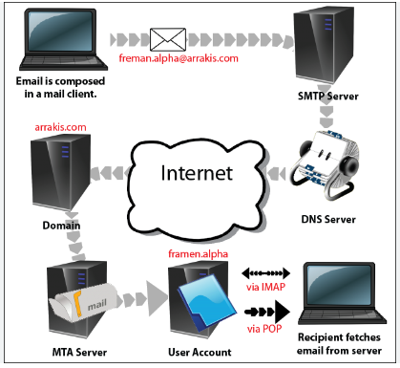
Uses of Computer Network
Communication medium: Computer network works based on communication medium type among the users.
For example, a company contains more than one computer has an email system which the employees use for daily communication.
It facilitates communications from one computer to another computer.

Slide 9


Uses of Computer Network
E-commerce: Computer network is also important in businesses. We can do the business over the internet.
For example, amazon.com is doing their business over the internet.

Slide 10
A History of Computer Networking
ARPANET began the networking long ago.
An agency named Advanced Research Project Agency (ARPA) was started by American, in the department of defense, in 1957.
In the mid-1960s, mainframe computers in research organizations were standalone devices.
Computers from different manufacturers were unable to communicate with one another.
In 1967, ARPA presented its ideas for ARPANET, a small network of connected computers.

Slide 11
A History of Computer Networking
The idea was that
each host computer would be attached to a specialized computer, called an interface message processor (IMP).
The IMPs would be connected to one another.
Each IMP had to be able to communicate with other IMPs as well as with its own attached host.

Slide 12
A History of Computer Networking
By 1969, ARPANET was a reality.
Four nodes, at the University of California at Los Angeles (UCLA), the University of California at Santa Barbara (UCSB), Stanford Research Institute (SRI), and the University of Utah, were connected via the IMPs to form a network.
Software called the Network Control Protocol (NCP) provided communication between the hosts.
Notes:
https://www.tutorialspoint.com/communication_technologies/communication_technologies_history_of_networking.htm#
https://www.javatpoint.com/history-of-computer-networking
https://www.computerhope.com/history/network.htm

Slide 13
A History of Computer Networking
TCP/IP
Ethernet
USENET
Links multiple networks together
Transfers data over a network using Cable
Transfers data over a network using phone lines
Telenet
Email
LAN
Domain Name System
The PhoneNet system is established and is connected to ARPANET
Uses domain names to manage the increasing number of users on the internet
Notes:
In 1973, Robert Kahn and Vinton Cerf collaborate to develop a protocol for linking multiple networks together. This later becomes the Transmission Control Protocol/Internet Protocol (TCP/IP), a technology that links multiple networks together such that, if one network is brought down, the others do not collapse.
Robert Metcalfe develops a system using cables that allows for transfer of more data over a network. He names this system Alto Aloha, but it later becomes known as Ethernet.
Tom Truscott and Steve Bellovin develop a Unix-based system for transferring data over phone lines via a dial-up connection. This system becomes USENET.
In 1982, the PhoneNet system is established and is connected to ARPANET and the first commercial network, Telenet. This broadens access to the internet and allows for email communication between multiple nations of the world.
In 1981, Metcalfe’s company 3Com announces Ethernet products for both computer workstations and personal computers; this allows for the establishment of local area networks (LANs).
Paul Mockapetris, Jon Postel and Craig Partridge create the Domain Name system, which uses domain names to manage the increasing number of users on the internet.
In 1985, the first domain is registered: symbolics.com, a domain belonging to a computer manufacturer.
In 1990, ARPANET is decommissioned. Tim Berners-Lee and his colleagues at CERN develop hypertext markup language (HTML) and the uniform resource locator (URL), giving birth to the first incarnation of the World Wide Web.
A watershed year for the internet comes in 1995: Microsoft launches Windows 95; Amazon, Yahoo and eBay all launch; Internet Explorer launches; and Java is created, allowing for animation on websites and creating a new flurry of internet activity.
In 1996, Congress passes the Communications Decency Act in an effort to combat the growing amount of objectionable material on the internet. John Perry Barlow responds with an essay, A Declaration of the Independence of Cyberspace.
Google is founded in 1998.
In 1999, the music and video piracy controversy intensifies with the launch of Napster.
The first internet virus capable of copying and sending itself to a user’s address book is discovered in 1999.

Slide 14
A History of Computer Networking
Hypertext markup language (HTML) and the uniform resource locator (URL) developed giving birth to the first incarnation of the World Wide Web.
HTML and URL
WWW
Google
WiFi
WPA
Popular protocols like WiFi and WPA were introduced.
Notes:
In 1973, Robert Kahn and Vinton Cerf collaborate to develop a protocol for linking multiple networks together. This later becomes the Transmission Control Protocol/Internet Protocol (TCP/IP), a technology that links multiple networks together such that, if one network is brought down, the others do not collapse.
Robert Metcalfe develops a system using cables that allows for transfer of more data over a network. He names this system Alto Aloha, but it later becomes known as Ethernet.
Tom Truscott and Steve Bellovin develop a Unix-based system for transferring data over phone lines via a dial-up connection. This system becomes USENET.
In 1982, the PhoneNet system is established and is connected to ARPANET and the first commercial network, Telenet. This broadens access to the internet and allows for email communication between multiple nations of the world.
In 1981, Metcalfe’s company 3Com announces Ethernet products for both computer workstations and personal computers; this allows for the establishment of local area networks (LANs).
Paul Mockapetris, Jon Postel and Craig Partridge create the Domain Name system, which uses domain names to manage the increasing number of users on the internet.
In 1985, the first domain is registered: symbolics.com, a domain belonging to a computer manufacturer.
In 1990, ARPANET is decommissioned. Tim Berners-Lee and his colleagues at CERN develop hypertext markup language (HTML) and the uniform resource locator (URL), giving birth to the first incarnation of the World Wide Web.
A watershed year for the internet comes in 1995: Microsoft launches Windows 95; Amazon, Yahoo and eBay all launch; Internet Explorer launches; and Java is created, allowing for animation on websites and creating a new flurry of internet activity.
In 1996, Congress passes the Communications Decency Act in an effort to combat the growing amount of objectionable material on the internet. John Perry Barlow responds with an essay, A Declaration of the Independence of Cyberspace.
Google is founded in 1998.
In 1999, the music and video piracy controversy intensifies with the launch of Napster.
The first internet virus capable of copying and sending itself to a user’s address book is discovered in 1999.

Slide 15
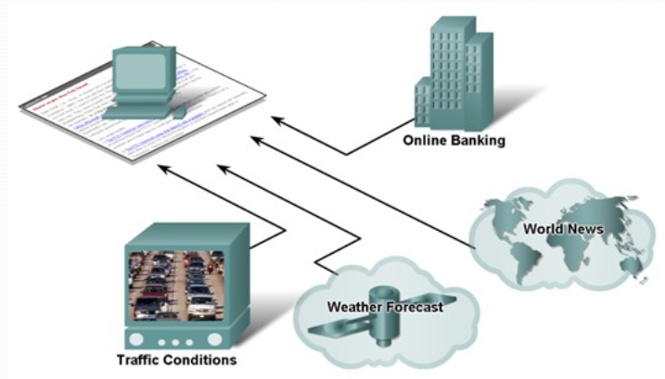
2. The impact of Networks on daily life
Benefits of instantaneous communication and how it supports and improves our daily lives.

Slide 16
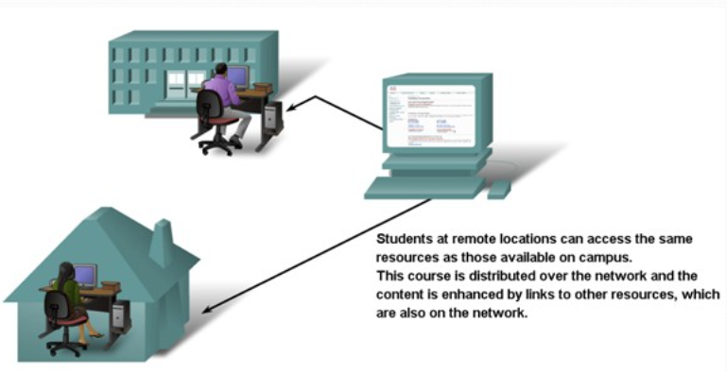
2. The impact of Networks on daily life
Networks changing the way we learn:
The Internet can enhance learning and makes it easier.
Courses delivered using Internet resources are commonly called online learning or e-learning.

Slide 17
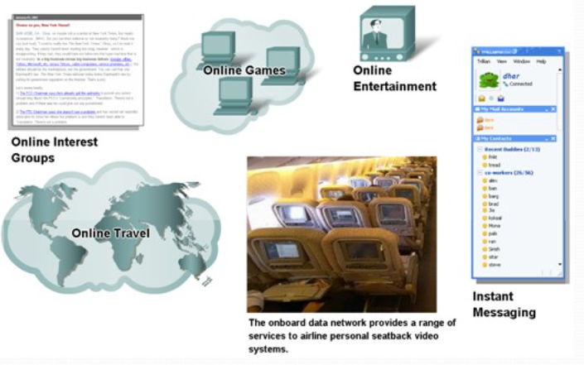
2. The impact of Networks on daily life
Networks changing the way we play:
Entertainment is getting much more fun these days.
Chatting and instant messaging
Online interest groups
Web blogging
Video and audio streaming
Online games

Slide 18
2. The impact of Networks on daily life
The use of network can enhance communication between employees in an organization and also with external clients.
The use of technology like VPN (virtual private network) allows employees to access company’s intranet remotely.
In certain countries, there is a rising trend on the concept of “working from home”.
Notes:
The use of network can enhance communication between employees in an organization and also with external clients.
Most companies have an intranet.
A private network belonging to the company.
Allows communication between employees and also between branches.
Some companies also have an extra net.
A network (or network resources) to provide suppliers, vendors, customers, limited access to corporate data.
Example of common data to be shared: order status, inventory, part lists.
The use of technology like VPN (virtual private network) allows employees to access company’s intranet remotely.
Work can be done even though the employee is outstation or at home.
In certain countries, there is a rising trend on the concept of “working from home”.
No longer need to go to the office every day.
Communications with other employees or clients can be done online.
Can work and take care of family at the same time.

Slide 19
3. The Network as a platform
The network has become a platform for distributing a wide range of services to end users in a reliable, efficient, and secure manner.
The Dedicated Network
Data networks are limited to exchanging character-based information between connected computer systems.
Traditional telephone, radio, and television networks were maintained separately from data networks.
Every one of these services required a dedicated network, with different communication channels and different technologies to carry a particular communication signal.
Each service had its own set of rules and standards to ensure successful communication.

Slide 20
3. The Network as a platform
The Converging Network
Consolidate different kinds of networks onto one platform.
Converged networks are capable of delivering voice, video streams, text, and graphics among many different types of devices over the same communication channel and network structure.
This platform provides access to a wide range of alternative and new communication methods that enable people to interact directly with each other almost instantaneously.
In a converged network, there are still many points of contact and many specialized devices, such as personal computers, phones, TVs, and tablet computers, but there is one common network infrastructure.
This network infrastructure uses the same set of rules, agreements, and implementation standards.

Slide 21
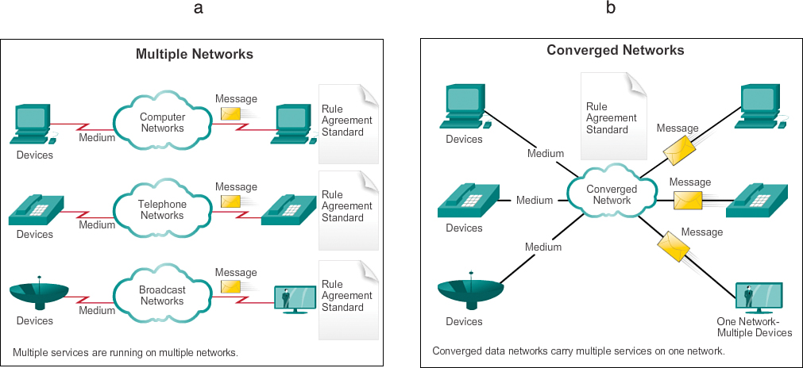
3. The Network as a platform
Notes:
https://www.ciscopress.com/articles/article.asp?p=2164577&seqNum=6

Slide 22
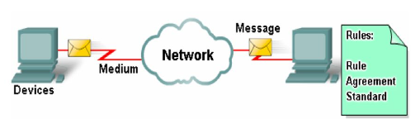
4. Elements of Computer Network
Networks are comprised of four basic elements: hardware, software, protocols and the connection medium.
All data networks are comprised of these elements, and cannot function without them.

Slide 23
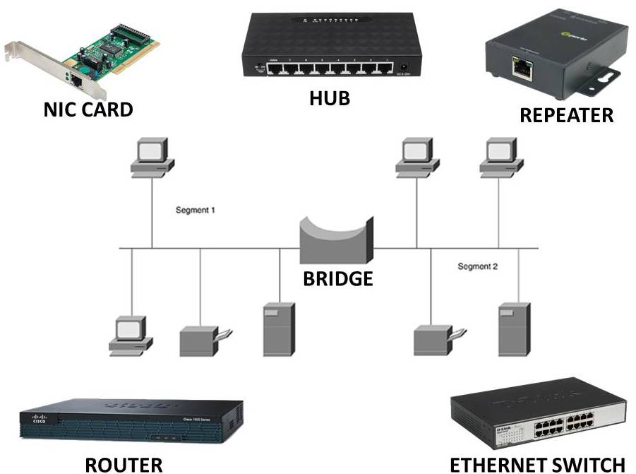
Hardware
The backbone of any network is the hardware that runs it.
Network hardware includes
network cards
routers or network switches
modems
Ethernet repeaters
Without this hardware, computers have no means of accessing a network.

Slide 24
Hardware: For Example
Network cards
give computers direct access to network media and enable them to connect to other equipment, including routers, switches, modems and repeaters.
Routers or switches
allow a single network connection from a modem to be divided between several computers.
Repeaters
refresh the network signal between Ethernet cable segments, allowing Category 5 cables to reach beyond their 300-foot maximum length without signal loss.

Slide 25
Software
It is used to allow hardware to interact with the network or to issue commands to it.
It commands network devices how to connect to the network, so that network hardware and network software interact well with each other.
It helps administrators deploy, manage and monitor a network.
For Example; connection monitoring software, networking clients and other tools designed to further facilitate your computer's ability to connect to the network.
Notes:
https://www.spiceworks.com/tech/networking/articles/what-is-network-software/

Slide 26
Protocols
There are some defined rules and conventions for communication between network devices. These are called Protocols.
Network protocols include:
mechanisms for devices to identify and make connections with each other,
formatting rules that specify how data is packaged into sent and received messages.
NB: this topic will be discussed in details in Chapter 4

Slide 27
Connection Medium
The medium used to connect the nodes of a network.
The means through which we send our data from one place to another is known as the Transmission (Connection) medium.
Without connections, a network cannot function.
The transmission medium is of two types:
Wired or Guided: For example, Twisted Pair Cable, Coaxial Cable, and Optical Fiber Cable.
Wireless or Unguided: For example, Radiowaves, Microwaves, and Infrared.
NB: this topic will be discussed in details in Chapter 2

Slide 28
5. Computer Network Architecture
Network architecture refers to a network’s structural and logical layout.
i.e. it the physical and logical design of the software, hardware, protocols, and media of the transmission of data.
It describes how computers are organized and how tasks are allocated to the computer.
Planning the network architecture is vital:
Because it either enhances or hinders the performance of the entire system.
For example; choosing the wrong transmission media or equipment for a particular expected server load, can cause slowdowns on the network.

Slide 29
5. Computer Network Architecture
Most network architectures adopt the Open Systems Interconnection (OSI) Model.
This conceptual model separates the network tasks into seven logical layers, from lowest to highest abstraction.
For Example:
The Physical layer, the lowest layer, deals with the wire and cable connections of the network.
The Application layer, the highest layer, involves APIs that deal with application-specific functions like chat and file sharing.
The OSI model makes it easier to troubleshoot the network by isolating problem areas from each other.

Slide 30
Types of Network Architecture
The two types of network architectures are:
Peer-to-Peer Network
It is a network in which all the computers are linked together with equal privilege and responsibilities for processing the data.
It is useful for small environments and has no dedicated Server.
Client-Server Network
It is a network model designed for the end users called clients, to access the resources from a central computer known as Server.
A server performs all the major operations such as security and network management.
A server is also responsible for managing all the resources such as files, directories, printer, etc.
All the clients communicate with each other through a server.
NB: this topic will be discussed in details in Chapter 3

Slide 31
Network Architecture Characteristics
Fault Tolerance
Fault Tolerance means the ability to continue working despite failures and Ensure no loss of services.
A fault-tolerant network is one that limits the number of devices that are impacted by faults, as the Internet will fail at times.
It’s built to recover quickly and utilize multiple paths between the source and destination, so if one faults, another steps in.
For Example:
Your PC is connected with a wireless router and the router is connected with router 1 and router 2 and these two routers ,in turn, is connected with the web server. Now suppose you searched for a link or any website, but unfortunately, the connection of your wireless router with router 1 is disconnected, so now the wireless router will make another connection with router 2 and send the request to the web server. This is what the Fault Tolerance means.

Slide 32
Network Architecture Characteristics
2. Scalability
Scalability means the ability to grow based on the needs and have good performance after growth.
A scalable network can expand quickly to support its new clients and applications without impacting the performance of the service being delivered to already existing users.
Example:
The best example of scalability is The Internet itself, now also many new users are connecting through the internet and communicating with other devices, but our network is working properly. This is what scalability is.

Slide 33
Network Architecture Characteristics
3. Quality of Service (QoS)
Quality of Service refers to the ability to set priorities and manage data traffic and reduce data loss, delay, etc.
The quality of service is a requirement of networks in the modern multi-cloud era.
Services need to be dependable, measurable, and at times, guaranteed without fear of compromised quality, which includes the controls to manage congested network traffic and network bandwidth.

Slide 34
Network Architecture Characteristics
4. Security
Security is the ability to prevent unauthorized access, misuse, or forgery. Also it is the ability to provide confidentiality, integrity and availability.
A high-level of security is a non-negotiable for an impactful network architecture as it serves as one of the fundamentals.
Security is addressed in the network infrastructure and in information security, which means physically securing a network is necessary and the information being transmitted, stored, and utilized in cloud-native environments.

Slide 35

THANK YOU!

