Slide 1
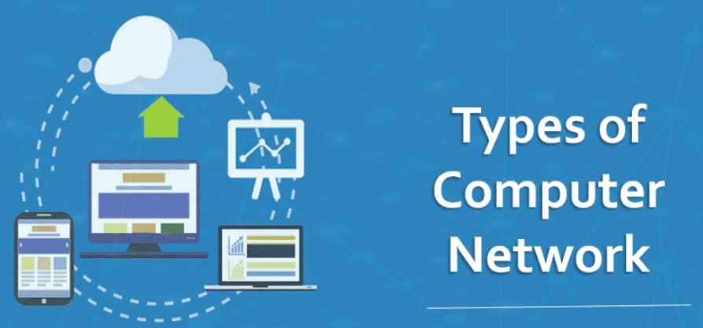
CHAPTER 3
Computer Network Types

Slide 2
Computer Network Types
A computer network is a system in which multiple computers are connected to share information and resources.
Computer network varies with each other based on
Their Functionality/Architecture
Peer-to-Peer Network vs Client-Server Network
Geographical coverage
PAN, LAN, MAN, WAN
Their Ownership
Private Network vs Public Network
Types of Communication media used
Guided Media network vs Unguided Media Network

Slide 3
Computer Network Architecture
Computer Network Architecture is defined as the physical and logical design of the software, hardware, protocols, and media of the transmission of data.
Simply we can say that how computers are organized and how tasks are allocated to the computer.
The two types of network architectures are:
Peer-To-Peer network
Client/Server network

Slide 4
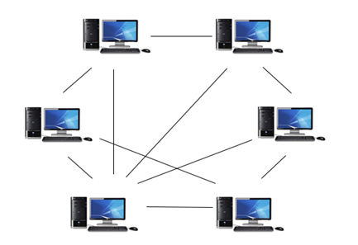
Peer-To-Peer (P2P) Network
all the computers are linked together with equal privilege and responsibilities for processing the data.
has no dedicated server
each device in the network serves as both a client and server.

Slide 5
Peer-To-Peer (P2P) Network
useful in residential areas, small offices, or small companies where each computer act as an independent workstation and stores the data on its hard drive.
special permissions are assigned to each computer for sharing the resources
BitTorrent, Skype, Kazaa are some of popular examples of P2P network.

Slide 6
P2P Network: Advantages
Easy to maintain: The network is easy to maintain because each node is independent of the other.
Less costly: Since each node acts as a server, therefore the cost of the central server is saved. Thus, there is no need to buy an expensive server.
No network manager: In a P2P network since each node manages his or her own computer, thus there is no need for a network manager.
Adding nodes is easy: Adding, deleting, and repairing nodes in this network is easy.
Less network traffic: In a P2P network, there is less network traffic than in a client/ server network.

Slide 7
P2P Network: Disadvantages
Data is vulnerable: Because of no central server, data is always vulnerable to getting lost because of no backup.
Less secure: It becomes difficult to secure the complete network because each node is independent.
Slow performance: In a P2P network, each computer is accessed by other computers in the network which slows down the performance of the user.
Files hard to locate: In a P2P network, the files are not centrally stored, rather they are stored on individual computers which makes it difficult to locate the files.

Slide 8
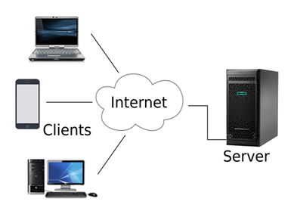
Client/Server Network
Client/Server network is a network model designed for the end users called clients, to access the resources such as files, video, etc. from a central computer called Server.
A server performs all the major operations such as security and network management.
A server is responsible for managing all the resources such as files, directories, printer, etc.
All the clients communicate with each other through a server.

Slide 9
Client/Server Network: Advantages
It contains centralized system with all data in a single place. Therefore we can back up the data easily.
It has a dedicated server that improves the overall performance of the whole system.
Security is better in Client/Server network as a single server administers the shared resources.
It also increases the speed of the sharing resources.
The capacity of the Client and Servers can be changed separately.

Slide 10
Client/Server Network: Disadvantages
More complex to install, configure, and manage
It is expensive as it requires the server (with large memory and Network OS)
It requires a dedicated network administrator to manage all the resources.
Clients are prone to viruses, Trojans and worms if present in the Server or uploaded into the Server.
Server are prone to Denial of Service (DOS) attacks.
Data packets may be spoofed or modified during transmission.
Phishing or capturing login credentials or other useful information of the user are common and MITM(Man in the Middle) attacks are common.

Slide 11
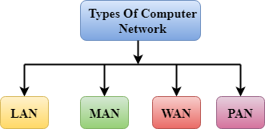
Network Types based on Size
A computer network can be categorized by their size or based on geographical area coverage.
PAN, LAN, MAN, and WAN are the four major types of networks designed to operate over the area they cover.

Slide 12
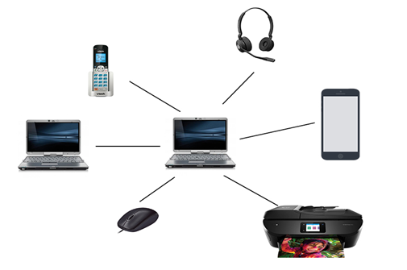
1. Personal Area Network (PAN)
It is a network arranged within an individual person, typically within a range of 10 meters.
It is used for connecting the computer devices of personal use such as laptop, mobile phones, media player and play stations.
PAN typically uses some form of wireless technology such as Wi-Fi, Bluetooth.

Slide 13
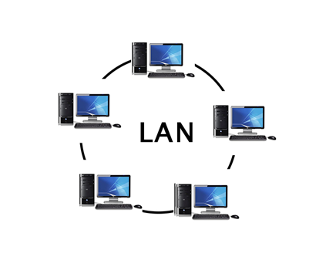
2. Local Area Network (LAN)
LANs cover a smaller geographical area (Size is limited to a few kilometers) and are privately owned.
One can use it for an office building, home, hospital, school, etc.
It is less costly as it is built with inexpensive hardware such as hubs, network adapters, and ethernet cables.
The data is transferred at an extremely faster rate (10 Mbps to 10 Gbps).

Slide 14
2. Local Area Network (LAN)
LAN provides higher security.
LAN is easy to design and maintain.
LAN works under its own local domain and controlled centrally.
A Communication medium used for LAN has twisted-pair cables and coaxial cables.
The smallest LAN may only use two computers, while larger LANs can accommodate thousands of computers.
The fault tolerance of a LAN is more and there is less congestion in this network.

Slide 15
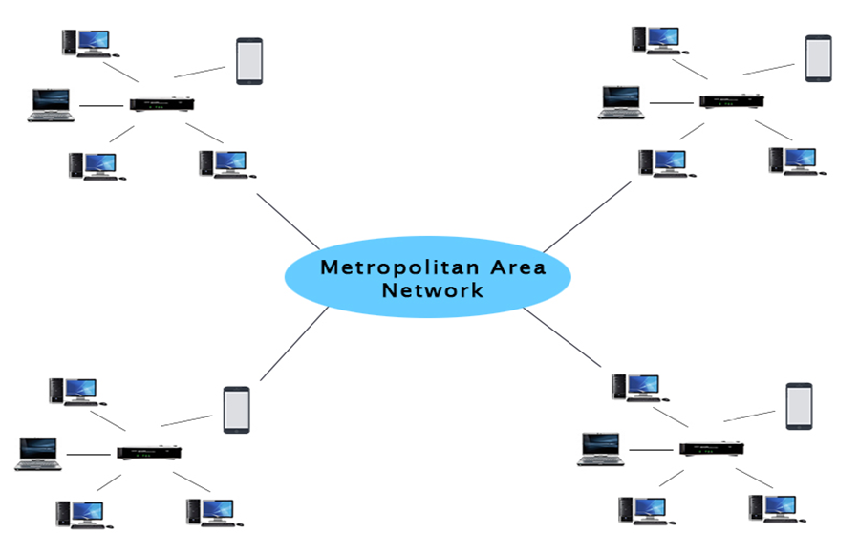
3. Metropolitan Area Network (MAN)
It is a network that covers a larger geographic area such as city by interconnecting a different LAN to form a larger network.
It can cover 5 to 50 KM range.

Slide 16
3. Metropolitan Area Network (MAN)
It’s hard to design and maintain a Metropolitan Area Network.
The fault tolerance of a MAN is less and also there is more congestion in the network.
Devices used for transmission of data through MAN are Modem and Wire/Cable.
Example: single cable TV network in a city
MAN can be used
in communication between the banks in a city.
in an Airline Reservation.
in a college within a city.
for communication in the military.

Slide 17
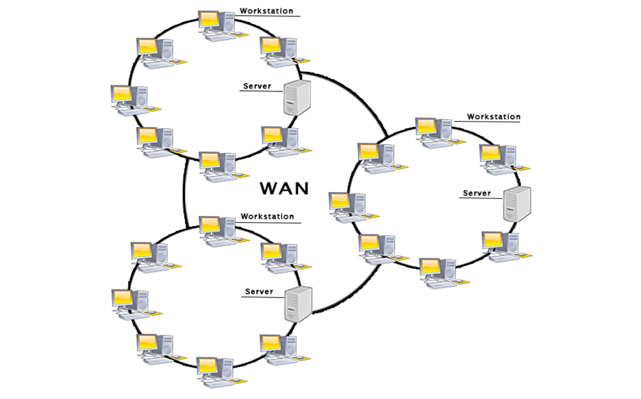
4. Wide Area Network (WAN)
Spans huge geographic area which may span across larger area and even a whole country or continent.
Connecting computers and covers a wide geographical area and it is contain a few smaller networks such as LANs, MANs.
Ownership of WAN is either private or public
i.e. it may be limited to an enterprise (a corporation or an organization) or accessible to the public.
The internet is one of the biggest WAN in the world.

Slide 18
4. Wide Area Network (WAN)
It spans over a large geographical area through a telephone line, fiber optic cable or satellite links.
It is widely used in the field of Business, government, and education.
It is difficult to design and maintain.
It covers a large area so fixing the problem is difficult.
Its installation cost very high.
Speeds of WAN ranges from a few kilobits per second (Kbps) to megabits per second (Mbps)
The fault tolerance of a WAN is less and there is more congestion in the network.

Slide 19
Internetwork
An internetwork is defined as two or more computer network LANs or WAN or computer network segments are connected using devices, and they are configured by a local addressing scheme.
An interconnection between public, private, commercial, industrial, or government computer networks can also be defined as internetworking.
An internetworking uses the internet protocol (IP).
The reference model used for internetworking is Open System Interconnection (OSI).

Slide 20
Types of Internetwork
1. Extranet:
An extranet is a communication network based on the internet protocol such as TCP/IP.
It is used for information sharing.
The access to the extranet is restricted to only those users who have login credentials.
An extranet is the lowest level of internetworking.
It can be categorized as MAN, WAN or other computer networks.
An extranet cannot have a single LAN, at least it must have one connection to the external network.

Slide 21
Types of Internetwork
2. Intranet:
An intranet is a private network based on the internet protocol such as TCP/IP.
An intranet belongs to an organization which is only accessible by the organization's employee or members.
The main aim of the intranet is to share the information and resources among the organization employees.
An intranet provides the facility to work in groups and for teleconferences.

Slide 22
Computer Network Topology
Topology refers to the way in which multiple devices are interconnected via communication links.
There are two types of topology: physical and logical.
Physical Topology
Refers to the arrangement or physical layout of computers, cables, and other components on the network
Can be referred as Physical layout, Design, Diagram, Map
Logical topology
It is logical flow of information in the network.

Slide 23
Computer Network Topology
Some of the factors that affect choice of topology for a network are:
Cost − Installation cost is a very important factor in overall cost of setting up an infrastructure. So cable lengths, distance between nodes, location of servers, etc. have to be considered when designing a network.
Flexibility − Topology of a network should be flexible enough to allow reconfiguration of office set up, addition of new nodes and relocation of existing nodes.
Reliability − Network should be designed in such a way that it has minimum down time. Failure of one node or a segment of cabling should not render the whole network useless.

Slide 24
Computer Network Topology
Some of the factors that affect choice of topology for a network are:
Scalability − Network topology should be scalable, i.e. it can accommodate load of new devices and nodes without perceptible drop in performance.
Ease of installation − Network should be easy to install in terms of hardware, software and technical personnel requirements.
Ease of maintenance − Troubleshooting and maintenance of network should be easy.

Slide 25
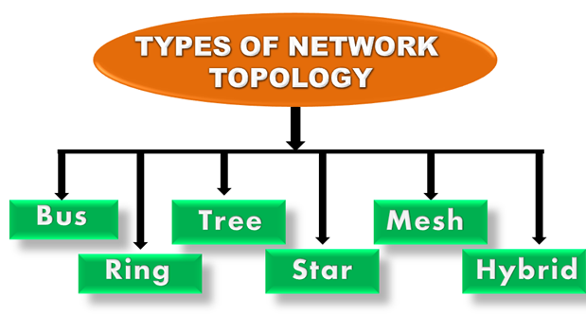
Computer Network Topology

Slide 26
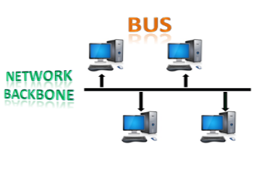
1. Bus Topology
Bus topology is a network type in which every computer and network device is connected to a single cable called backbone.
Each node is either connected to the backbone cable by drop cable or directly connected to the backbone cable.

Slide 27
1. Bus Topology: Advantage
Low-cost: nodes are directly connected to the cable without passing through a hub. Therefore, the initial cost of installation is low.
Scalable: Easy to connect a computer or peripheral to a linear bus.
Coaxial or twisted pair cables are mainly used in bus-based networks that support upto 10 Mbps.
Limited failure: a failure in one node or cable will not have any effect on other nodes.
Bus topology is familiar technology as installation and troubleshooting techniques are well known.

Slide 28
1. Bus Topology: Disadvantage
Entire network shuts down if there is a break in the main cable.
Terminators are required at both ends of the backbone cable.
Absorbs signal reaching the end of the cable; thus avoiding reflection of the signal back in to the system and prevent collusion with regular traffic.
Difficult to identify the problem if the entire network shuts down.
Signal interference: If two nodes send the messages simultaneously, then the signals of both the nodes collide with each other.
Security is very low.

Slide 29
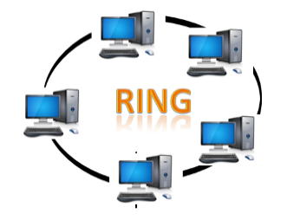
2. Ring Topology
All microcomputers and other communication devices are connected in a continuous loop.
Electronic messages are passed around the ring in one direction, with each node serving as the repeater, until they reach the right destination.
Since, all messages are flowing in only one direction; failure of a single node can compromise the entire network.

Slide 30
2. Ring Topology
The node that receives the message from the previous computer will retransmit to the next node.
The data flows in one direction, i.e., it is unidirectional.
The data in a ring topology flow in a clockwise direction.
It has no terminated ends, i.e., each node is connected to other node and having no termination point.
The most common access method of the ring topology is token passing.
Token passing: It is a network access method in which token is passed from one node to another node.
Token: It is a frame that circulates around the network.

Slide 31
2. Ring Topology
Advantage
The data transmission is high-speed.
The possibility of collision is minimum
Cheap to install and expand.
Communication system is not dependent on the single host computer
Disadvantage
The failure of a single node in the network can cause the entire network to fail.
Troubleshooting is difficult
The addition of stations in between or the removal of stations can disturb the whole topology.
Less secure.
Adding new devices increases the communication delay.

Slide 32
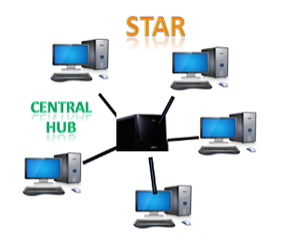
3. Star Topology
Star topology is an arrangement of the network in which every node is connected to the central hub, switch or a central computer.
Data passes through the central device before continuing to its destination.
The hub or concentrator manages and controls all functions of the network.
Coaxial cable or RJ-45 cables are used to connect the computers.
Star topology is the most popular topology in network implementation.

Slide 33
3. Star Topology
Advantage
Easy to fault identification and fault isolation, i.e., troubleshooting is quite efficient
Complex network control features can be easily implemented.
Failure in one cable/node will not affect the entire network.
It is a familiar technology as its tools are cost-effective.
It is easily expandable as new stations can be added to the open ports on the hub.
It is cost-effective as it uses inexpensive coaxial cable.
High data speeds: It supports a bandwidth of approx. 100Mbps.
Disadvantage
If the concentrator (hub) on which the whole topology relies fails, the whole system will crash down.
Performance is based on the single concentrator i.e. hub.

Slide 34
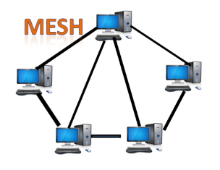
4. Mesh Topology
Mesh technology is an arrangement of the network in which computers are interconnected with each other through various redundant connections.
There are multiple paths from one computer to another computer.
It does not contain the switch, hub or any central computer which acts as a central point of communication.
Mesh topology is mainly used for WAN implementations where communication failures are a critical concern.
Mesh topology is mainly used for wireless networks.
The Internet is an example of the mesh topology.
Mesh topology can be formed by using the formula:
Number of cables = (n*(n-1))/2;
Where n is the number of nodes that represents the network.

Slide 35
4. Mesh Topology
Advantage
The mesh topology networks are very reliable as if any link breakdown will not affect the communication between connected computers.
Communication is very fast between the nodes.
Adding new devices would not disrupt the communication between other devices.
Disadvantage
High Cost: A mesh topology contains a large number of connected devices such as a router and more transmission media than other topologies.
Mesh topology networks are very large and very difficult to maintain and manage.
Redundant connections are high that reduces the efficiency of the network.

Slide 36
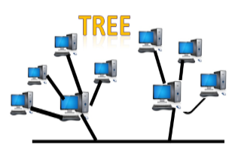
5. Tree Topology
Tree topology combines the characteristics of bus topology and star topology.
A tree topology is a type of structure in which all the computers are connected with each other in hierarchical fashion.
The top-most node in tree topology is known as a root node, and all other nodes are the descendants of the root node.
There is only one path exists between two nodes for the data transmission. Thus, it forms a parent-child hierarchy.

Slide 37
5. Tree Topology: Advantage
Support for broadband transmission: Tree topology is mainly used to provide broadband transmission, i.e., signals are sent over long distances without being attenuated.
Easily expandable: We can add the new device to the existing network.
Easily manageable: In tree topology, the whole network is divided into segments known as star networks which can be easily managed and maintained.
Error detection and error correction are very easy in a tree topology.
The breakdown in one station does not affect the entire network.
It has point-to-point wiring for individual segments.

Slide 38
5. Tree Topology: Disadvantage
A tree topology mainly relies on main bus cable and failure in main bus cable will damage the overall network.
The cost is high because of the cabling and devices.
If any fault occurs in the node, then it becomes difficult to troubleshoot the problem.
If new devices are added, it becomes difficult to reconfigure.

Slide 39
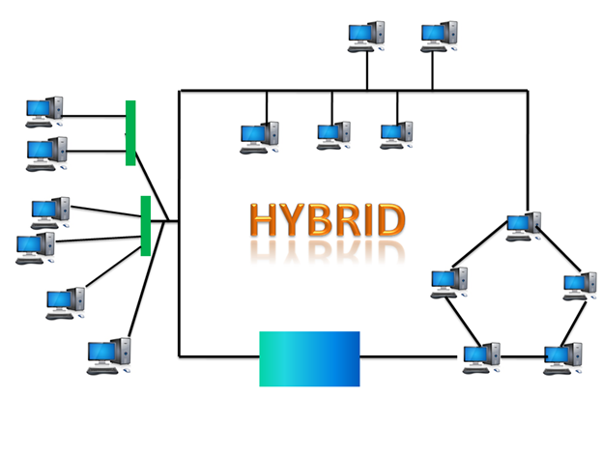
6. Hybrid Topology
It is the combination of two or more different topologies.
A Hybrid topology is a connection between different links and nodes to transfer the data.

Slide 40
6. Hybrid Topology
Advantage
This topology is very flexible.
The size of the network can be easily expanded by adding new devices, i.e. it is scalable
If a fault occurs in any part of the network will not affect the functioning of the rest of the network, i.e., it is reliable.
Disadvantage
It is challenging to design the architecture of the Hybrid Network.
Hubs used in this topology are very expensive.
The infrastructure cost is very high as a hybrid network requires a lot of cabling and network devices.

Slide 41
Switching Techniques
In large networks, there may be more than one paths for transmitting data from sender to receiver.
Selecting a path that data must take out of the available options is called switching.
There are two popular switching techniques:
Circuit switching
Packet switching

Slide 42
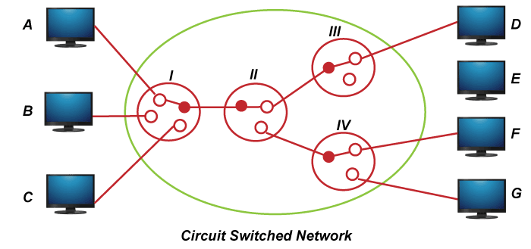
Circuit Switching
It is one of the simplest data communication methods in which a dedicated path is established between the sending and receiving device.
it needs a dedicated line for data transmission.
When any network node wants to send data, a call request signal is sent to the receiver and acknowledged back to ensure availability of dedicated path. This dedicated path is then used to send data.

Slide 43
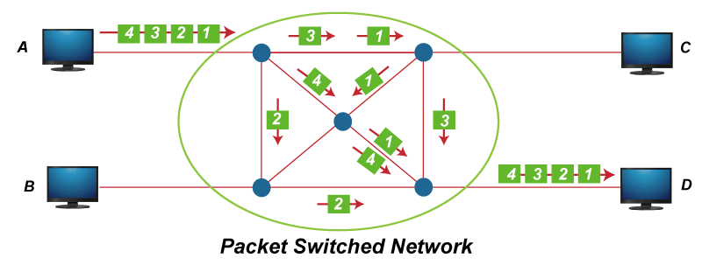
Packet Switching
In packet switching, data is broken down into small packets with each packet having source and destination addresses, travelling from one router to the next router.
These data chunks or “packets” allow for faster, more efficient data transfer.

Slide 44
Quiz (5%)
What are the conditions you need check to choose P2P over client-server network architecture?
If school of computing asks you to configure network to all the offices and laboratory classes, which topology do you prefer and why?

Slide 45

THANK YOU!

