Slide 1

CHAPTER 4
Network Protocols

Slide 2
Protocol and Standards
What is Protocol?
A protocol is a set of rules that govern data communications.
A protocol defines what is communicated, how it is communicated, and when it is communicated.
The key elements of a protocol are syntax, semantics and timing.
Syntax
Syntax refers to the structure or format of the data, meaning the order in which they are presented.
For example, a simple protocol might expect the first 8 bits of data to be the address of the sender, the second 8 bits to be the address of the receiver, and the rest of the stream to be the message itself.

Slide 3
Protocol and Standards
Semantics
Semantics refers to the meaning of each section of bits.
How is a particular pattern to be interpreted, and what action is to be taken based on that interpretation?
For example, does an address identify the route to be taken or the final destination of the message?
Timing.
Timing refers to two characteristics: when data should be sent and how fast they can be sent.
For example, if a sender produces data at 100 Mbps but the receiver can process data at only 1 Mbps, the transmission will overload the receiver and some data will be lost.

Slide 4
Standards
Standards are essential in creating and maintaining an open and competitive market for equipment manufacturers and in guaranteeing national and international interoperability of data and telecommunications technology and processes.
Standards provide guidelines to manufacturers, vendors, government agencies, and other service providers to ensure the kind of interconnectivity necessary in today's marketplace and in international communications.

Slide 5
Standards
Data communication standards fall into two categories:
De facto (meaning "by fact" or "by convention")
Standards that have not been approved by an organized body but have been adopted as standards through widespread use are de facto standards.
De facto standards are often established originally by manufacturers who seek to define the functionality of a new product or technology.
De jure (meaning "by law" or "by regulation").
Those standards that have been legislated by an officially recognized body are de jure standards.

Slide 6
Standards Organizations
Standards are developed through the cooperation of standards creation committees, forums, and government regulatory agencies.
Standards Creation Committees
International Organization for Standardization (ISO)
International Telecommunication Union-Telecommunication (ITU-T)
American National Standards Institute (ANSI)
Institute of Electrical and Electronics Engineers (IEEE)
Electronic Industries Association (EIA)
Forums made up of representatives from interested corporations.
The forums work with universities and users to test, evaluate, and standardize new technologies.
All communications technology is subject to regulation by government agencies such as the Federal Communications Commission (FCC) in the United States.

Slide 7
Network Models
A network is a combination of hardware and software that sends data from one location to another.
The hardware consists of the physical equipment that carries signals from one point of the network to another.
The software consists of instruction sets that make possible the services that we expect from a network.
Layered Architecture
We use the concept of layers in our daily life.
As an example,
let us consider two friends who communicate through postal mail.
The process of sending a letter to a friend would be complex if there were no services available from the post office.

Slide 8
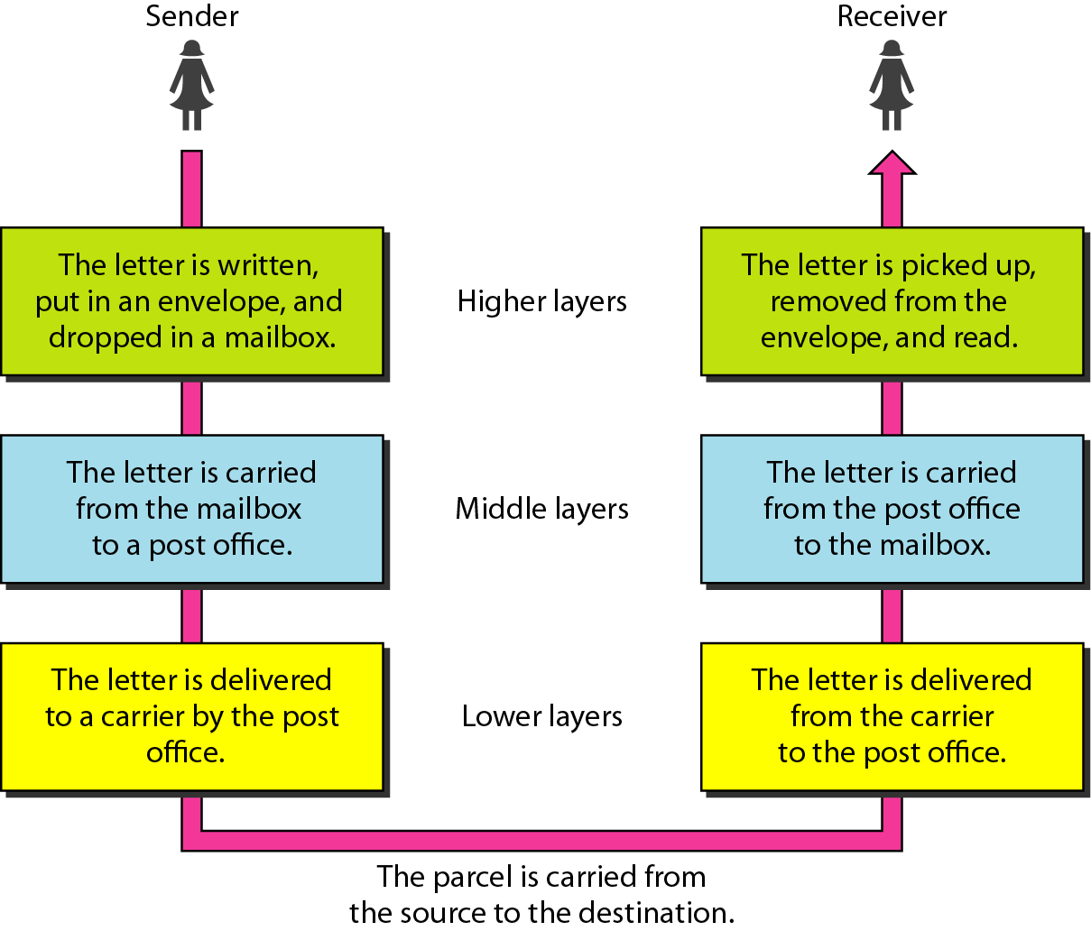
Layered Architecture
Tasks involved in sending a letter

Slide 9
Layered Architecture
The main aim of the layered architecture is to divide the design into small pieces.
Each lower layer adds its services to the higher layer to provide a full set of services to manage communications and run the applications.
It provides modularity and clear interfaces, i.e., provides interaction between subsystems.
It ensures the independence between layers by providing the services from lower to higher layer without defining how the services are implemented. Therefore, any modification in a layer will not affect the other layers.

Slide 10
Layered Architecture
The basic elements of layered architecture are services, protocols, and interfaces.
Service:
It is a set of actions that a layer provides to the higher layer.
Protocol:
It defines a set of rules that a layer uses to exchange the information with peer entity.
These rules mainly concern about both the contents and order of the messages used.
Interface:
It is a way through which the message is transferred from one layer to another layer.

Slide 11
Layered Architecture
With layered architectures, communications between two corresponding layers requires a unit of data called a protocol data unit (PDU).
As data passes from one layer into another, headers are added and removed from the PDU. This process of adding or removing PDU information is called encapsulation/ decapsulation.
The Application layer along with the header added at layer 7 is given to layer 6, the Presentation layer.
This layer adds its header and passed the whole package to the layer below. This Process is called Encapsulation.
The corresponding layers at the receiving side removes the corresponding header added at that layer and sends the remaining data to the above layer. This process is called Decapsulation.

Slide 12
The OSI Model
The International Standards Organization (ISO) is a multinational body dedicated to worldwide agreement on international standards.
An ISO standard that covers all aspects of network communications is the Open Systems Interconnection (OSI) model.
It was first introduced in the late 1970s.
An open system is a set of protocols that allows any two different systems to communicate regardless of their underlying architecture.

Slide 13
The OSI Model
The purpose of the OSI model is to show how to facilitate communication between different systems without requiring changes to the logic of the underlying hardware and software.
The OSI model is not a protocol; it is a model for understanding and designing a network architecture that is flexible, robust, and interoperable.
The OSI model is a layered framework for the design of network systems that allows communication between all types of computer systems.
It consists of seven separate but related layers, each of which defines a part of the process of moving information across a network.

Slide 14
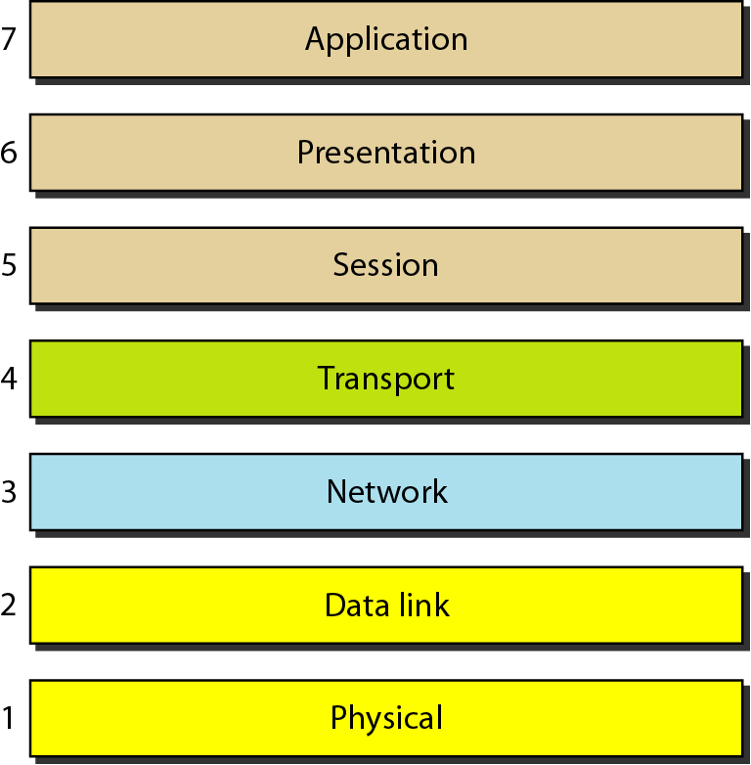
The OSI Model Layers
The lower four layers (transport, network, data link and physical -Layers 4, 3, 2, and 1) are concerned with the flow of data from end to end through the network.
The upper three layers of the OSI model (application, presentation and session - Layers 7, 6 and 5) are orientated more toward services to the applications.
Before data is passed from one layer to another, it is broken down into packets.

Slide 15
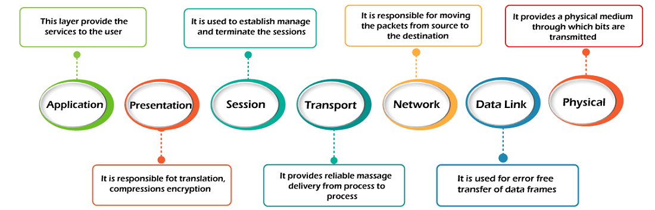
The OSI Model Layers

Slide 16
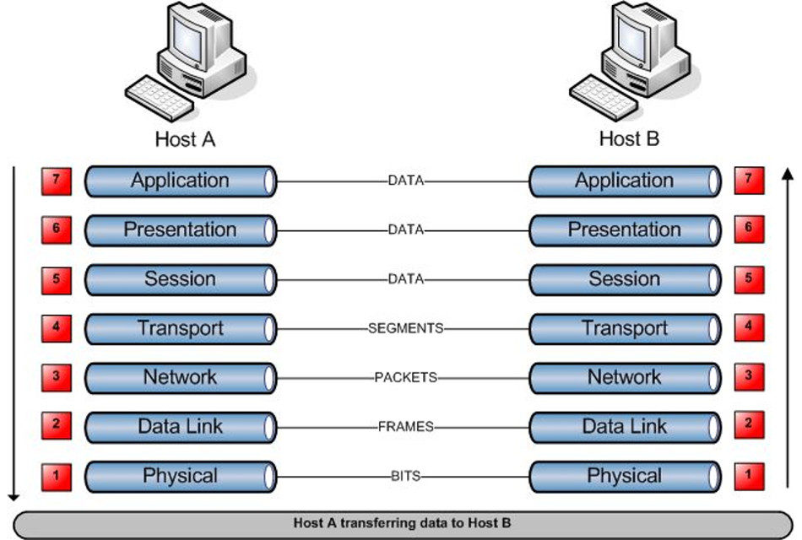
The OSI Model Layers

Slide 17
Layer 1: Physical Layer
The physical layer is responsible for movements of individual bits from one hop (node) to the next.
Regulates the transmission of a stream of bits over a physical medium.
The layer that actually interacts with the transmission media.
Defines how the cable is attached to the network adapter and what transmission technique is used to send data over the cable.
It is the lowest layer of the OSI model.
It establishes, maintains and deactivates the physical connection.
It specifies the mechanical, electrical and procedural network interface specifications.

Slide 18
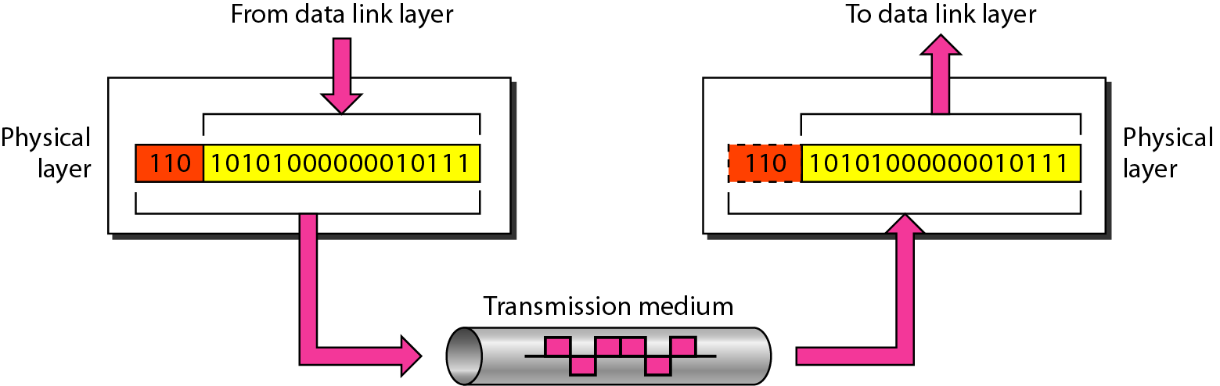
Layer 1: Physical Layer
On the sender side, the physical layer receives the data from Data Link Layer and encodes it into signals to be transmitted onto the medium.
On the receiver side, the physical layer receives the signals from the transmission medium decodes it back into data and sends it to the Data Link Layer.

Slide 19
Layer 1: Physical Layer
Functions of a Physical layer:
Line Configuration: It defines the way how two or more devices can be connected physically.
Data Transmission: It defines the transmission mode whether it is simplex, half-duplex or full-duplex mode between the two devices on the network.
Topology: It defines the way how network devices are arranged.
Signals: It determines the type of the signal used for transmitting the information.

Slide 20
Layer 1: Physical Layer
Components of the physical layer include:
Cabling system components
Adapters that connect media to physical interfaces
Connector design and pin assignments
Hub, repeater, and patch panel specifications
Wireless system components
Parallel SCSI (Small Computer System Interface)

Slide 21
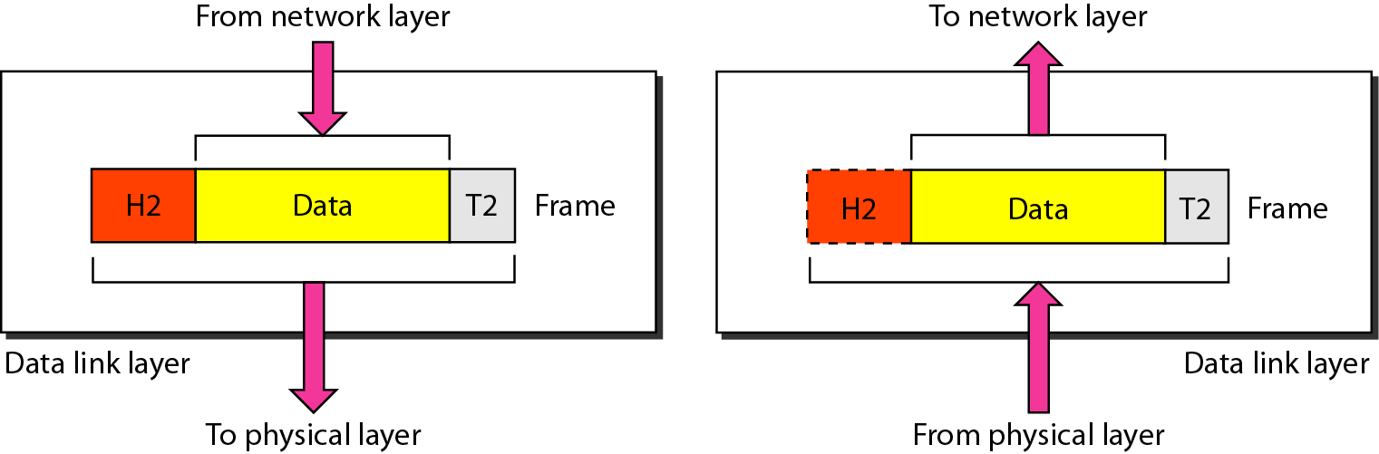
Layer 2: Data Link Layer
The data link layer is responsible for moving frames from one hop (node) to the next.
Provides reliable transmission of frames
It waits for an acknowledgment from the receiving computer.
Retransmits frames for which acknowledgement not received

Slide 22
Layer 2: Data Link Layer
Data link layer has two sub-layers:
Logical Link Control Layer:
It is responsible for transferring the packets to the Network layer of the receiver that is receiving.
It identifies the address of the network layer protocol from the header.
It also provides flow control.
Media Access Control Layer:
It is a link between the Logical Link Control layer and the network's physical layer.
It is used for transferring the packets over the network.

Slide 23
Layer 2: Data Link Layer
Functions of the Data-link layer
Framing: The data link layer translates the physical's raw bit stream into packets known as Frames.
The Data link layer adds the header and trailer to the frame.
The header which is added to the frame contains the hardware destination and source address.
Physical Addressing: The Data link layer adds a header to the frame that contains a destination address.
The frame is transmitted to the destination address mentioned in the header.

Slide 24
Layer 2: Data Link Layer
Functions of the Data-link layer
Flow Control: it is the main functionality of the Data-link layer.
It is the technique through which the constant data rate is maintained on both sides so that no data get corrupted.
It ensures that the transmitting station such as a server with higher processing speed does not exceed the receiving station, with lower processing speed.
Error Control: Error control is achieved by adding a calculated value CRC (Cyclic Redundancy Check) that is placed to the Data link layer's trailer which is added to the message frame before it is sent to the physical layer.
If any error seems to occur, then the receiver sends the acknowledgment for the retransmission of the corrupted frames.

Slide 25
Layer 2: Data Link Layer
Functions of the Data-link layer
Access Control: When two or more devices are connected to the same communication channel, then the data link layer protocols are used to determine which device has control over the link at a given time.
Common networking components that function at layer 2 include
Network interface cards
Ethernet and Token Ring
Switches
Bridges

Slide 26
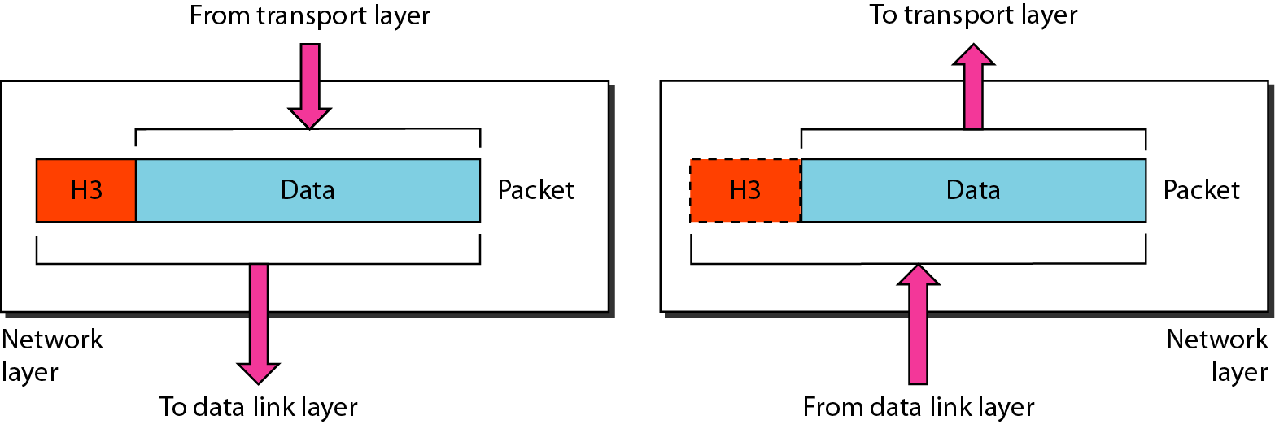
Layer 3: Network Layer
The network layer is responsible for the delivery of individual packets from the source host to the destination host.
It is a layer 3 that manages device addressing, tracks the location of devices on the network.

Slide 27
Layer 3: Network Layer
It determines the best path to move data from source to the destination based on the network conditions, the priority of service, and other factors.
The Data link layer is responsible for routing and forwarding the packets.
Routers are the layer 3 devices, they are specified in this layer and used to provide the routing services within an internetwork.
The protocols used to route the network traffic are known as Network layer protocols.
Examples of protocols are IPv4 and Ipv6.

Slide 28
Layer 3: Network Layer
Functions of Network Layer:
Internetworking: An internetworking is the main responsibility of the network layer. It provides a logical connection between different devices.
Addressing: A Network layer adds the source and destination address to the header of the frame. Addressing is used to identify the device on the internet.
Routing: Routing is the major component of the network layer, and it determines the best optimal path out of the multiple paths from source to the destination.
Packetizing: A Network Layer receives the packets from the upper layer and converts them into packets. This process is known as Packetizing. It is achieved by internet protocol (IP).

Slide 29
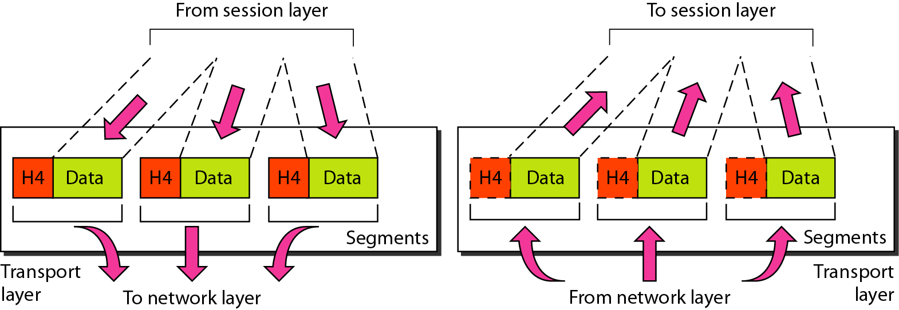
Layer 4: Transport Layer
The transport layer is responsible for the delivery of a message from one process to another.
i.e., process to process delivery of the entire message.

Slide 30
Layer 4: Transport Layer
At the sending side, the transport layer receives data from the session layer, divides it into units called segments and sends it to the network layer.
At the receiving side, the transport layer receives packets from the network layer, converts and arranges into proper sequence of segments and sends it to the session layer.
To ensure process to process delivery the transport layer makes use of port address to identify the data from the sending and receiving process.
It is a 16 bit address.
For Example, TELNET uses port address 23, HTTP uses port address 80.

Slide 31
Layer 4: Transport Layer
Manages transmission packets
Repackages long messages when necessary into small packets for transmission
Reassembles packets in correct order to get the original message.
Handles error recognition and recovery.
Transport layer at receiving acknowledges packet delivery.
Resends missing packets

Slide 32
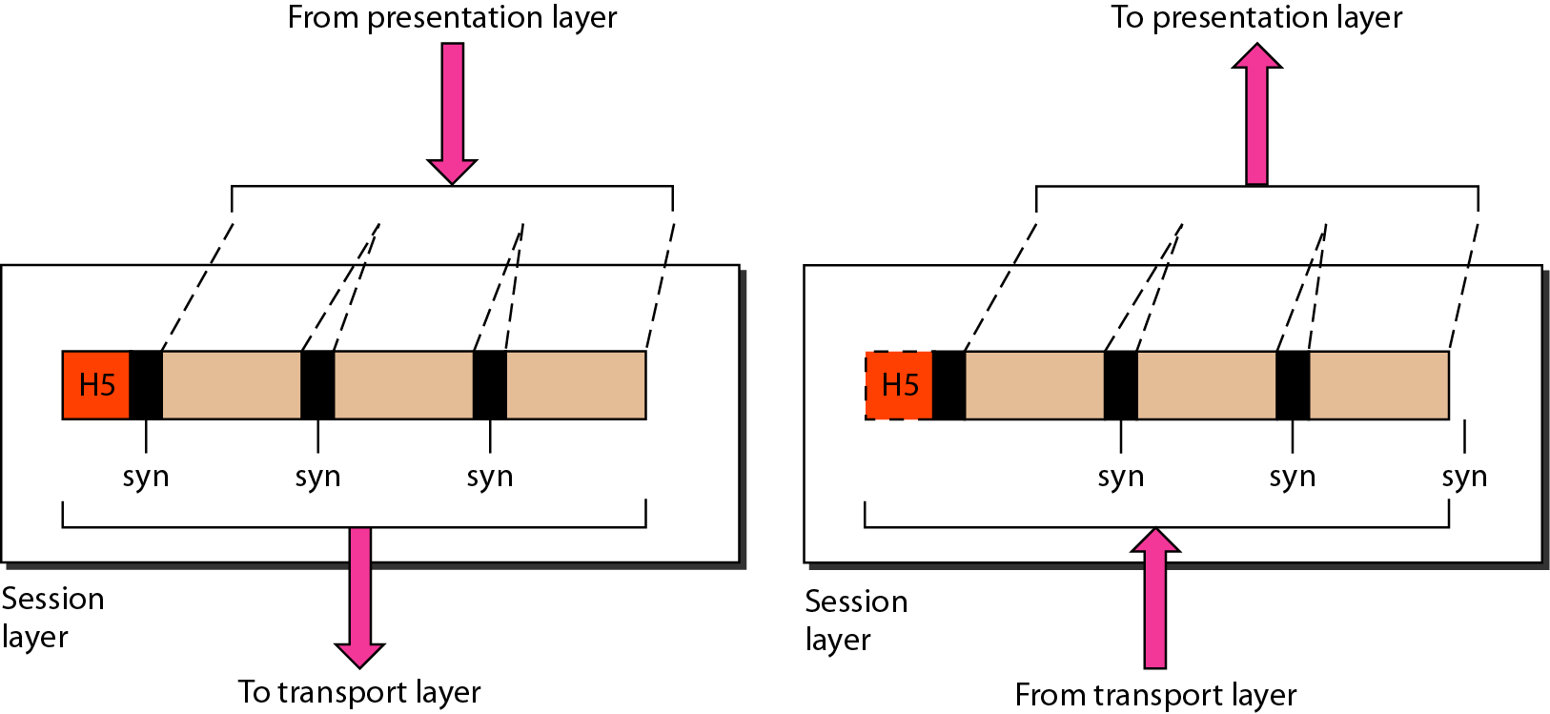
Layer 5: Session Layer
The session layer is responsible for dialog control and synchronization.
Allows users on different machines to establish sessions between them.
The session layer defines how to start, control and end conversations (called sessions) between applications.

Slide 33
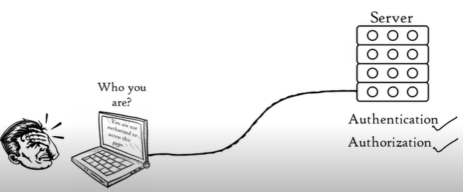
Layer 5: Session Layer
Allows two applications on different computers to establish, use, and end a session.
e.g. file transfer, remote login
Establishes dialog control
Regulates which side transmits, plus when and how long it transmits.
Performs:
Authentication: Who u are?
(Username and Password)
Authorization: Privileges
Session management :
data download form the server

Slide 34
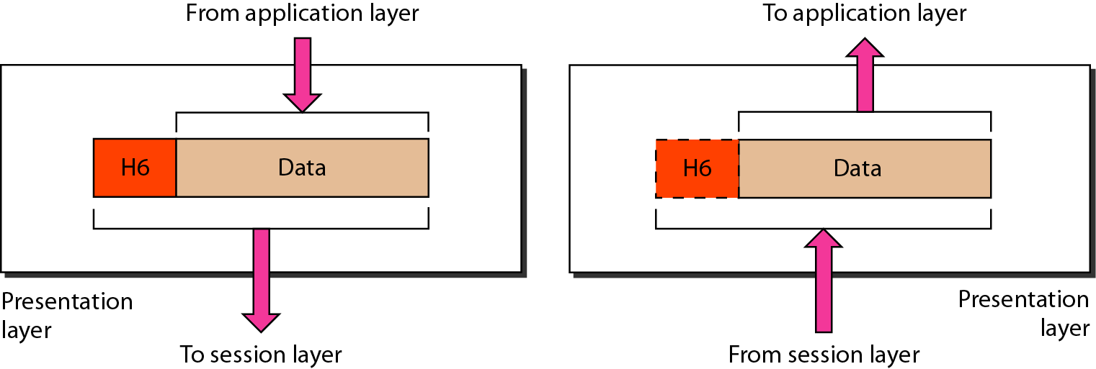
Layer 6: Presentation Layer
The presentation layer is responsible for translation, compression, and encryption.
A Presentation layer is mainly concerned with the syntax and semantics of the information exchanged between the two systems.
The Presentation layer is also known as the syntax layer.

Slide 35
Layer 6: Presentation Layer
Ensures that the information that the application layer of one system sends out is readable by the application layer of another system.
If necessary, the presentation layer translates between multiple data formats by using a common format.
The Presentation layer acts as a data translator for a network.
Protocol: SSL (secure socket layer)
Examples :- JPEG, MPEG, ASCII, HTML.

Slide 36
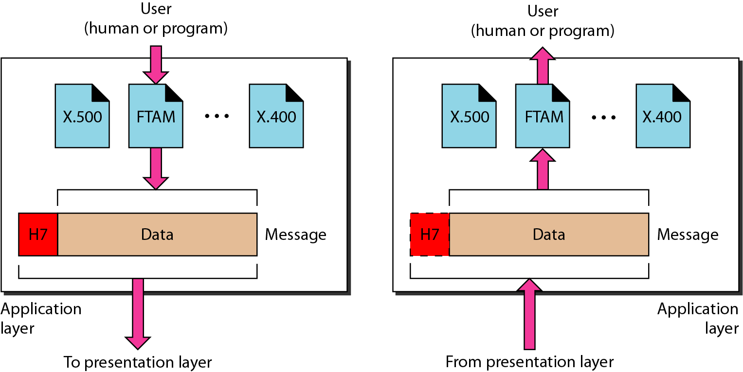
Layer 7: Application Layer
The application layer is responsible for providing services to the user.
An application layer serves as a window for users and application processes to access network service.

Slide 37
Layer 7: Application Layer
Represents services that directly support software applications for file transfers, database access, and electronic mail etc.
The application layer, provides an interface for the end user operating a device connected to a network
Perform user activities
Provide the services to the user
Both the end user and the application layer interact directly with the software application.
The application layer is the OSI layer that is closest to the user.
It provides network services to the user’s applications.
Contains all the higher level protocols that are commonly needed by users.

Slide 38
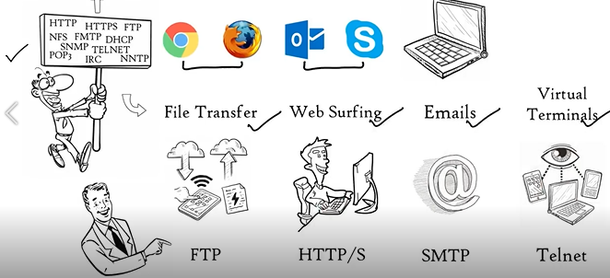
Layer 7: Application Layer
Protocols:
HTTP, HTTPs: for web surfing
FTP: for file transfer
SMTP: for emails

Slide 39
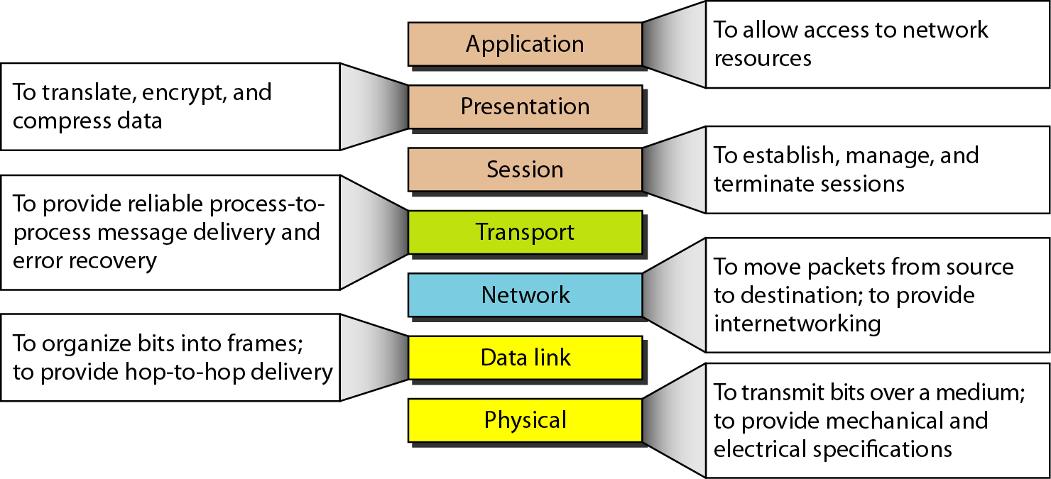
The OSI Model Layers: Summary

Slide 40
The TCP/IP Model
The TCP/IP model was developed prior to the OSI model. Therefore, the layers in the TCP/IP protocol suite do not exactly match those in the OSI model.
The original TCP/IP model was defined as having four layers: host-to-network, internet, transport, and application.
However, when TCP/IP is compared to OSI, we can say that
the host-to-network layer is equivalent to the combination of the physical and data link layers.
the internet layer is equivalent to the network layer, and
the application layer is roughly doing the job of the session, presentation, and application layers with the transport layer in TCP/IP taking care of part of the duties of the session layer.

Slide 41
The TCP/IP Model
So in this lecture, we assume that the TCP/IP model is made of five layers: physical, data link, network, transport, and application.
The first four layers provide physical standards, network interfaces, internetworking, and transport functions that correspond to the first four layers of the OSI model.
The three top most layers in the OSI model, however, are represented in TCP/IP by a single layer called the application layer.

Slide 42
The TCP/IP Model
TCP/IP is a hierarchical protocol made up of interactive modules, each of which provides a specific functionality; however, the modules are not necessarily interdependent.
Whereas the OSI model specifies which functions belong to each of its layers, the layers of the TCP/IP protocol suite contain relatively independent protocols that can be mixed and matched depending on the needs of the system.
The term hierarchical means that each upper-level protocol is supported by one or more lower-level protocols.

Slide 43
The TCP/IP Model
At the transport layer, TCP/IP defines three protocols:
Transmission Control Protocol (TCP)
User Datagram Protocol (UDP)
Stream Control Transmission Protocol (SCTP).
At the network layer, the main protocol defined by TCP/IP is the Internetworking Protocol (IP); there are also some other protocols that support data movement in this layer.

Slide 44
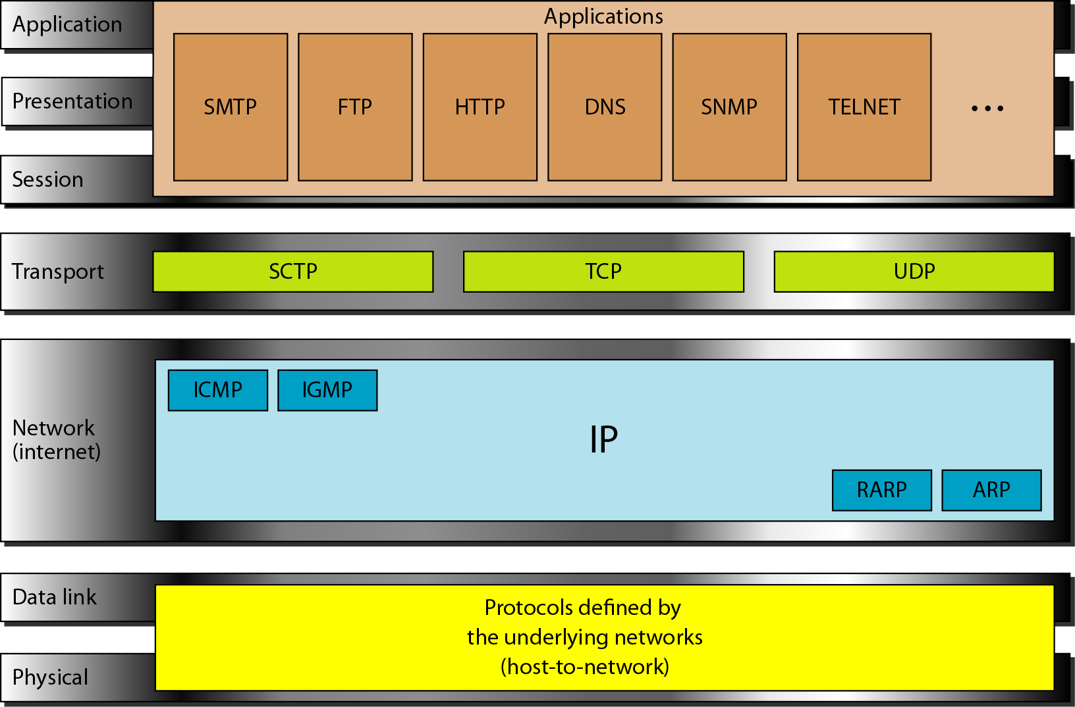
The TCP/IP Model

Slide 45
1. Physical and Data Link Layers
These layers define how the data should be sent physically through the network.
These layers are mainly responsible for the transmission of the data between two devices on the same network.
At the physical and data link layers, TCP/IP does not define any specific protocol.
It supports all the standard and proprietary protocols.
A network in a TCP/IP internetwork can be a local-area network or a wide-area network.

Slide 46
2. Network Layer
The main responsibility of the Network layer is to send the packets from any network, and they arrive at the destination irrespective of the route they take.
At the network layer (or, more accurately, the internetwork layer), TCP/IP supports the Internetworking Protocol.
IP, in turn, uses four supporting protocols: ARP, RARP, ICMP, and IGMP.
For example:
ARP (Address Resolution Protocol): used to find the physical address from the IP address.
ICMP (Internet Control Message Protocol) : used to report the problems, not correct them. The responsibility of the correction lies with the sender.

Slide 47
2. Network Layer: IP
The Internetworking Protocol (IP) is the transmission mechanism used by the TCP/IP protocols.
It is an unreliable and connectionless protocol a best effort delivery service.
The term best effort means that IP provides no error checking or tracking.
IP assumes the unreliability of the underlying layers and does its best to get a transmission through to its destination, but with no guarantees.
IP transports data in packets called datagrams, each of which is transported separately.
Datagrams can travel along different routes and can arrive out of sequence or be duplicated.
IP does not keep track of the routes and has no facility for reordering datagrams once they arrive at their destination.

Slide 48
2. Network Layer
Address Resolution Protocol (ARP)
The ARP is used to associate a logical address with a physical address. On a typical physical network, such as a LAN, each device on a link is identified by a physical or station address, usually imprinted on the network interface card (NIC). ARP is used to find the physical address of the node when its Internet address is known.
Reverse Address Resolution Protocol
The RARP allows a host to discover its Internet address when it knows only its physical address. It is used when a computer is connected to a network for the first time or when a diskless computer is booted.
Internet Control Message Protocol
The ICMP is a mechanism used by hosts and gateways to send notification of datagram problems back to the sender. ICMP sends query and error reporting messages.
Internet Group Message Protocol
The IGMP is used to facilitate the simultaneous transmission of a message to a group of recipients.

Slide 49
3. Transport Layer
Traditionally the transport layer was represented in TCP/IP by two protocols: TCP and UDP.
IP is a host-to-host protocol, meaning that it can deliver a packet from one physical device to another.
UDP and TCP are transport level protocols responsible for delivery of a message from a process (running program) to another process.
A new transport layer protocol, SCTP, has been devised to meet the needs of some newer applications

Slide 50
3. Transport Layer
User Datagram Protocol (UDP)
The UDP is the simpler of the two standard TCP/IP transport protocols.
It is a process-to-process protocol that adds only port addresses, checksum error control, and length information to the data from the upper layer.
Stream Control Transmission Protocol (SCTP)
The SCTP provides support for newer applications such as voice over the Internet.
It is a transport layer protocol that combines the best features of UDP and TCP.

Slide 51
3. Transport Layer
Transmission Control Protocol (TCP)
The TCP provides full transport-layer services to applications.
TCP is a reliable stream transport protocol.
The term stream, in this context, means connection-oriented: A connection must be established between both ends of a transmission before either can transmit data.
At the sending end of each transmission, TCP divides a stream of data into smaller units called segments.
Each segment includes a sequence number for reordering after receipt, together with an acknowledgment number for the segments received.
Segments are carried across the internet inside of IP datagrams.
At the receiving end, TCP collects each datagram as it comes in and reorders the transmission based on sequence numbers.

Slide 52
4. Application Layer
An application layer is the top most layer in the TCP/IP model.
It is responsible for handling high-level protocols, issues of representation.
This layer allows the user to interact with the application.
When one application layer protocol wants to communicate with another application layer, it forwards its data to the transport layer.
Every application cannot be placed inside the application layer except those who interact with the communication system.
For example: text editor cannot be considered in application layer while web browser using HTTP protocol to interact with the network where HTTP protocol is an application layer protocol.

Slide 53
4. Application Layer
Following are the main protocols used in the application layer:
HTTP: HTTP stands for Hypertext transfer protocol.
This protocol allows us to access the data over the world wide web.
It transfers the data in the form of plain text, audio, video.
It is known as a Hypertext transfer protocol as it has the efficiency to use in a hypertext environment where there are rapid jumps from one document to another.
SNMP: SNMP stands for Simple Network Management Protocol.
It is a framework used for managing the devices on the internet by using the TCP/IP protocol suite.
SMTP: SMTP stands for Simple mail transfer protocol.
The TCP/IP protocol that supports the e-mail is known as a Simple mail transfer protocol. This protocol is used to send the data to another e-mail address.

Slide 54
4. Application Layer
Following are the main protocols used in the application layer:
DNS: DNS stands for Domain Name System.
An IP address is used to identify the connection of a host to the internet uniquely. But, people prefer to use the names instead of addresses. Therefore, the system that maps the name to the address is known as Domain N
TELNET: It is an abbreviation for Terminal Network.
It establishes the connection between the local computer and remote computer in such a way that the local terminal appears to be a terminal at the remote system.
FTP: FTP stands for File Transfer Protocol.
FTP is a standard internet protocol used for transmitting the files from one computer to another computer.

Slide 55
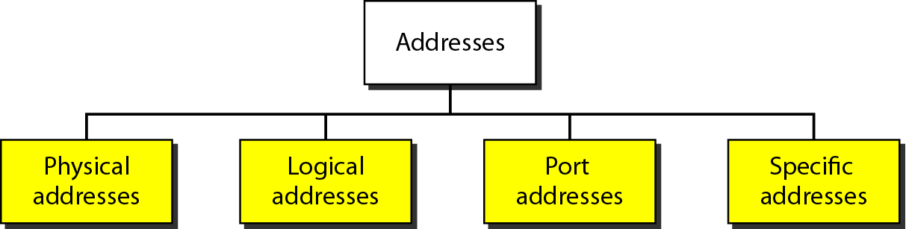
Addressing in TCP/IP
Four levels of addresses are used in an internet employing the TCP/IP protocols: physical (link) addresses, logical (IP) addresses, port addresses, and specific addresses.

Slide 56
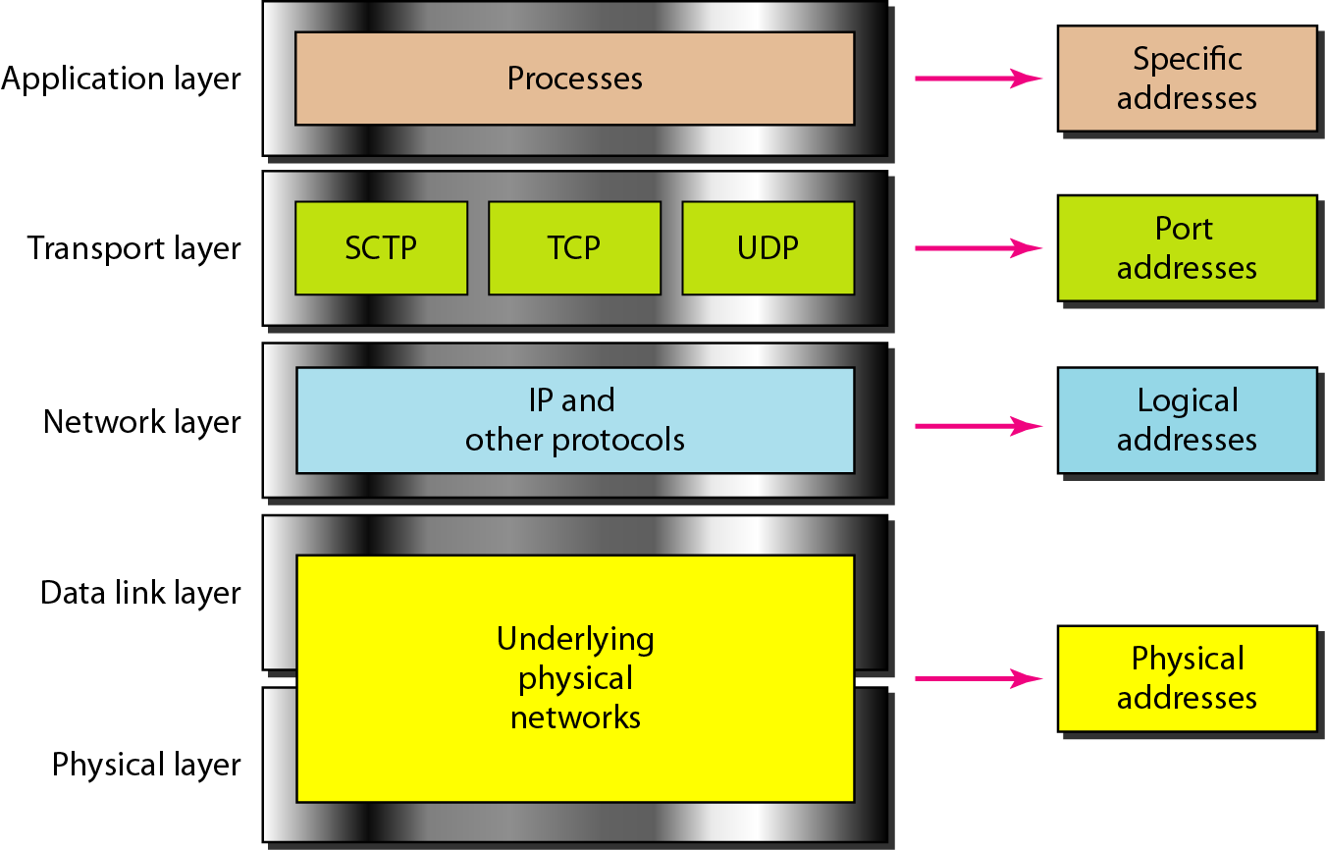
Addressing in TCP/IP
Relationship of layers and addresses in TCP/IP.

Slide 57
A. Physical Addresses
The physical address, also known as the link address, is the address of a node as defined by its LAN or WAN.
It is included in the frame used by the data link layer.
It is the lowest-level address.
The physical addresses have authority over the network (LAN or WAN).
The size and format of these addresses vary depending on the network.
For example, Ethernet uses a 6-byte (48-bit) physical address that is imprinted on the network interface card (NIC). LocalTalk (Apple), however, has a I-byte dynamic address that changes each time the station comes up

Slide 58
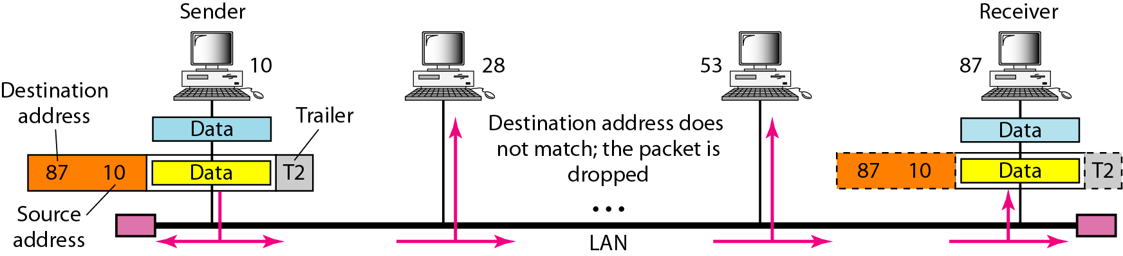
A. Physical Addresses
Example 1: In the following figure a node with physical address 10 sends a frame to a node with physical address 87.
The two nodes are connected by a link (bus topology LAN).
As the figure shows, the computer with physical address 10 is the sender, and the computer with physical address 87 is the receiver.

Slide 59
A. Physical Addresses
Example 2: Most local-area networks use a 48-bit (6-byte) physical address written as 12 hexadecimal digits; every byte (2 hexadecimal digits) is separated by a colon, as shown below:
07:01:02:01:2C:4B
A 6-byte (12 hexadecimal digits) physical address.

Slide 60
B. Logical Addresses
Logical addresses are necessary for universal communications that are independent of underlying physical networks. Physical addresses are not adequate in an internetwork environment where different networks can have different address formats.
A universal addressing system is needed in which each host can be identified uniquely, regardless of the underlying physical network.
The logical addresses are designed for this purpose. A logical address in the Internet is currently a 32-bit address that can uniquely define a host connected to the Internet.
No two publicly addressed and visible hosts on the Internet can have the same IP address.

Slide 61
B. Logical Addresses
Example: The Following Figure (next slide) shows a part of an internet with two routers connecting three LANs.
Each device (computer or router) has a pair of addresses (logical and physical) for each connection.
In this case, each computer is connected to only one link and therefore has only one pair of addresses.
Each router, however, is connected to three networks (only two are shown in the figure).
So each router has three pairs of addresses, one for each connection.

Slide 62
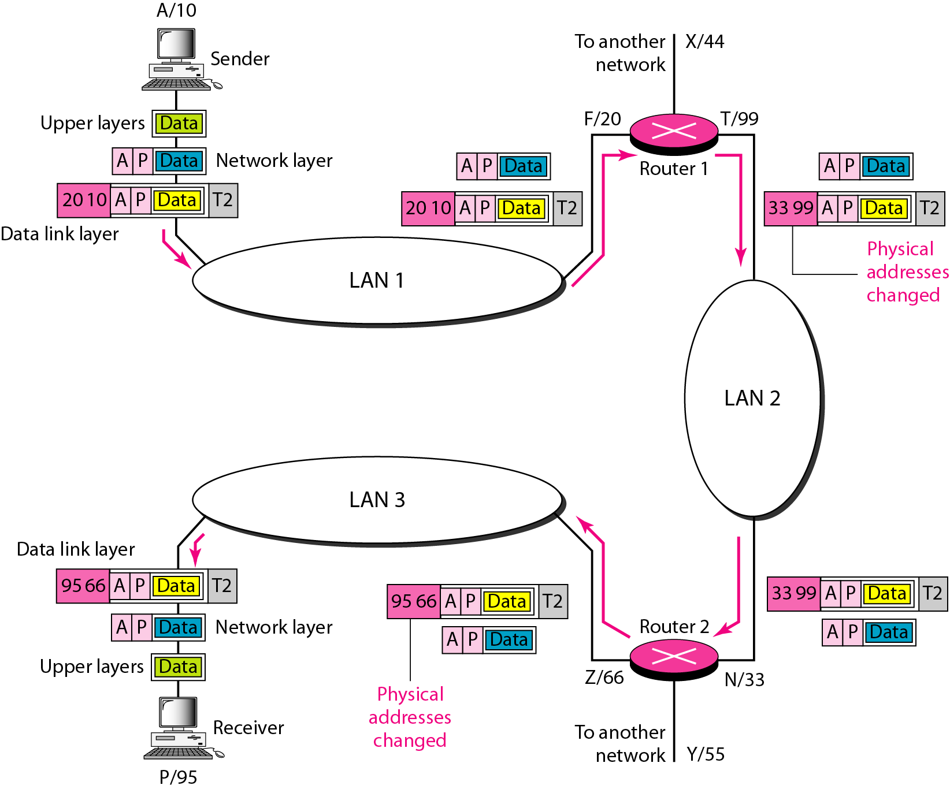
B. Logical Addresses

Slide 63
C. Port Addresses
The IP address and the physical address are necessary for a quantity of data to travel from a source to the destination host.
However, arrival at the destination host is not the final objective of data communications on the Internet.
A system that sends nothing but data from one computer to another is not complete.
Today, computers are devices that can run multiple processes at the same time.
The end objective of Internet communication is a process communicating with another process.

Slide 64
C. Port Addresses
For example,
Computer A can communicate with computer C by using TELNET. At the same time, computer A communicates with computer B by using the File Transfer Protocol (FTP).
For these processes to receive data simultaneously, we need a method to label the different processes.
In other words, they need addresses.
In the TCP/IP architecture, the label assigned to a process is called a port address.
A port address in TCP/IP is 16 bits in length.

Slide 65
C. Port Addresses
Example: The following Figure (Next Slide) shows two computers communicating via the Internet.
The sending computer is running three processes at this time with port addresses a, b, and c.
The receiving computer is running two processes at this time with port addresses j and k.
Process a in the sending computer needs to communicate with process j in the receiving computer.
Note
Physical addresses change from hop to hop, logical and port addresses remain the same from the source to destination.
A port address is a 16-bit address represented by one decimal number as shown: 753.

Slide 66
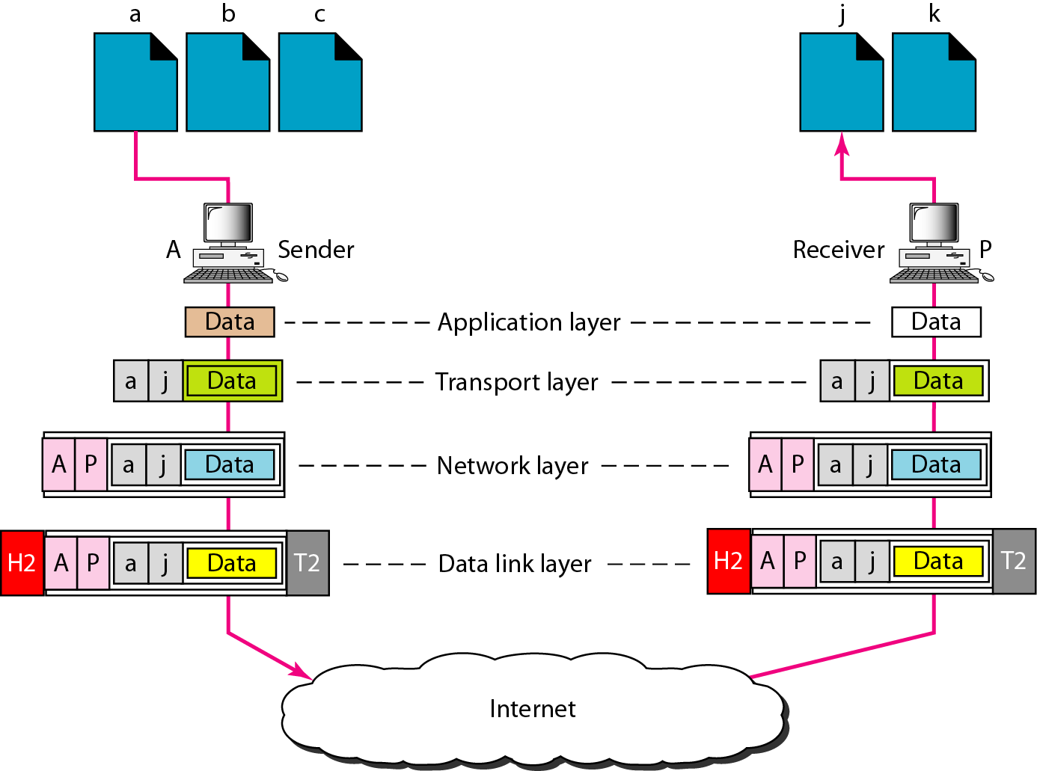
Port Addresses

Slide 67
Specific Addresses
Some applications have user-friendly addresses that are designed for that specific address.
Examples include the e-mail address (for example, biniyam.abdi@ddu.edu.et) and the Uniform Resource Locator (URL) (for example, www.ddu.edu.et).
The first defines the recipient of an e-mail and the second is used to find a document on the World Wide Web
These addresses, however, get changed to the corresponding port and logical addresses by the sending computer.

Slide 68
OSI vs TCP/IP Model
OSI Model | TCP/IP Model
It stands for Open System Interconnection. | It stands for Transmission Control Protocol.
OSI model has been developed by ISO (International Standard Organization). | It was developed by ARPANET (Advanced Research Project Agency Network).
It is an independent standard and generic protocol used as a communication gateway between the network and the end user. | It consists of standard protocols that lead to the development of an internet. It is a communication protocol that provides the connection among the hosts.
In the OSI model, the transport layer provides a guarantee for the delivery of the packets. | The transport layer does not provide the surety for the delivery of packets. But still, we can say that it is a reliable model.
This model is based on a vertical approach. | This model is based on a horizontal approach.
It is also known as a reference model through which various networks are built. For example, the TCP/IP model is built from the OSI model. It is also referred to as a guidance tool. | It is an implemented model of an OSI model.
Protocols in the OSI model are hidden and can be easily replaced when the technology changes. | In this model, the protocol cannot be easily replaced.
It consists of 7 layers. | It consists of 4 layers.
OSI model defines the services, protocols, and interfaces as well as provides a proper distinction between them. It is protocol independent. | In the TCP/IP model, services, protocols, and interfaces are not properly separated. It is protocol dependent.

Slide 69
Group Assignment 1 (10%)
Briefly discuss Switching and Multiplexing concept & their types.
Briefly discuss Ethernet and Wireless Networks.
Briefly discuss 4G and 5G Mobile Communication Technology.
NB:
Maximum page is 8 without including cover page and table of contents (if any).
The document has to be well organized and written.
Deadline: 25/09, 2017 E.C
Submit your assignment with PDF format via email to biniyam.abdi@ddu.edu.et

Slide 70

THANK YOU!

