Slide 1
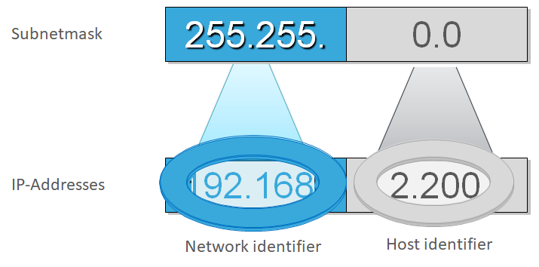
CHAPTER 5
IP Addressing and Subnetting

Slide 2
Introduction
Communication at the network layer is host-to-host (computer-to-computer); a computer somewhere in the world needs to communicate with another computer somewhere else in the world.
Usually, computers communicate through the Internet. The packet transmitted by the sending computer may pass through several LANs or WANs before reaching the destination computer.
For this level of communication, we need a global addressing scheme; we called this logical addressing in chapter 4.
We use the term IP address to mean a logical address in the network layer of the TCP/IP protocol suite.

Slide 3
Introduction
The Internet addresses are 32 bits in length; this gives us a maximum of 2³² (4,294,967,296) addresses.
These addresses are referred to as IPv4 (IP version 4) addresses or simply IP addresses if there is no confusion.
The need for more addresses, in addition to other concerns about the IP layer, motivated a new design of the IP layer called the new generation of IP or IPv6 (lP version 6).
In this version, the Internet uses 128-bit addresses that give much greater flexibility in address allocation.
gives us a maximum of 2¹²⁸ addresses
These addresses are referred to as IPv6 addresses.

Slide 4
IPv4 addresses
An IPv4 address is a 32-bit address that uniquely and universally defines the connection of a device (for example, a computer or a router) to the Internet.
They are unique in the sense that each address defines one, and only one, connection to the Internet.
Two devices on the Internet can never have the same address at the same time.
On the other hand, if a device operating at the network layer has N connections to the Internet, it needs to have N addresses.
The IPv4 addresses are universal in the sense that the addressing system must be accepted by any host that wants to be connected to the Internet.

Slide 5
IPv4 addresses
IP addresses are not produced randomly.
They are generated mathematically and are further assigned by the IANA (Internet Assigned Numbers Authority), a department of the ICANN.
ICANN stands for Internet Corporation for Assigned Names and Numbers.
It is a non-profit corporation founded in the US back in 1998 with an aim to manage Internet security and enable it to be available by all.

Slide 6
IPv4 addresses
There are two prevalent notations to show an IPv4 address: binary notation and dotted-decimal notation.
In binary notation, the IPv4 address is displayed as 32 bits.
These bits are divided into four sections, referred to as octets or bytes
Example: 01110101 10010101 00011101 00000010
To make the IPv4 address more compact and easier to read, Internet addresses are usually written in decimal form with a decimal point (dot) separating the bytes.
The following is the dotted-decimal notation of the above address: 117.149.29.2
Note: each byte (octet) is 8 bits and each number in dotted-decimal notation is a value ranging from 0 to 255.

Slide 7
IPv4 addresses
Example 1: Change the following IPv4 addresses from binary notation to dotted-decimal notation.
10000001 00001011 00001011 11101111
11000001 10000011 00011011 11111111
Solution
We replace each group of 8 bits with its equivalent decimal number and add dots for separation.
129.11.11.239
193.131.27.255

Slide 8
IPv4 addresses
Example 2: Find the error, if any, in the following IPv4 addresses.
111.56.045.78
221.34.7.8.20
75.45.301.14
11100010.23.14.67
Solution
There must be no leading zero (045).
There can be no more than four numbers in an IPv4 address.
Each number needs to be less than or equal to 255 (301 is outside this range).
A mixture of binary notation and dotted-decimal notation is not allowed.

Slide 9
Classful Addressing
IPv4 addressing used the concept of classes. This architecture is called classful addressing.
In classful addressing, the address space is divided into five classes: A, B, C, D, and E. Each class occupies some part of the address space.
An address space is the total number of addresses used by the protocol.
If a protocol uses N bits to define an address, the address space is 2^{N} because each bit can have two different values (0 or 1) and N bits can have 2^{N} values.
Example:
Address space for IPv4 address is 2³² = 4,294,967,296
Address space for IPv6 address is 2¹²⁸ = 3.4×10³⁸

Slide 10
Classful Addressing
Class A addresses are designed for large organizations with a large number of attached hosts or routers.
Class B addresses are designed for midsize organizations with tens of thousands of attached hosts or routers.
Class C addresses are designed for small organizations with a small number of attached hosts or routers.
Class D addresses are designed for multicasting.
Class E addresses are reserved for future use;

Slide 11
Classful Addressing
We can find the class of an address when given the address in binary notation or dotted-decimal notation.
If the address is given in binary notation, the first few bits can immediately tell us the class of the address.
If the address is given in decimal-dotted notation, the first byte defines the class.
If the first bit is a zero (0), the address is Class A address.
If the first two bits are 10, the address is a Class B address.
If the first three bits are 110, the address is a Class C address.
If the first four bits are 1110, the address is a Class D address.
If the first four bits are 1111, the address is a Class E address

Slide 12
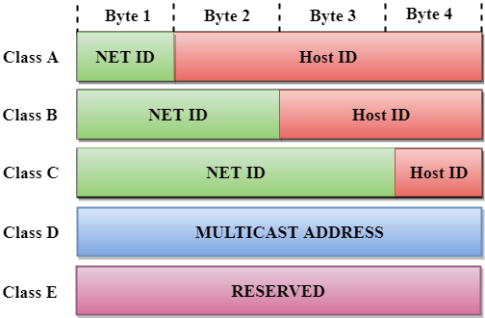
Network ID and Host ID
In classful addressing, an IP address in class A, B, or C is divided into Network ID (NetID) which represents the number of networks and Host ID (HostID) which represents the number of hosts.
In class A, one byte defines the NetID and three bytes define the HostID.
In class B, two bytes define the NetID and two bytes define the HostID.
In class C, three bytes define the NetID and one byte defines the HostID.

Slide 13
Classes and Blocks
One problem with classful addressing is that each class is divided into a fixed number of blocks with each block having a fixed size as shown below:
The number of networks (Blocks) and the number of hosts (Block size) per class can be derived by this formula:
Number of Networks = 2^network-bits
Number of Hosts/Network = 2^host-bits – 2
When calculating hosts' IP addresses, 2 IP addresses are decreased because they cannot be assigned to hosts,
i.e. the first IP of a network is network number and the last IP is reserved for Broadcast IP.

Slide 14
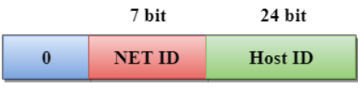
Class A Addressees
In Class A, an IP address is assigned to those networks that contain a large number of hosts.
The network ID is 8 bits long.
The host ID is 24 bits long.
In Class A, the first bit in higher order bits of the first octet is always set to 0 and the remaining 7 bits determine the network ID. The 24 bits determine the host ID in any network.
Thus the first octet ranges from 0 – 127.
Class A IP address format is: N.H.H.H or 0NNNNNNN.HHHHHHHH.HHHHHHHH.HHHHHHHH

Slide 15
Class A Addressees
Class A addresses only include IP starting from 1.x.x.x to 126.x.x.x
The default subnet mask for Class A IP address is 255.0.0.0
Class A addressing can have 126 networks (2⁷-2) and 16,777,214 hosts (2²⁴-2).
Only 126 Class A networks can exist in the entire Internet, because 0.0.0.0 is a special IP address and 127.x.x.x is reserved for loopback IP addresses,
Only about 40 Class A addresses are actually assigned to companies or organizations.
The rest are
Either reserved for use by IANA (Internet Assigned Numbers Authority) or
Assigned to organizations that manage IP assignments for geographic regions such as Europe, Asia, and Latin America.

Slide 16
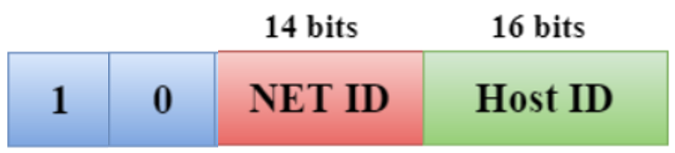
Class B Addressees
In Class B, an IP address is assigned to those networks that range from small-sized to large-sized networks.
The Network ID is 16 bits long.
The Host ID is 16 bits long.
In Class B, the higher order bits of the first octet is always set to 10, and the remaining14 bits determine the network ID. The other 16 bits determine the Host ID.
Thus the first octet ranges from 128 – 191.
Class B IP Addresses range from 128.0.x.x to 191.255.x.x.
The default subnet mask for Class B is 255.255.x.x.
Class B has 16,384 (2¹⁴) Network addresses and 65,534 (2¹⁶-2) Host addresses.
Class B IP address format is: N.N.H.H or 10NNNNNN.NNNNNNNN.HHHHHHHH.HHHHHHHH

Slide 17

Class C Addressees
In Class C, an IP address is assigned to only small-sized networks.
The Network ID is 24 bits long.
The host ID is 8 bits long.
In Class C, the higher order bits of the first octet is always set to 110, and the remaining 21 bits determine the network ID. The 8 bits of the host ID determine the host in a network.
Thus the first octet ranges from 192 – 223.
Class C IP addresses range from 192.0.0.x to 223.255.255.x.
The default subnet mask for Class C is 255.255.255.x.
Class C has 20,971,52 (2²¹) Network addresses and 254 (2⁸-2) Host addresses.
Class C IP address format is: N.N.N.H or 110NNNNN.NNNNNNNN.NNNNNNNN.HHHHHHHH

Slide 18

Class D Addressees
In Class D, an IP address is reserved for multicast addresses.
It does not possess subnetting.
The higher order bits of the first octet is always set to 1110, and the remaining bits determines the host ID in any network.
Thus the first octet ranges from 224 – 239.
Class D has IP address range from 224.0.0.0 to 239.255.255.255.
Class D does not have any subnet mask.
Class D has 268,435,454 (2²⁸-2) host addresses.
In multicasting data is not destined for a particular host, therefore, there is no need to extract host address from the IP address.

Slide 19

Class E Addressees
In Class E, an IP address is used for the future use or for the research and development purposes.
It does not possess any subnetting.
The higher order bits of the first octet is always set to 1111, and the remaining bits determines the host ID in any network.
Thus the first octet ranges from 240 – 255.
IP addresses in this class ranges from 240.0.0.0 to 255.255.255.254.
Class E does not have any subnet mask.
Class E has 268,435,454 (2²⁸-2) host addresses.

Slide 20
Classful Addressing - Summary
Class | Fix Bits | First address (Binary Notation) | Last address (Binary Notation) | First address (Decimal Notation) | Last address (Decimal Notation)
A | 0 | 00000000 | 01111111 | 0 | 127
B | 10 | 10000000 | 10111111 | 128 | 191
C | 110 | 11000000 | 11011111 | 192 | 223
D | 1110 | 11100000 | 11101111 | 224 | 239
E | 1111 | 11110000 | 11111111 | 240 | 255

Slide 21
Rules for assigning Host ID and Net ID
The Host ID is assigned based on the following rules:
The Host ID must be unique within any network.
The Host ID in which all the bits are set to 0 cannot be assigned as it is used to represent the network ID of the IP address.
The Host ID in which all the bits are set to 1 cannot be assigned as it is reserved for the multicast address.
The following are the rules for assigning Network ID:
The network ID cannot start with 127 as 127 is used by Class A.
The Network ID in which all the bits are set to 0 cannot be assigned as it is used to specify a particular host on the local network.
The Network ID in which all the bits are set to 1 cannot be assigned as it is reserved for the multicast address.

Slide 22
IPv4 - Reserved Addresses
There are a few reserved IPv4 address spaces which cannot be used on the internet.
These addresses serve special purpose and cannot be routed outside the Local Area Network.
Private IP Addresses
Every class of IP, (A, B & C) has some addresses reserved as Private IP addresses.
These IPs can be used within a network, campus, company and are private to it.
Packets containing these private addresses are dropped by the Routers.

Slide 23
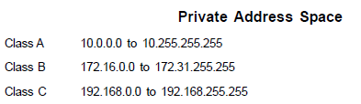
IPv4 - Reserved Addresses
In order to communicate with the outside world, these IP addresses must have to be translated to some public IP addresses using NAT (Network Address Translation) process, or Web Proxy server can be used.

Slide 24
IPv4 - Reserved Addresses
Loopback IP Addresses
The IP address range 127.0.0.0 – 127.255.255.255 is reserved for loopback, i.e. a Host’s self-address, also known as localhost address.
This loopback IP address is managed entirely by and within the operating system.
Loopback addresses, enable the Server and Client processes on a single system to communicate with each other.
When a process creates a packet with destination address as loopback address, the operating system loops it back to itself without having any interference of NIC.
This address is mostly used for testing purposes like client-server architecture on a single machine.

Slide 25
IPv4 - Reserved Addresses
Link-local Addresses
Link local address ranges from 169.254.0.0 -- 169.254.255.255
In case a host is not able to acquire an IP address from the DHCP (Dynamic Host Configuration Protocol) server and it has not been assigned any IP address manually, the host can assign itself an IP address from a range of reserved Link-local addresses.

Slide 26
Example
Find the class of each address.
00000001 00001011 00001011 11101111
11000001 10000011 00011011 11111111
14.23.120.8
252.5.15.111
Solution
The first bit is 0. This is a class A address.
The first 2 bits are 1; the third bit is 0. This is a class C address.
The first byte is 14 (between 0 and 127); the class is A.
The first byte is 252 (between 240 and 255); the class is E.

Slide 27
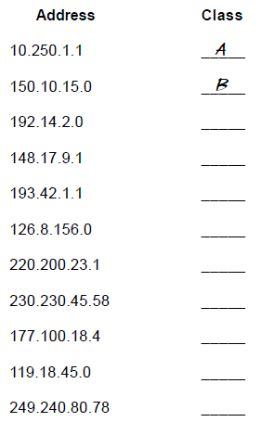
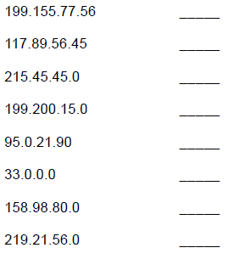
Exercise 1: Address Class Identification

Slide 28
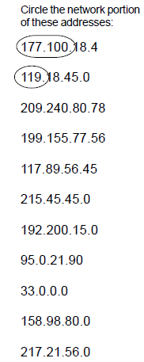
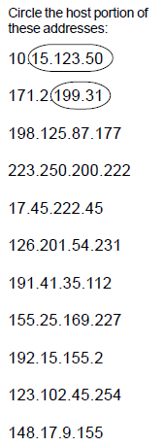
Exercise 2: Network and Host Identification

Slide 29
Subnetting
Subnetting is the process of creating networks that aren’t limited to the scales provided by Class A, B, C IP addresses
Subnetting is used to create smaller broadcast domains and to better utilize the bits in the host ID.
With subnetting, you can create networks with more realistic host limits.
Subnetting provides a more flexible way to designate which portion of an IP address represents the network ID and which portion represents the host ID.
Subnetting lets you select an arbitrary number of bits to use for the network ID

Slide 30
Subnetting
Two reasons compel people to use subnetting
To allocate the limited IP address space more efficiently
Performance reasons
A subnet is a network that falls within a Class A, B, or C network
Subnets are created by using one or more of the Class A, B, or C host bits to extend the network ID
subnets can have network IDs of any length
The router is aware of the separate subnetted network IDs and will route IP packets to the appropriate subnet.

Slide 31

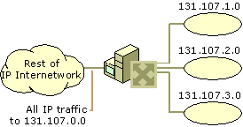
Subnetting
Network 131.107.0.0 before subnetting
Network 131.107.0.0 after subnetting

Slide 32
Subnet Masks
A 32-bit number which is used to inform the router which portion of the host ID should be used for the subnet network ID
The bits of the subnet mask are defined as:
All bits that correspond to the network ID are set to 1.
All bits that correspond to the host ID are set to 0
Each host on a TCP/IP network requires a subnet mask even on a single-segment network
A default subnet mask is based on the IP address classes
The default subnet masks are
Class A – 255.0.0.0
Class B – 255.255.0.0
Class C – 255.255.255.0

Slide 33
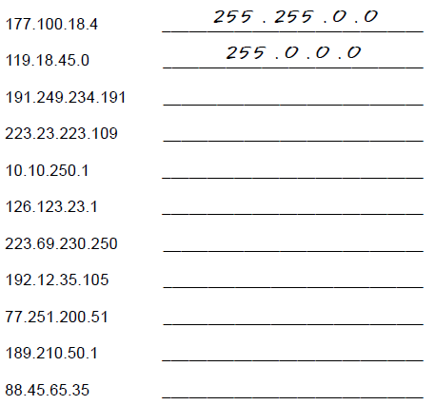
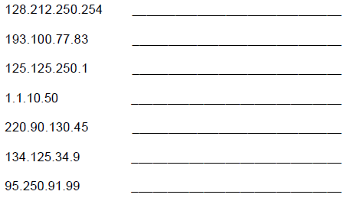
Exercise 3: Default Subnet Masks
Write the correct default subnet mask for each of the following addresses:

Slide 34
Subnetting
To determine the network ID of an IP address, the router must have both the IP address and the subnet mask.
The router then performs a bitwise operation called a Logical AND on the IP address in order to extract the network ID.
For example, here’s how the network address is extracted from an IP address using the 20-bit subnet mask:
144 28 16 17
IP address: 10010000 00011100 00100000 00001001
Subnet mask: 11111111 11111111 11110000 00000000
Network ID: 10010000 00011100 00100000 00000000
144 28 16 0
Thus, the network ID for this subnet is 144.28.16.0

Slide 35
Subnetting
Network Prefix is a shorthand notation that is used to indicate how many bits of an IP address represent the network ID.
The network prefix is indicated with a slash immediately after the IP address, followed by the number of network ID bits to use
For example, the IP address 144.28.16.17 with the subnet mask 255.255.240.0 can be represented as 144.28.16.17/20
Network prefix notation is also called Classless Inter-Domain Routing notation, or just CIDR for short.

Slide 36
Subnetting
The table lists the default subnet masks using the network prefix notation for the subnet mask
Since all hosts on the same network must be using the same network ID, the ID must be defined by the same subnet mask
Address Class | Bits for Subnet Mask | Network Prefix
Class A | 11111111 00000000 00000000 00000000 | /8
Class B | 11111111 11111111 00000000 00000000 | /16
Class C | 11111111 11111111 11111111 00000000 | /24

Slide 37
Subnetting
For Example: 157.55.0.0/16 is not the same network ID as 157.55.0.0/24.
The network ID 157.55.0.0/16 implies a range of valid host IP addresses from 157.55.0.1 to 157.55.255.254.
The network ID 157.55.0.0/24 implies a range of valid host IP addresses from 157.55.0.1 to 157.55.0.254.
A few additional restrictions that are placed on subnet masks are:
The minimum number of network ID bits is eight.
The maximum number of network ID bits is 30.
Because the network ID is always composed of consecutive bits set to 1, only nine values are possible for each octet of a subnet mask (including 0).

Slide 38
Example 1: Subnetting
Suppose we are using 255.255.240.0 as a subnet mask and 172.16.0.0 as a Network address (172.16.0.0/20)
Answer these five questions:
How many subnets does the subnet mask produce?
How many valid hosts per subnet?
What are the valid subnets?
What are the valid hosts in each subnet?
What is the broadcast address of each subnet?
How many subnets?
2^{x} – 2 , where X is the amount of masked bits, or the 1s
In this example, . there are 2⁴–2 = 14 subnets

Slide 39
Example 1: Subnetting
How many hosts per subnet?
2^{x} – 2, where X is the amount of unmasked bits, or the 0s
In this example, there are 2¹² – 2 = 4094 hosts per subnet
What are the valid subnets?
256 – subnet mask = base number.
For example, 256 – 240 = 16, 32, 48, … 224
What is the broadcast address for each subnet?
Broadcast address is all host bits turned on, which is the number immediately after the last host number.
Valid subnet | First Valid host | Last Valid host | Broadcast
16 | 16.1 | 31.254 | 31.255
32 | 32.1 | 47.254 | 47.255

Slide 40
Example 2: Subnetting
Given: 192.168.10.0 =Network address and
255.255.255.192 =Subnet address
How many subnets [ usable Host] ?
2^{x}–2=amount of subnets.
X is the amount of masked bits, or the 1s.
11000000 is 2²–2.
In this example, there are 2 subnets.
How many hosts per subnet?
2^{x}–2=amount of hosts per subnet.
X is the amount of unmasked bits, or the 0s.
11000000 is 2⁶–2.
In this example, there are 62 hosts per subnet.
What are the valid subnets?
256–subnet mask = base number.
For example, 256 – 192 = 64.

Slide 41
Example 3: Subnetting
1, IP Address 192.100.10.0 and subnet Mask: 255.255.255.240
2, IP Address=165.100.0.0 Subnet Mask=255.255.255.192
Solution:
1. It is Class C, Subnet = 14, Host=14, Borrowed bit=4
2. It is Class B, Subnet=1022, Host=62, Borrowed bit= 10

Slide 42
Supernetting and Classless Inter-Domain Routing
With the recent growth of the Internet, it became clear to the Internet authorities that the class B network IDs would soon be depleted.
For most organizations, a class C network ID does not contain enough host IDs.
A class B network ID has enough bits to provide a flexible subnetting scheme within the organization.
Rather than assigning a class B network ID, the Internet Network Information Center (InterNIC) assigns a range of class C network IDs that contain enough network and host IDs for the organization’s needs.
This is known as supernetting.
For example, rather than allocating a class B network ID to an organization that has up to 2,000 hosts, the InterNIC allocates a range of 8 class C network IDs.
Each class C network ID accommodates 254 hosts, for a total of 2,032 host IDs.

Slide 43
Supernetting and Classless Inter-Domain Routing
While this technique helps conserve (save) class B network IDs, it creates a new problem.
Using conventional routing techniques, the routers on the Internet now must have 8 class C network ID entries in their routing tables to route IP packets to the organization.
To prevent Internet routers from becoming overwhelmed with routes, a technique called Classless Inter-Domain Routing (CIDR) is used.
CIDR is used to collapse multiple network ID entries into a single entry corresponding to all of the class C network IDs allocated to that organization.

Slide 44
Supernetting and Classless Inter-Domain Routing
Conceptually, CIDR creates the routing table entry: {Starting Network ID, count},
where Starting Network ID is the first class C network ID and the count is the number of class C network IDs allocated.
In practice, a supernetted subnet mask is used to convey the same information. To express the situation where 8 class C network IDs are allocated starting with Network ID 220.78.168.0:
Note that the first 21 bits (underlined) of all the above Class C network IDs are the same.
The last three bits of the third octet vary from 000 to 111
Starting Network ID | 220.78.168.0 | 10011110 01001110 10101000 00000000
Ending Network ID | 220.78.175.0 | 10011110 01001110 10101111 00000000

Slide 45
Supernetting and Classless Inter-Domain Routing
The CIDR entry in the routing tables of the Internet routers becomes:
In network prefix notation, the CIDR entry is 220.78.168.0/21.
A block of addresses using CIDR is known as a CIDR block.
In order to support CIDR, routers must be able to exchange routing information in the form of {Network ID, Subnet Mask} pairs.
RIP for IP version 2, OSPF, and BGPv4 are routing protocols that support CIDR.
Network ID | Subnet Mask | Subnet Mask (binary)
220.78.168.0 | 255.255.248.0 | 11111111 11111111 11111000 00000000

Slide 46
Public and Private Addresses
There are two types of addresses employed on the Internet, public addresses and private addresses
Public Addresses
are assigned by InterNIC (Internet Network Information Center)
consist of class-based network IDs or blocks of CIDR-based addresses (called CIDR blocks) that are guaranteed to be globally unique to the Internet
Private Address
An IP address in the private address space is never assigned as a public address
IP addresses within the private address space are known as private addresses

Slide 47
Public and Private Addresses
The private address space is defined by the following three address blocks:
10.0.0.0/8
is a class A network ID
allows the following range of valid IP addresses: 10.0.0.1 to 10.255.255.254
has 24 host bits that can be used for any subnetting scheme within the private organization
172.16.0.0/12
interpreted either
as a block of 16 class B network IDs or
as a 20-bit assignable address space (20 host bits) which can be used for any subnetting scheme within the private organization.
allows the following range of valid IP addresses: 172.16.0.1 to 172.31.255.254.

Slide 48
Public and Private Addresses
192.168.0.0/16
interpreted
either as a block of 256 class C network IDs
or as a 16-bit assignable address space (16 host bits), which can be used for any subnetting scheme within the private organization
allows the following range of valid IP addresses: 192.168.0.1 to 192.168.255.254
Traffic to destination private addresses are not reachable on the Internet.
Internet traffic from a host that has a private address must
either send its requests to an application layer gateway (such as a proxy server), which has a valid public address,
or have its private address translated into a valid public address by a network address translator (NAT) before it is sent on the Internet.

Slide 49
Dynamic Host Configuration Protocol (DHCP)
Dynamic Host Configuration Protocol (DHCP)
an open, industry standard, frees network administrators from having to configure all of the computers manually
assigns an IP address to a machine from the pool of available IP addresses.
The four steps to assign an IP address dynamically
The DHCP client asks for an IP address (DHCP Discover)
The DHCP server offers an address (DHCP Offer)
accepts the offer and requests the address (DHCP Request)
officially assigned the address (DHCP Acknowledge)

Slide 50
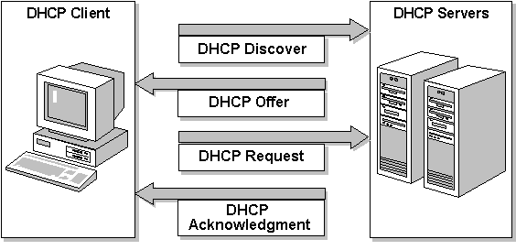
Dynamic Host Configuration Protocol (DHCP)
The DHCP server places an administrator-defined time limit on the address assignment, called a lease

Slide 51
Surprise
Write at least three (3)
1. Good side and bad side of me and the course

Slide 52

THANK YOU!

Slide 53
QUIZ (5%)
137.107.0.1 belongs to class________.
Extract the network address from 144.28.16.17 using the 19-bit subnet mask?
Represent the IP address 172.16.0.0 and subnet mask 255.255.192.0 using network prefix notation?
If the first four bits are 1110, the address is a Class __________ address.
5. Given : 192.168.10.0 =Network address
255.255.255.192 =Subnet address
1. How many Subnet?
2. How many hosts per subnet?
3. What are valid subnet?

