Slide 1
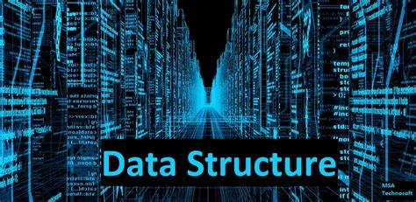
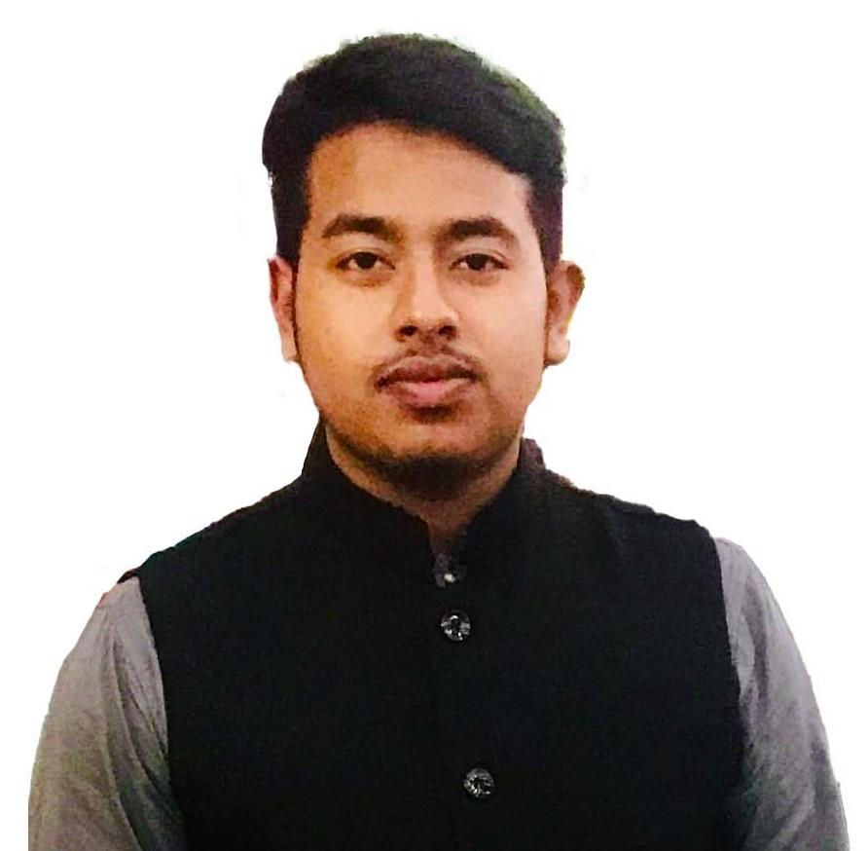
Data Structure and algorithm 2
By Mohammed Ahsan Meah

Slide 2
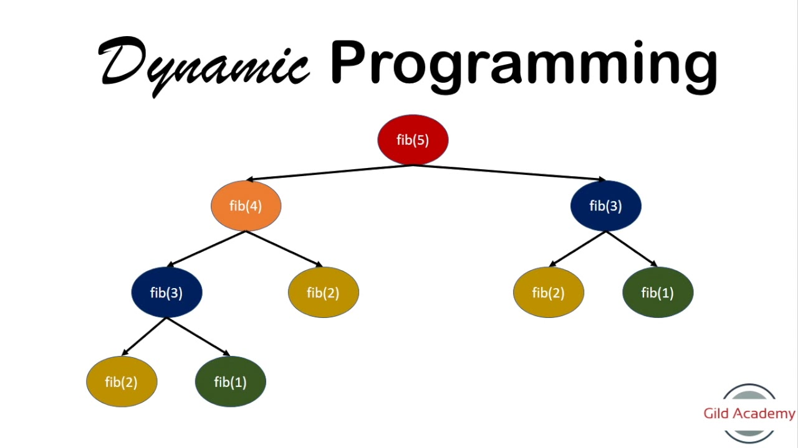
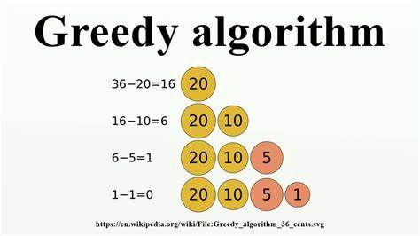
Syllabus
Dynamic programming
2. Greedy Algorithm

