Slide 1
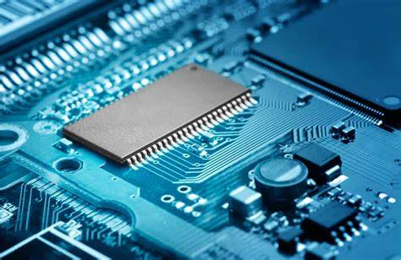

Microprocessor
By Mohammed Ahsan Meah

Slide 2
Syllabus
Minimum mode read/write operation
Maximum mode read/write operation
Timing Diagram
DMA
PIC architecture
Co processor

