Slide 1

Data-Efficient Learning from EMG Signals for Hand Gesture Recognition
Course: CS618 – Advanced Robotics and Automation
Mohammed Mizan Alanazi
Supervisor: Prof. Yassine Bouteraa

Slide 2
Outlines
Background
What's Robotics
What's sEMG
Methodology
Dataset
Why ResCNN and Segment-Level Majority Voting
ResCNN Architecture
Experimental Results
Evaluation
Conclusion

Slide 3
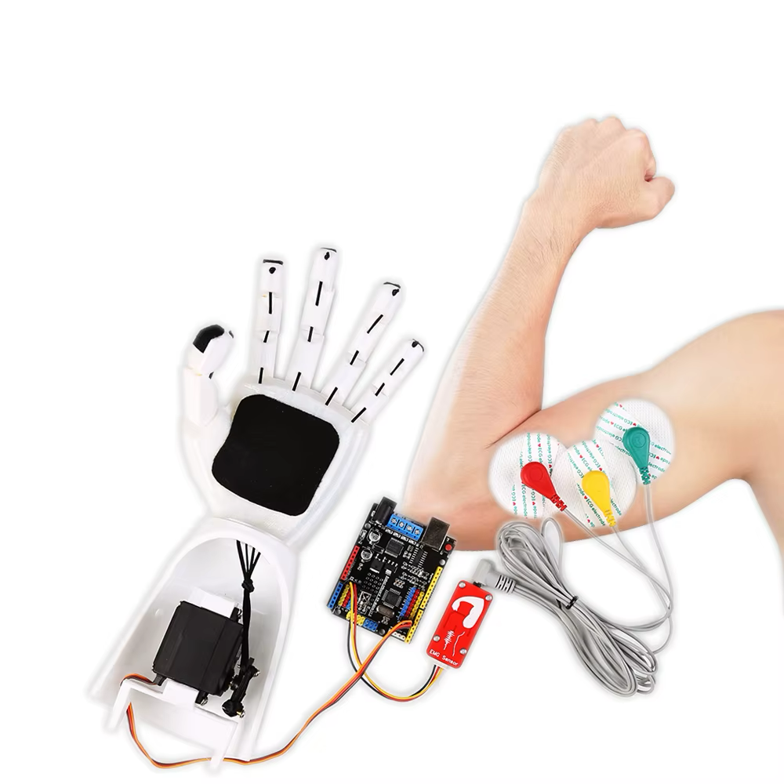
Background
What's Robotics?
Robotics integrates sensing, computation, and actuation to build machines that interact with the physical world.
In Human-Robot Interaction (HRI):
Surface EMG (sEMG) signals from forearm muscles enable intuitive, non-invasive control of prosthetic hands and robotic manipulators.
A user simply performs a hand gesture → muscles generate electrical signals → EMG electrodes capture them → a machine learning classifier decodes the gesture → the robot responds.
Goal of this project:
Build a cross-subject deep learning model that accurately classifies 5 hand gestures from 12-channel sEMG signals, generalizing to unseen subjects.

Slide 4
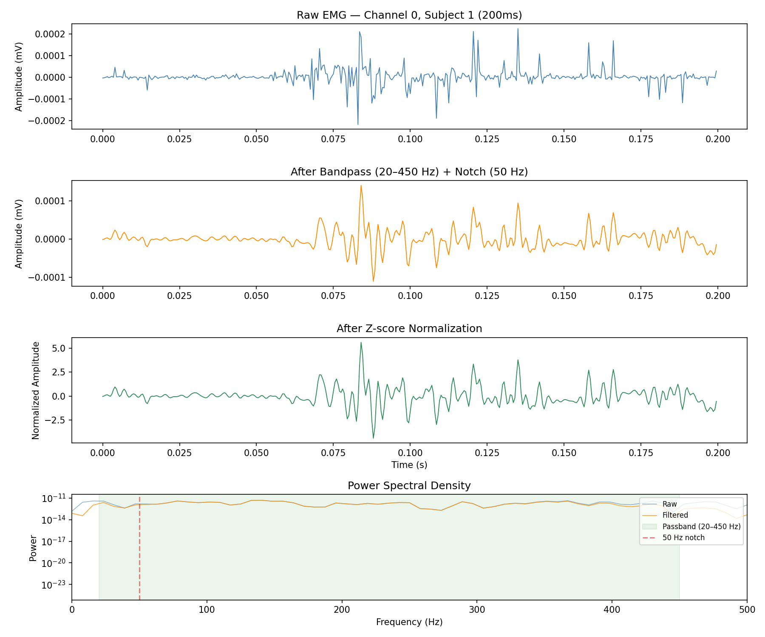
Background
What's sEMG?
Surface Electromyography (sEMG) measures the electrical activity produced by skeletal muscles via non-invasive electrodes placed on the skin.
Setup in this project:
12-channel Delsys Trigno electrodes placed around the forearm
Sampling rate: 2000 Hz — captures fine temporal muscle activation patterns
Each channel records a spatial view of muscle activation
Preprocessing pipeline:
1. Bandpass filter (20–450 Hz) — removes motion artifacts & high-frequency noise
2. Notch filter (50 Hz) — removes powerline interference
3. Per-subject Z-score normalization — prevents data leakage across subjects

Slide 5
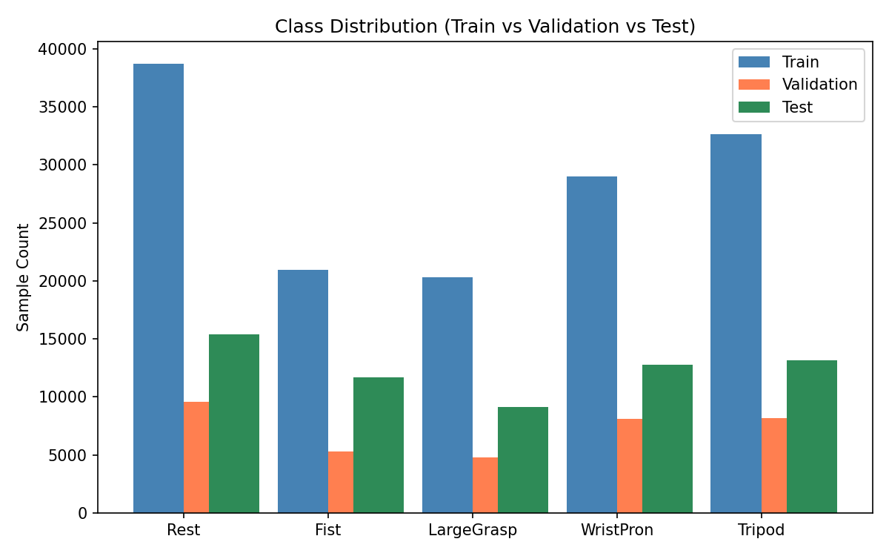
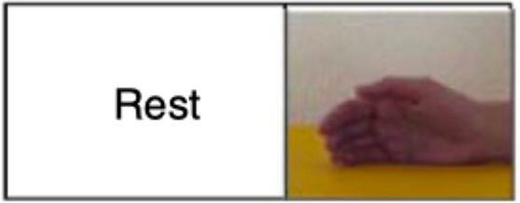
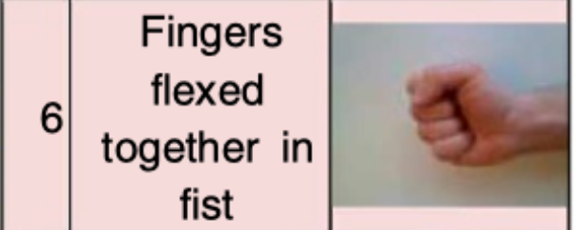
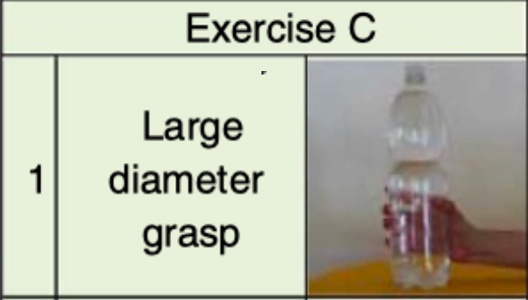
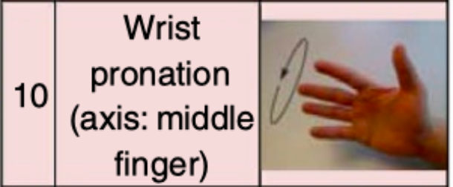
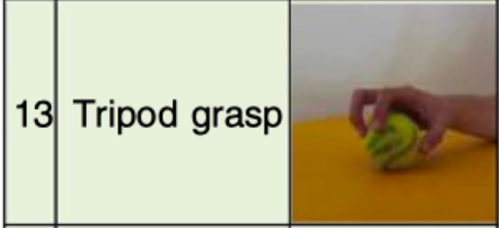
Methodology
Dataset — NinaPro DB2
Property | Value
Subjects | 40 healthy individuals
Channels | 12 sEMG (Delsys Trigno)
Sampling Rate | 2000 Hz
Selected Gestures | 5 (Rest, Fist, LargeGrasp, WristPron, Tripod)
Repetitions/Gesture | 6
Train / Val / Test | 24 / 6 / 10 subjects (cross-subject)
Rest (Class 0)
Fist (Class 1)
LargeGrasp (Class 2)
WristPron (Class 3)
Tripod (Class 4)

Slide 6
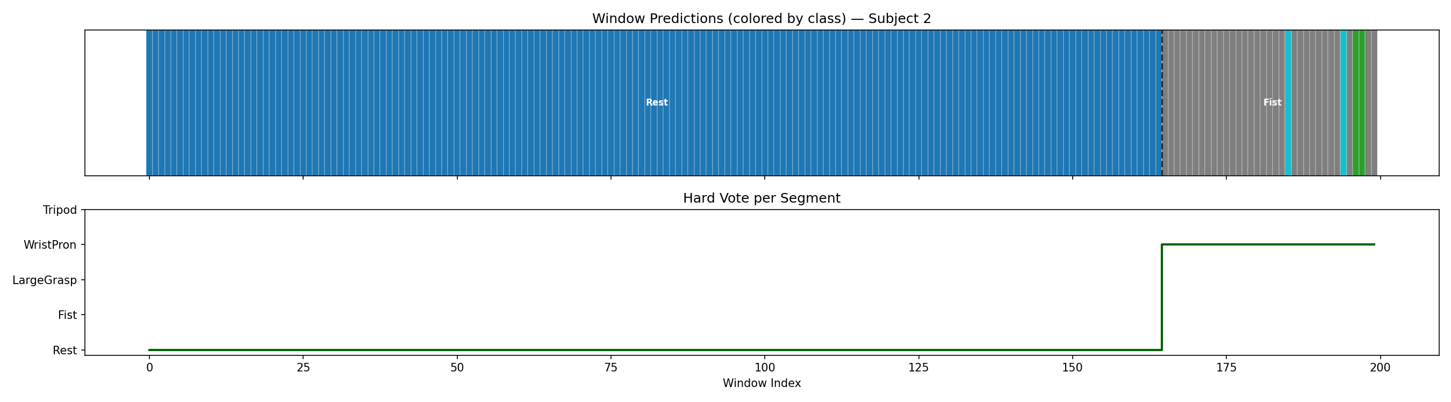
Methodology
Why ResCNN & Segment-Level Majority Voting
Why a Simple ResCNN?
Only 40 subjects & 5 classes — complex models (e.g., Transformers, GAN) would overfit easily.
Residual connections allow gradient flow through 3 blocks while BatchNorm + GELU + Dropout(0.5) provide strong regularization.
Data augmentation: Gaussian noise (σ=0.03), adaptive Mixup (α=0.25→0.05→0 at epoch 50).
Why Majority Voting?
Sliding windows overlap by 75% — adjacent windows see the same gesture segment. A single window-level prediction is noisy (~70% acc).
Result: ~70% window accuracy → ~90% segment-level accuracy after voting.

Slide 7
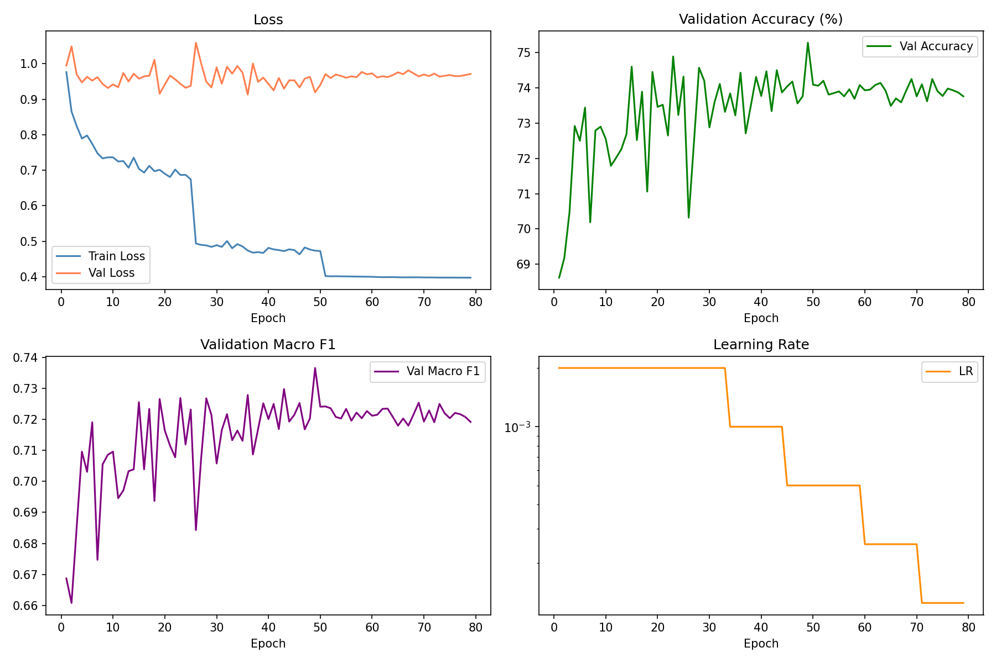
Methodology
ResCNN Architecture
System Pipeline:
Raw EMG (12ch) → Bandpass + Notch → Z-score Norm → Sliding Windows (200pt, step=50) → ResCNN → Softmax → Majority Voting → Gesture Prediction
ResCNN Design (3 Residual Blocks):
Stem: Conv1d(12→64, k=15) → BatchNorm → GELU → MaxPool(2)
Block 1: Conv(64→64, k=15) → BN → GELU → Conv(64→64) → BN → GELU → shortcut → MaxPool(2)
Block 2: Conv(64→128, k=7) → BN → GELU → Conv(128→128) → BN → GELU → shortcut → MaxPool(2)
Block 3: Conv(128→256, k=3) → BN → GELU → Conv(256→256) → BN → GELU → shortcut → MaxPool(2)
Head: AdaptiveAvgPool(1) → Dropout(0.5) → Linear(256→5)
Total trainable parameters: ~647K.

Slide 8
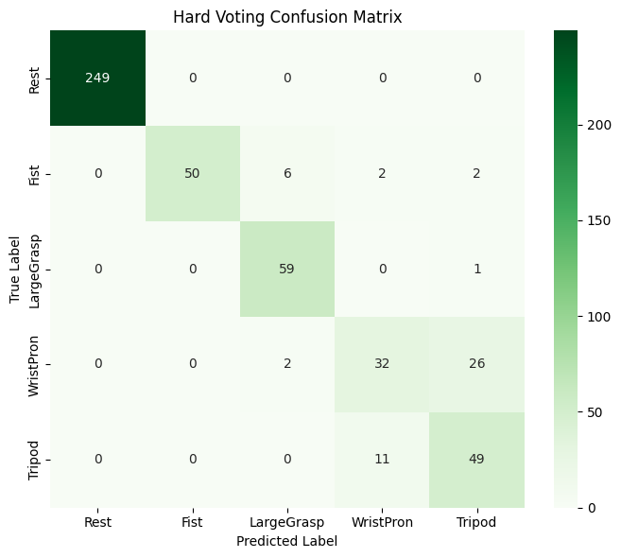
Experimental Results
Evaluation
Metric | Window-Level | Hard Vote | Soft Vote
Accuracy | 69.87% | 89.78% | 89.37%
Macro F1 | 0.68 | 0.83 | 0.82
Best Val Acc | 75.28% (epoch 49) | — | —

Slide 9
Conclusion
Achieved 89.78% cross-subject accuracy using a compact ResCNN (~647K params) with segment-level majority voting.
Majority voting boosted accuracy from 69.87% (window-level) to 89.78% (hard vote) — a 19.9 percentage point gain.
Compact architecture with data augmentation (mixup, Gaussian noise) and strong regularization (Dropout 0.5, BatchNorm) prevented overfitting on the small dataset (40 subjects).
Per-subject normalization and strict train/val/test subject separation ensured zero data leakage.

Slide 10

Any Question

