Slide 1
Hello!

Slide 2
WorkFree

Slide 3
What the work free
New idea
New Project

Slide 4
The idea
1

Slide 5
New Project
4000
3000
2000
1000
0

Slide 6
The most important points are for the work to be a comfortable environment to increase the rate of productivity and raise the quality of the services provided

Slide 7
New concept
New style with new concept in payment

Slide 8
New style with work in middle east
White
Is the color of milk and fresh snow, the color produced by the combination of all the colors of the visible spectrum.
Black
Is the color of ebony and of outer space. It has been the symbolic color of elegance, solemnity and authority.

Slide 9
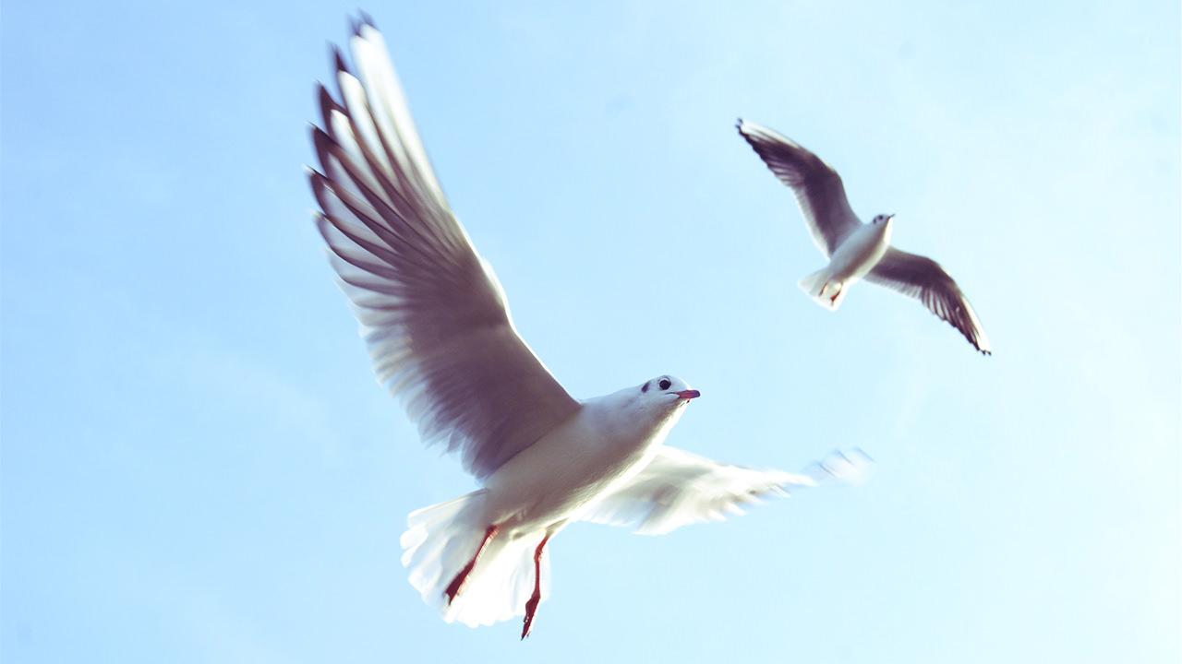
What the best impact?
Fly freely with us.

Slide 10
Our plan
our office

Slide 11
Roles
Roles | A
Admins | 7
Clients | 30
Freelancers | 40

Slide 12
Mobile
WorkFree App

Slide 13
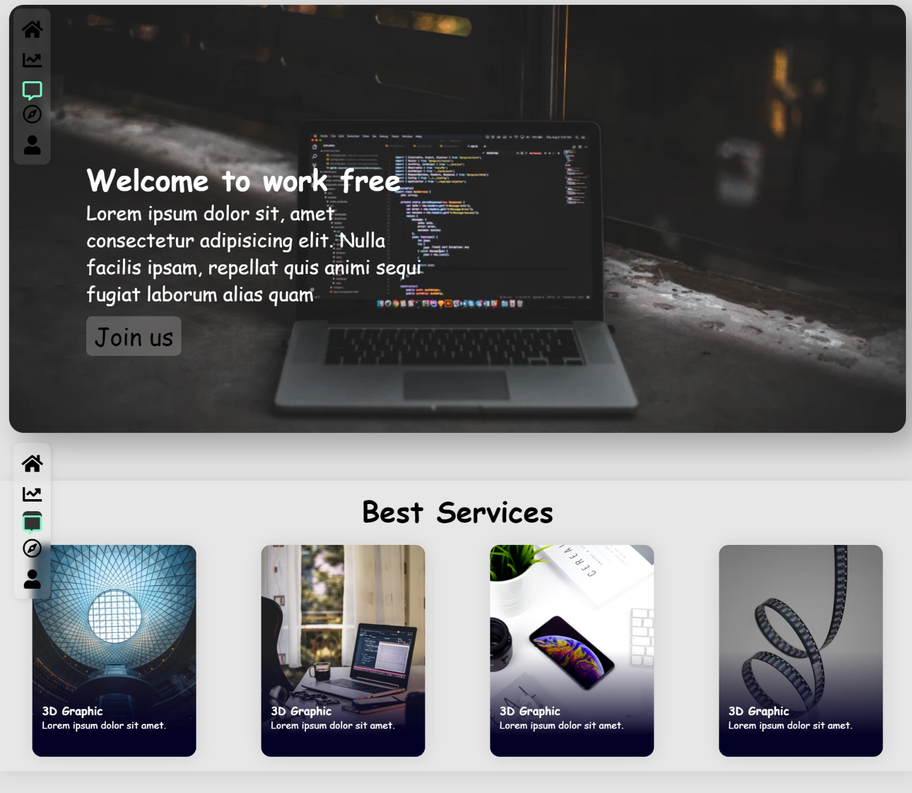
Tablets & IPads

Slide 14
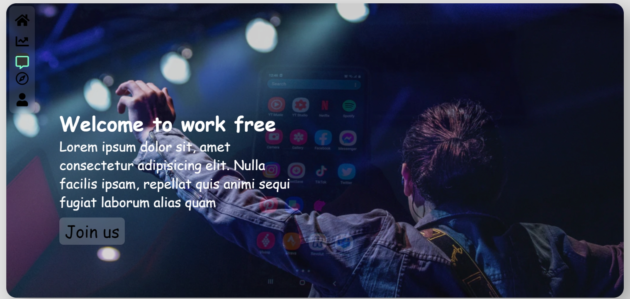
Desktop

Slide 15
Features in future
Increase the scope of work
Mobile Application
Increase scope of support
1
3
5
2
4
6
Add arabic language
Add management tools
Make more theme

Slide 16
Thanks!
Any questions?
You can find me at:
@mohammed-aljasem
Mohammed.m.aljasem@gmail.com

