Slide 1

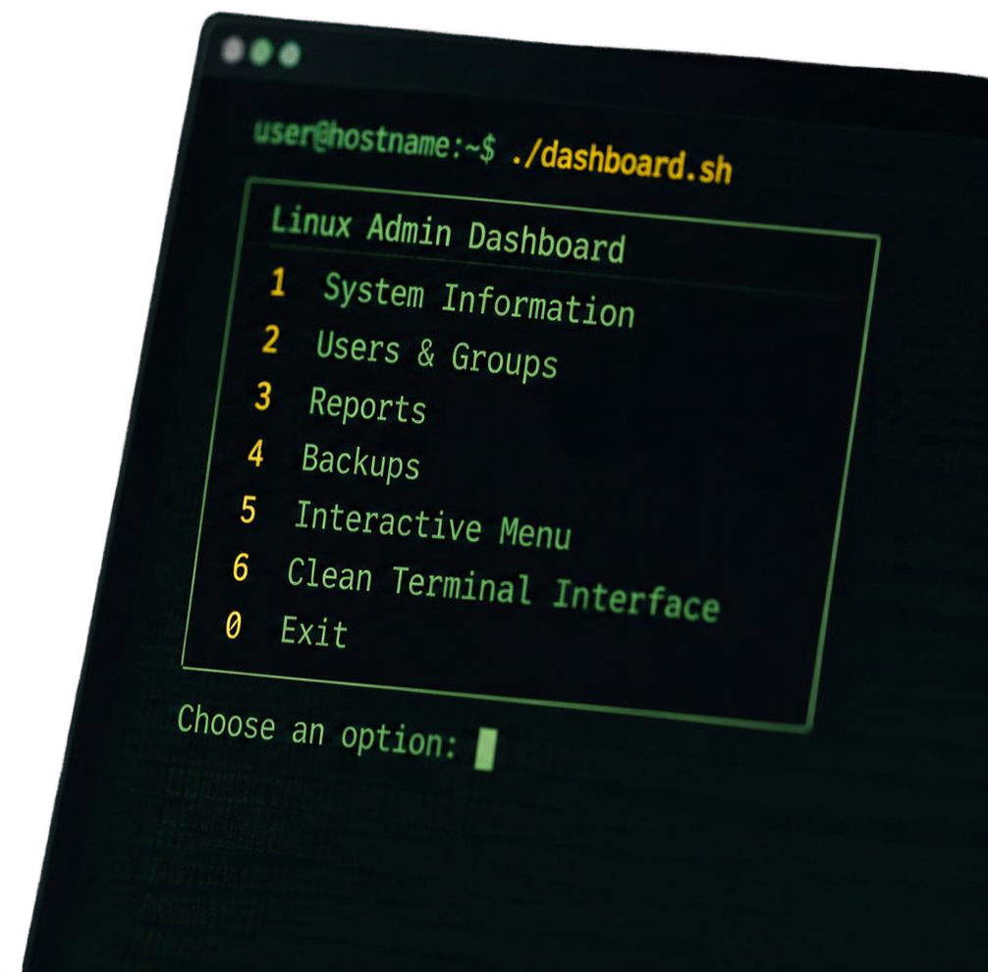

Terminal-Based
username:~$ ./dashboard.sh
Linux Admin Dashboard
A practical terminal interface for system inspection, user and group management, reports, backups, and everyday Linux administration
TECHNOLOGIES
Mohammed Alqerem
Bash and Linux
Computer Science Student learning Linux and Bash scripting
user@hostname:~$

Slide 2










SYSTEM INFORMATION
USERS & GROUPS
REPORTS
What the Dashboard Provides
View current user, hostname, working directory, date and time, and disk usage.
Display all users, display all groups, and search for a specific user.
Store generated system reports inside the reports directory.
INTERACTIVE MENU
CLEAN TERMINAL INTERFACE
BACKUPS
Bringing essential Linux administration tasks into one terminal application.
Store backup files inside the backups directory.
Simple terminal navigation, user-friendly numbered options, and pause functionality between operations.
Uses clear to keep the dashboard organized and readable.
user@hostname : ~$

Slide 3









Project Structure and Getting Started
PROJECT FILES
GETTING STARTED
Linux-admin-dashboard/
dashboard.sh
reports/
backups/
README.md
user@hostname:~$ git clone <your-repository-url>
user@hostname:~$ cd linux-admin-dashboard
SETUP ON START
user@hostname:~$ chmod +x dashboard.sh
mkidr -p reports
mkidr -p backups
REQUIREMENTS
user@hostname:~$ ./dashboard.sh
A Linux-based operating system
Bash shell
Terminal access
or
user@hostname:~$ bash dashboard.sh
COMMON COMMANDS
whoami, hostname, pwd, date, df, grep

Slide 4






Inside the
Interactive Bash Workflow
From menu selection to function execution.
system_info()
Shows user, host, directory, date, time, and disk usage
Choose an option:
user@hostname:-$ system_info
users_info()
Lists users, lists groups, searches for a user
1. System Information
2. Users and Groups
3. Reports
4. Backups
5. Exit
whoami
user
hostname
hostname
reports()
pwd
/home/user
Opens reports directory with generated reports
date
Mon May 19 10:15:45 2025
df -h
/dev/sdai 50G 20G 27G 43%
backsups()
Stores backup files in the backups directory
Press Enter to continue...
Choose an option:
pause()
Waits for Enter to continue
BASH CONCEPTS IN ACTION
Variables
Functions
While loops
If statements
Case statements
Read input
Exit status using $?
File and directory management
Linux users and groups
COMMANDS YOU SEE
whoami hostname pwd date df grep

Slide 5

















Purpose. Outcomes.
What’s Next.
01
02
03
04
05
PURPOSE
LEARNING
OUTCOMES
NEXT STEPS
SUPPORT
BUILT WITH
Combine Linux commands and Bash scripting concepts into one practical terminal application.
CPU and memory monitoring
Network information
Installed package management
Service management
Automatic report generation
Advanced backup options
Permission management
System statistics
If you find the project useful, consider giving the repository
a star.
Linux and Bash
Linux administration
Bash scripting
Terminal commands
User interaction
System monitoring
Basic file management
user@hostname::~$
Continuing to learn. Building better. Ship it.

