Slide 1
Mohammed Alrabai JS Bootcamp - Backend Final Project

Slide 2
Our Project
LMS (Learning Management System)
Our project is about developing an e-learning platform that allows teachers to create and manage educational courses through a dashboard. Teachers can create, edit, and delete their own courses.
Through the available API in our project, students can create accounts, log in, and access all courses. They can enroll in a course and cancel their enrollment, all through the API.

Slide 3

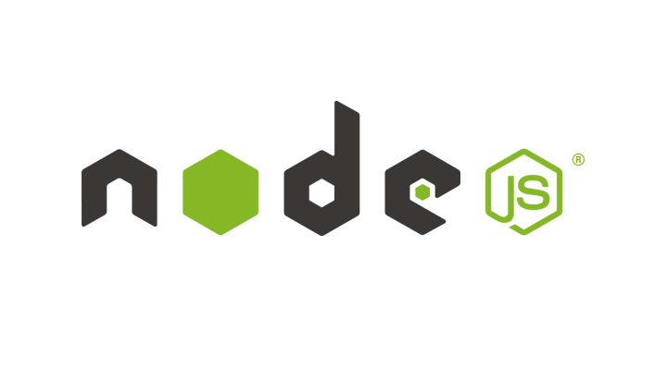

Technologies Used Backend
List of libraries Used :
bcrypt
dotenv
ejs
jsonwebtoken
moment
mongoose

Slide 4



Technologies Used Frontend
MVC And Router

Slide 5
DEMO

