Slide 1

WIPRO NGA Program _26SUB0726-JAVA J2EE INTEGRATION
Capstone Project Presentation – 23rd June 2026
Project Title Here - Smart Parking Management System
Presented by – Mohammed Athaf, Naveen Muthu
www.rpsconsulting.in
General - RPS Data

Slide 2
Smart Parking Management System
Introduction
The Smart Parking Management System is a web-based application built to streamline the management of parking lots, parking slots, vehicle reservations, entry and exit tracking, billing, and digital payments.
The platform enables customers to locate available parking spaces, book slots in advance, and complete payments online — all from a single interface.
Administrators gain centralized control over the entire parking infrastructure through a unified dashboard, improving visibility and operational efficiency.
The system eliminates manual processes, reduces human error, and significantly enhances the overall parking experience for both users and operators.
General - RPS Data
2026 - RPS Consulting all rights reserved 2

Slide 3
Existing System
In traditional parking systems:
Parking slots are assigned manually, causing delays and inefficient use of space.
Drivers are forced to search for available spots without any real-time guidance.
Parking records are maintained manually, making them error-prone and difficult to audit.
Billing is computed by hand, leading to inconsistencies and revenue leakage.
There is no real-time monitoring of parking slot availability for administrators.
Overall parking management is inefficient and highly susceptible to human errors.
These limitations lead to longer wait times, reduced throughput, and poor customer satisfaction.
General - RPS Data
2026 - RPS Consulting all rights reserved 2

Slide 4
Proposed System
The proposed Smart Parking Management System fully automates the end-to-end parking workflow.
The system delivers:
Secure user registration and authentication.
Vehicle details management and tracking.
Parking lot and slot administration.
Online slot reservation with real-time availability.
Automated vehicle entry and exit logging.
System-generated billing and integrated payment processing.
Real-time monitoring of parking slot status.
Comprehensive administrative dashboard for oversight and reporting.
The solution is designed to be scalable, secure, and user-friendly.
General - RPS Data
2026 - RPS Consulting all rights reserved 2

Slide 5
Project Objectives
Objectives
Automate parking slot allocation and optimize space utilization.
Manage and log vehicle entry and exit with accuracy.
Provide an online reservation facility for advance slot booking.
Generate billing statements automatically based on parking duration.
Maintain structured parking records for auditing and reporting.
Enable secure user authentication and role-based authorization.
Deploy the application using Docker containers and Kubernetes orchestration.
Automate the build and deployment pipeline using Jenkins CI/CD.
General - RPS Data
2026 - RPS Consulting all rights reserved 2

Slide 6
System Architecture
Objectives
THREE – TIER ARCHITECTURE
Smart Parking Management System
PRESENTATION LAYER
(Thymeleaf)
BUSINESS LAYER
(Spring Boot)
DATA LAYER
(MySQL)
• User Interface
• Form Validation
• Server-side Rendering
• Dashboard Visualization
• Business Logic
• Authentication
• Authorization
• Reservation Processing
• Billing Calculation
• Parking Allocation
• Store User Information
• Store Vehicle Details
• Store Parking Information
• Store Reservations
• Store Parking Records
• Store Billing Records
User
(Browser)
→
Web
Application
→
Application
Server
→
Database
Server
General - RPS Data
2026 - RPS Consulting all rights reserved 2

Slide 7
Presentation Layer
The project follows a three-tier architecture.
Responsibilities:
Developed using Thymeleaf — a server-side Java template engine integrated with Spring Boot.
Responsible for rendering the User Interface dynamically on the server before delivery to the browser.
Handles form validation and user input processing on the server side.
Manages server-side page rendering and dashboard visualization for both customer and admin views.
Interacts with the Spring Boot backend directly through model attributes, eliminating the need for separate API calls from the frontend.
Users interact with the application through standard web pages served by the backend.
General - RPS Data
2026 - RPS Consulting all rights reserved 2

Slide 8
Business Layer
Developed using Spring Boot.
Responsibilities:
Encapsulates all core Business Logic governing parking operations.
Handles user Authentication and role-based Authorization using Spring Security and JWT.
Processes Reservation requests — slot selection, availability checks, and confirmation.
Performs Billing Calculation based on vehicle entry time, exit time, and applicable rates.
Manages Parking Slot Allocation, status updates, and conflict resolution.
Exposes REST APIs (consumed internally by Thymeleaf controllers) for structured data flow.
Integrates with MySQL via Spring Data JPA for all persistence operations.
General - RPS Data
2026 - RPS Consulting all rights reserved 2

Slide 9
Data Layer
Developed using MySQL.
Stores and manages User Information including credentials and role assignments.
Maintains Vehicle Details linked to each registered customer.
Persists Parking Information covering lot configurations and slot metadata.
Retains Reservation records capturing booking details and timestamps.
Stores Parking Records that log vehicle entry, exit, and duration for every session.
Preserves Billing Records containing charge calculations and payment status.
Responsibilities:
General - RPS Data
2026 - RPS Consulting all rights reserved 2

Slide 10
System Modules & Features
The Smart Parking Management System is structured around two primary user roles — Administrator and Customer — each with distinct capabilities and access levels.
The Administrator oversees users, parking lots, parking slots, parking records, and revenue monitoring, ensuring full control and efficient maintenance of the infrastructure.
The Customer interacts with the system by creating an account, logging in, registering vehicles, reserving parking slots, making payments, and downloading billing receipts.
JWT-based authentication is embedded throughout the system to protect resources, enforce role-based access, and secure all sensitive user data.
The application centralizes all parking operations — vehicle management, lot and slot handling, reservations, billing, and payments — into one cohesive platform, cutting manual effort and improving efficiency.
General - RPS Data
2026 - RPS Consulting all rights reserved 2

Slide 11
System Workflow
The workflow begins with user authentication — upon successful login, a JWT token is issued and used to authorize all subsequent requests, ensuring secure communication across the application.
Customers register their vehicles and choose a parking lot based on current availability. The system instantly reflects available slots filtered by lot and vehicle type, and a reservation is created once the user confirms a slot.
At vehicle entry, the system captures the entry timestamp and marks the selected slot as occupied. When the vehicle exits, the exit time is recorded, parking duration is computed, and the slot is released back to available status.
The billing module automatically calculates charges based on the session duration and triggers payment processing. A receipt is made available for download upon successful payment.
All data flows through the following entities: User, Vehicle, Parking Lot, Parking Slot, Reservation, Parking Record, and Billing — ensuring complete traceability of every parking session.
General - RPS Data
2026 - RPS Consulting all rights reserved 2

Slide 12
DevOps, Deployment & Benefits
The system is built with Thymeleaf for server-side rendering, Spring Boot for backend logic, and MySQL for persistent data storage. Spring Security with JWT handles access control; Swagger provides API documentation; and Spring Boot Actuator monitors application health and metrics.
For environment-agnostic deployment, the application is containerized using Docker. Kubernetes orchestrates the containers across nodes, delivering high availability and simplified rollout management.
A Jenkins CI/CD pipeline automates the entire delivery lifecycle — from source code checkout and application build to testing, Docker image creation, and Kubernetes deployment — ensuring fast and reliable releases.
General - RPS Data
2026 - RPS Consulting all rights reserved 2

Slide 13
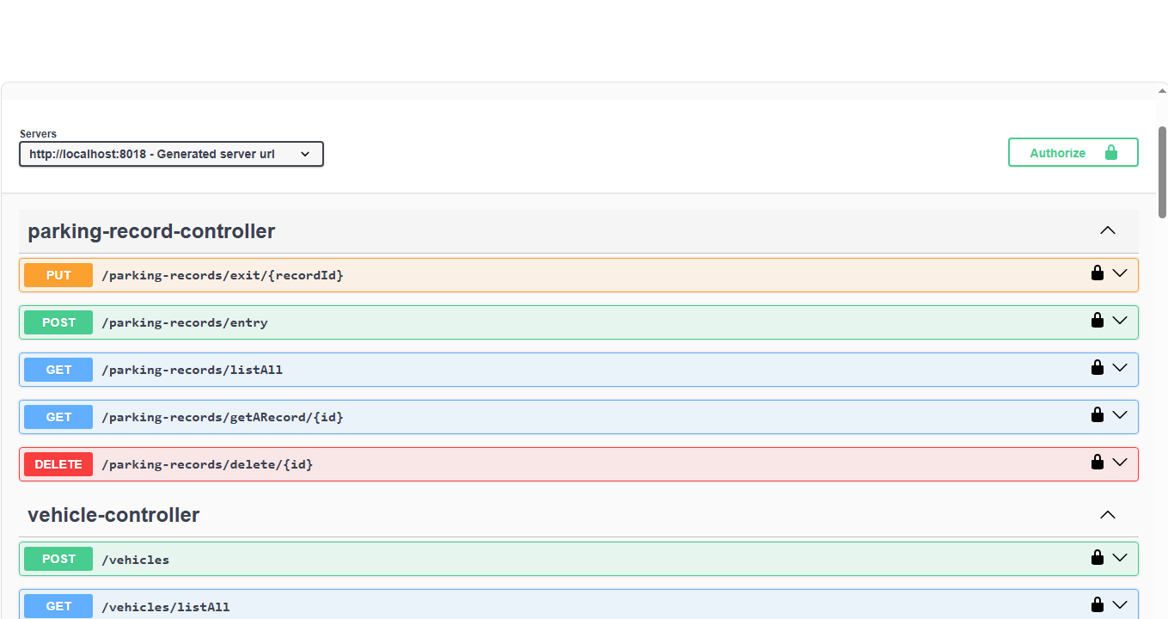
Smart Parking Management System
Swagger REST API Documentation
General - RPS Data
2026 - RPS Consulting all rights reserved 2

Slide 14
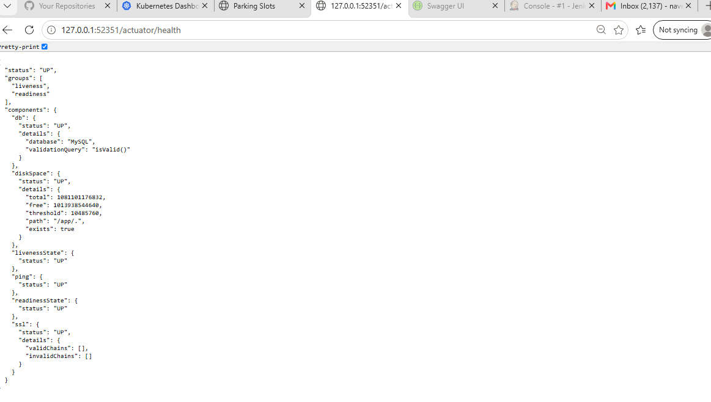
Smart Parking Management System
Spring Boot Actuator Health Monitoring
General - RPS Data
2026 - RPS Consulting all rights reserved 2

Slide 15
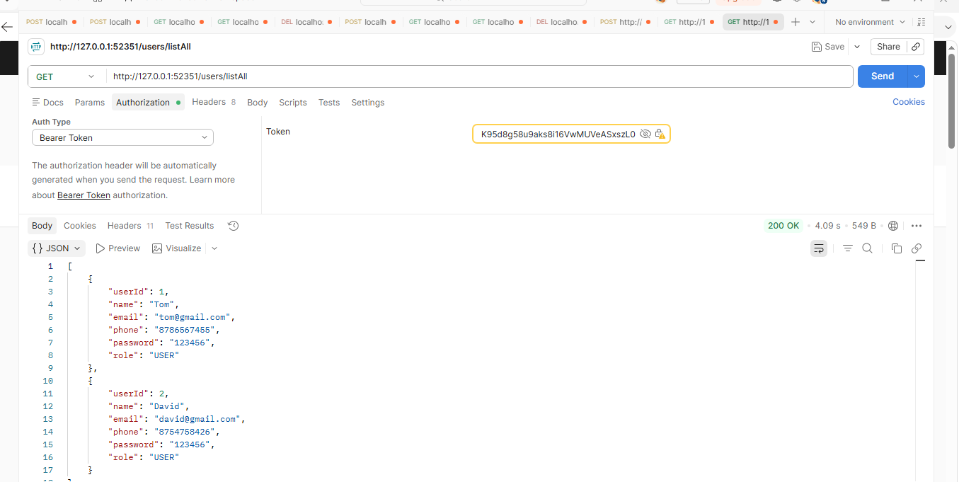
Smart Parking Management System
Postman API Verification Testing
General - RPS Data
2026 - RPS Consulting all rights reserved 2

Slide 16
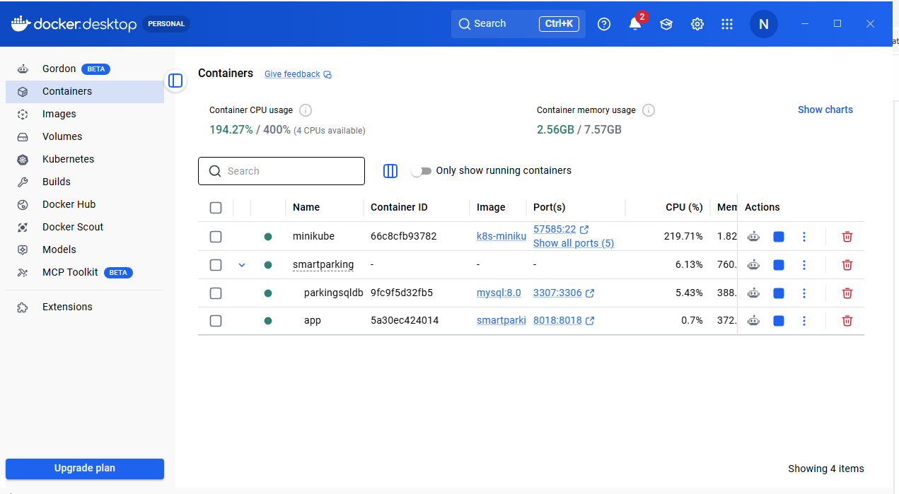
Smart Parking Management System
Docker Containers Deployment
General - RPS Data
2026 - RPS Consulting all rights reserved 2

Slide 17
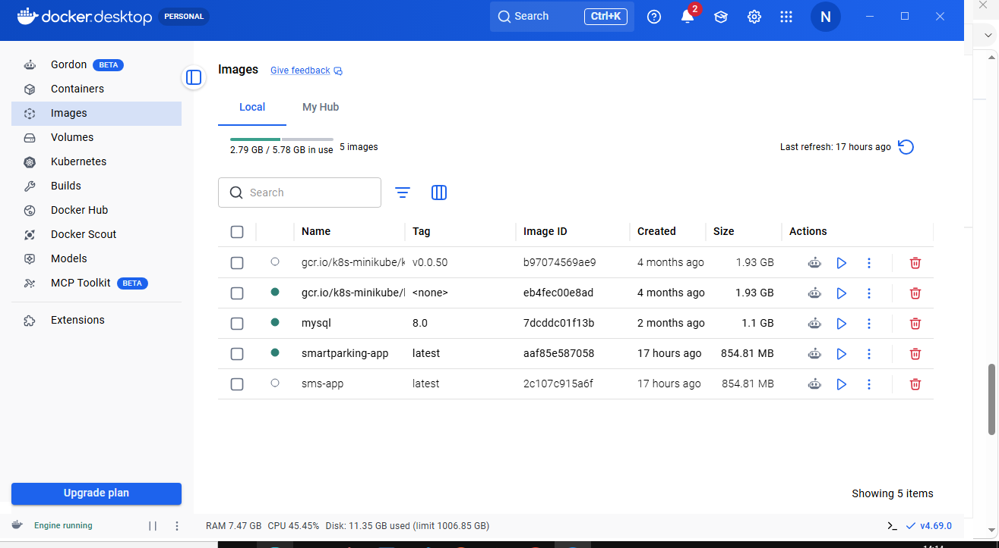
Smart Parking Management System
Docker Container Images
General - RPS Data
2026 - RPS Consulting all rights reserved 2

Slide 18
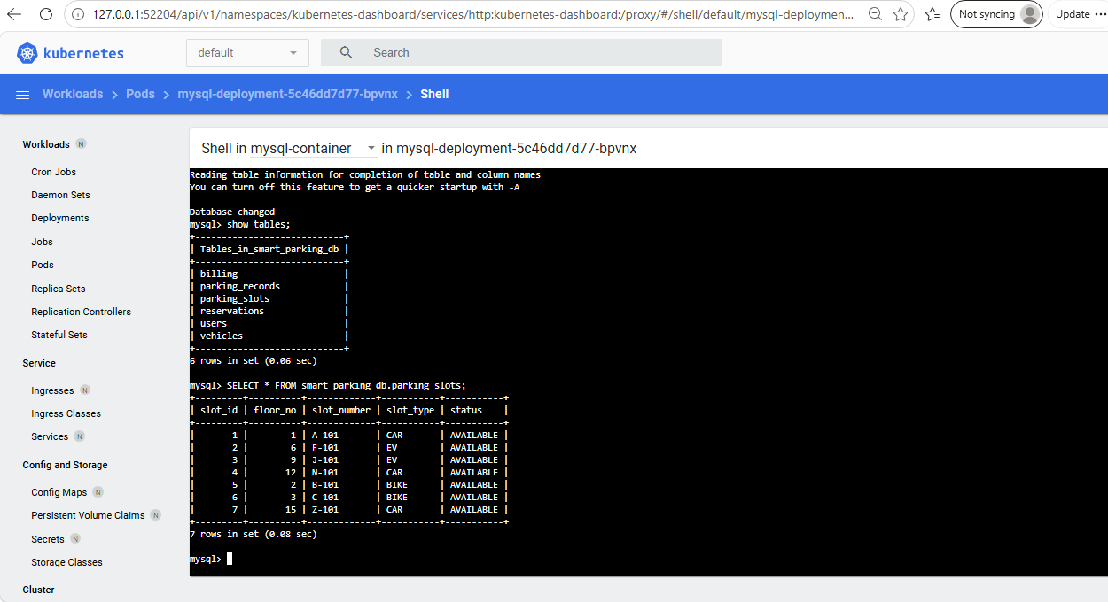
Smart Parking Management System
Kubernetes MySQL Database Service
General - RPS Data
2026 - RPS Consulting all rights reserved 2

Slide 19
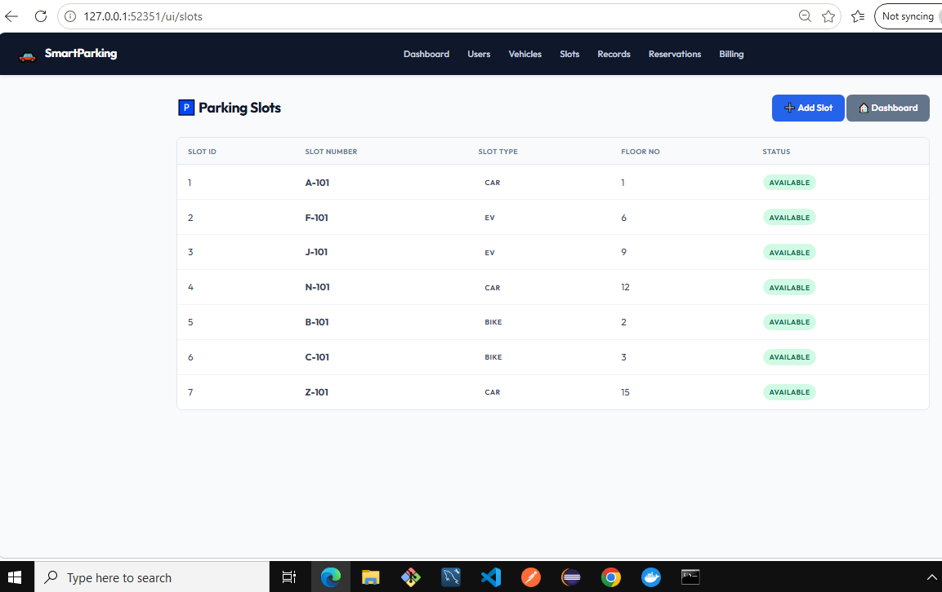
Smart Parking Management System
Kubernetes Web UI Deployment
General - RPS Data
2026 - RPS Consulting all rights reserved 2

Slide 20
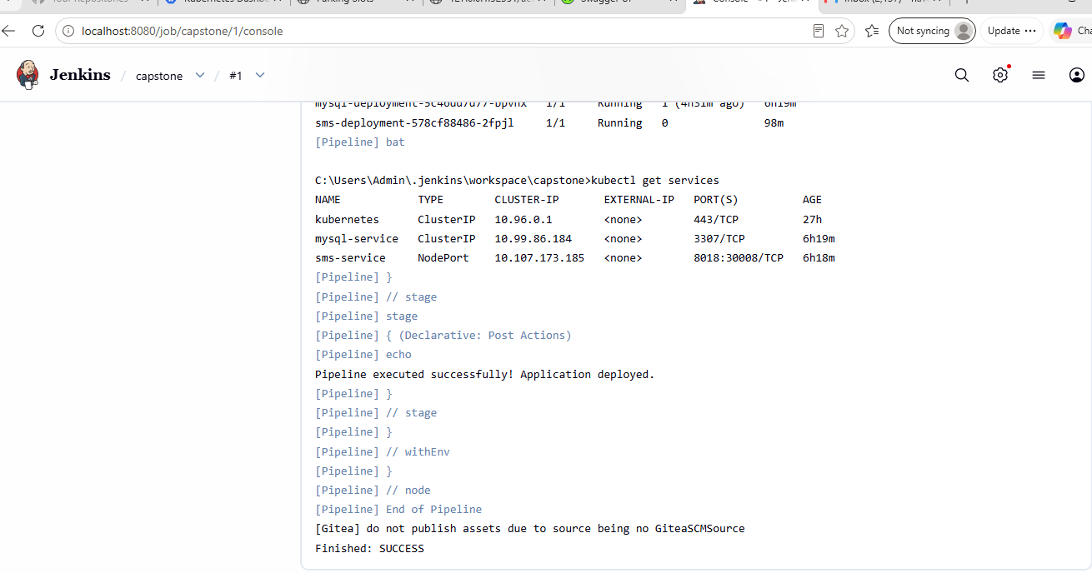
Smart Parking Management System
Jenkins CI/CD Build Pipeline
General - RPS Data
2026 - RPS Consulting all rights reserved 2

Slide 21
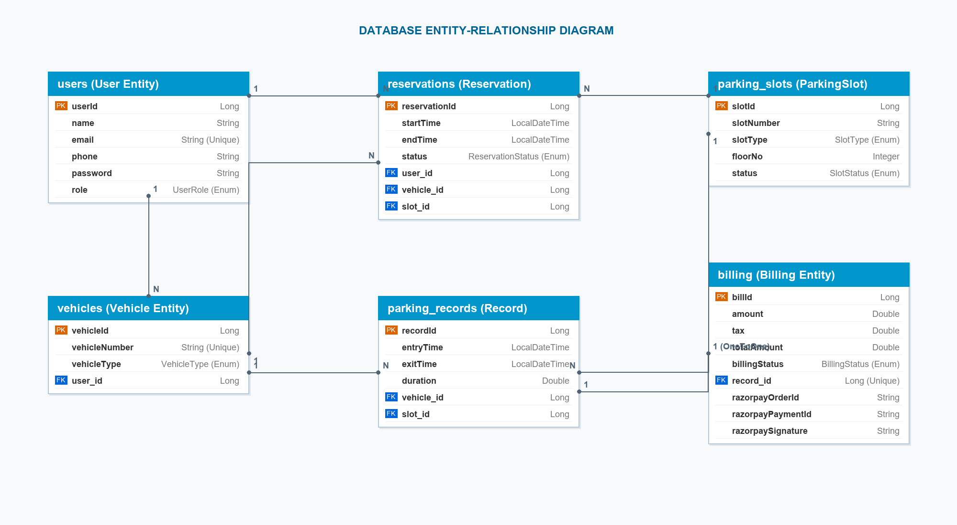
Smart Parking Management System
Entity Relationship Diagram
General - RPS Data
2026 - RPS Consulting all rights reserved 2

Slide 22
Benefits:
Fully automated parking management eliminates manual intervention.
Real-time slot tracking ensures accurate occupancy visibility.
Secure JWT-based authentication protects user data and system resources.
Automatic billing generation and integrated payment processing improve accuracy.
Enhanced user experience through seamless online reservation and digital receipts.
Containerized deployment with Docker and Kubernetes ensures portability and resilience.
Jenkins CI/CD automation accelerates software delivery and reduces deployment risk.
Future Enhancement:
Integration with IoT sensors and RFID technology for automated entry and exit gate control.
Implementation of database clustering and replication for high availability and fault tolerance.
Optimization of container resources to reduce cloud infrastructure overhead.
Addition of predictive analytics for parking demand forecasting and dynamic pricing.
General - RPS Data
2026 - RPS Consulting all rights reserved 2

