Slide 1
GDG AL-ZAHER · DATA SCIENCE FINAL PROJECT 2026
CropWise
🌾
Egypt Crop Yield Prediction
1964–2024
77
4,329
FAOSTAT history
crops
modeling records
Data source: FAOSTAT — Crop Production
Team: Mohamed Dahi · Shorouk · Shams
CropWise · GDG Al-Zaher Data Science 2026
1
Notes:
CropWise predicts crop yield in Egypt from historical FAOSTAT data. Three-person team, GDG Al-Zaher Data Science Final Project 2026.

Slide 2
The problem
Crop yield varies across crops and across years
PROBLEM
CONSEQUENCE
OPPORTUNITY
Yield differs by crop and changes year to year
A single year's yield is hard to anticipate
60+ years of FAOSTAT history
→
→
Egypt crop yields span roughly 840 kg/ha to over 100,000 kg/ha across the 77 modeled crops.
Without a reference estimate, there is no data-driven starting point for what a crop's yield is likely to be.
Yield changes slowly for most crops, so recent history carries real predictive signal.
CropWise · GDG Al-Zaher Data Science 2026
2
Notes:
Problem to consequence to opportunity. We make no claims about economic impact; the point is that yield is a measurable quantity with a long history.

Slide 3
Project objective
Analyze historical patterns, then estimate yield from history
Use historical agricultural data from Egypt to analyze crop yield patterns and build a machine learning system that estimates crop yield from historical information.
Data check
EDA & visuals
Feature engineering
Baseline + 2 models
Evaluation & errors
Prediction interface
Chronological split · all features use past information only
CropWise · GDG Al-Zaher Data Science 2026
3
Notes:
The objective statement, then the end-to-end workflow.

Slide 4
The dataset
FAOSTAT Crop Production — Egypt
1964–2024
4,329
77
kg/ha
modeling period
modeling records
crops
target: Yield
Crop × Year × Historical variables
Chronological split
Crop
Year
Yield_Lag1
Prod_Lag1
Area_Lag1
→ Yield
Train 1964–2013
3,502 rows
Test 2014–2024
827 rows
Tuning used a validation split inside train (2004–2013).
Wheat
t
···
···
···
···
Rice
t
···
···
···
···
⋮
⋮
···
···
···
···
CropWise · GDG Al-Zaher Data Science 2026
4
Notes:
Compact dataset overview. Train and test are split by time, not randomly.

Slide 5
Data understanding & quality
From raw FAOSTAT export to modeling records
22,568
raw Egypt rows · 156 items · 1961–2024
18,118
rows kept: Production, Area harvested, Yield · 140 items
4,562
complete crop-year records (all three elements)
4,329
records with lag features · 77 crops · 1964–2024
• 288 missing Value entries in the raw export (22,568 rows)
• Lag features need prior years, so the first year of each crop is dropped
• Rows with missing lag features were removed; the final matrix has no missing values
CropWise · GDG Al-Zaher Data Science 2026
5
Notes:
Numbers are from Data_Check.ipynb. Raw export includes livestock products, which were filtered out.

Slide 6
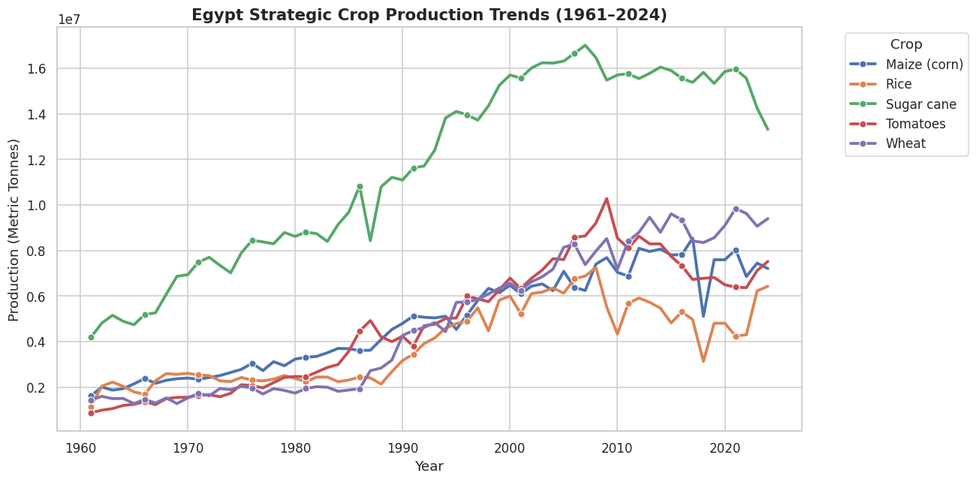
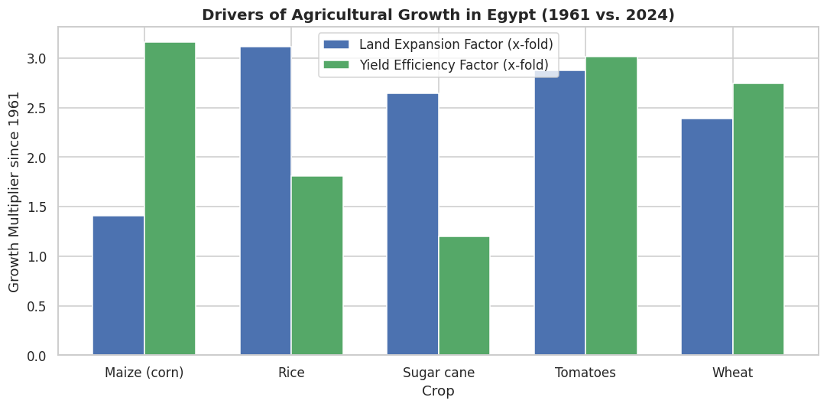
EDA: what did we discover?
Three patterns that shaped the modeling
Production has trended upward
Yield gains vs. land expansion
Sugar cane leads in volume; wheat and maize rise steadily since the 1980s.
2024 vs 1961: maize yield ×3.2 on ×1.4 area; rice area ×3.1 with yield ×1.8.
Yield scale differs sharply
Sugar cane averages ~101,800 kg/ha; the median crop ~9,700 kg/ha.
CropWise · GDG Al-Zaher Data Science 2026
6
Notes:
Images are from Visualization_and_Insights.ipynb; the bar chart is recomputed from the 4,329-row modeling dataset. EDA visuals cover the five major crops (wheat, rice, maize, sugar cane, tomatoes).

Slide 7
Feature engineering
Raw history becomes predictive features — without using the future
t-3
t-2
t-1
t
Known past
Target: Yield (kg/ha)
Yi el d_Lag1
Yi el d_Lag2
Yi el d_Rol l I ng Mean_3Y
Produc t i on_Lag1
yield at t-1
yield at t-2
mean of t-1…t-3
production at t-1
Area_Lag1
Area_Growth_Lag1
Producti on_Growth_Lag1
Crop identity (Item) added as a categorical feature
harvested area at t-1
area change into t-1
production change into t-1
No future information is used to predict the target.
CropWise · GDG Al-Zaher Data Science 2026
7
Notes:
Features use only past years. We never use same-year Production or Area harvested to predict same-year Yield.

Slide 8
Machine learning approach
Simple baseline first, then two models of increasing flexibility
1
Historical features
2
Preprocessing
3
Persistence baseline
7 lag/rolling/growth + crop
one-hot crop · scale numerics (train-fit)
yield = last year's yield
4
Linear Regression
5
Decision Tree
6
Evaluation
linear relationships
non-linear · depth tuned (5)
MAE · MSE · RMSE · R²
Depth chosen on a chronological validation split (2004–2013): best max_depth = 5. Final scores come from the untouched 2014–2024 test set.
CropWise · GDG Al-Zaher Data Science 2026
8
Notes:
Persistence baseline: predicted yield equals last year's yield. It tells us whether a model adds anything beyond "yield changes slowly".

Slide 9
Model performance
Final test results (2014–2024, 827 records)
Model | MAE | RMSE | R²
Persistence Baseline | 929 | 2,672 | 0.973
Linear Regression | 1,140 | 2,498 | 0.977
Decision Tree (depth 5) | 1,361 | 2,695 | 0.973
Green = best on that metric. MAE and RMSE in kg/ha.
Reading the metrics
MAE = typical error. RMSE penalizes large misses. Linear Regression lowers RMSE by ~7% vs. baseline, but the baseline has the smaller typical error.
CropWise · GDG Al-Zaher Data Science 2026
9
Notes:
Say it carefully: baseline has the lowest MAE; Linear Regression has the lowest RMSE and highest R². No model wins every metric. Linear Regression is the app default because it has the lowest RMSE.

Slide 10
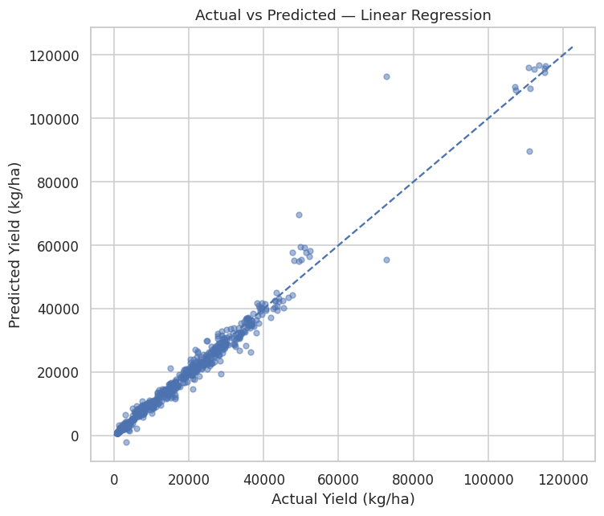
Error analysis: where models struggle
Absolute error grows with the yield scale of the crop
Linear Regression: actual vs predicted
Sugar cane and sugar beet carry the largest absolute errors (e.g. sugar cane MAE: baseline 8,328 · linear 7,444 · tree 8,939 kg/ha) — their yields are 5–10× larger than typical crops, so same-percentage misses look bigger.
CropWise · GDG Al-Zaher Data Science 2026
10
Notes:
Mean absolute error rises with yield level for every model. Sugar cane and sugar beet dominate the worst predictions. Sugar cane 2020 actual 72,880 kg/ha vs previous year 110,877: a sharp drop all three models missed.

Slide 11
Model interpretation
Recent historical yield carries the predictive signal
Yield_Lag1 and Yield_RollingMean_3Y dominate both views: recent historical yield is strongly associated with current-year yield. The tree's Sugar cane term reflects that crop's very large yield scale.
CropWise · GDG Al-Zaher Data Science 2026
11
Notes:
Standardized coefficients come from Linear_Regression_Model.ipynb; tree importances from Final_Model_Analysis.ipynb. These are associations in predictive models, not causal effects.

Slide 12
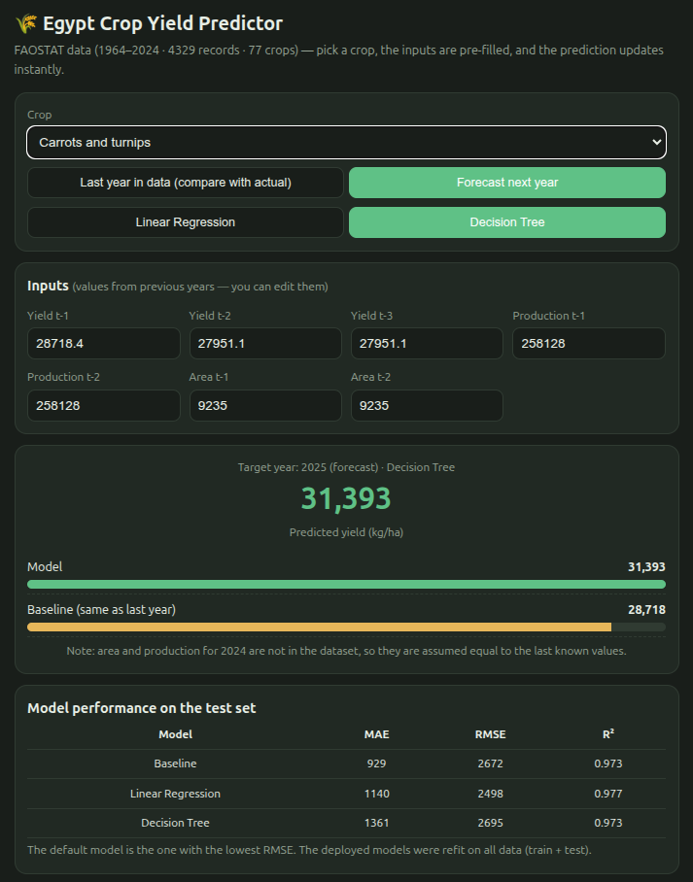
The final product
CropWise prediction interface
1
Select a crop
77 crops; Linear Regression or Decision Tree
2
Review / edit historical inputs
Yield t-1…t-3, Production t-1…t-2, Area t-1…t-2
3
Generate a prediction
Last year (compare with actual) or Forecast next year
4
Compare with the baseline
Model vs. "same as last year"
5
Review model performance
MAE · RMSE · R² on the test set
Runs entirely in the browser — no installation, no server.
CropWise · GDG Al-Zaher Data Science 2026
12
Notes:
The screenshot is the real interface from the API folder. It shows Carrots and turnips, Decision Tree, forecast for 2025.

Slide 13
System architecture
What is actually implemented in the repository
TRAINING (offline)
FAOSTAT CSV
Data processing (notebooks)
train / test CSVs
train_model.py (scikit-learn)
model.json
PREDICTION (in the browser)
User
crop_yield_app.html
Preprocess inputs
Linear / Tree from model.json
Predicted yield (kg/ha)
Deployed models were refit on all data (train + test); reported test scores come from the train-only fit.
Stack: Python · pandas · NumPy · scikit-learn · HTML/JavaScript
CropWise · GDG Al-Zaher Data Science 2026
13
Notes:
The API folder contains train_model.py, model.json and crop_yield_app.html. There is no separate server: the HTML app computes predictions in the browser using the exported model.json.

Slide 14
Limitations & future work
LIMITATIONS
FUTURE WORK
Historical agricultural data is the only information source
No weather, rainfall or temperature variables
No soil, fertilizer, irrigation or pest/disease data
Predictions follow historical patterns — not causal forecasts
Persistence baseline is hard to beat on MAE
Add weather and climate data (rainfall, temperature)
Add soil and irrigation variables
Explore more advanced ensemble models
Investigate crop-specific models
Explore target transformations
CropWise · GDG Al-Zaher Data Science 2026
14
Notes:
Limitations come directly from the README. Future work is framed as directions, not promises.

Slide 15
Conclusion
Problem
Estimate crop yield from Egypt's FAOSTAT history
Data
Recent yield is the strongest signal; yield scales differ sharply
Models
Linear Regression: best RMSE 2,498 and R² 0.977; baseline: best MAE 929
Product
Browser app: pick a crop, edit inputs, compare with baseline
Limit
History only — no weather, soil or irrigation
CropWise turns historical agricultural data into a practical, data-driven crop yield prediction workflow.
github.com/Mohammed-Dahi/Egypt-Crop-Yield-Prediction
Mohamed Dahi · Shorouk · Shams | Thank you — Q&A
CropWise · GDG Al-Zaher Data Science 2026
15
Notes:
Close on the final sentence, then GitHub, team, Q&A.

