Slide 1
DATA SCIENCE · MACHINE LEARNING PROJECT
Diabetes Prediction
Using Machine Learning Classification Models
Predicting the likelihood of diabetes from patient health and demographic data, using a comparison of four classification algorithms.
Mohammed Dahi
Machine Learning & Data Analysis Project

Slide 2
PROJECT OVERVIEW
What This Project Does
This project builds a machine-learning system that predicts whether a person has diabetes, based on health and demographic information. Several classification algorithms are trained, compared, and the best-performing model is selected using test accuracy and supporting metrics.
TASK
Binary Classification
TARGET
0 = No Diabetes · 1 = Diabetes
⌖
Objective
SOURCE
Develop an AI-based classification system that predicts diabetes using patient-related features such as age, BMI, blood glucose level, HbA1c level, hypertension, heart disease, and smoking history.
Kaggle — Diabetes Prediction Dataset
SPLIT
80% Train / 20% Test
Diabetes Prediction Using Machine Learning
2

Slide 3
THE DATA
Dataset Overview
100,000
Feature | Type | Description
gender | categorical | Male / Female / Other
age | numeric | Patient age in years
hypertension | binary | 0 = No, 1 = Yes
heart_disease | binary | 0 = No, 1 = Yes
smoking_history | categorical | Never, current, former, no info
bmi | numeric | Body mass index
HbA1c_level | numeric | Avg. blood sugar, 2–3 months
blood_glucose_level | numeric | Blood glucose at time of test
diabetes | binary — target | 0 = No Diabetes, 1 = Diabetes
patient records
9
columns (8 features + target)
No missing values
Verified clean; duplicate rows removed during preprocessing
Diabetes Prediction Using Machine Learning
3

Slide 4
METHODOLOGY
Project Workflow
1
Data Loading
2
Data Exploration
3
Data Cleaning
4
Exploratory Data Analysis
5
Data Preprocessing
6
Train-Test Split
7
Model Training
8
Model Evaluation
9
Best Model Selection
Diabetes Prediction Using Machine Learning
4

Slide 5
PREPARATION
Data Cleaning & Preprocessing
The dataset was inspected and prepared before training, following a consistent pipeline applied identically to every model.
01
Checked for missing values
02
Checked & removed duplicates
03
Checked for invalid values
None found across all 100,000 records.
Duplicate rows dropped to avoid data leakage.
Reviewed ranges of numeric fields for outliers/errors.
04
Separated features & target
05
Handled numerical features
06
Handled categorical features
Predictors isolated from the diabetes label.
Scaled continuous variables (age, BMI, HbA1c, glucose).
One-hot encoded gender and smoking_history.
Diabetes Prediction Using Machine Learning
5

Slide 6
EXPLORATORY DATA ANALYSIS
Class Balance & Correlation with Diabetes
Target Class Distribution
Correlation with Diabetes
Diabetes cases are a minority class (~8–9% of records) — accuracy alone can be misleading here.
Diabetes Prediction Using Machine Learning
6

Slide 7
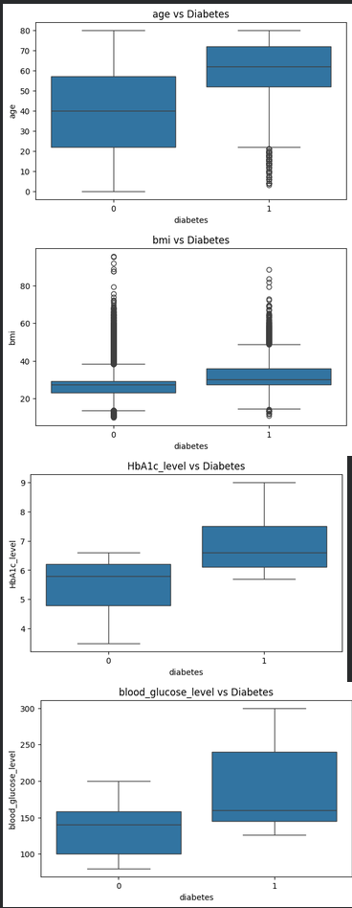
EXPLORATORY DATA ANALYSIS
Feature Patterns by Diabetes Status
Boxplots of the four strongest predictors show a clear separation between patients with and without diabetes.
Age
Diabetic patients skew markedly older, with a higher median.
BMI
Higher and more spread-out BMI values among diabetic patients.
HbA1c Level
Sharpest separation of all features — a strong predictive signal.
Blood Glucose
Consistently elevated and more variable in diabetic patients.
Diabetes Prediction Using Machine Learning
7

Slide 8
MODELING
Four Classification Algorithms
Each model was trained on the same 80/20 split and evaluated with identical metrics.
LR
DT
RF
KNN
Logistic Regression
Decision Tree
Random Forest
K-Nearest Neighbors
A simple, interpretable linear baseline for binary classification.
A tree-based model that predicts using a sequence of decision rules.
An ensemble of decision trees that votes for a more robust prediction.
Classifies each patient based on the most similar training records.
★ BEST MODEL
Diabetes Prediction Using Machine Learning
8

Slide 9
RESULTS
Model Performance Comparison
BEST MODEL
Random Forest
96.92%
test accuracy
Random Forest outperformed the other three algorithms by combining many decision trees, giving it the strongest balance of accuracy and stability on unseen test data.
Diabetes Prediction Using Machine Learning
9

Slide 10
BEST MODEL DEEP DIVE
Random Forest — Detailed Evaluation
Confusion Matrix (Test Set, n = 19,230)
Classification Report
Predicted
Class | Precision | Recall | F1-Score
No Diabetes (0) | 0.97 | 1.00 | 0.98
Diabetes (1) | 0.95 | 0.69 | 0.80
Weighted Avg | 0.97 | 0.97 | 0.97
No Diabetes
Diabetes
No Diabetes
17,472
62
Actual
530
1,166
Diabetes
How to read this
The model is excellent at ruling out diabetes (100% recall on the majority class) and correctly identifies 69% of actual diabetes cases (recall = 0.69), with 95% precision when it does flag diabetes. The lower recall on the minority class reflects the class imbalance in the dataset (~91.5% vs ~8.5%) and is a natural target for future improvement.
Only 62 false alarms and 530 missed cases out of 19,230 patients.
Diabetes Prediction Using Machine Learning
10

Slide 11
TAKEAWAYS
Key Findings & Future Improvements
FUTURE IMPROVEMENTS
KEY FINDINGS
Hyperparameter tuning
Cross-validation
✓
Blood glucose level and HbA1c level are the strongest predictors of diabetes.
✓
Age and BMI show a clear, meaningful relationship with diabetes risk.
Additional ML algorithms
Feature importance analysis
✓
Hypertension and heart disease add useful, if smaller, predictive signal.
Address class imbalance (precision/recall focus)
Deploy as a web application
✓
Ensemble methods (Random Forest) outperform single models on this data.
Diabetes Prediction Using Machine Learning
11

Slide 12
PROJECT SUMMARY
A Reliable Foundation for
Diabetes Risk Prediction
Across four models trained and evaluated on 100,000 patient records, Random Forest delivered the strongest and most balanced performance — 96.92% test accuracy — driven primarily by blood glucose level, HbA1c level, age, and BMI.
Disclaimer: developed for educational and machine-learning practice purposes only. Not a medical diagnostic tool.
Thank You
Mohammed Dahi · Machine Learning & Data Analysis Project

