Slide 1
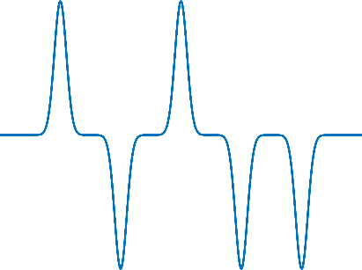
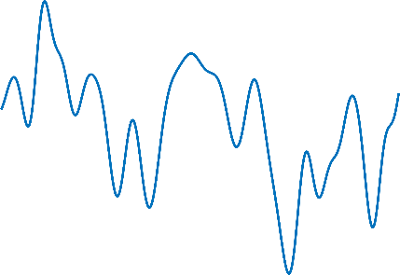
Recovery of signal distorted by nonlinearity in optical communications using deep learning
DL PROJECT 2021

Slide 2
Content
Problem description
Coherent communication process
Main challenges
Data modeling
Output data decoding
Workflow
Data preparation
Metric estimation
Base work
Models
Convnet
FC-model with parallel layers
FC-model with concatenation
Results
‹#›

Slide 3
Problem description
‹#›

Slide 4

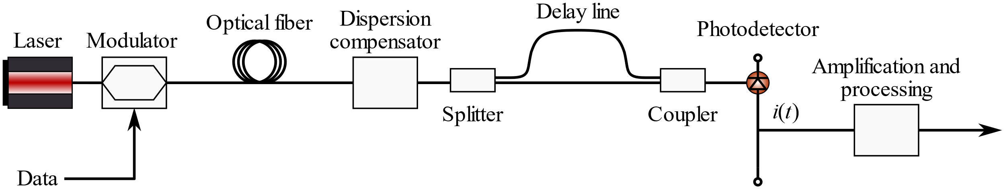

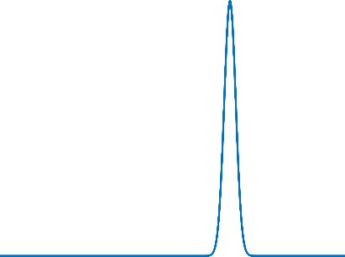
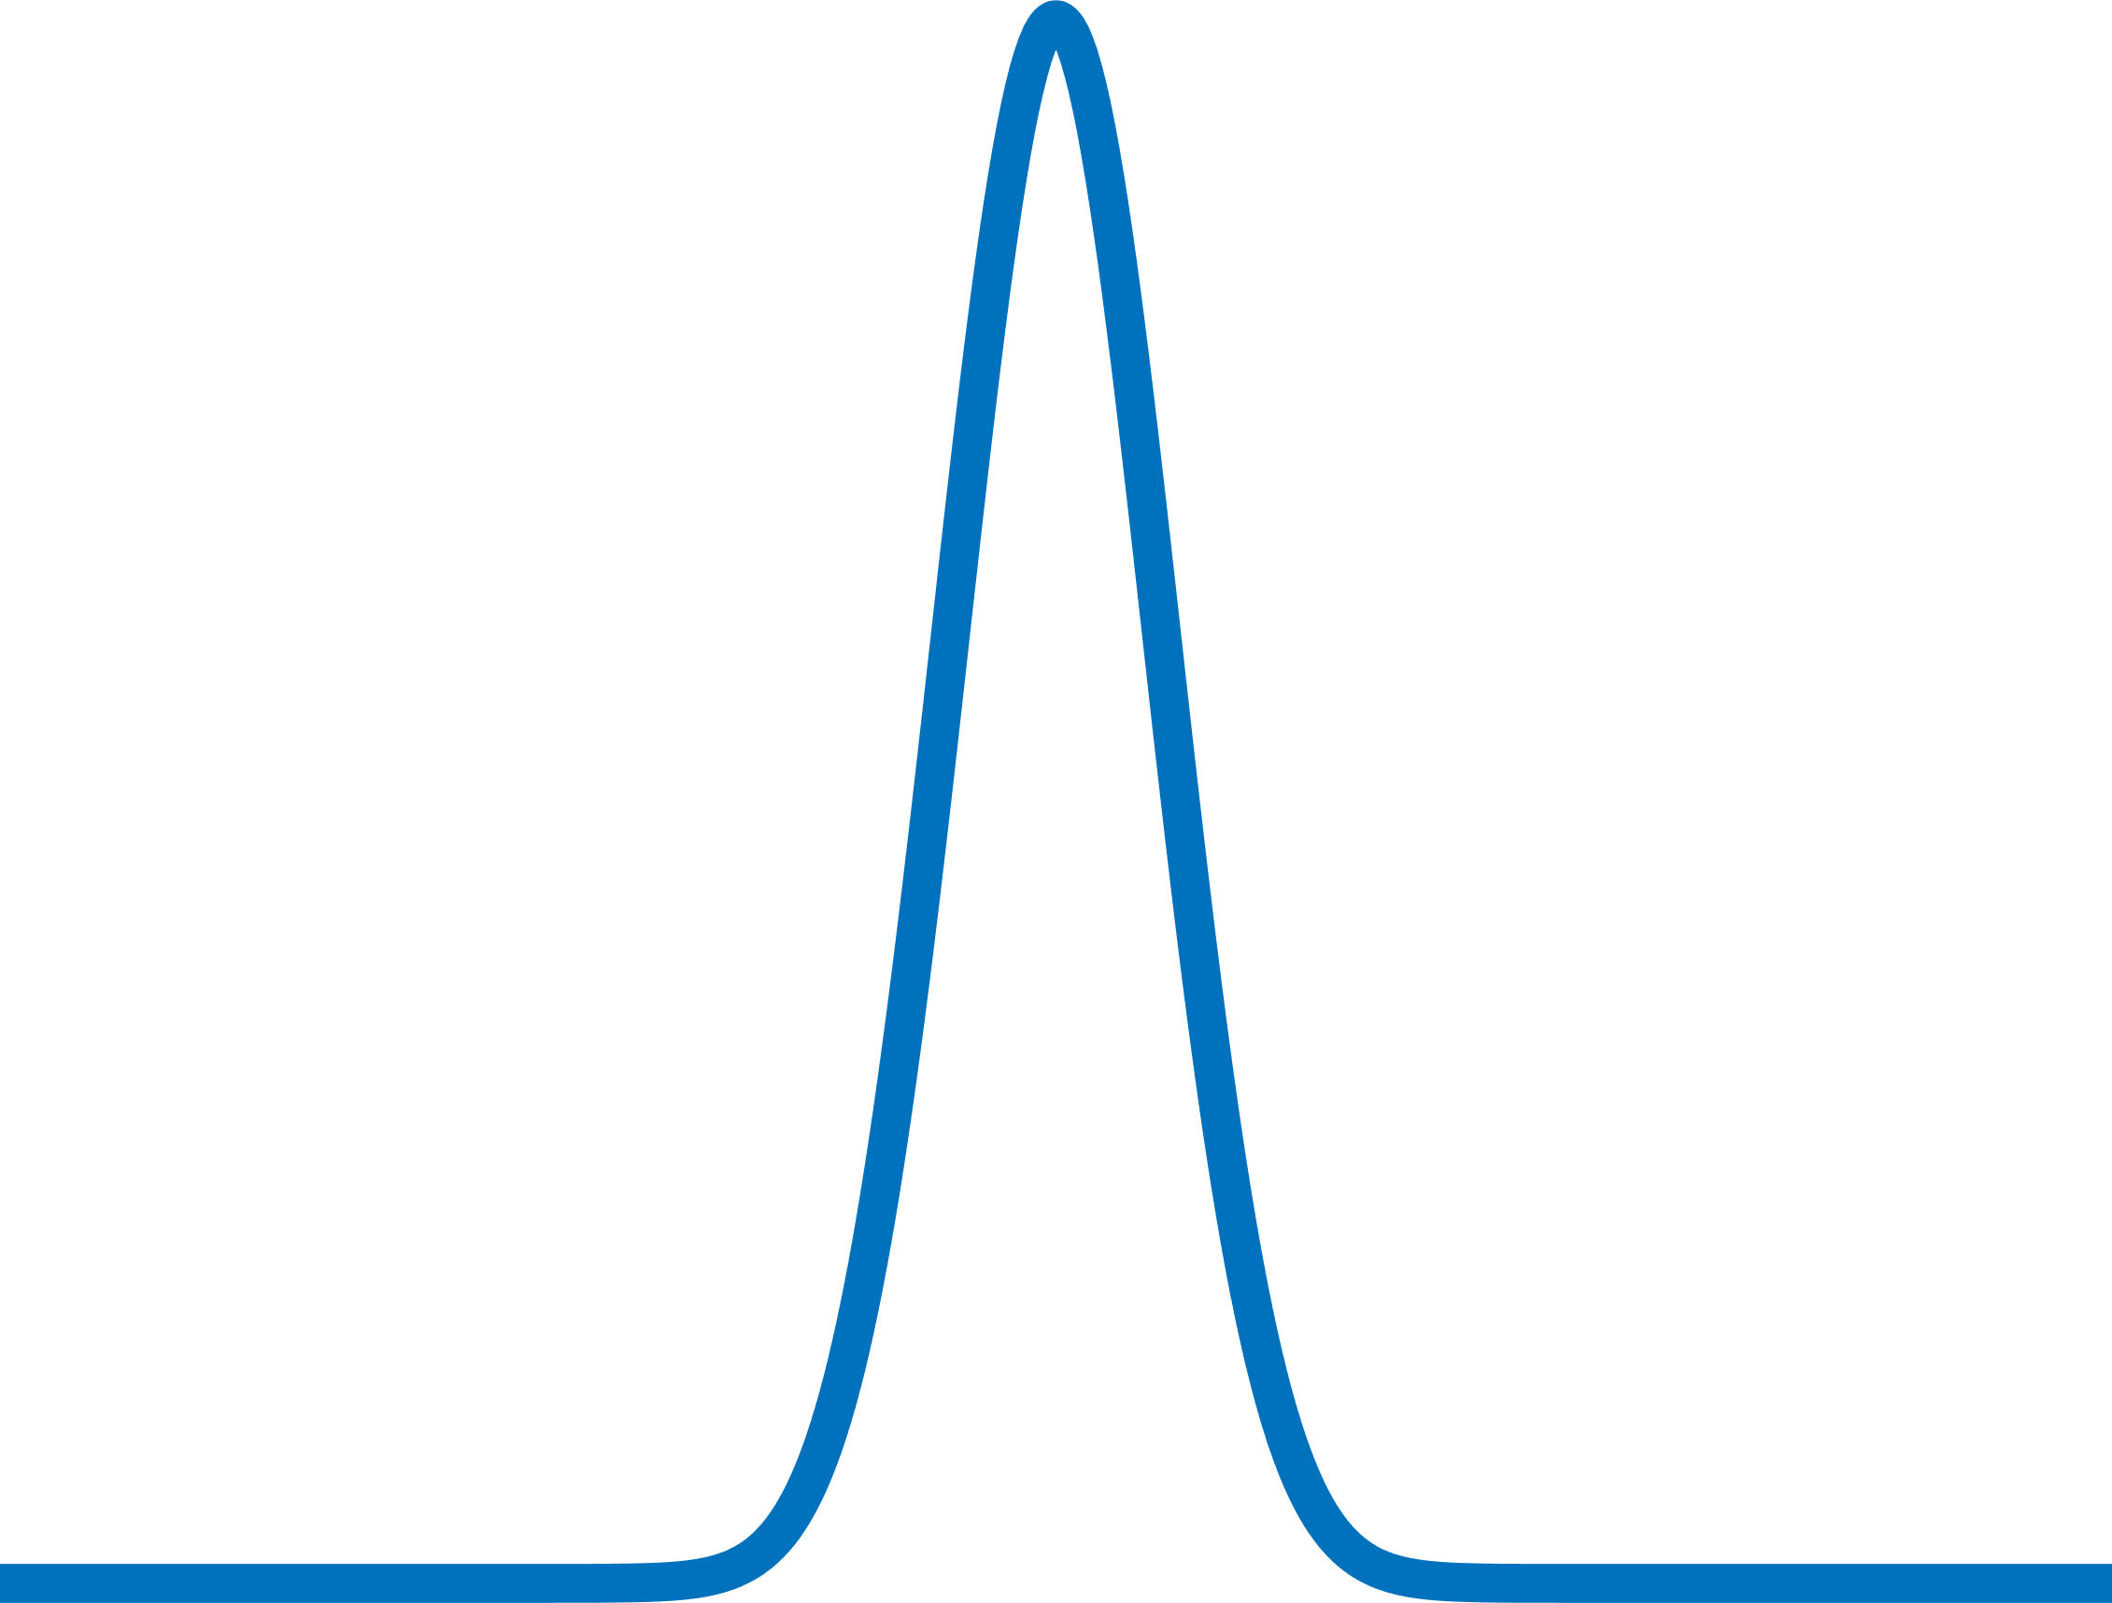
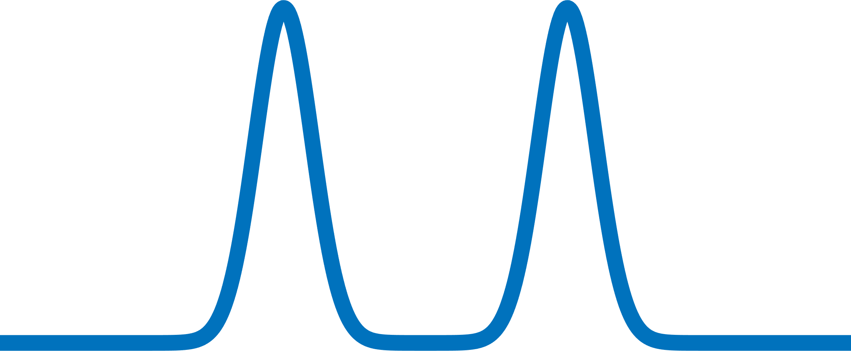


Coherent communications. Ideal case
Decoded signal
Transmitted signal
Decoding:
Same phase -> logical “1”
Opposite phase -> logical “0”
‹#›

Slide 5
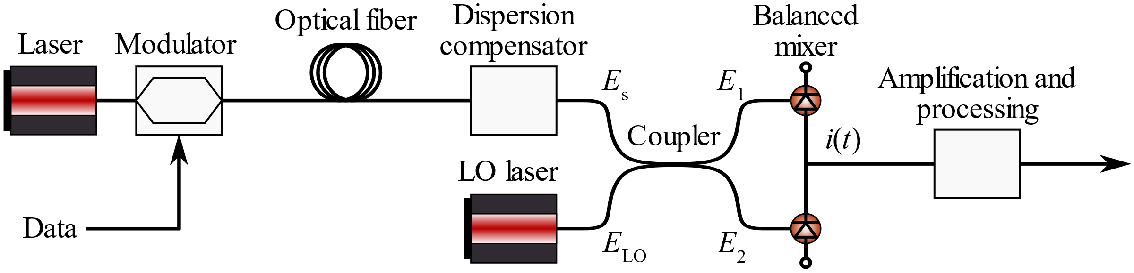


Coherent communications. Real case
Digital back propagation
‹#›

Slide 6
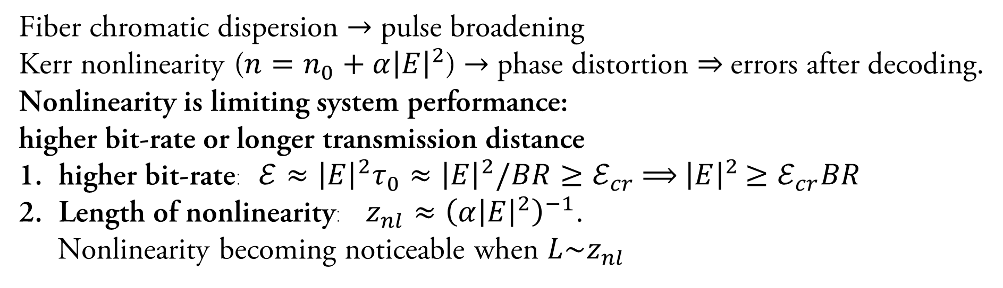


Main challenges
‹#›

Slide 7
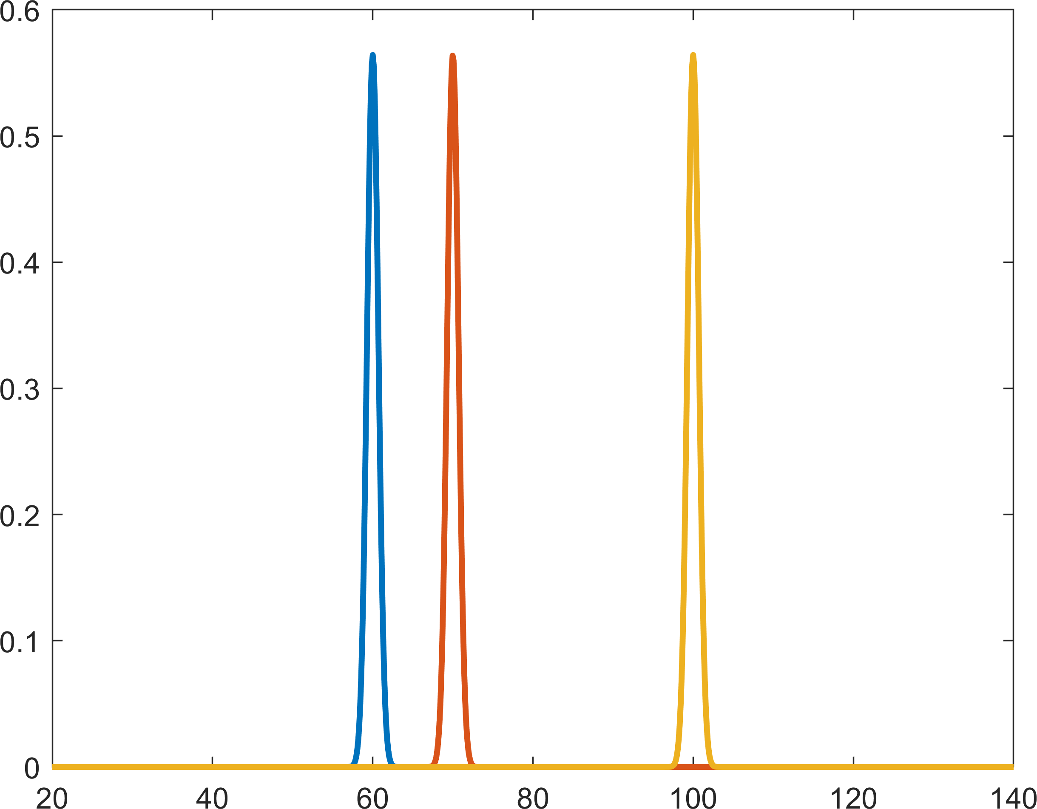
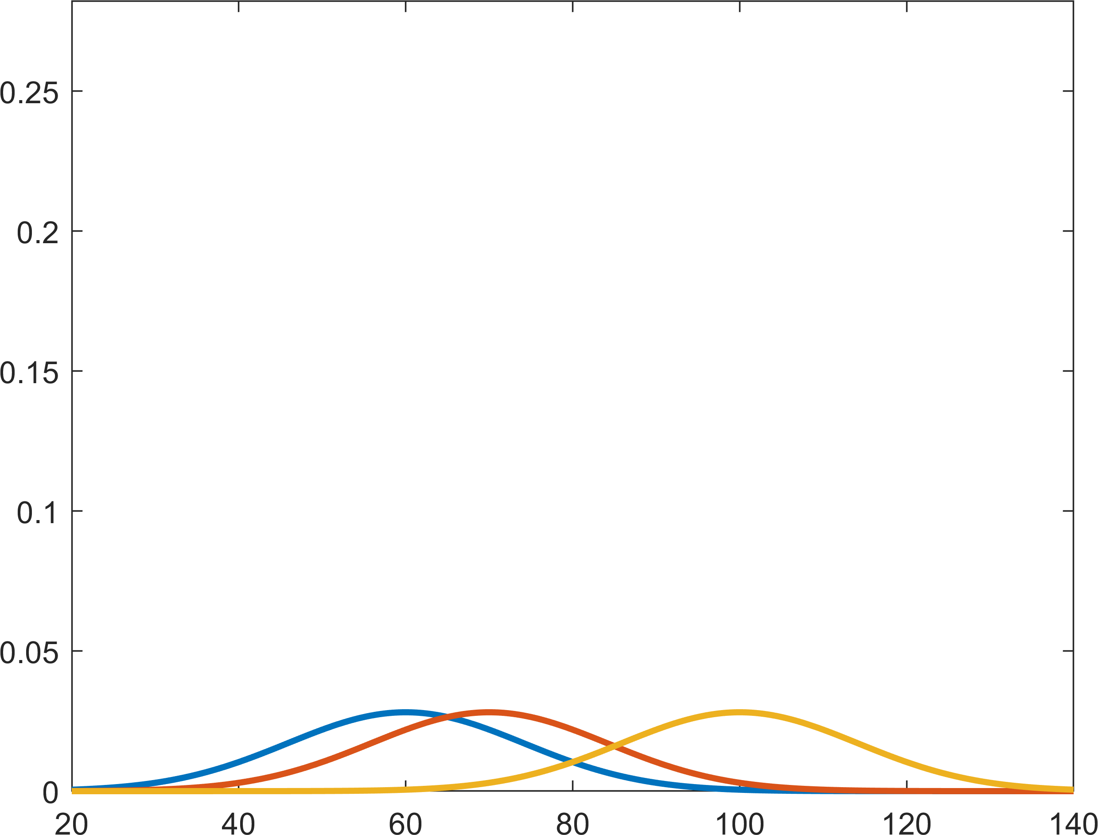
Mamyshev effect
Pulses overlapping
Has the Gaussian shape
Collects energy from the triplet surrounding pulses
For wave interaction is a mechanism that create energy redistribution along bit pattern which lead to amplitude jitter of the output signal – Mamyshev effect
‹#›

Slide 8
Data modeling
‹#›

Slide 9
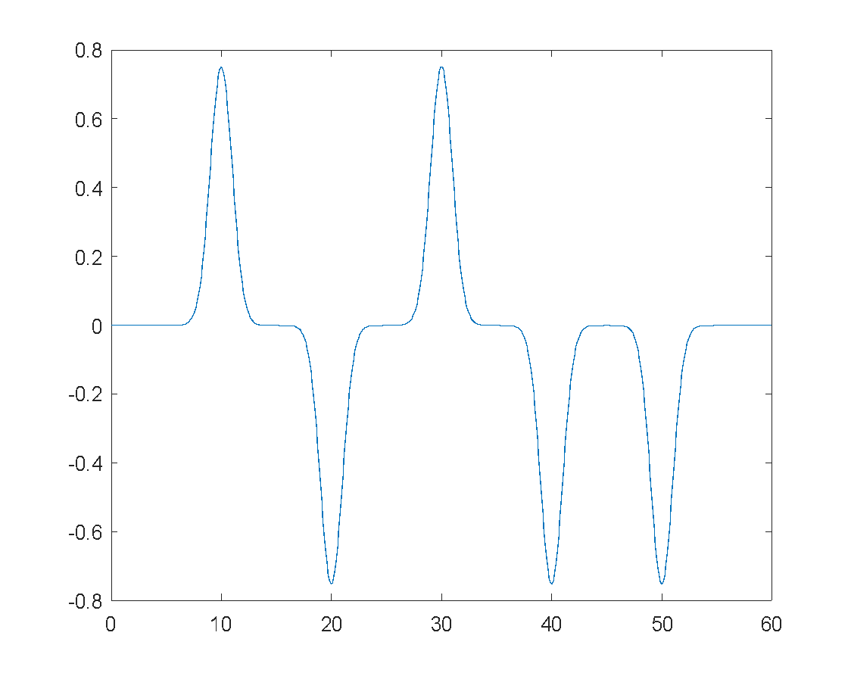
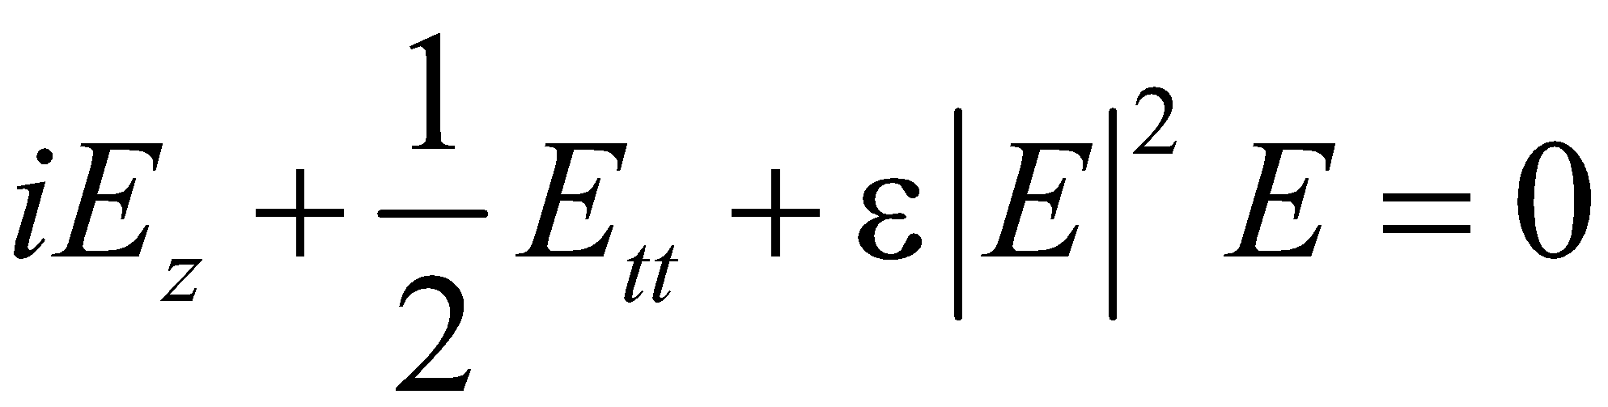
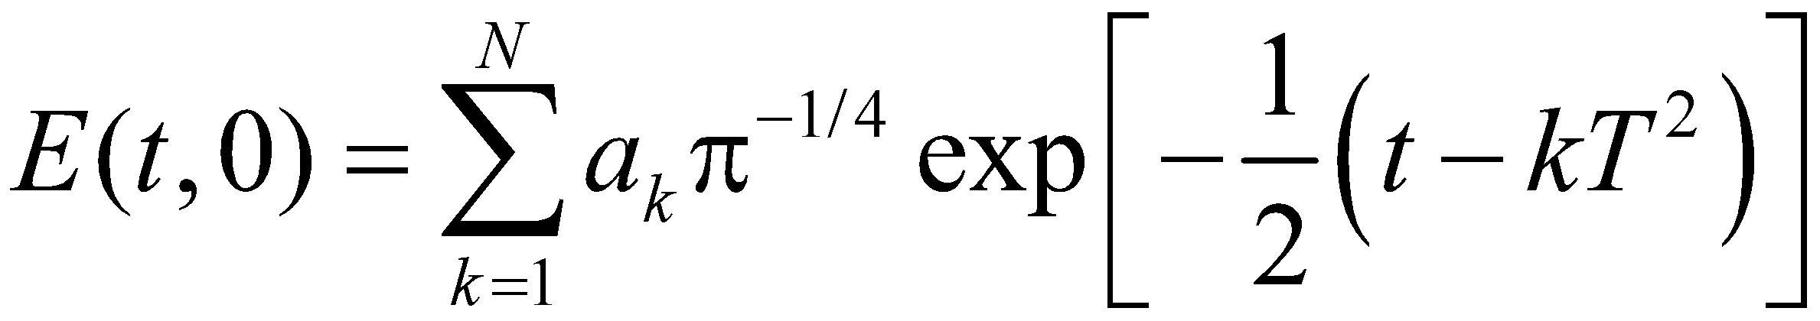
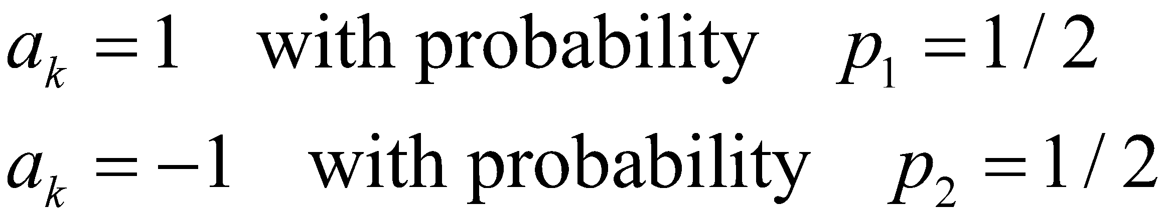
Modeling equation
Dimensionless NLS:
(7)
Bit-sequence launched at the front end of the system is represented by periodic train of gaussian pulses with Differential Phase Shift Keying (DPSK)
(8)
(9)
‹#›

Slide 10
Output data decoding
‹#›

Slide 11
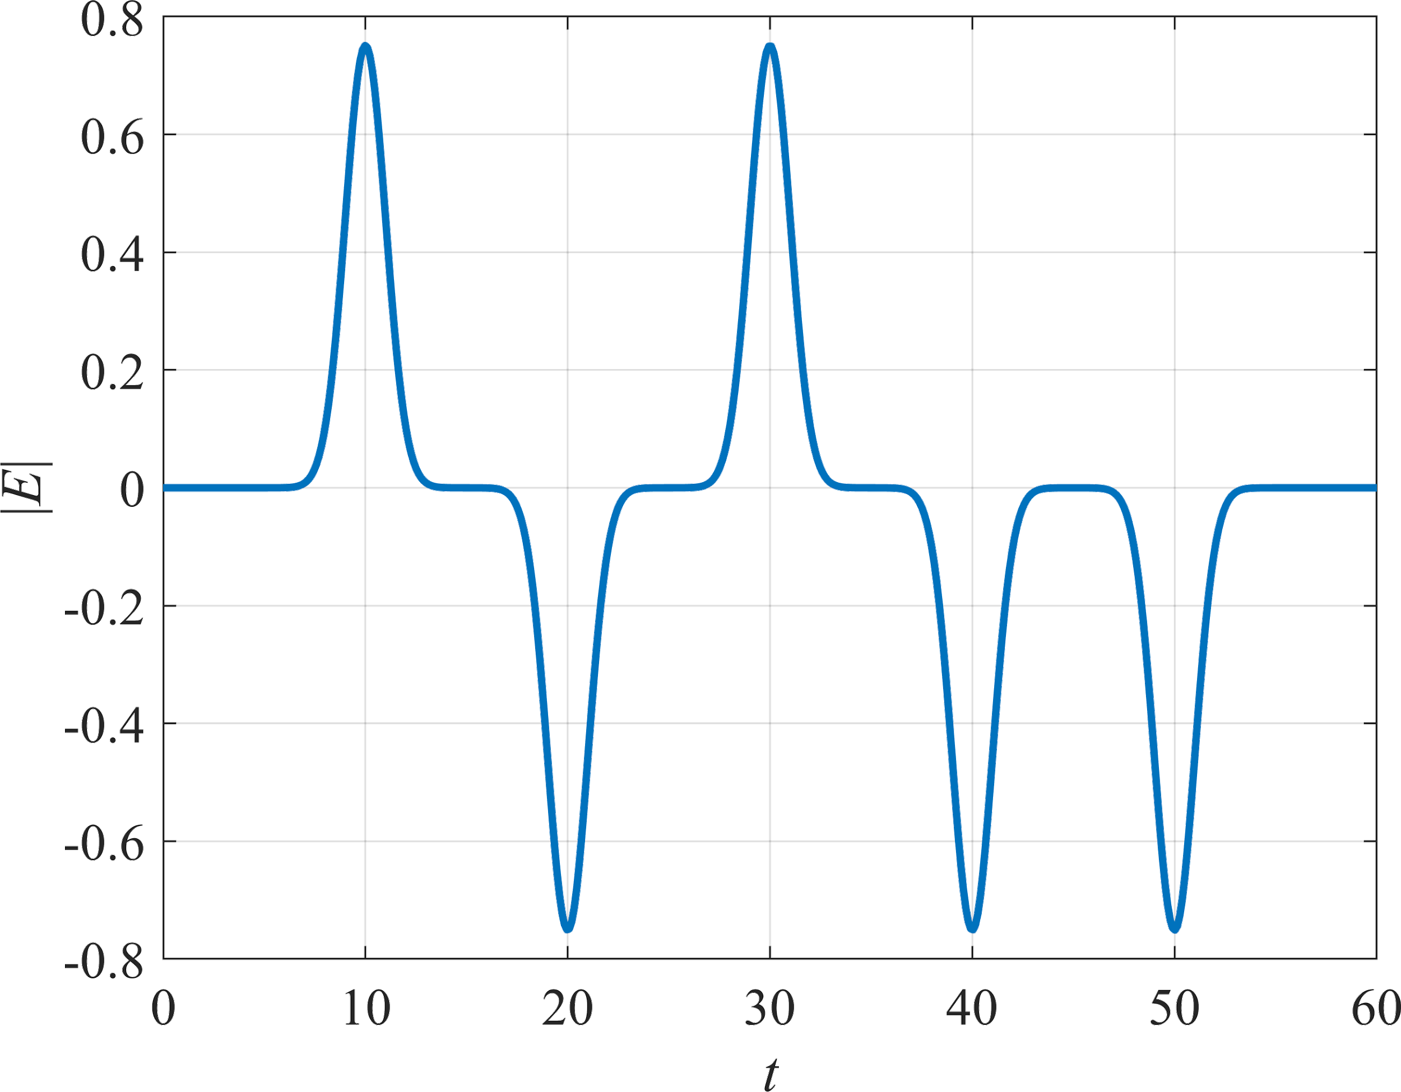
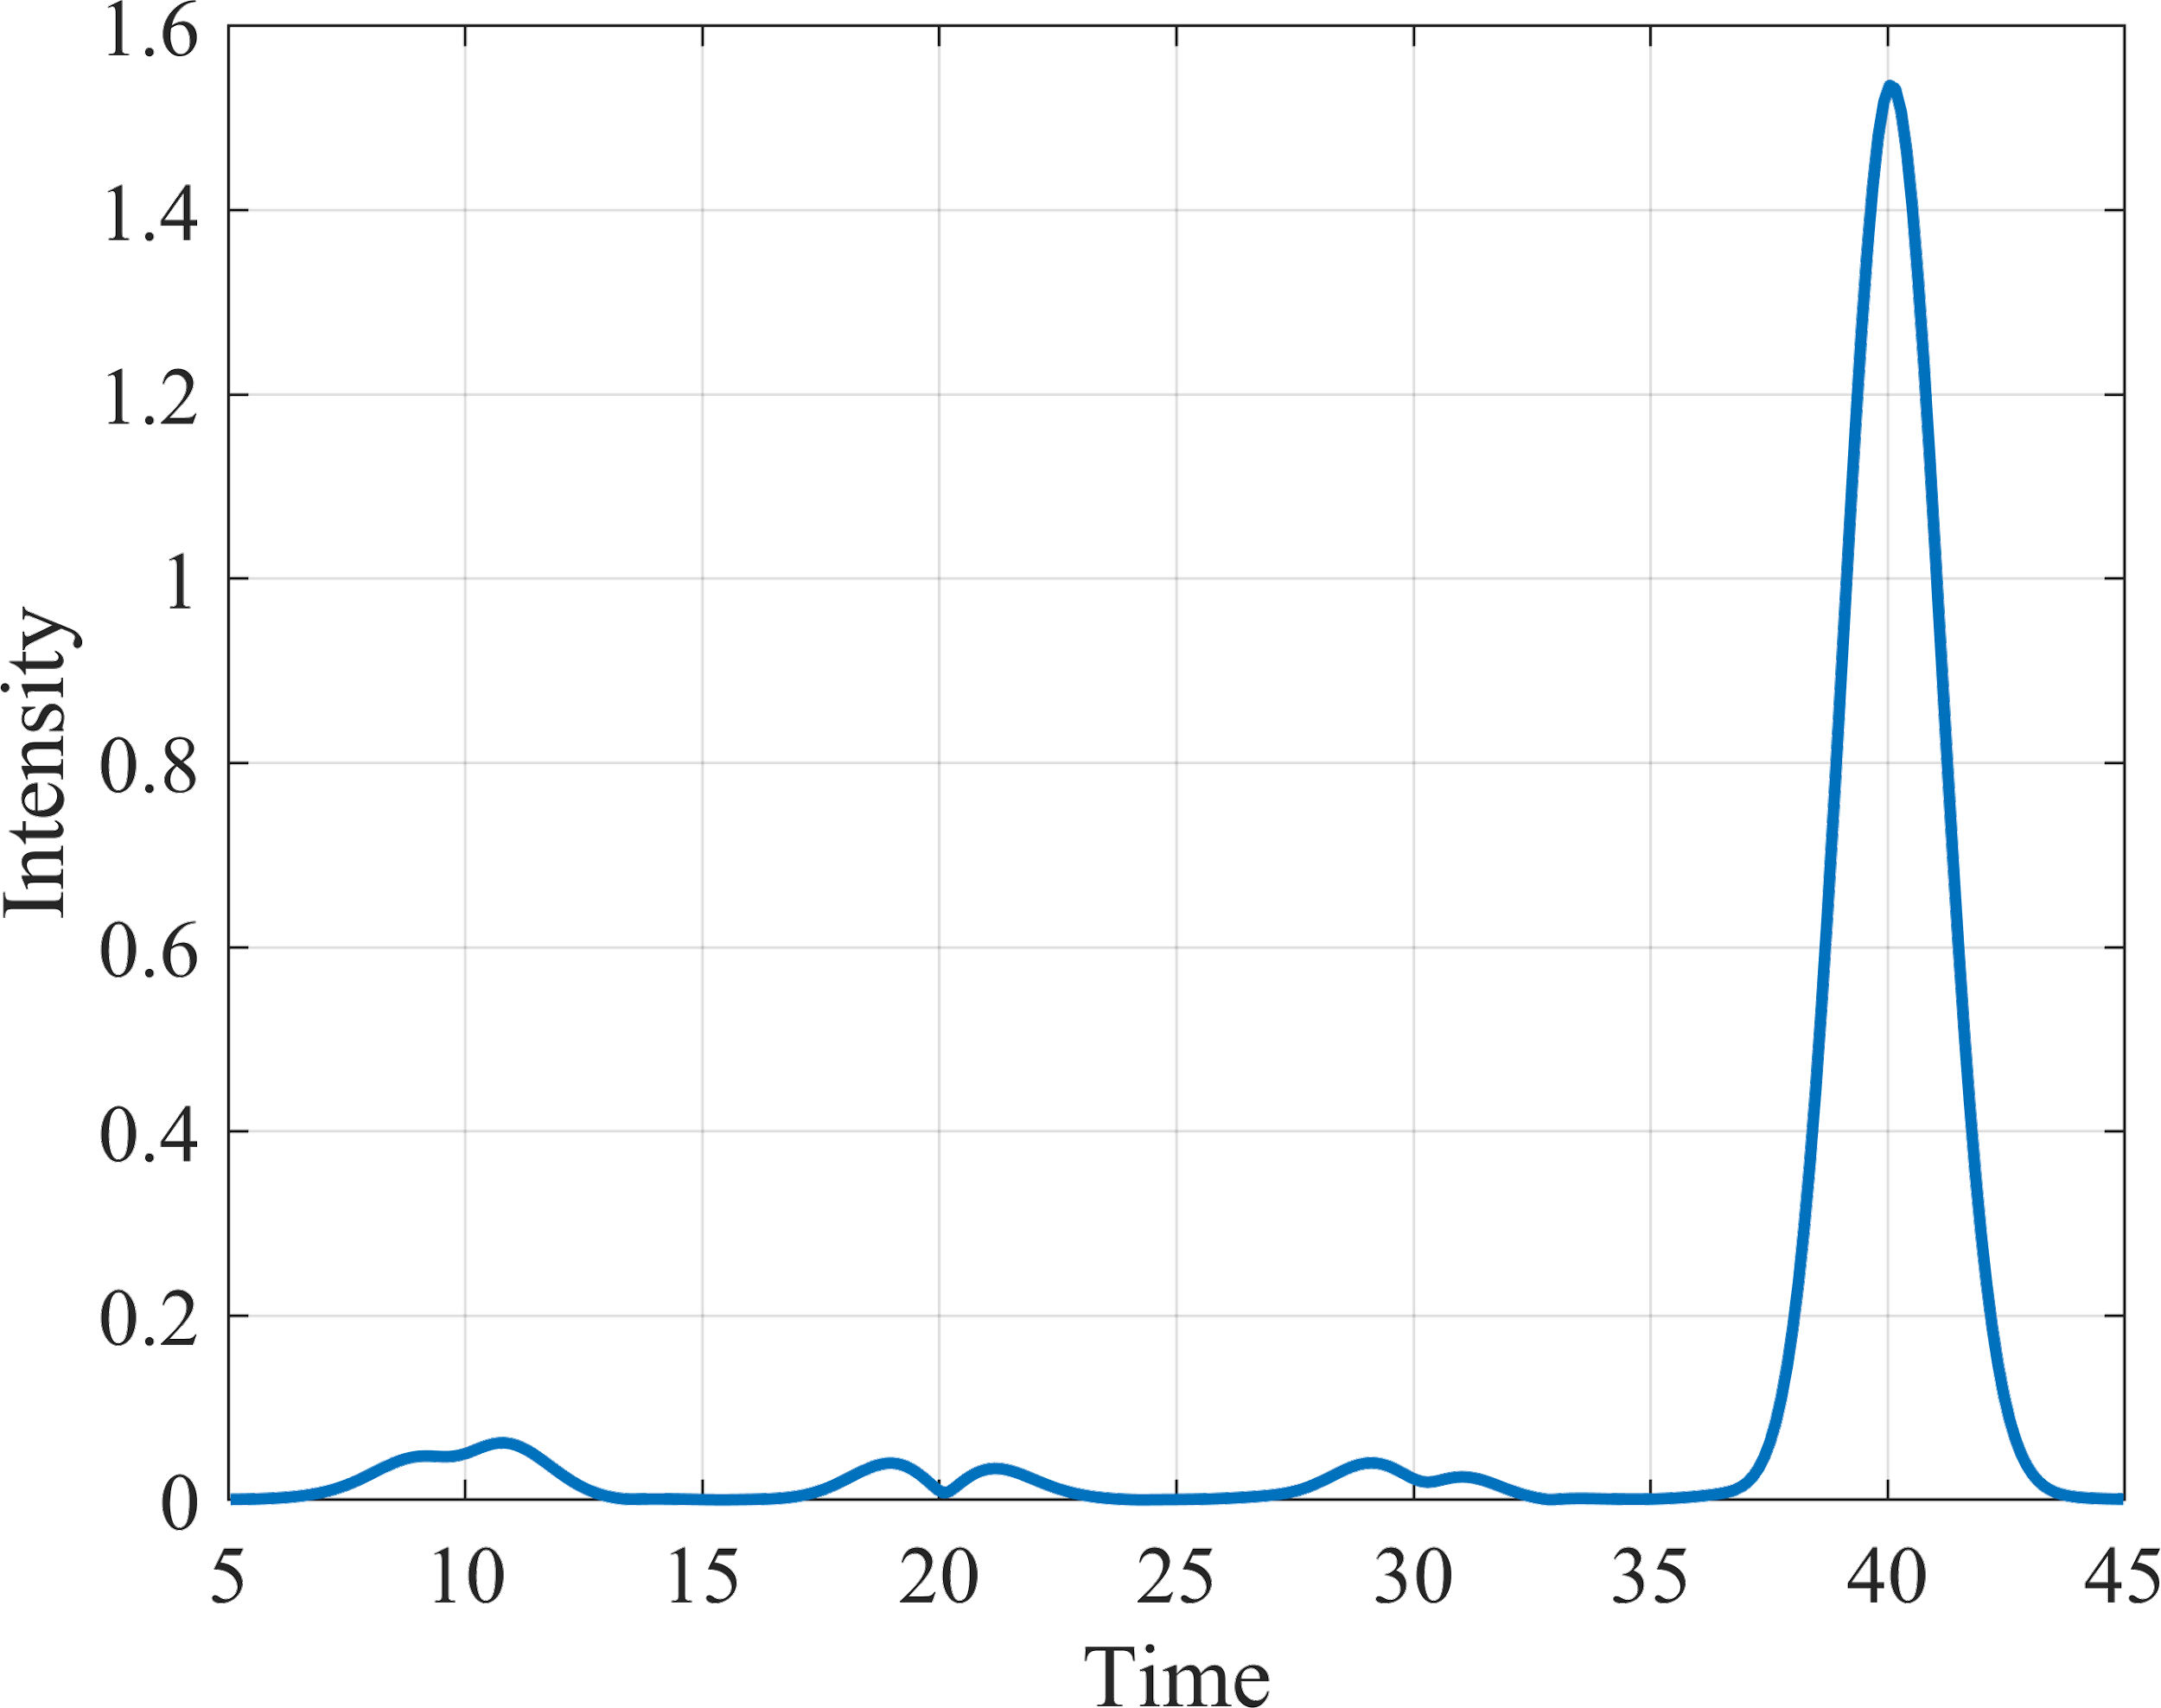
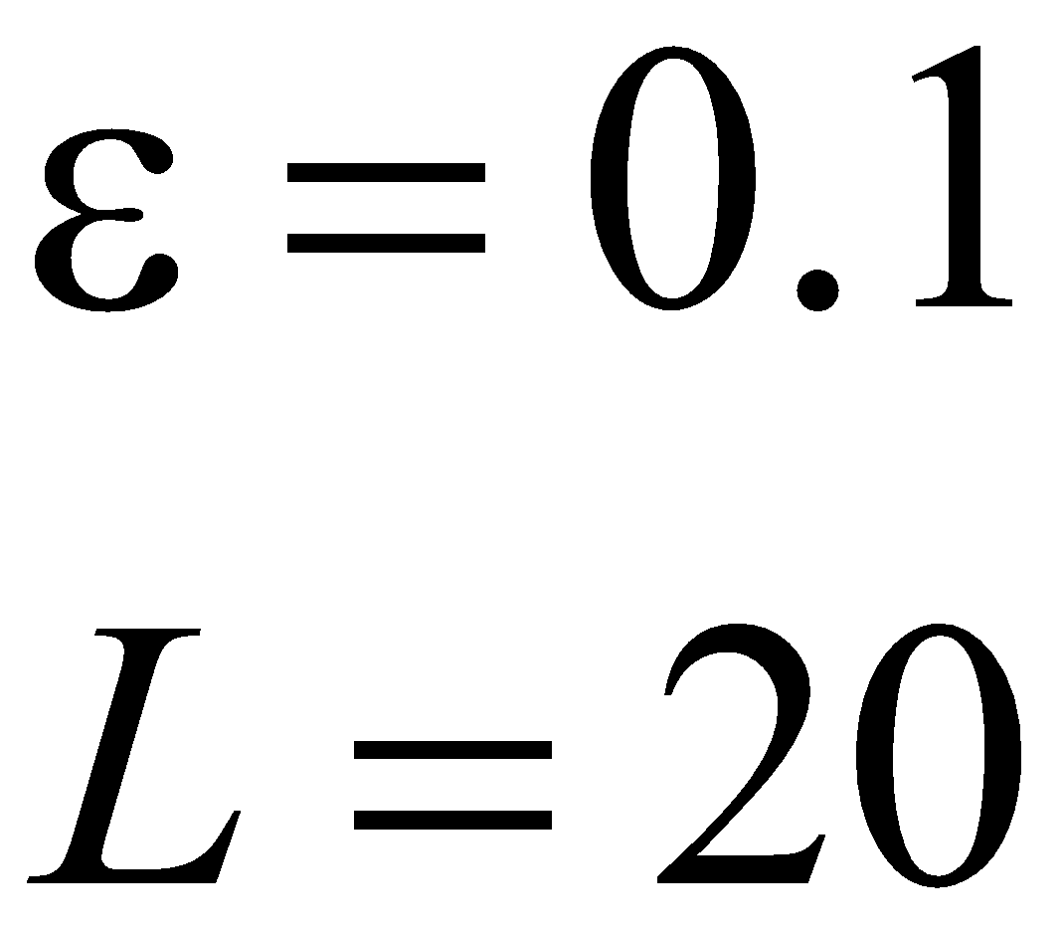
Decoding. Modeling case
Input signal
Output decoded signal
“Ghost pulses”
Not zero
0
0
0
1
Encoded sequence: 0 0 0 1
‹#›

Slide 12
Direct decoding. Modeling case
Decoding bit sequence:
0 0 0 1
Wi <Wth
W4 >Wth
0
0
0
1
BER - Bit Error Ratio
Wi - energy of ith pulse
‹#›
Wth = 0.5*W(ligical 1) - threshold

Slide 13
Workflow
‹#›

Slide 14
Workflow
Data preparation
Data generation
Decoding
BER and
Q factor
Forward digital propagation
Model
Decoding
‹#›

Slide 15
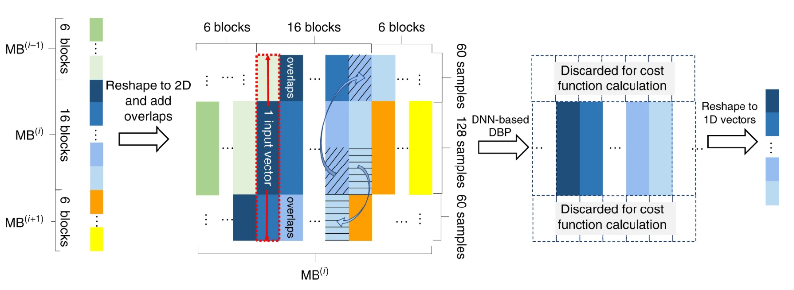
Data preparation
1d time data - simple time series
2d time data - regrouping time in 2d blocks
‹#›
Source: https://www.nature.com/articles/s41467-020-17516-7

Slide 16
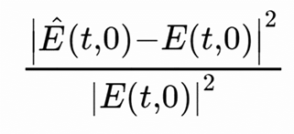
Metric estimation
Loss: Error Vector Magnitude (EVM) and MSE
Evaluation: BER and Q factor
from dataset
Decoding
0 0 0 1 ...
BER = Nerror/Ntotal
(the smaller the better)
Decoding
0 0 1 1 ...
model output
‹#›

Slide 17
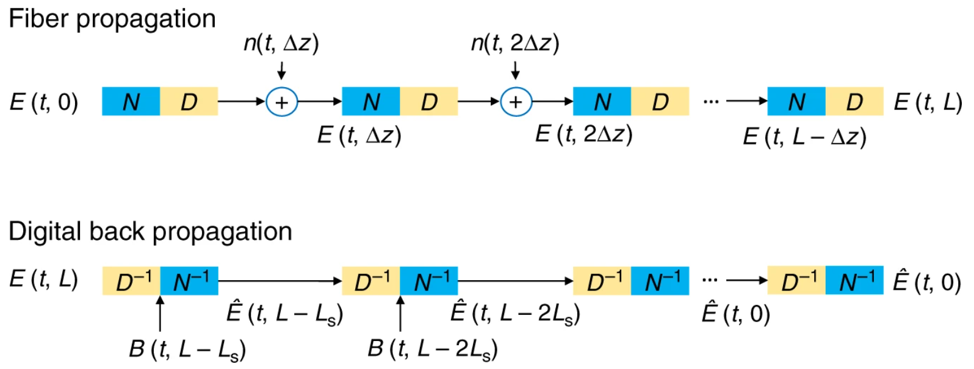
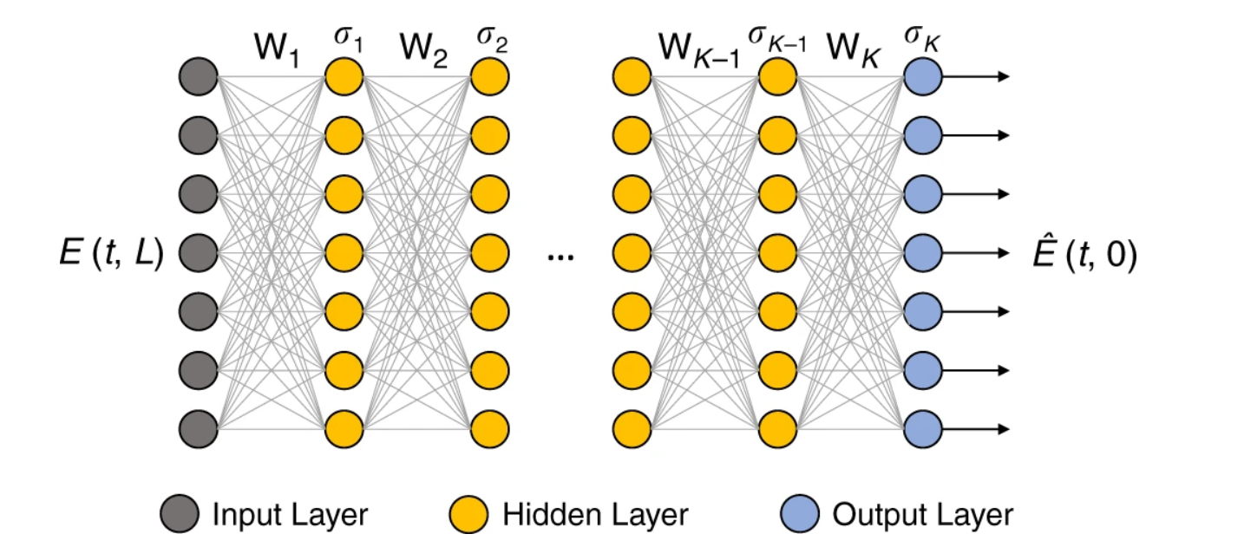
Base work: DNN based DBP
‹#›
Source: https://www.nature.com/articles/s41467-020-17516-7

Slide 18
Models
‹#›

Slide 19
Convnet
‹#›

Slide 20
FC-model with parallel layers
‹#›

Slide 21
FC-model with concatenation
‹#›

Slide 22
Results
‹#›

Slide 23
Literature
Nonlinear optics: Agrawal, G. P. (2000). Nonlinear fiber optics.
Coherent communications: https://www.osapublishing.org/jlt/abstract.cfm?URI=jlt-34-1-157
DNN based DBP: https://www.nature.com/articles/s41467-020-17516-7
Another Textbooks for Additional Reading:
B E A Saleh, M C Teich, “Fundamentals of Photonics”, ISBN 978 0 471 35832 9 2007
G P Agrawal, “Fiber optic communication systems”, ISBN 0 471 21571 6 John Wiley Sons Inc New York, 2002
Ivan P Kaminow Tingye Li, Alan E Willner “Optical Fiber Telecommunications Systems and Networks”, SIXTH EDITION, ISBN 978 0 12 396960 6
‹#›

Slide 24
Thank you for attention
Our team:
Ilya Kuk
Author of the project idea. Work on Data generation code.
Alexey Larionov
Author of the project idea. Work on Data generation code.
Razan Dibo
Work on Data generation code.
Sergei Gostilovich
Work on metrics (BER). Worked on presentation as well as report.
Mohammed Deifallah
Work on Data generation code.
Stanislav Krikunov
Work on Data generation code.
Alexander Blagodarnyi
Work on Data generation code.
‹#›

