Slide 1


Sentiment
Analysis

Slide 2

P365 Group-1 members:
Name: B Hemanth Kumar
Mail.id: bomminenihemanthkumar9@gmail.com
Name: Mohammed Fayaz Ahamed
Mail.id: mohammedfayazahamed20@gmail.com
Name: Asif Mallick
Mail.id: asifmallick1007@gmail.com
Name: Krishi Mahesh Gohil
Mail.id: gohilkrishi@gmail.com
Name: VANKAYALA SAIKUMAR
Mail.id: saik27104@gmail.com
Name: Devanshi Vipul Goradia
Mail.id: devanshigoradia1997@gmail.com
Name: Rohit Sanjay Pawar
Mail.id: pawarrohit027@gmail.com

Slide 3

Slide 2: Introduction
Introduction
Process of analyzing text data to determine sentiment polarity
Customer feedback analysis
Brand reputation management
Market research insights

Slide 4
Overview of Sentiment Analysis Process
Gather textual data from various sources
Tokenization, stop word removal, stemming, lemmatization
Text preprocessing
Train machine learning models on labeled data
Model training
Assess model performance using metrics like accuracy, precision, recall
TF-IDF vectorization to represent text as numerical features
Feature extraction
Deployment
Model evaluation

Slide 5
Dataset Description
Dataset used for sentiment analysis
Number of samples: 305
Features: review text, sentiment label
Sample review texts
"Great product! Highly recommended."
"Disappointed with the quality. Will not purchase again."

Slide 6
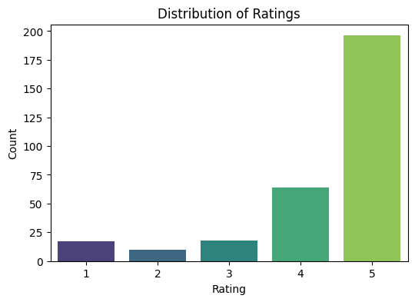
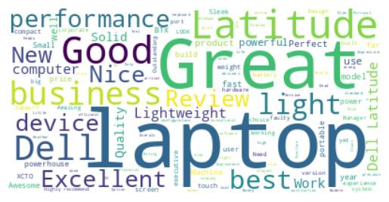
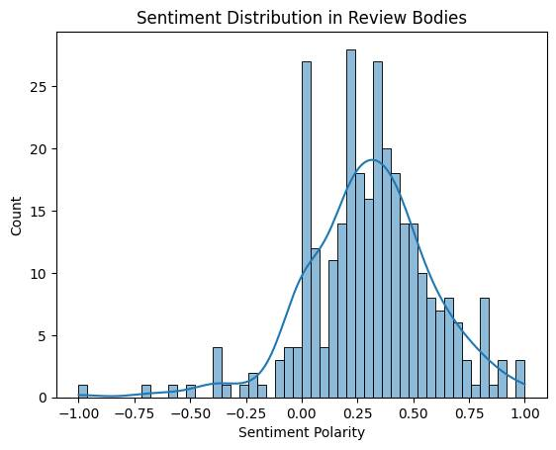
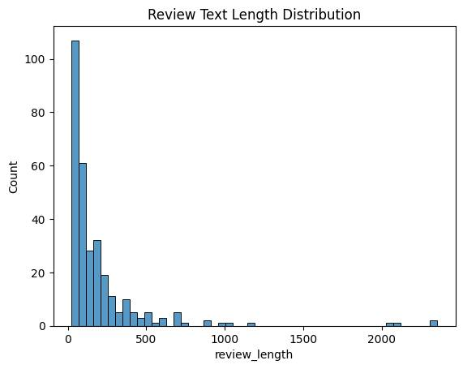
Word Cloud of All Reviews

Slide 7

Preprocessing Text Data
Text Pre-processing Steps
Tokenization: Split text into words or tokens
Stop word removal: Remove common words like "and", "the"
Stemming and Lemmatization: Reduce words to their base form
Example of preprocessed text
Original: "I loved this product."
Preprocessed: "love product"

Slide 8
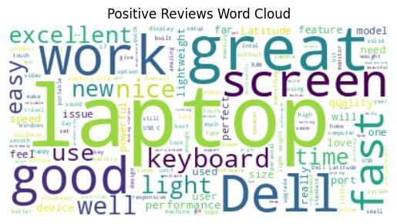
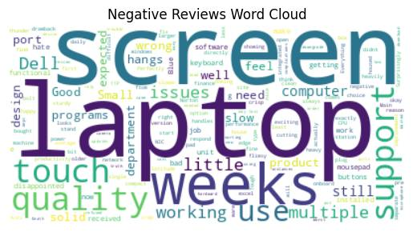

Slide 9
Feature Extraction
Transform
Feature extraction with TF-IDF
Transform text data into numerical vectors
Weight
Weight terms based on their frequency in documents
Example of TF-IDF vectorization
Term
Term "great" has higher weight due to frequency and importance in text

Slide 10
Machine Learning Models
Naive Bayes
Logistic Regression
Support Vector Machine
Random Forest
Discuss trade-offs in model complexity, interpretability, and performance

Slide 11
Model Training and Evaluation
Split
Split data into training and testing sets
Train
Train each model on training data
Evaluate
Evaluate model performance using accuracy
Visualize
Visualize true positive, true negative, false positive, false negative

Slide 12
Deployment with Streamlit
We utilize Streamlit to create the web application.
The design includes UI elements and functionalities that simplify entering reviews into the designated review box.
Upon clicking the 'Analyze' button, the application promptly displays the sentiment of the review.
The web application is accessible through the URL provided by Streamlit.

Slide 13
Deployment with Streamlit
Import the libraries, load the trained random forest model.
Include the text preprocessing and vectorizing to make the model understand.
Run the web application to get the user desired outputs.

Slide 14

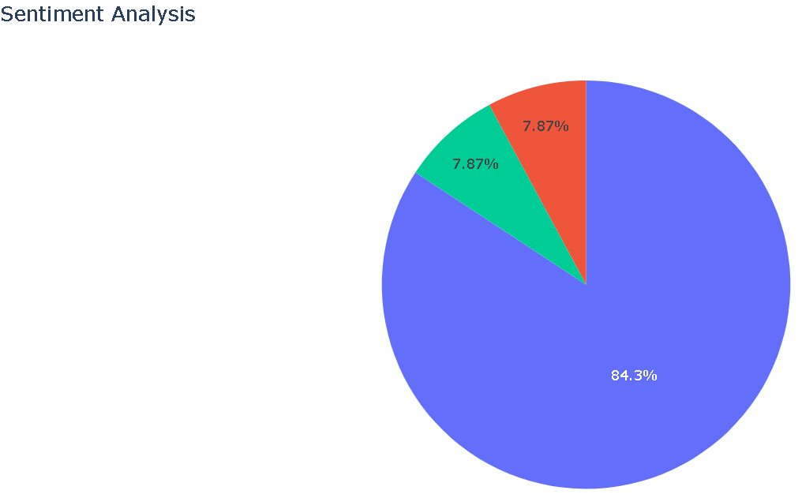
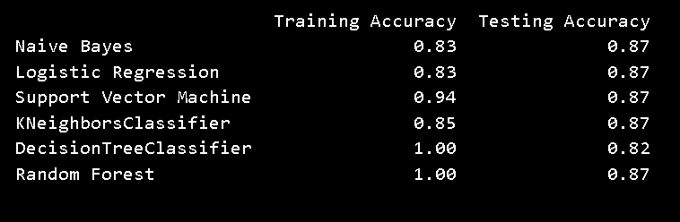
Results and Insights
Overview of model performance metrics

Slide 15

Slide 13: Conclusion
Sentiment analysis process
Data preprocessing techniques
Model training and evaluation
Deployment with Streamlit
Importance of sentiment analysis
Enhances customer experience
Conclusion:
Summary of key
points covered
Thank you

Slide 16
Recommendations
We use Random Forest to predict the outcome, but there are many other models available in the market that can be adopted for potentially better results.
Our challenge was to build the model with fewer records. It is suggested to add more data for the model to predict accurately.
It is highly recommended to perform the deep learning techniques for to capture complex patters in case of an imbalanced dataset.

