Slide 1
CHRONIC INFLAMMTION
Healing and Repair

Slide 2
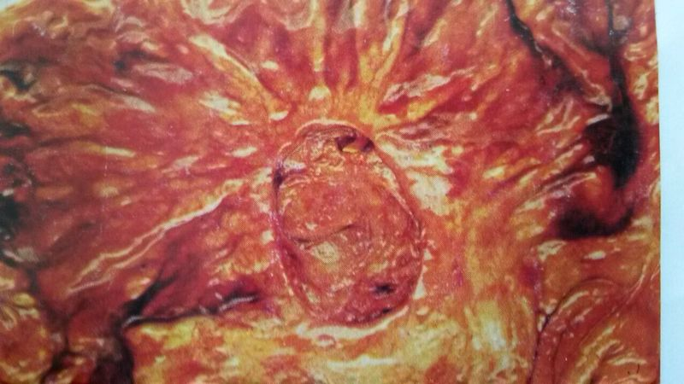
↓
Ulcer
→
←
Chronic Peptic Ulcer : Stomach

Slide 3
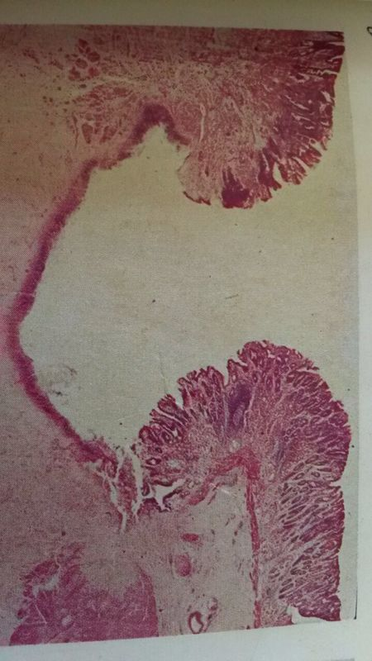
←
↑
Chronic Peptic Ulcer : Stomach

Slide 4
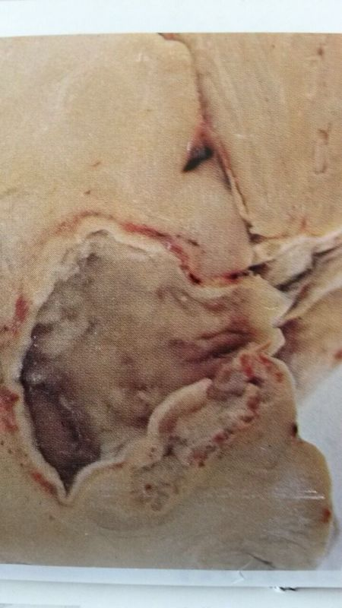
→
←
Abscess
Chronic Abscess : Brain

Slide 5
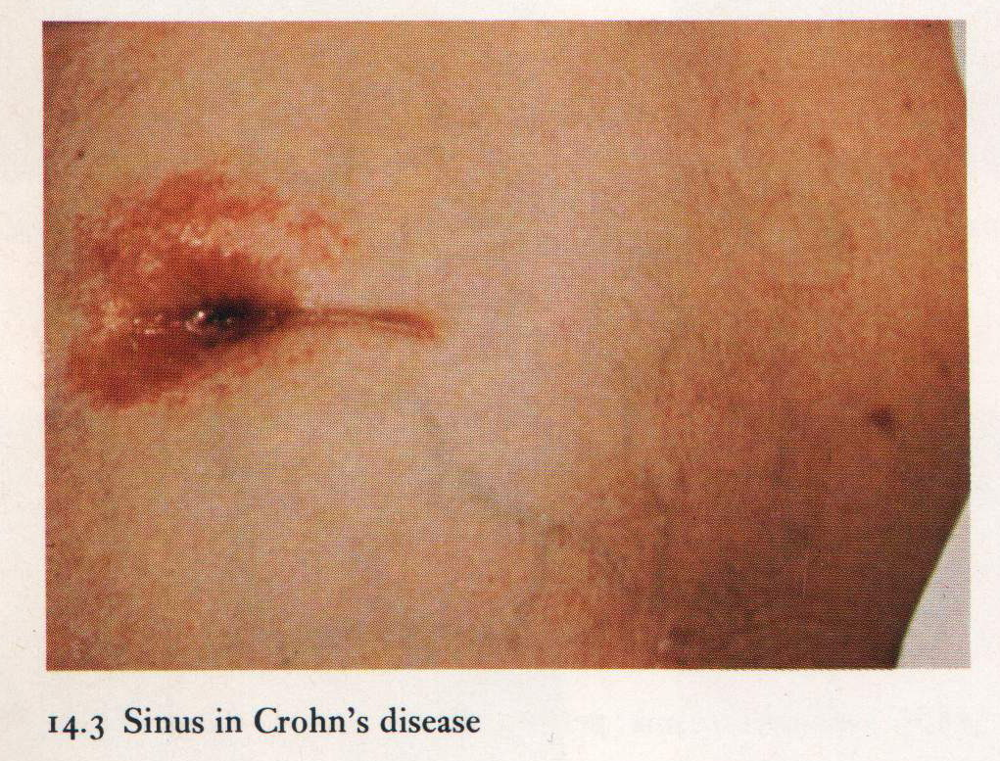
SINUS
↓
Abdominal Wall
Chronic Sinus in Crohn Disease

Slide 6
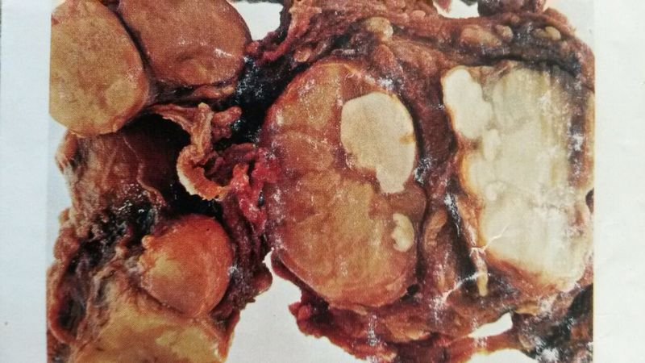
Caseation Tuberculosis : Lymph Nodes

Slide 7
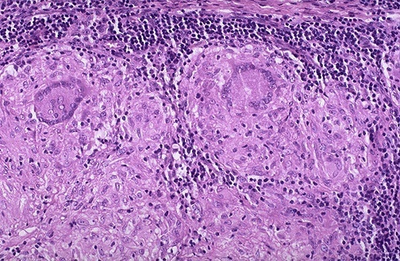
↑
→
Langhans Giant Cells
Tuberculosis : Lymph Node

Slide 8
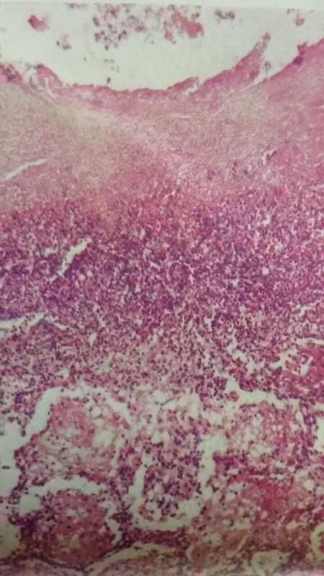
←
Cavity
Tuberculous Pneumonia : Lung

Slide 9
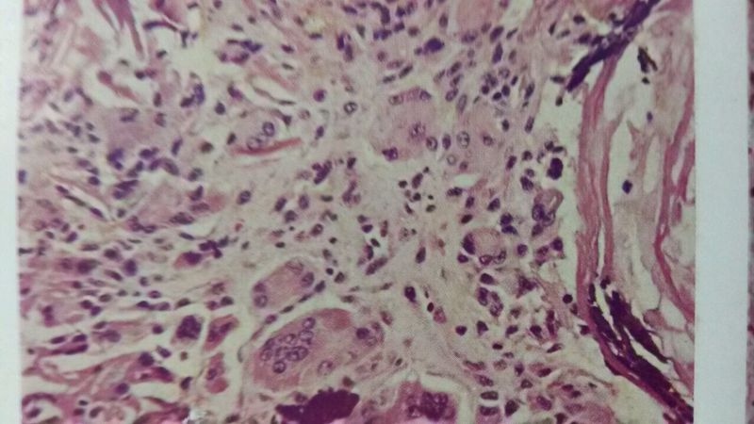
→
Foreign body
Giant Cell
Keratin
↓
Ruptured Epidermoid Cyst Foreign-Body Giant Cell Reaction

Slide 10
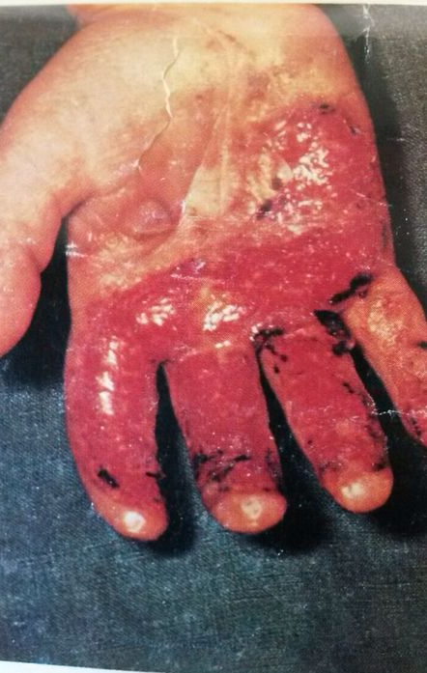
Granulation Tissue
(Skin)

Slide 11
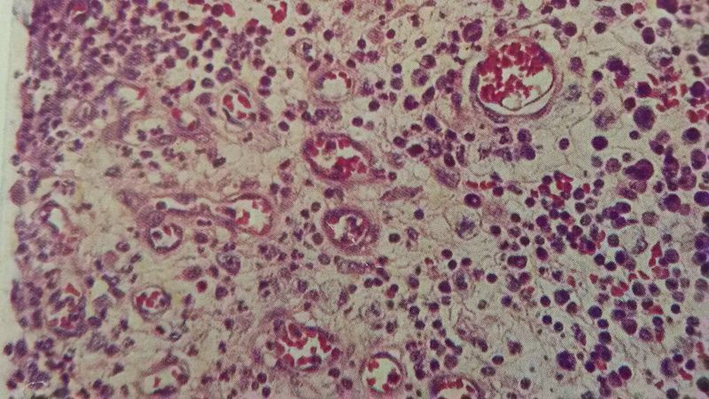
Granulation Tissue

Slide 12
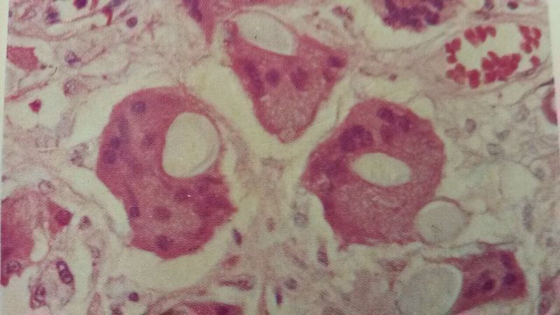
←
→
Suture Material
Healing Wound : Skin

Slide 13
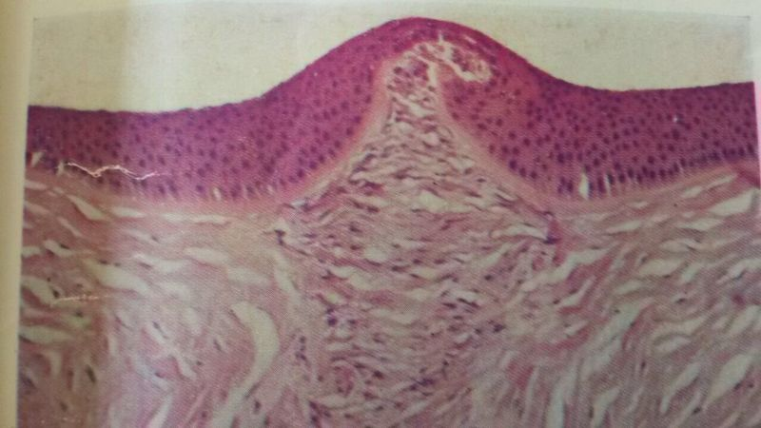
Scar
Healing Wound : Cornea

Slide 14
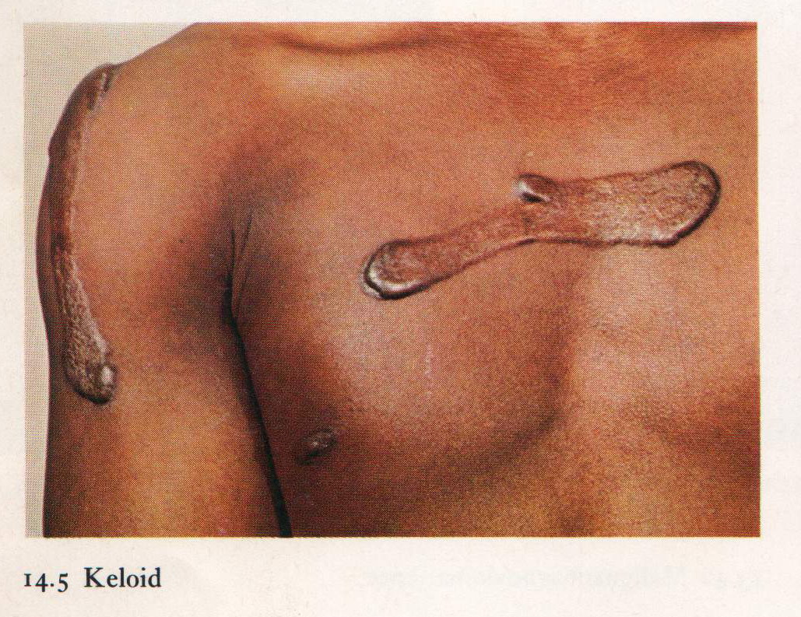
Keloid - skin

Slide 15
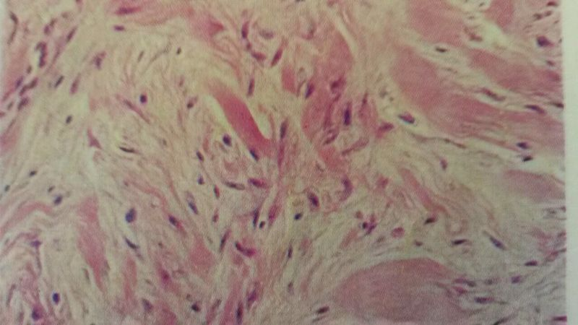
Keloid : Skin

