Slide 1
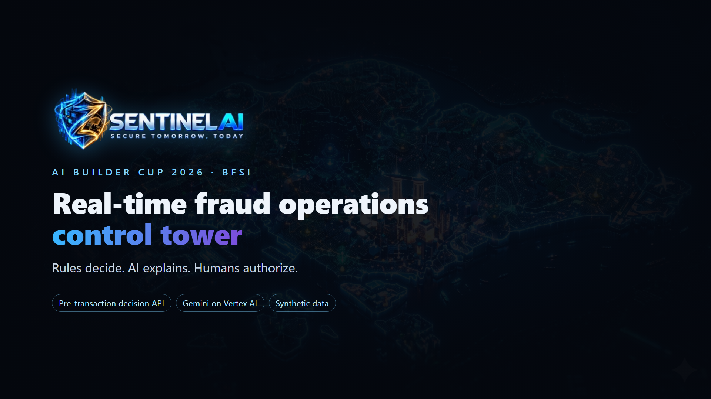


Slide 2
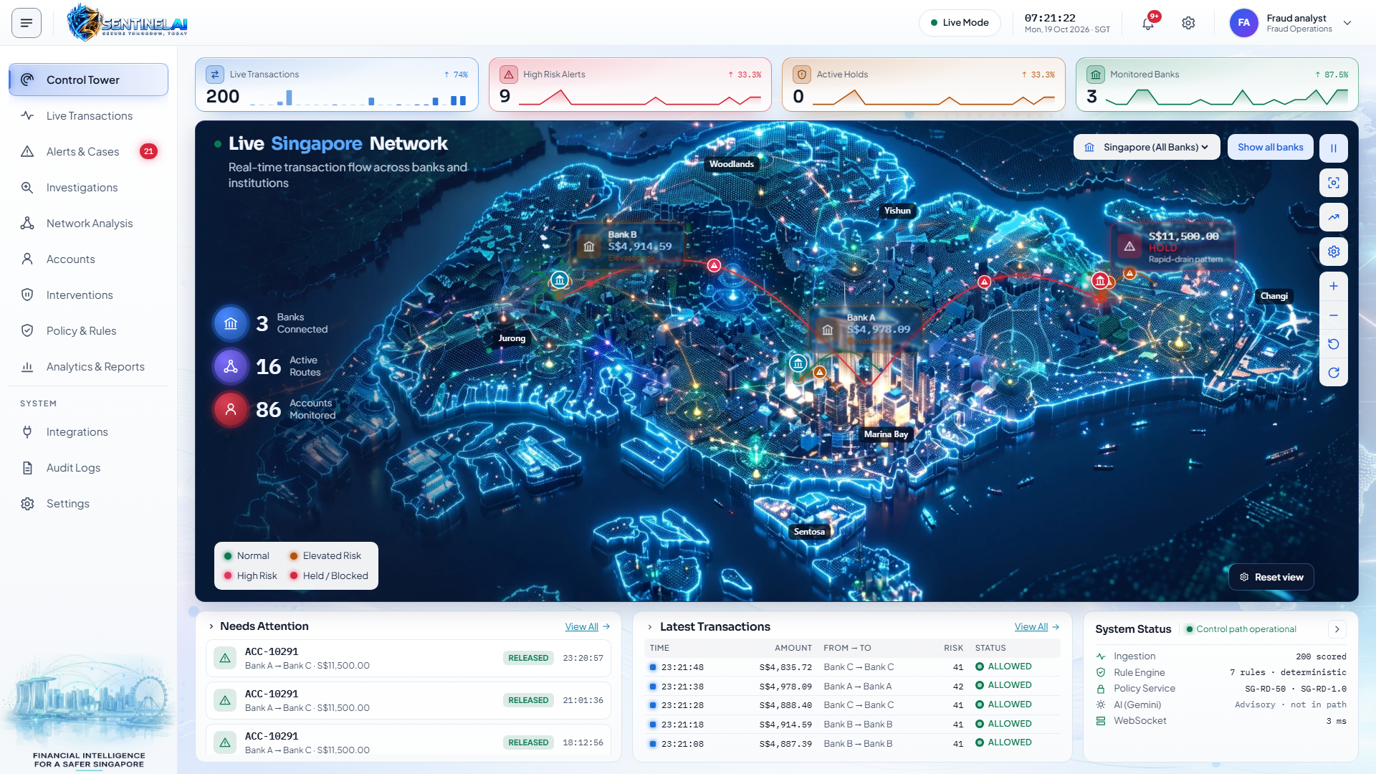
SYNTHETIC DATA · DEMO
1 Normal operations
Live stream across three synthetic institutions

Slide 3
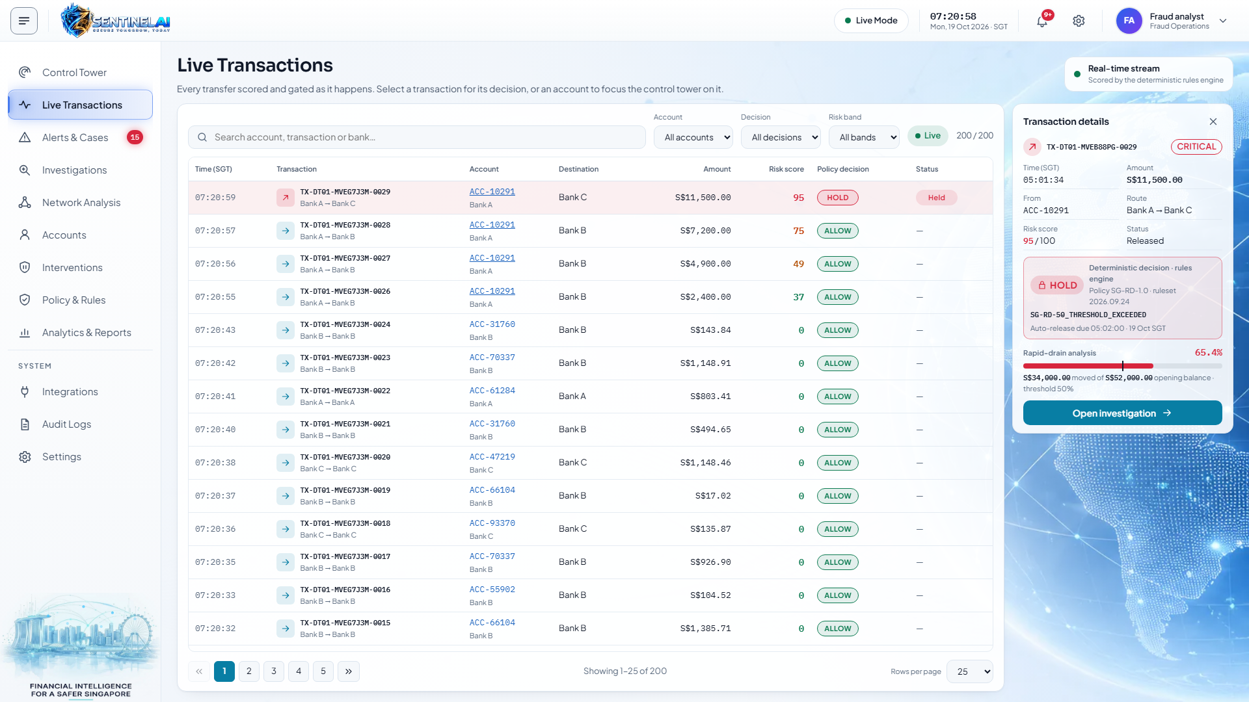
SYNTHETIC DATA · DEMO
2 Pre-transaction decision API
ALLOW or HOLD before the transfer commits

Slide 4
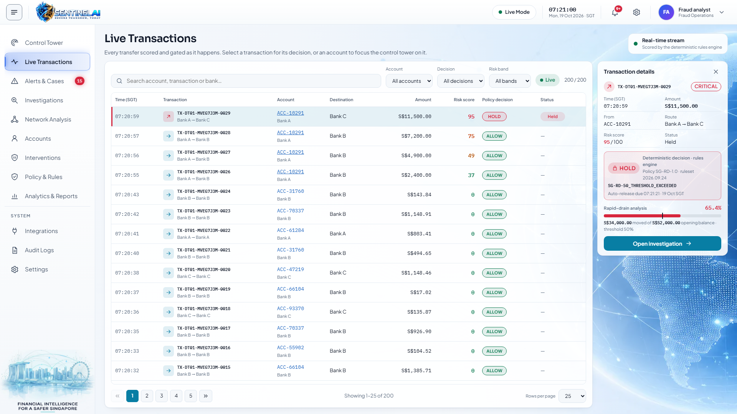
SYNTHETIC DATA · DEMO
3 Rapid-drain gate: HOLD
65.4% of S$52,000 moved in 24 hours. Gate: 50%

Slide 5
SYNTHETIC DATA · DEMO
3 Rapid-drain gate: HOLD
65.4% of S$52,000 moved in 24 hours. Gate: 50%

Slide 6
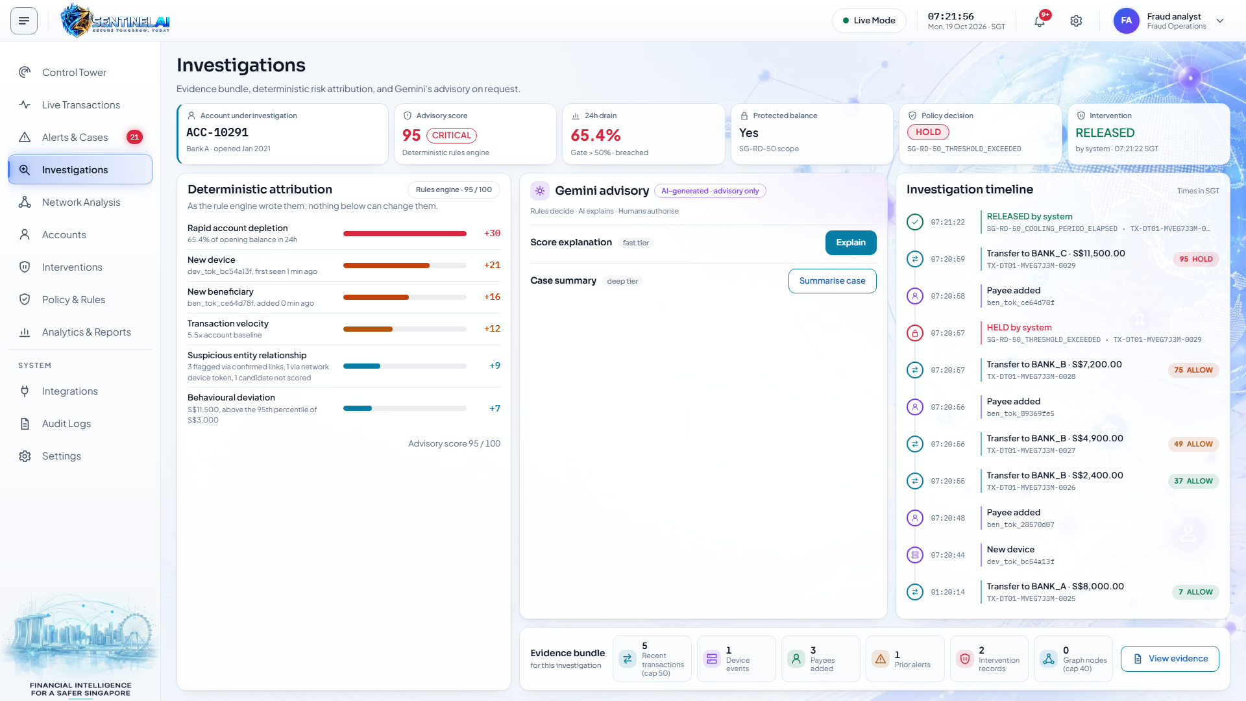
SYNTHETIC DATA · DEMO
4 Deterministic attribution
Score 95: every point traced to a rule

Slide 7
SYNTHETIC DATA · DEMO
4 Deterministic attribution
Score 95: every point traced to a rule

Slide 8
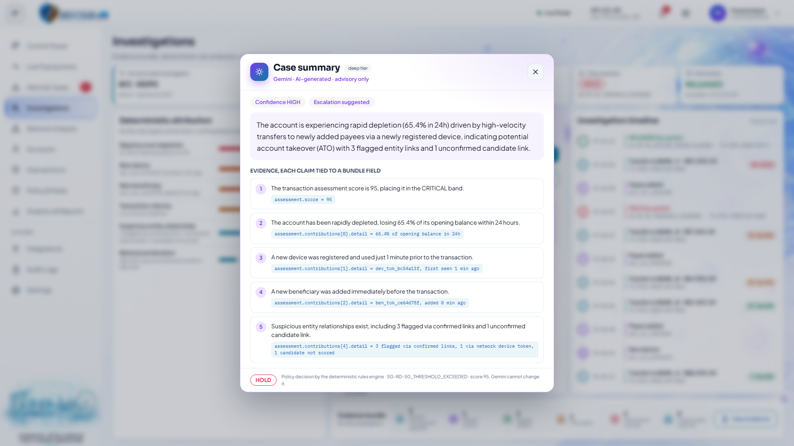
SYNTHETIC DATA · DEMO
5 AI explains
Gemini on Vertex AI. Advisory only. Every claim cites evidence.

Slide 9
SYNTHETIC DATA · DEMO
5 AI explains
Gemini on Vertex AI. Advisory only. Every claim cites evidence.

Slide 10
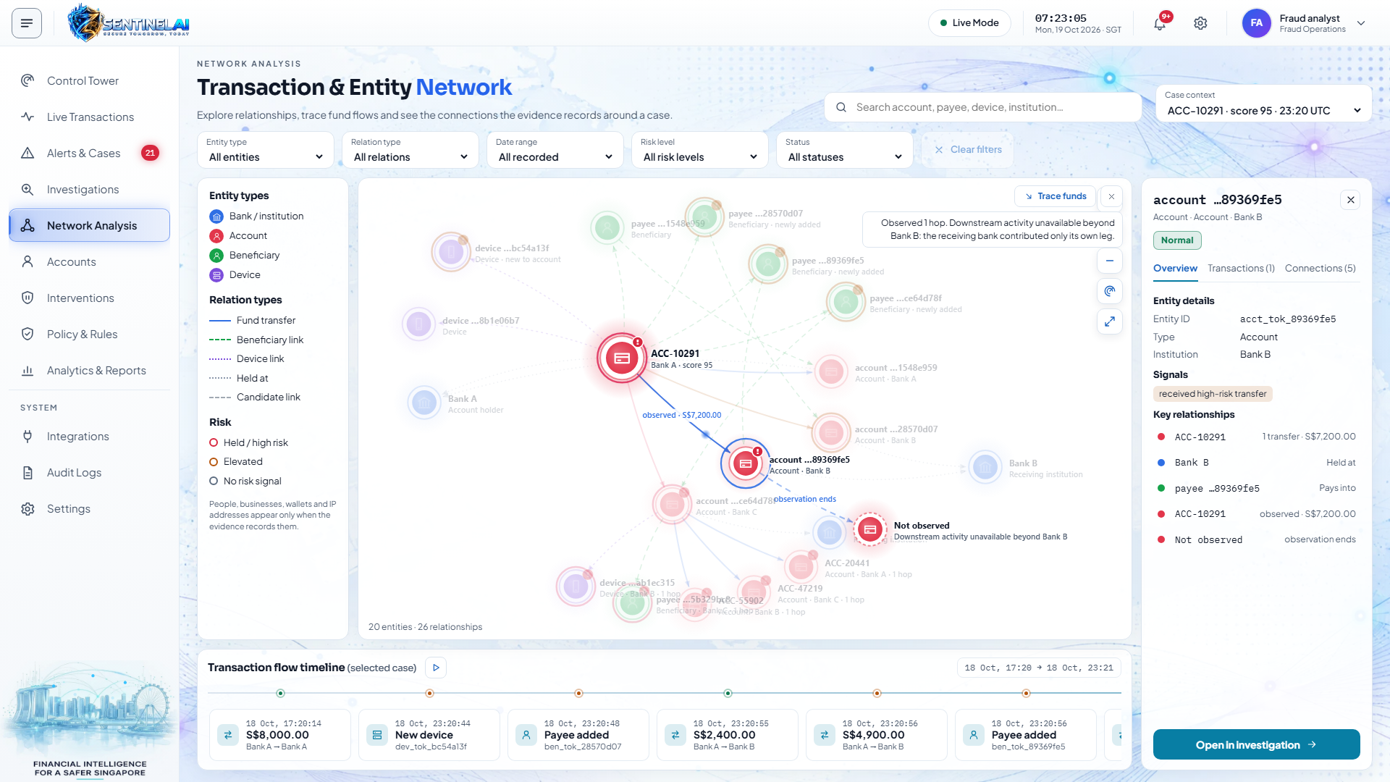
SYNTHETIC DATA · DEMO
6 Network and fund trace
Cross-bank trace with an explicit observed boundary

Slide 11
SYNTHETIC DATA · DEMO
6 Network and fund trace
Cross-bank trace with an explicit observed boundary

Slide 12
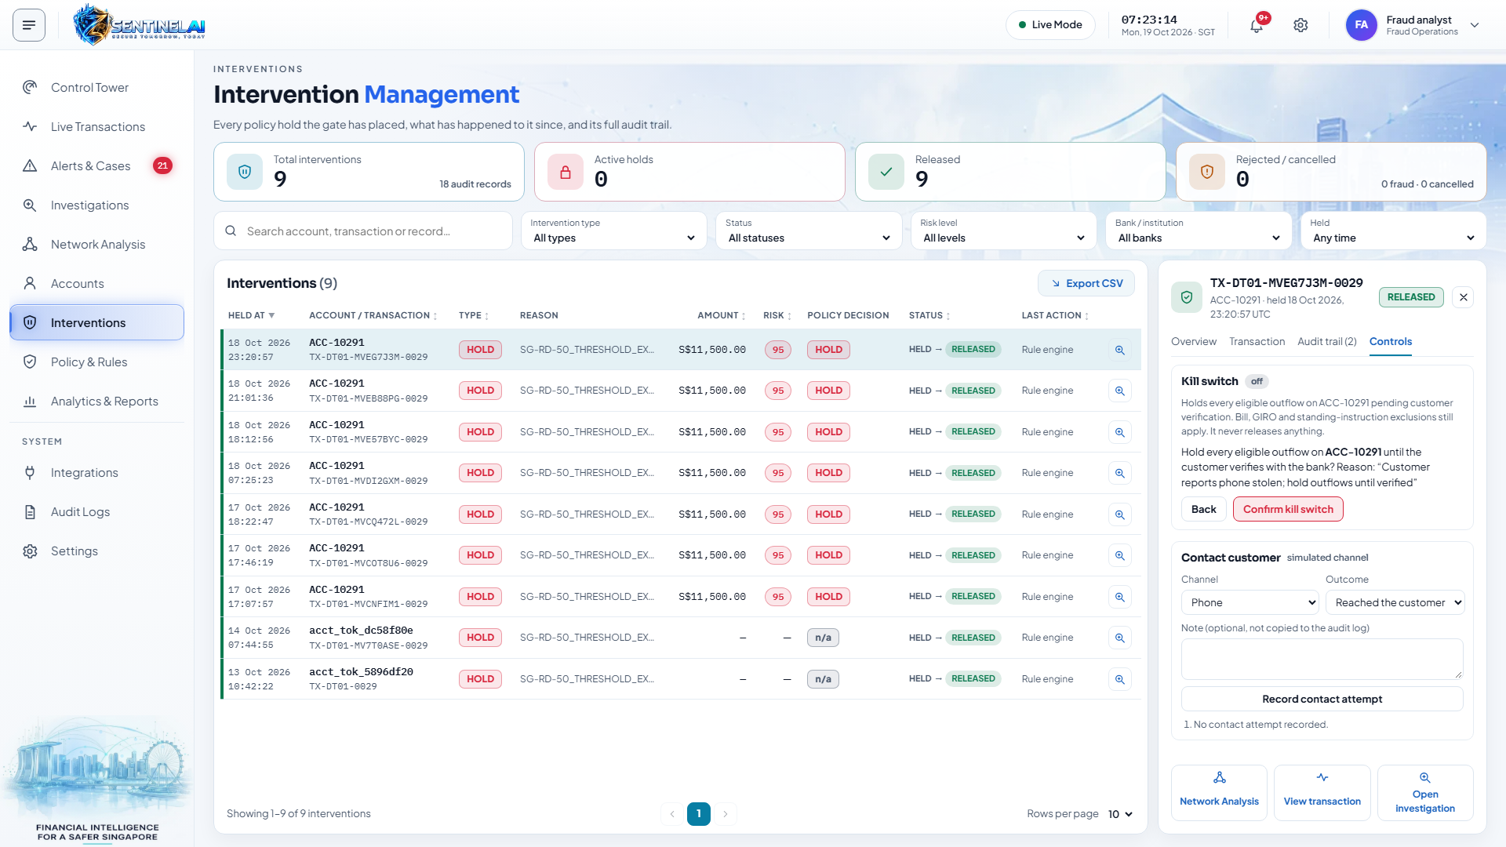
SYNTHETIC DATA · DEMO
7 Humans authorize
Contact customer, kill switch, verified release. All audited.

Slide 13
SYNTHETIC DATA · DEMO
7 Humans authorize
Contact customer, kill switch, verified release. All audited.

Slide 14
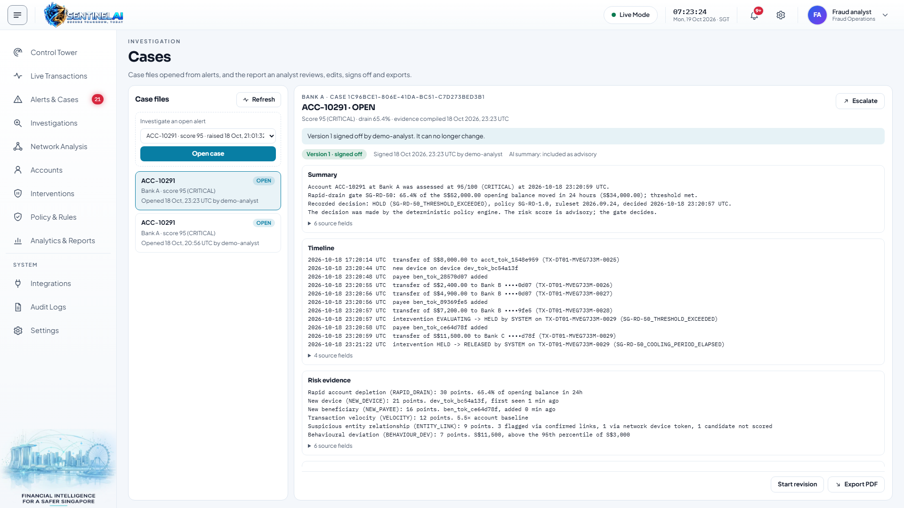
SYNTHETIC DATA · DEMO
8 One-click case report
Generated from recorded facts. Edited, signed off, exported as PDF

Slide 15
SYNTHETIC DATA · DEMO
8 One-click case report
Generated from recorded facts. Edited, signed off, exported as PDF

Slide 16
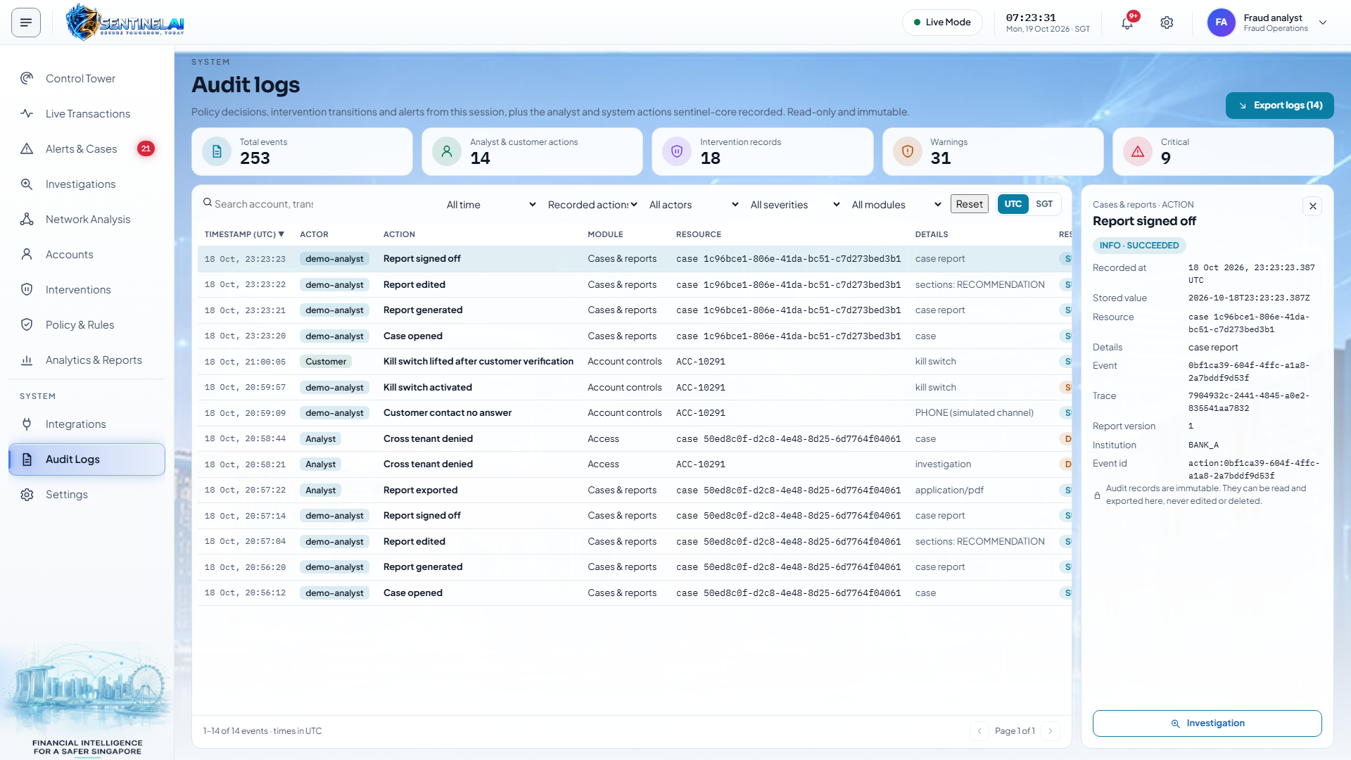
SYNTHETIC DATA · DEMO
9 Bank lens and audit
Designed as a multi-tenant platform; demonstrated as a single deployment on synthetic data.

Slide 17
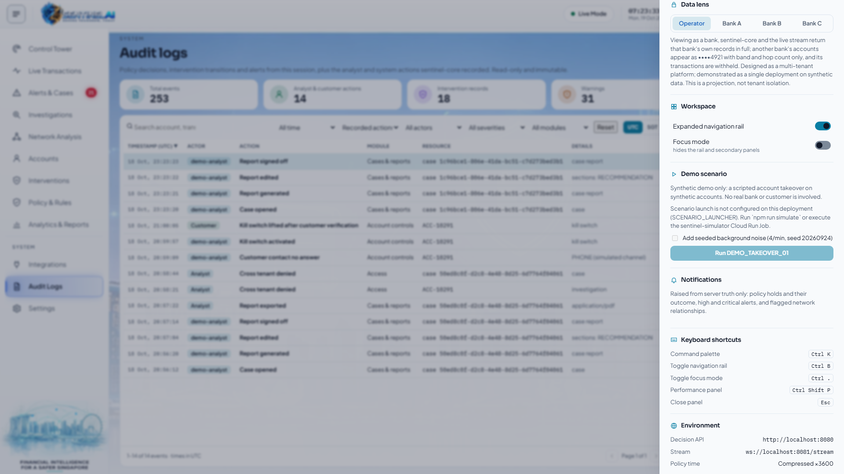
9 Bank lens and audit
Designed as a multi-tenant platform; demonstrated as a single deployment on synthetic data.

Slide 18
