Slide 1
Team Details
a. Team name: ZEUS SHIELD (project: SENTINEL AI)
b. Team leader name: Mohammed Ilyas
c. Problem Statement: Scammers can drain a customer's savings in minutes, before a bank can react. Singapore's rapid account-draining safeguard calls for a hold before settlement, but fraud teams need a transparent, auditable way to enforce it, explain it and act on it in real time. SENTINEL AI is that control tower: rules decide, AI explains, humans authorize.
Notes:
Team SENTINEL AI. Leader: Mohammed Ilyas. All data in the project is synthetic.

Slide 2
Brief about the idea
Detect. Explain. Intervene. Investigate.
The operating principle
SENTINEL AI is a real-time fraud operations control tower for retail banking. It turns Singapore's rapid account-draining safeguard into a deterministic policy gate.
For a personal account with a protected balance of S$50,000, a transfer that, with the previous 24 hours of outflows, moves more than 50% of the balance is held before it settles.
A pre-transaction decision API returns ALLOW, HOLD or REJECT with an itemised risk breakdown. Bank operators review each hold in a live Control Tower, Alerts & Cases and an investigation workspace.
Rules decide
Seven pure rules and one policy gate set every outcome.
AI explains
Gemini explains a decision already made. It cannot change a score.
Humans authorize
Release needs customer verification and is audited.
Notes:
No language model sits in the path of a financial decision. All data is synthetic.

Slide 3
Opportunities
1
How different is it from existing ideas?
2
How will it solve the problem?
3
USP of the proposed solution
Most fraud tools score risk with opaque models. SENTINEL AI enforces an explicit, versioned policy gate.
The gate acts before settlement, not after the money has left.
Built around one concrete safeguard: the S$50,000 protected balance and 50% in 24 hours rule.
Holds a draining transfer in the decision API, before it settles.
Shows operators an itemised score and the evidence behind it.
Contacts the customer, verifies, then releases or blocks, with every step on an append-only audit trail.
Rules decide. AI explains. Humans authorize.
Gemini output is schema-validated and every claim must cite a field in the evidence bundle, or it is removed.
Explanations never recommend releasing a hold.

Slide 4
List of features offered by the solution
1
Transaction simulator
2
Real-time risk engine
Deterministic takeover scenario on synthetic data, plus seeded noise traffic.
Seven pure rules and a policy gate return ALLOW, HOLD or REJECT.
3
Rapid-drain detection
4
Intervention workflow
50% of balance in 24 hours, with configurable thresholds.
Customer contact, account kill-switch and verified release, all audited.
5
Investigation workspace
6
AI explanation and summary
Deterministic attribution, timeline and evidence bundle per case.
Gemini on Vertex AI, advisory only, every claim cites evidence.
7
Entity graph
8
Case reports and audit
Server-side two-hop network and a fund trace that stops at the observed boundary.
Report lifecycle, analyst sign-off, PDF export and a full audit log.
Also: Control Tower, Live Transactions, Accounts, Policies & Rules, Analytics, Integrations, bank data lens, performance panel.

Slide 5
Process flow diagram
1 Detect
2 Decide
3 Explain
4 Intervene
5 Investigate
Simulator sends a transfer to the pre-transaction decision API.
Rules engine and policy gate return ALLOW, HOLD or REJECT.
Gemini explains the decision from the evidence bundle. Advisory only.
Operator contacts the customer. Release only after verification.
Graph, timeline and case report. Everything is audited.
Worked example from the demo: account takeover on ACC-10291
S$52,000
S$34,000
65.4%
95
opening balance
moved in 24 hours
of balance, gate is 50%
CRITICAL, policy: HOLD
Rule SG-RD-50 fires, the transfer is held before settlement, and the operator releases it only after customer verification.

Slide 6
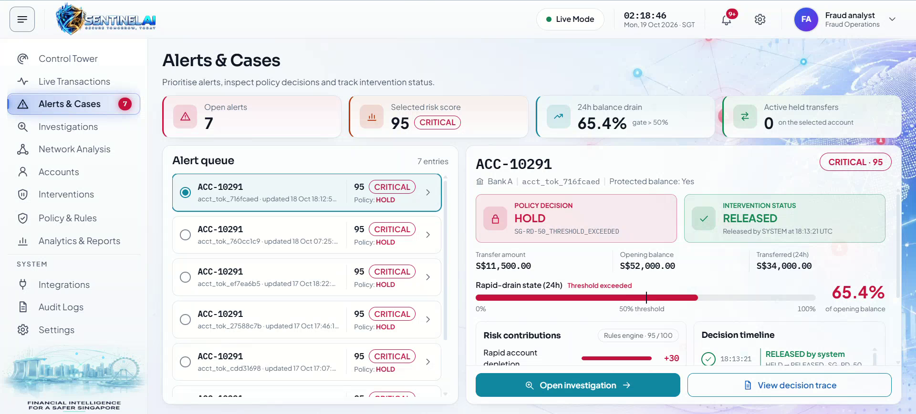
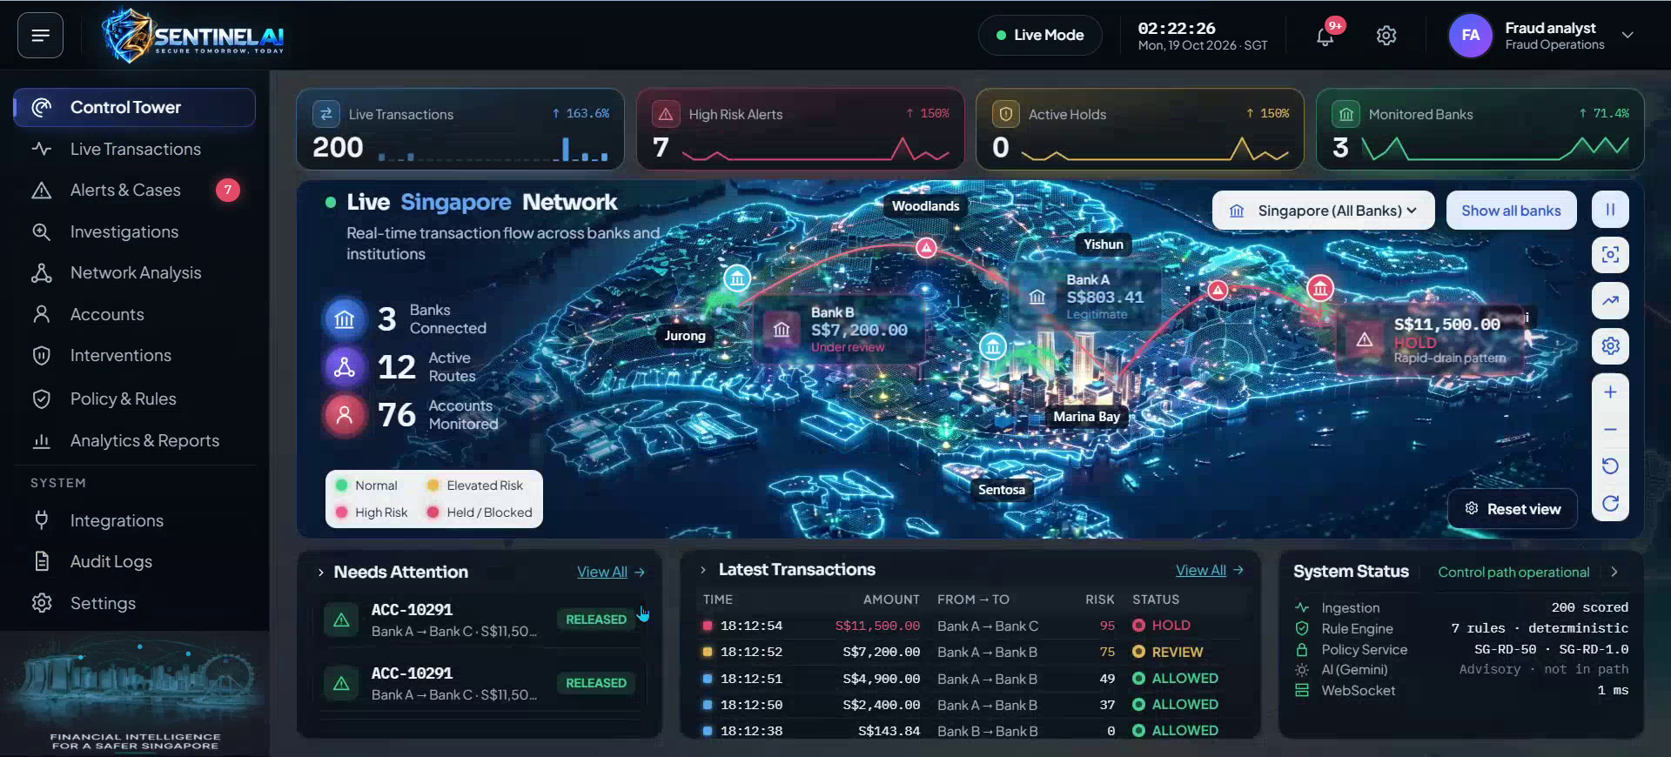
Wireframes/Mock diagrams of the proposed solution
Alerts & Cases (light theme)
Control Tower (dark theme)
Design language: a single console for bank operators with light and dark themes, a persistent module navigator, and the policy decision always shown next to AI output.
These are screens of the working prototype, not static mock-ups.

Slide 7
Architecture diagram of the proposed solution
Simulator
Decision API
Pub/Sub
decide
events
Cloud Run Job
synthetic transfers
Cloud Run, asia-southeast1
7 pure rules + policy gate
ordered lifecycle events
OIDC push to backend
Operator UI
REST
Gemini gateway
evidence
Vertex AI: Gemini
Angular on Cloud Run
structured output,
evidence-cited claims
explains and summarises.
Never decides
Stream gateway
changes
MongoDB Atlas on Google Cloud (asia-southeast1)
WebSocket, Cloud Run
system of record, change streams feed the live dashboard
Cloud Build + Artifact Registry deploy to Cloud Run on every push to main. Secret Manager holds the Atlas connection string. No API keys in the repo.

Slide 8
Technologies to be used in the solution
Google Cloud
Application
Data and quality
Vertex AI: Gemini, structured output
Cloud Run: UI, decision API, stream gateway, simulator job
Pub/Sub: ordered lifecycle events
Cloud Build and Artifact Registry
Secret Manager
Angular for the operator console
TypeScript workspaces: domain, rules, scenarios, core, stream, simulator, ui
WebSocket live stream
ESLint import-boundary rules
MongoDB Atlas on Google Cloud, change streams
Bounded two-hop graph traversal
405 automated tests
Synthetic data only
Gemini runs only from the backend with the service account's own credentials. Model IDs are configuration, not code, and the browser never sees one.

Slide 9
Estimated implementation cost (optional)
Component | Cost model | How it is kept low
Cloud Run (4 components) | Per request and CPU time | Scale to zero. Simulator runs as a job.
Vertex AI: Gemini | Per token | Cached per assessment. Demo account pre-warmed. Never in the decision path.
Pub/Sub | Per volume delivered | Lifecycle events only. The decision never waits on it.
MongoDB Atlas | Cluster tier | Single deployment on synthetic data for the demo.
Cloud Build, Artifact Registry, Secret Manager | Small usage-based fees | One secret. One build per push to main.
A priced estimate is not included because the prototype has not been load-tested in a deployed environment. The design choices above are the main cost controls.

Slide 10
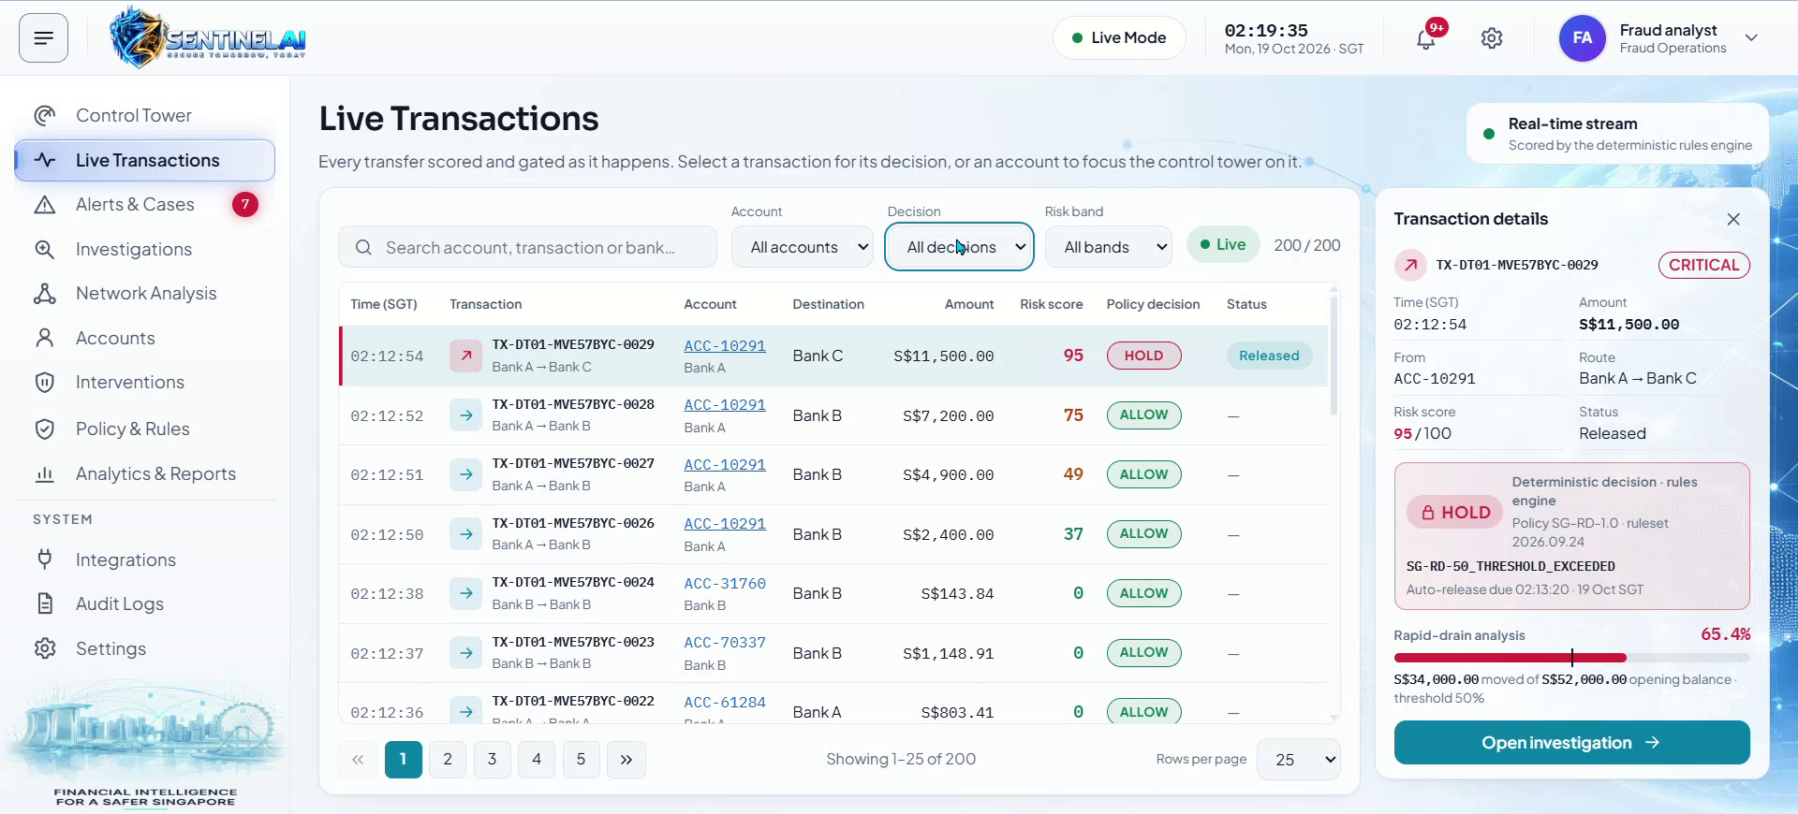
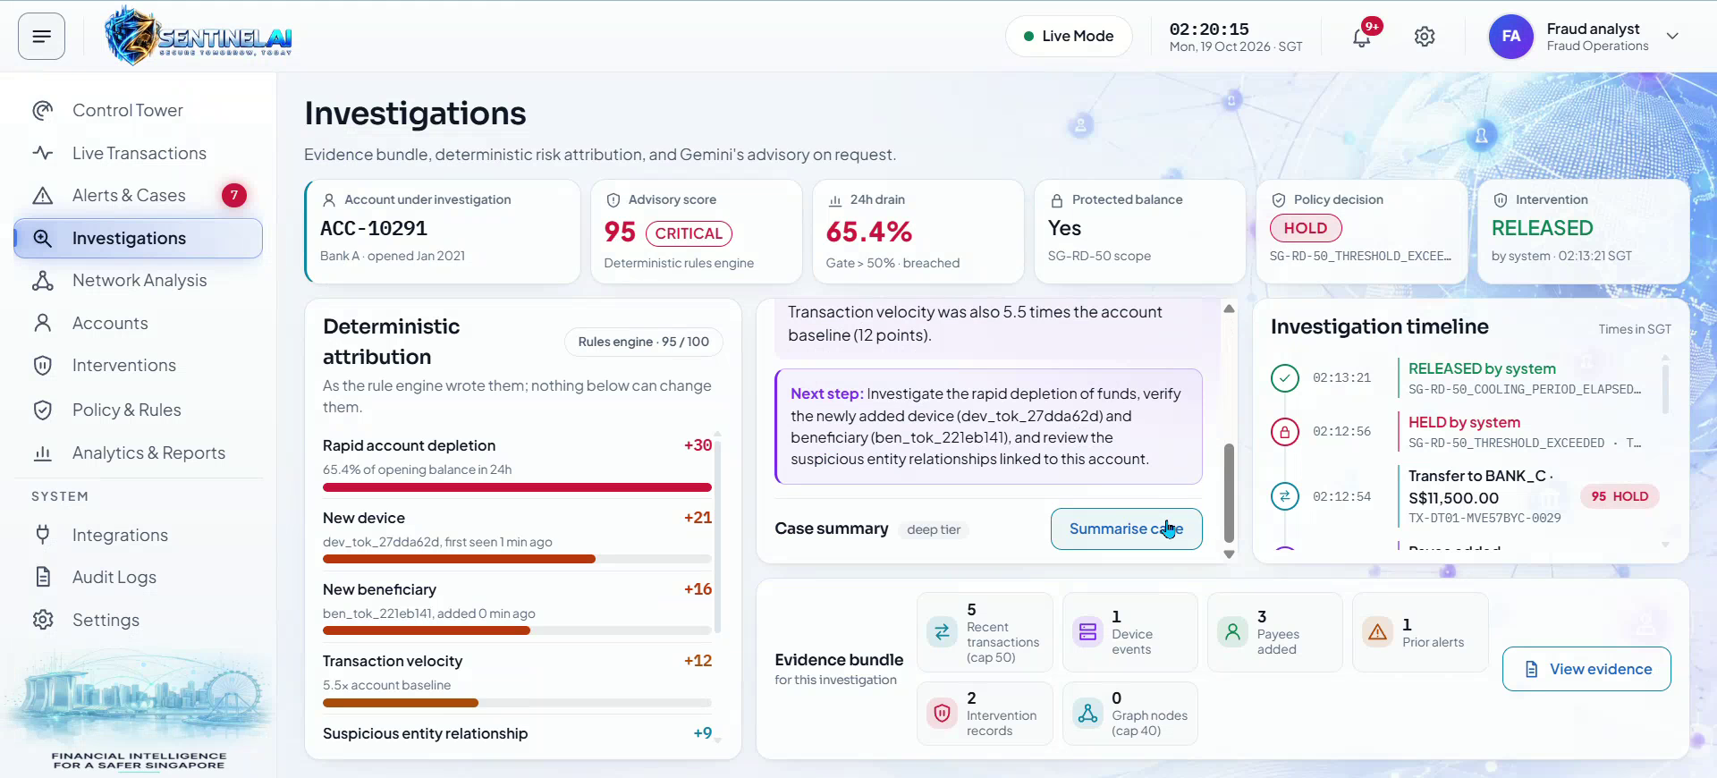
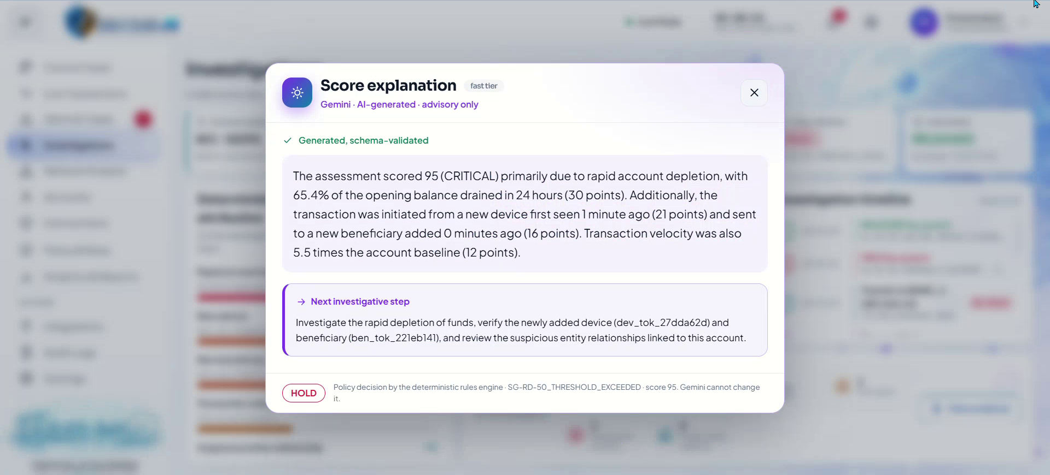
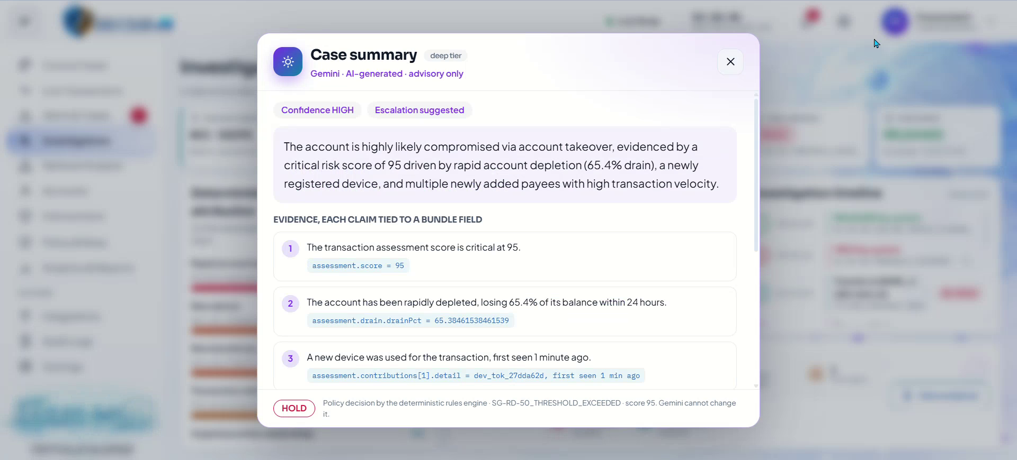
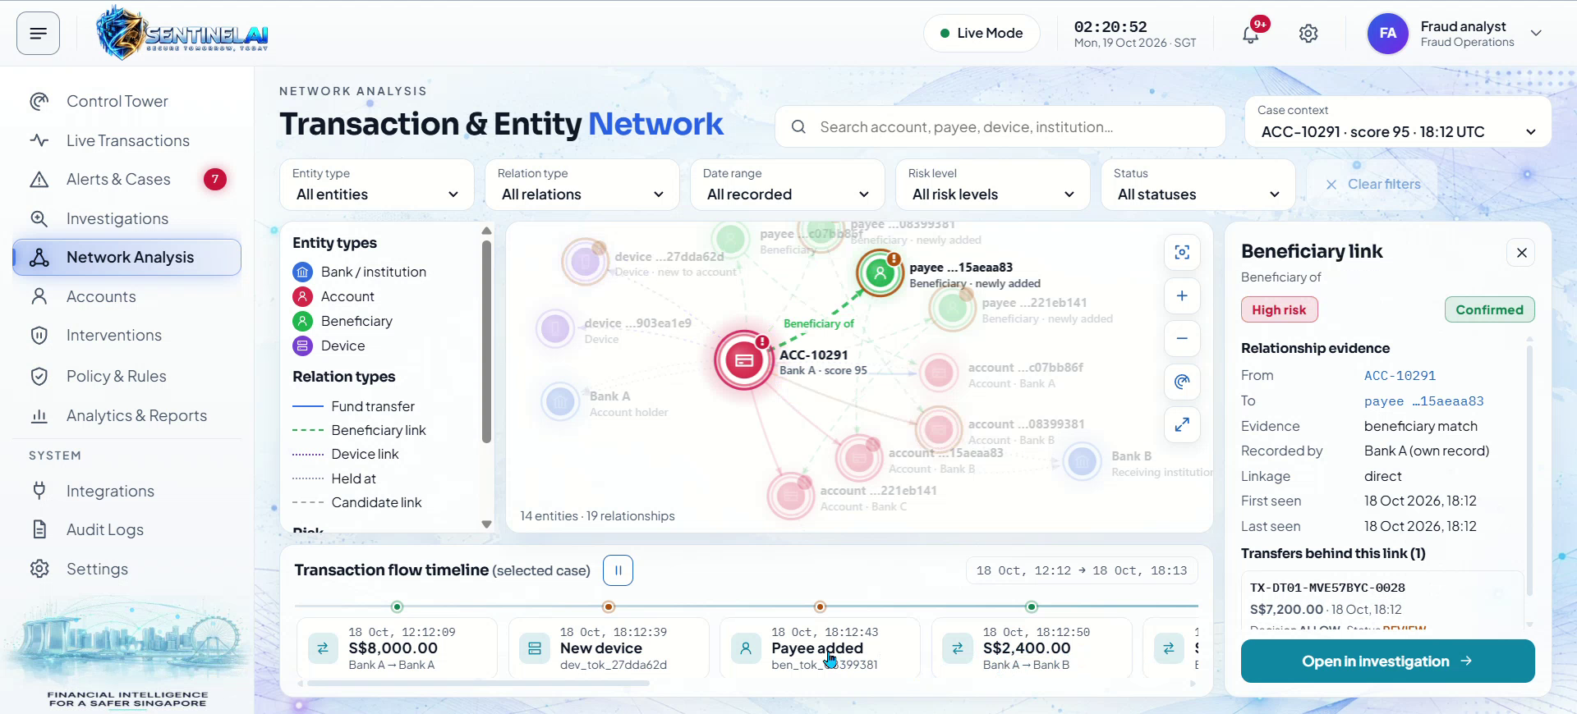
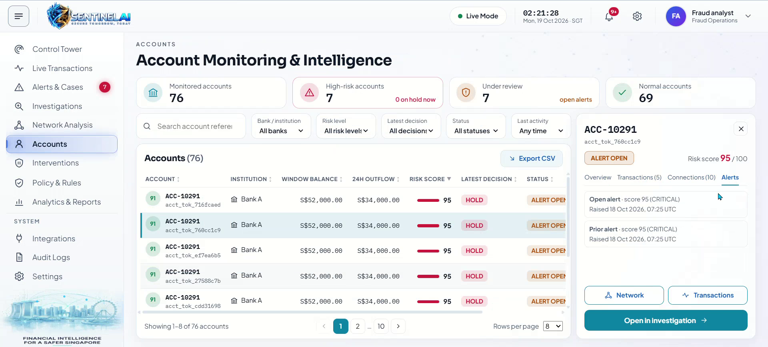
Snapshots of the prototype (1 of 2)
Live Transactions with policy decision
Investigation workspace
Gemini score explanation
Gemini case summary with evidence
Transaction & entity network
Account monitoring & intelligence

Slide 11
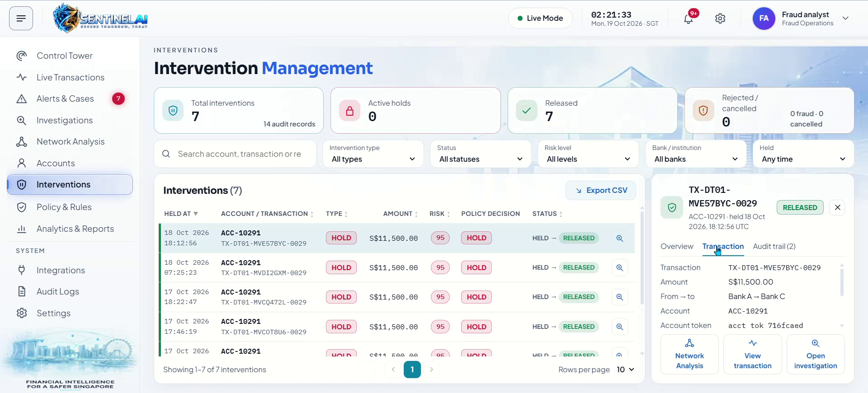
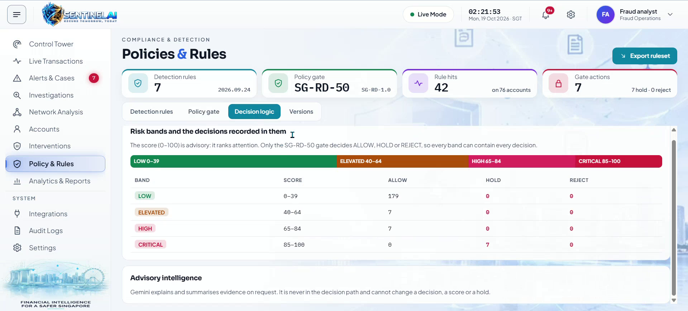
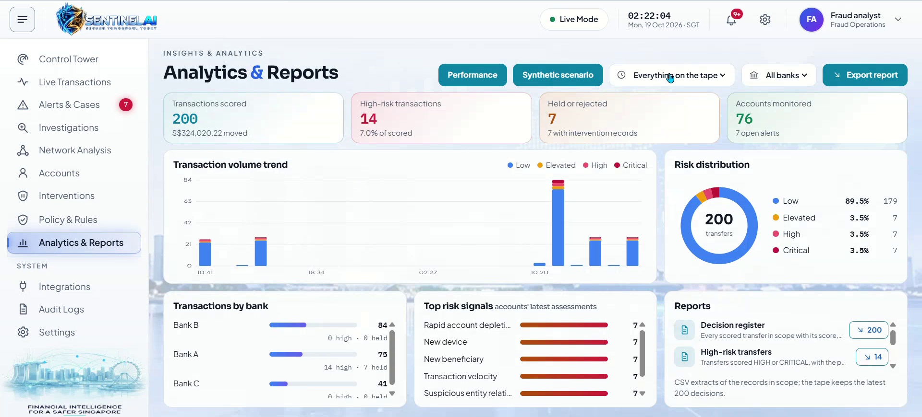
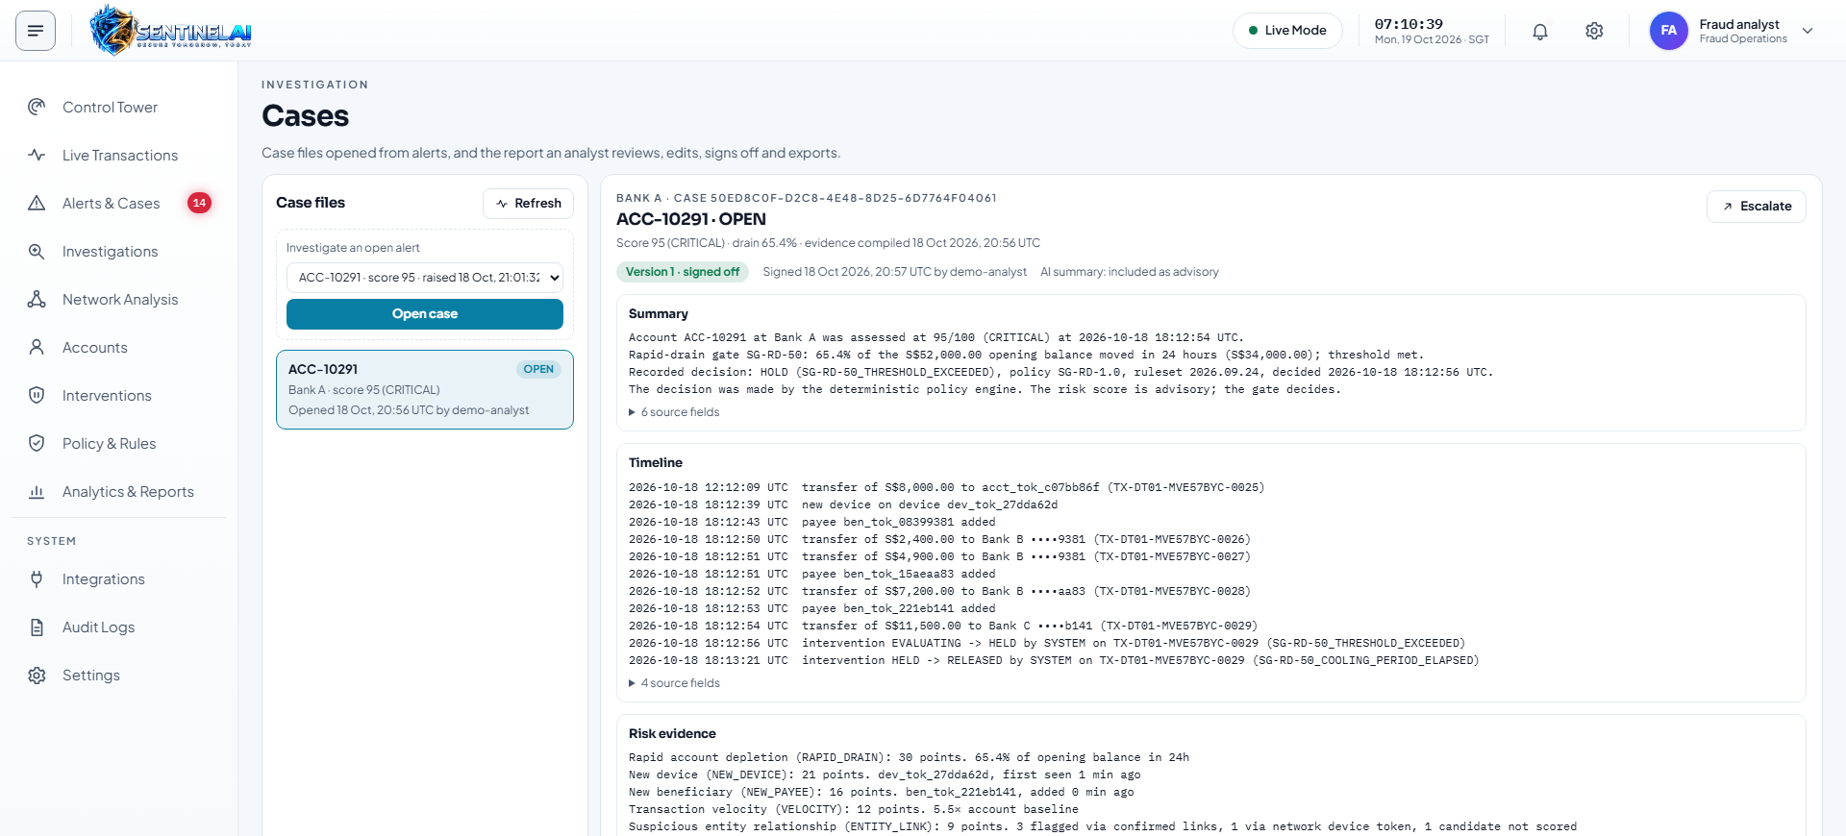
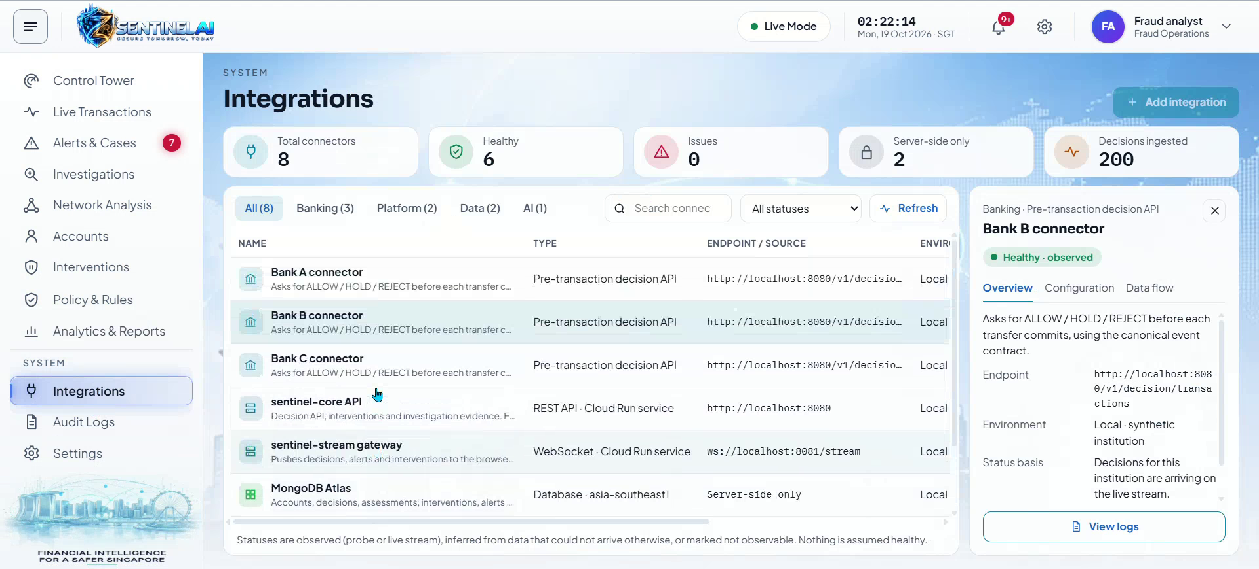
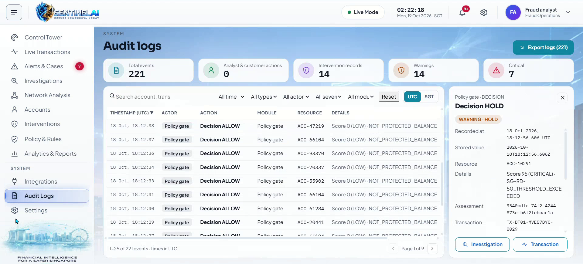
Snapshots of the prototype (2 of 2)
Intervention management
Policies & Rules: policy gate
Analytics & Reports
Case report with sign-off
Integrations
Audit logs

Slide 12
Prototype Performance report/Benchmarking
405
22
0
What was verified
npm run verify passed on 19 Oct 2026: typecheck, lint, tests and builds for all workspaces
Takeover repeats identically; seeded noise scores ELEVATED and never reaches HOLD
Cross-bank reads are refused (403) and audited before any model call
Checked live: signed case report to PDF, fund trace, kill switch, bank lens
automated tests passed
control-path scenario tests
language-model calls in the decision path
Measured locally, not yet deployed
Laptop to remote Atlas: decision API p95 about 1.0 s and graph query p95 about 0.6 s, above the 80 ms and 150 ms targets. Deployed and Gemini timings are not yet measured.

Slide 13
Additional Details/Future Development
Per-tenant sign-in
Scenario launcher in the cloud
The bank lens is enforced by the API and the stream today; next, derive it from a per-tenant identity provider.
Built for local runs and the Cloud Run Job; next, operator sign-in and the job invoker permission.
Browser end-to-end coverage
Meet latency targets
Automated browser tests for case reports, lens switching, themes and responsive sizes.
The performance panel now measures; next, cache graph queries and benchmark in region.
Deployment and Gemini verification
Gemini outage drill
Load and latency checks in an authorized cloud environment.
A control that shows holds and audit continuing while the model is unavailable.
Scope note: all institutions and data are synthetic. No real bank or COSMIC integration is claimed.

Slide 14
Provide links to your:
GitHub Public Repository
https://github.com/Mohammed-Ilyas-AI/Sential-AI
Demo Video Link (3 Minutes)
Add the video link here once it is uploaded
Final Product Link
https://sentinal-ai.cloud.run/

