Slide 1


Anjuman Institute Of Technology And Management
Anjumanabad, Bhatkal - 581320
Department Of Computer Science And Engineering
Presentation on
Intelligent Multi-Floor Parking Management System using ANPR & OCR
Presented by:
Under the guidance of:
Mohammed Mafaz (2AB21CS036)
Mohammed Suhail (2AB21CS040)
Syed Abdul Muqsit (2AB21CS053)
Mafaz Siddiqua (2AB21CS024)
Ms. Arzoo Rumana
Assistant Professor,
Department of CSE

Slide 2

Presentation Outline
Abstract
Introduction
Problem Statement
Existing System
Proposed System
Literature Survey
Design & Modules
Process Explanation
Results
Conclusion
Future Work

Slide 3
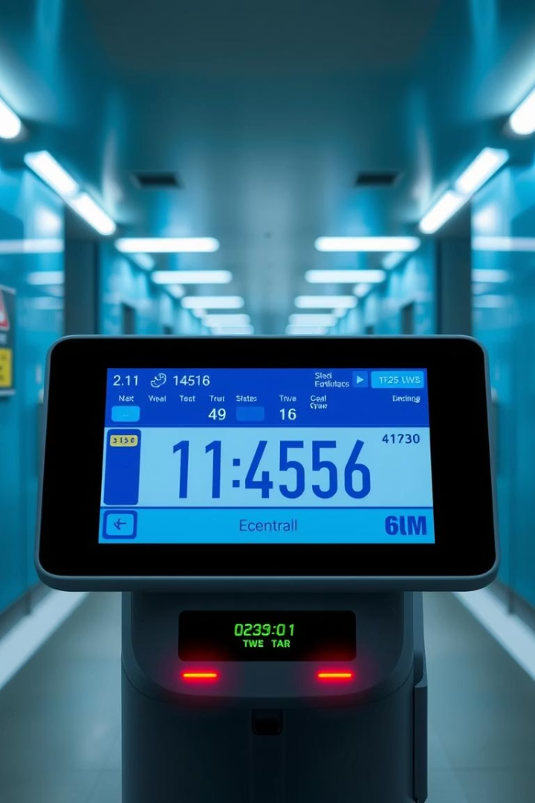
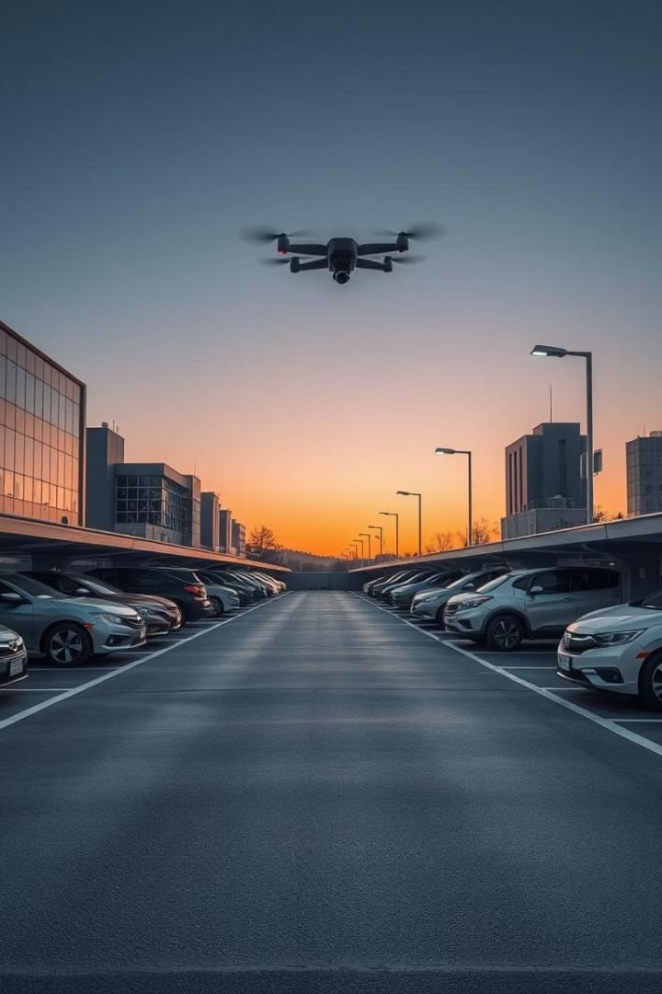

Abstract
This project presents an intelligent multi-floor parking management system leveraging Automatic Number Plate Recognition (ANPR) to automate vehicle entry, slot assignment, occupancy tracking, and payment processing, delivering a robust, real-time dashboard for efficient space utilization and user convenience.

Slide 4
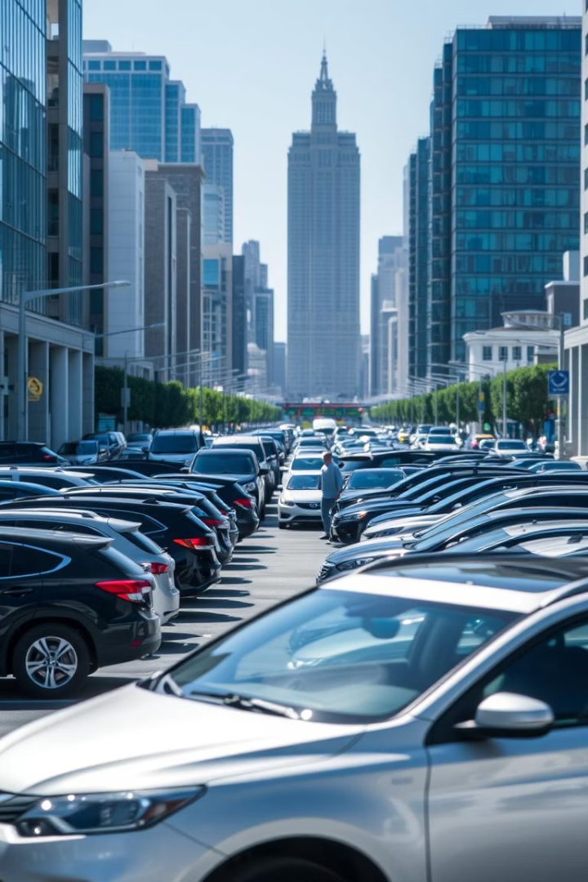
Introduction
Urban Parking Challenges
Manual parking management causes inefficiencies, disputes, and lack of transparency in vehicle tracking and payments.
Our Innovative Solution
A multi-camera system powered by Django enables automated detection, billing, and gate control to enhance urban parking efficiency.

Slide 5
Problem Statement
Manual Recording Issues
Visibility & Payment Concerns
Gate Operation Limitations
Errors from human entry/exit logging cause delays and inaccuracies affecting billing and security.
No instant view of available slots and slow, risky payment collection processes.
Exit gates depend on personnel to operate, limiting automation and increasing operational costs.

Slide 6
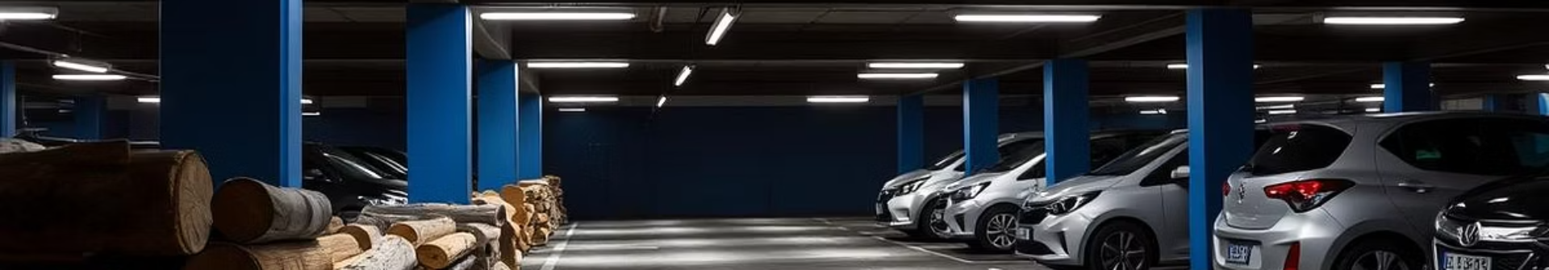
Existing System
Paper Logbooks & RFID Barriers
Static CCTV without ANPR
Manual logs and RFID rely heavily on human oversight and suffer from data fragmentation.
No automatic recognition prevents efficient tracking; manual monitoring is time consuming.
Limited Payment Options
Absence of Real-Time Dashboard
Predominantly cash-based payments slow exit process and create security issues.
No centralized system to display live slot occupancy or transaction status.

Slide 7
Proposed System
Entrance Camera
Section Cameras
Exit & UI Integration
Administrative Dashboard
Automatically captures license plate and timestamps vehicle entry using OCR.
Detect vehicles in individual parking slots and assign them unique slot IDs.
Computes parking duration, presents UPI QR code for payment, and opens gate upon successful transaction.
Provides real-time occupancy data and enables manual handling of cash payments.

Slide 8
Literature Review 1
Title | ParkNest - The Smart Parking System Using IoT
Authors | Gagan S, Ravi H.K.
Published Date | 2024
Journal/Conference | 2024 IEEE International Conference on Smart Systems for applications in Electrical Sciences (ICSSES)
What Has Been Researched | - Developed a smart parking prototype with IR sensors and NodeMCU to detect slot availability. - Android app built with Firebase integration for real-time slot updates, booking, and navigation. - Gate automation using servo motors. - Focused on reducing congestion and CO₂ emissions.
Research Gap Identified | - Limited scalability to larger parking zones. - Prototype is small (6 slots only). - No dynamic pricing or predictive analytics. - Security, energy efficiency, and multi-facility integration are not deeply addressed.

Slide 9
Literature Review 2
Title | Enhancing IoT ECO System - Smart Parking System
Authors | Avinash S, Muthukrishnan S, Ms. R. Aishwarya
Published Date | 2025
Journal/Conference | 2025 IEEE International Students’ Conference on Electrical, Electronics, and Computer Science (SCEECS)
What Has Been Researched | - Proposed a scalable smart parking system using RFID for automated gate access and proximity sensors for real-time occupancy tracking. - Integrated IoT framework for seamless data flow and real-time guidance via mobile app. - System includes dynamic pricing, reservation, and predictive analytics using ML.
Research Gap Identified | - Implementation challenges in real-world citywide deployment. - Security/privacy concerns regarding user data. - High initial setup cost and potential integration complexity with existing infrastructure.

Slide 10
Design and Modules
Payment API & Gate Control
Admin & Dashboard
Camera Interface
Data Layer
Centralized management interface displaying occupancy, transaction history, and manual payment handling.
Utilizes OpenCV with YOLOv8 for vehicle detection and EasyOCR for plate recognition.
Django ORM manages database models for cameras, slots, parking records, and payments.
Razorpay integrated with UPI QR code generation and automated gate control via HTTP/GPIO protocols.

Slide 11
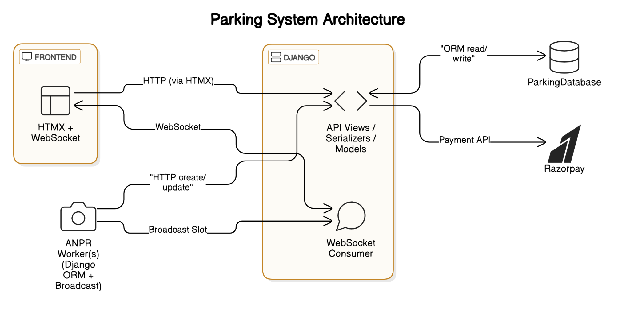
System Architecture

Slide 12
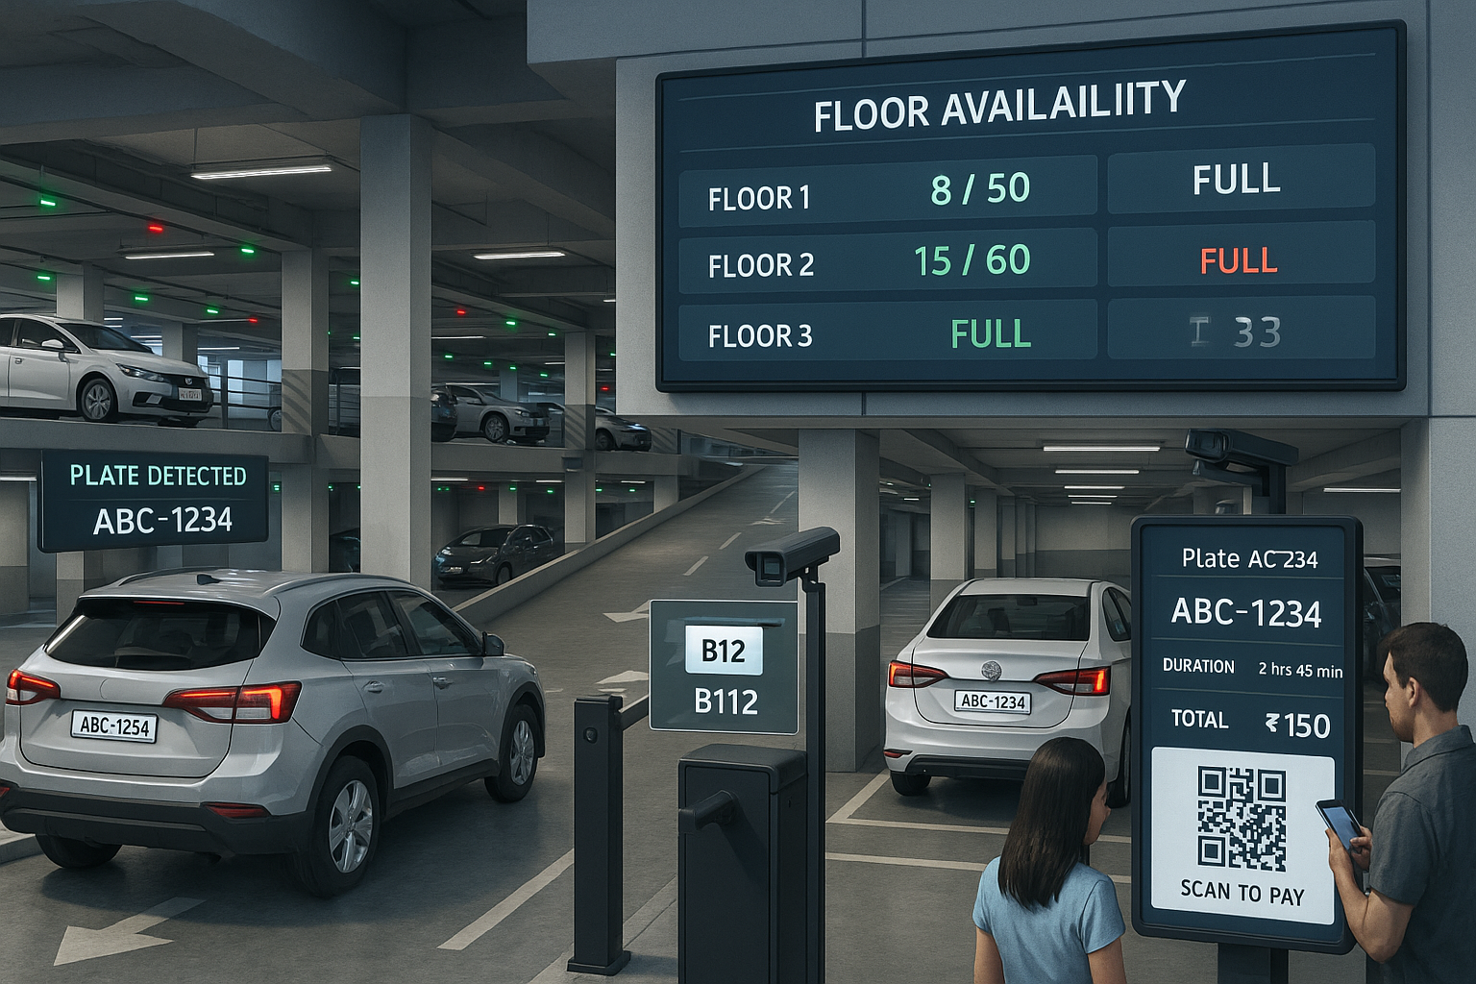
Process Explanation
Entrance Flow
Vehicle detected; license plate OCR creates parking record with timestamp.
Slot Assignment
Slot cameras detect vehicle within defined polygons to associate record with specific parking slot.
Exit Flow
Plate re-scanned, parking duration calculated; UPI QR generated for payment, gate opens on confirmation.
Cash Payment Fallback
Manual payment confirmation by cashier updates record and triggers gate opening.

Slide 13
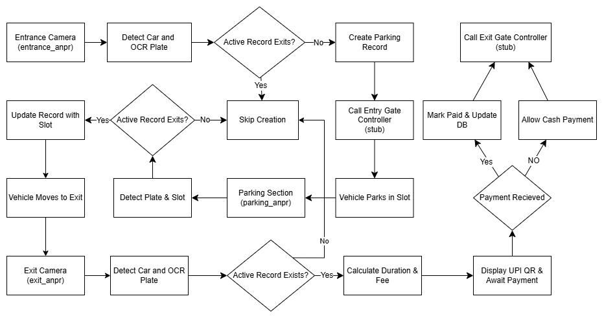
Flow Diagram

Slide 14
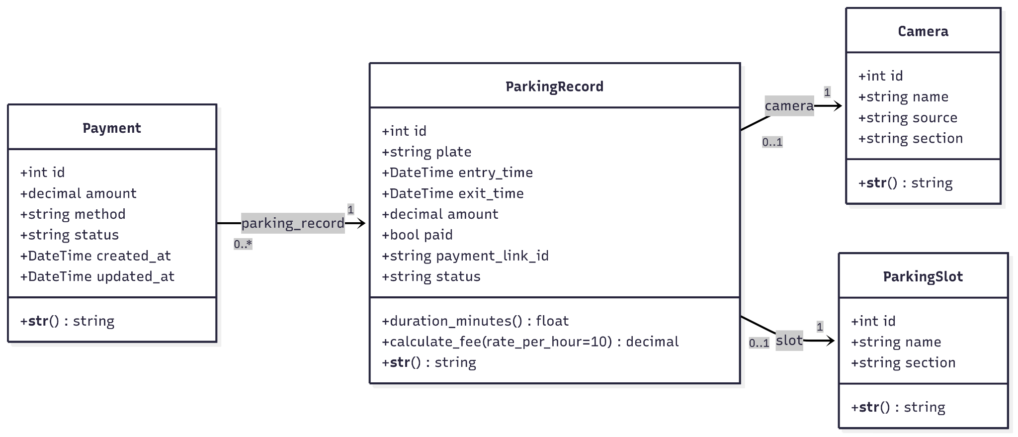
UML Class Diagram

Slide 15
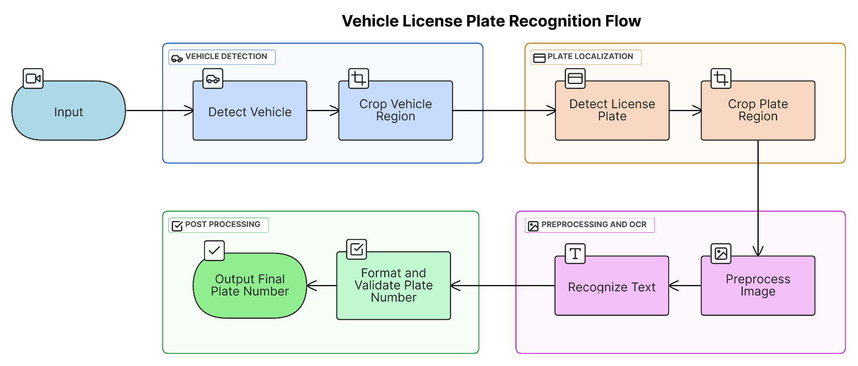
ANPR Flow

Slide 16
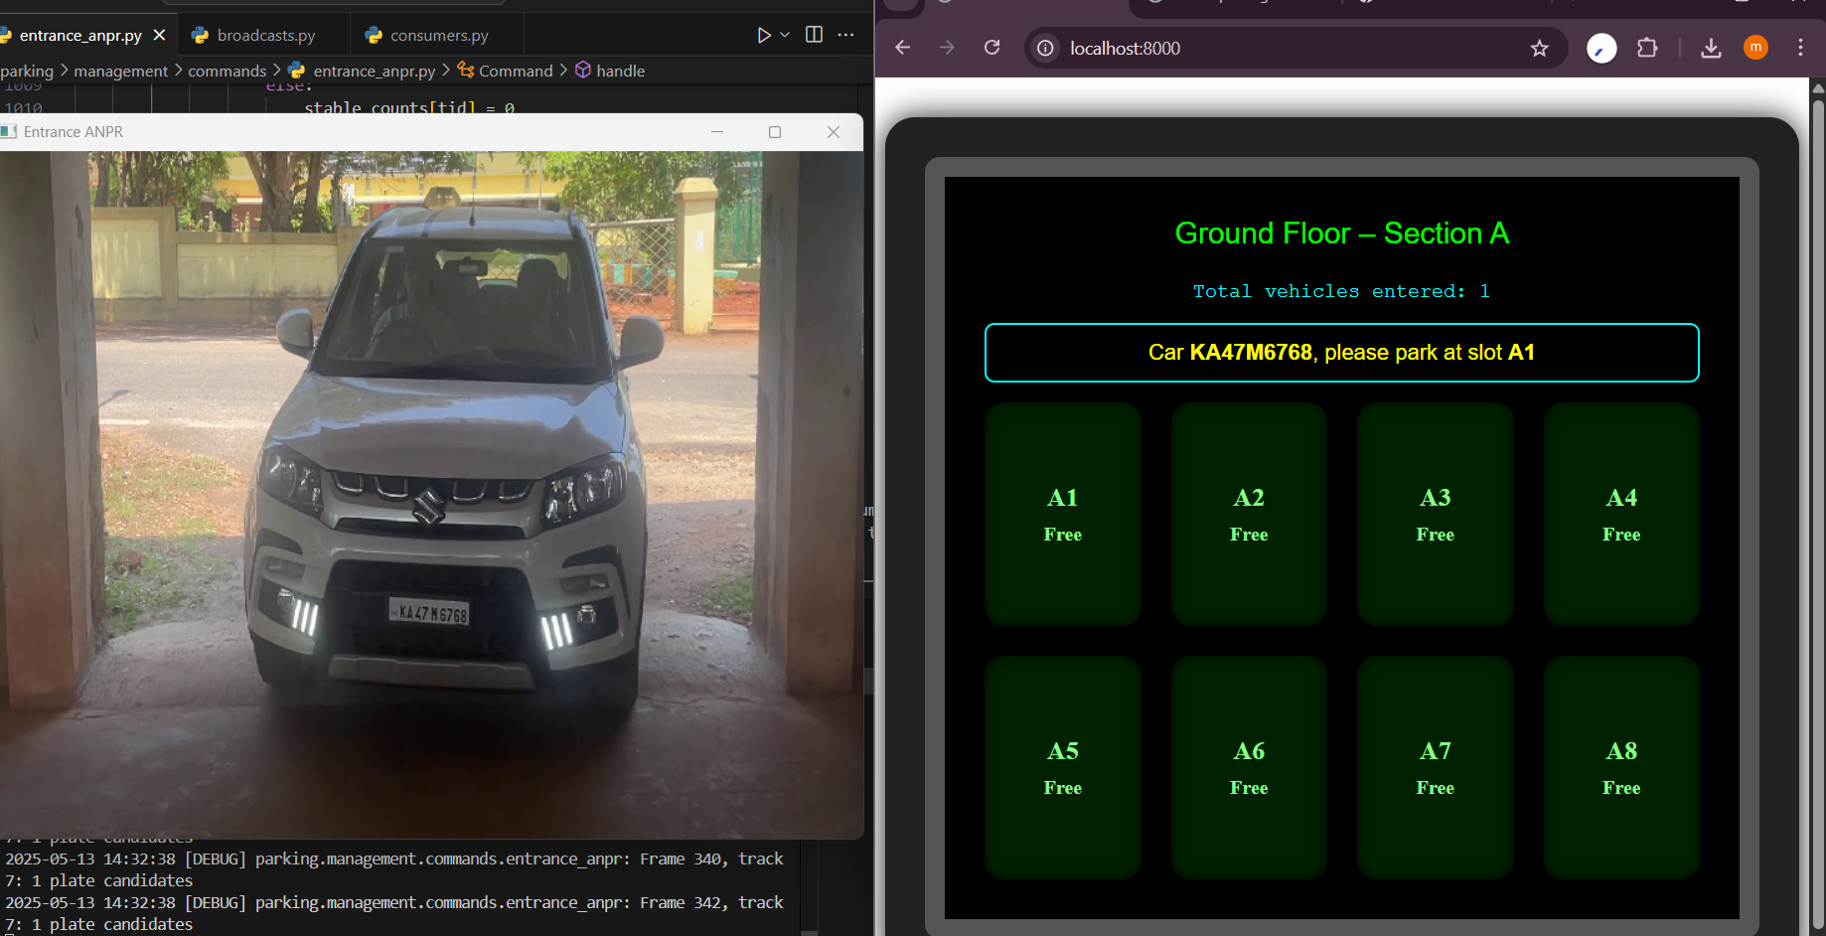
Results
Entrance camera feed to ANPR
Ground floor Tv Screen

Slide 17
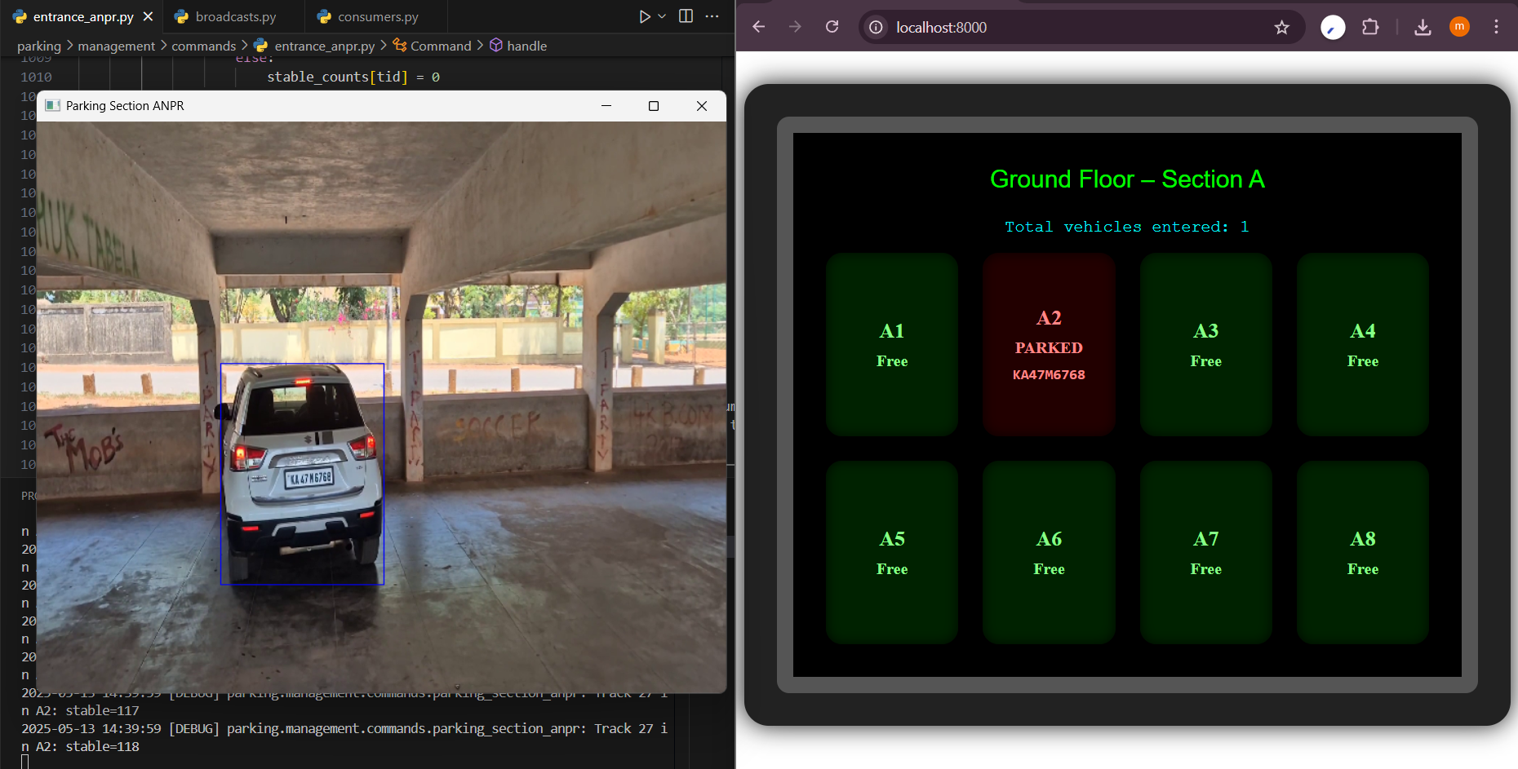
Results
Parking camera feed to ANPR
Ground floor Tv Screen

Slide 18
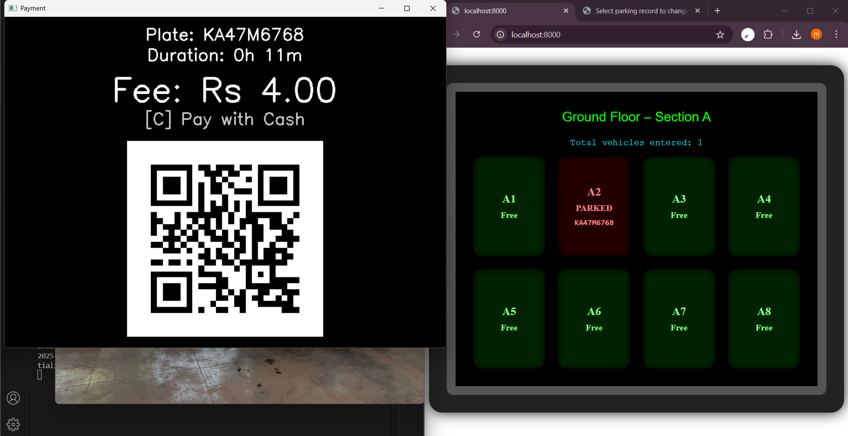
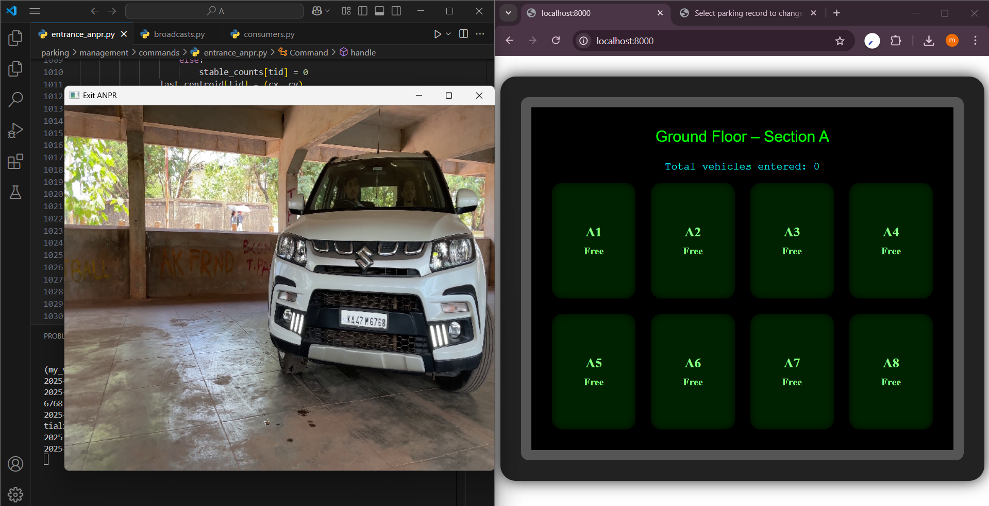
Results
Payment window at exit gate
After exiting the parking section

Slide 19
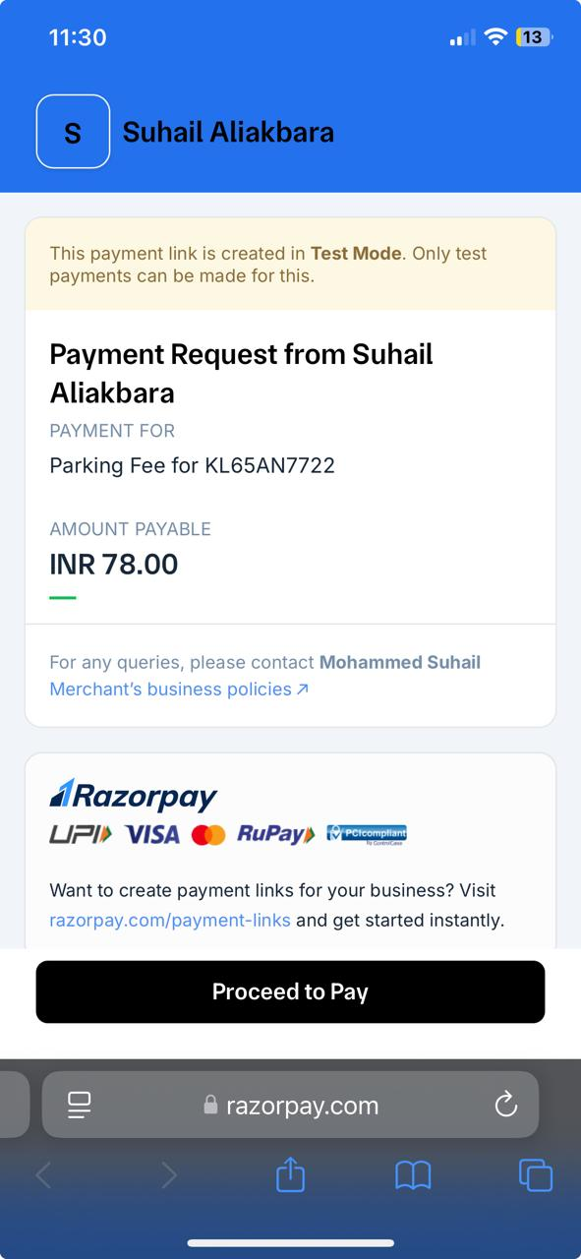
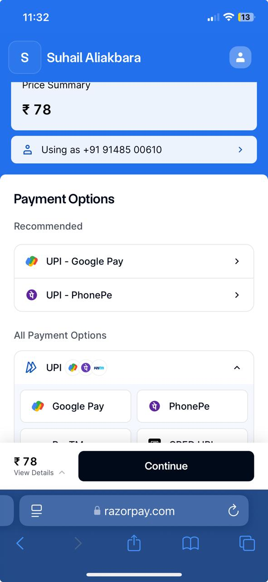
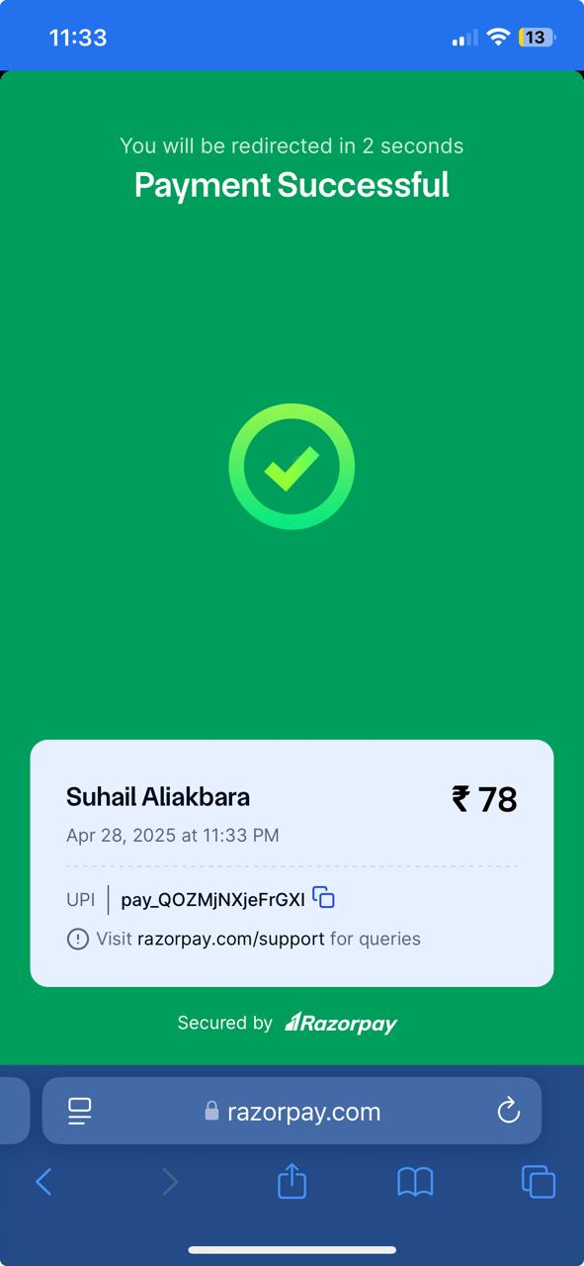
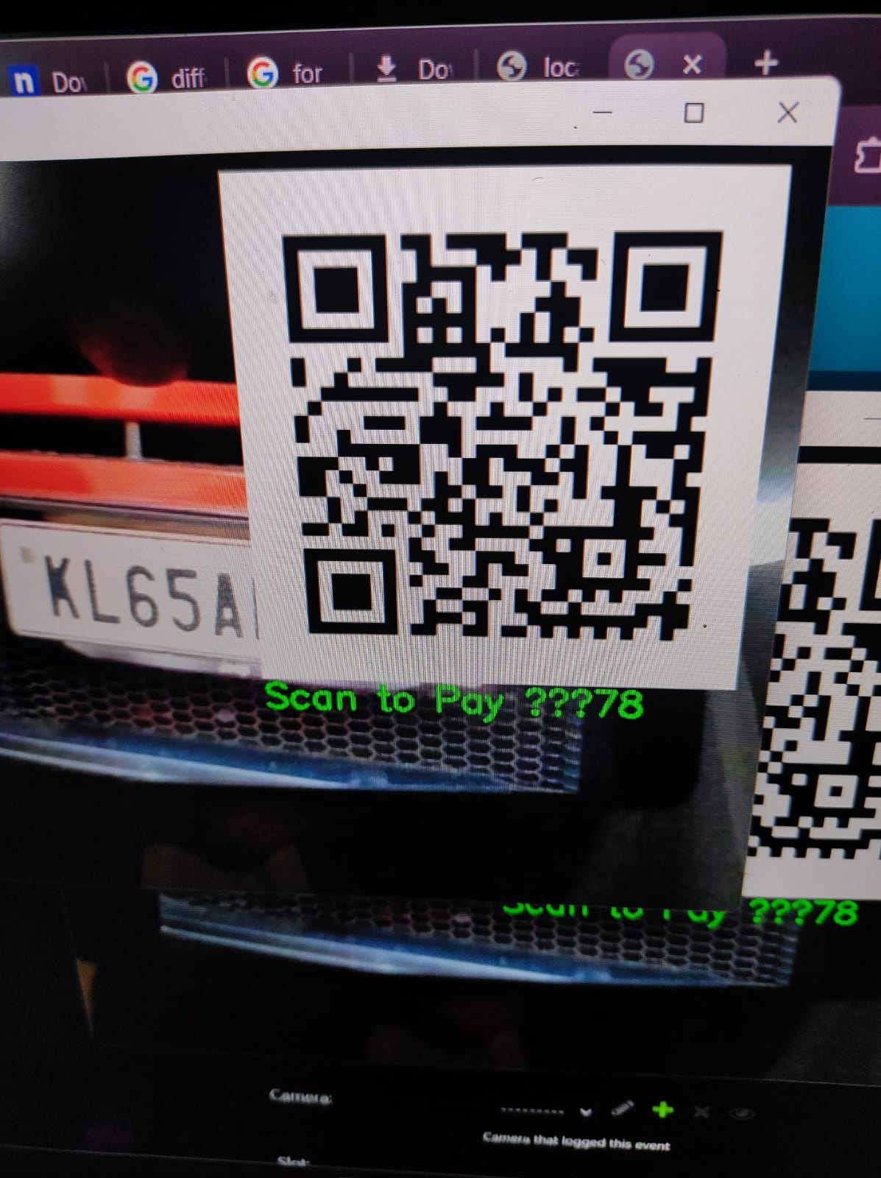
Results

Slide 20
Conclusions
Presented an end-to-end ANPR-driven parking system that automates entry, slot assignment, occupancy tracking, and exit payments.
Showcased integration of YOLOv8n for vehicle detection and EasyOCR for plate reading in a streamlined pipeline.
Delivered a responsive, web-based dashboard using Django Channels and HTMX—eliminating the need for dedicated hardware displays.
Validated core functionality in a 4-slot prototype, demonstrating reliable plate recognition and real-time updates.

Slide 21
Future Work
End-to-End Hardware Deployment: Incorporate real cameras, gate actuators, and LED guidance signs to fully realize the automated parking vision.
SaaS Platform: Evolve into a multi-tenant cloud service with centralized management, billing, and analytics.
Mobile & API Integrations: Offer native mobile apps and public APIs for seamless third-party integrations (e.g., EV charging, loyalty).
Advanced Analytics: Add demand forecasting, dynamic pricing models, and anomaly detection to optimize utilization.

Slide 22
References
1.“ParkNest – The Smart Parking System Using IoT,”, 2024.
2,“Efficient Smart Parking Space Identification and Classification System Using YOLOv8 Network Model,” Proc. IEEE Intl. Conf. on IoT & Distributed Computing Systems (IDCIoT), 2025.
3. “ChirpPark: A Smart and Sustainable Parking System Protocol for Smart Cities and Multi‑Agent Vehicles,” Proc. IEEE Smart Cities & Future Computing (SCFC), 2024.
4. “IoT Assisted Smart Parking System for Vehicles using Logical Sensors and Remote Monitoring Facility,” Proc. IEEE Int’l Conf. on Power, Electronics, Control & Transmission Systems (ICPECTS), 2024.
5. “Enhancing IoT ECO System – Smart Parking System,” unpublished, 2025.
://razorpay.com/docs/api/payment-links/

Slide 23
Thank You
We appreciate your attention. Please feel free to ask questions or request further technical details on the Intelligent Multi-floor parking management system.

