Slide 1

Introducing Planit: Your Personalized Guide to Self-Improvement
Welcome to Planit, your comprehensive app designed to help you achieve your goals and live a more fulfilling life. This app provides personalized guidance and support to help you build better habits, track progress, and unlock your full potential.

Slide 2

Habit Tracking: Stay Motivated and Reach Your Goals
Track your study sessions, recording the time spent on each subject and analyzing your progress over time. This feature will help you stay motivated and on track with your learning goals. You can set daily or weekly study goals and receive progress updates.

Slide 3
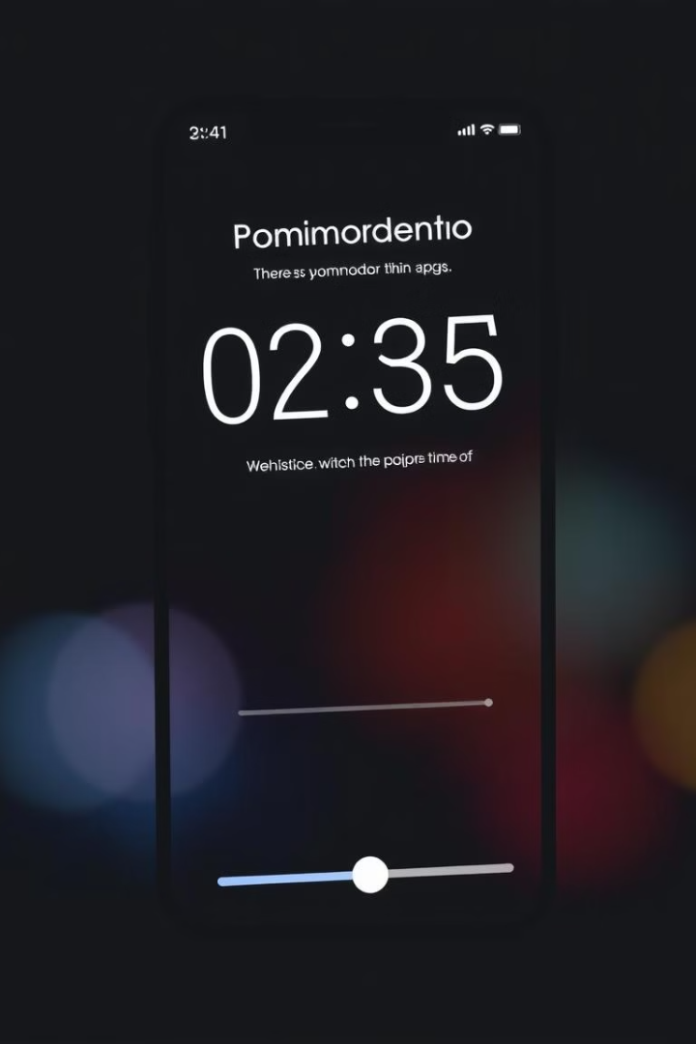



Productivity Timer: Boost Efficiency and Eliminate Distractions
Focus Sessions
Set focused work sessions using the Pomodoro technique, working in blocks of time with short breaks in between.
Minimize Distractions
Enable focus mode to block distracting notifications and websites, allowing you to concentrate on your tasks.
Track Your Time
Monitor your productivity levels with detailed statistics, analyze your work patterns, and identify areas for improvement.

Slide 4
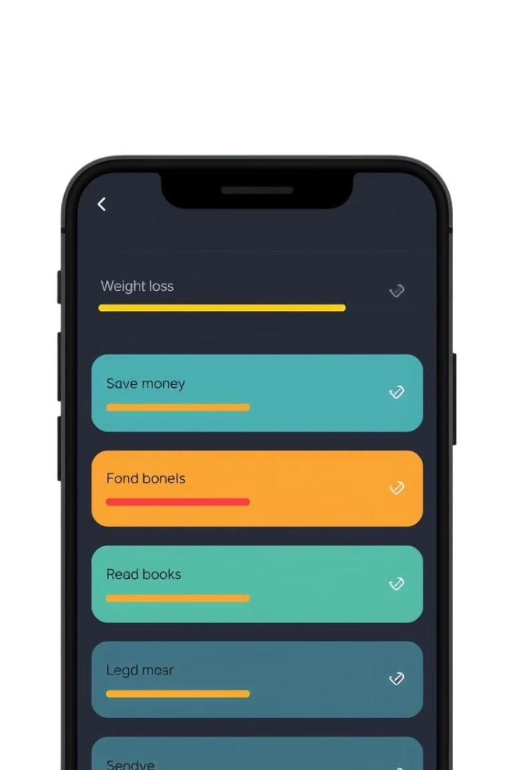
Personal Goal Tracking: Measure Your Progress and Celebrate Milestones
Set Goals
Track Progress
Set specific, measurable, achievable, relevant, and time-bound (SMART) goals to provide clear direction and motivation.
Monitor your progress towards your goals with visual representations, such as progress bars, charts, or graphs, to stay motivated.
Celebrate Milestones
Recognize and celebrate your achievements along the way, acknowledging your efforts and reinforcing your commitment to your goals.

Slide 5



How We Create It
1️⃣ UI/Design:
2️⃣ Functionality (Coding):
Keep the timer visible and user-friendly, using a modern dark theme to match your app's style.
Next, we design reusable components like buttons, icons, input fields, and checkboxes.

Slide 6
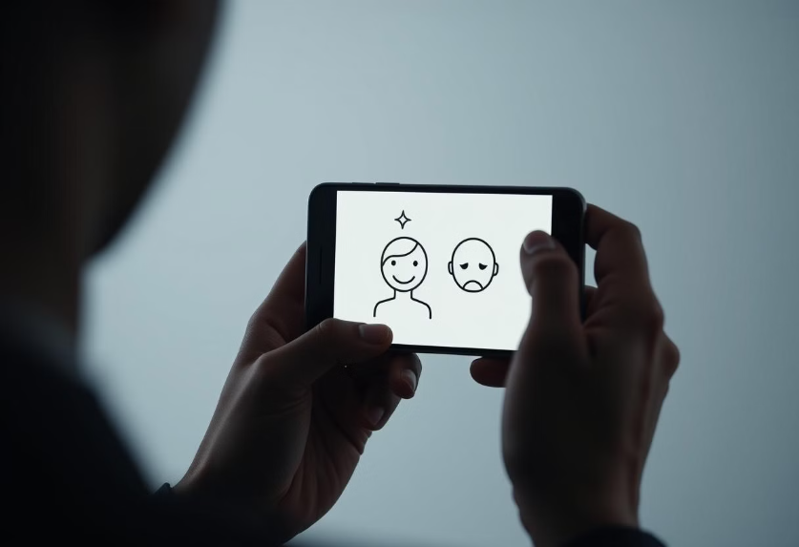
Key Challenges in Developing a Self-Improvement App
User Experience (UX)
Maintaining User Motivation
Personalization
Developing a successful self-improvement app requires addressing key challenges. UX must balance simplicity with engagement. Maintaining user motivation is crucial for long-term adoption. Personalization ensures users find value and trust. Protecting user data is paramount for building a strong foundation.

Slide 7
Our Team of Innovators
Mohammed Mahmoud
1
Team Leader, leading the vision and development of the app.
2
Antoniuos Sameh
Backend developer and system architect
Mohammed Ezat
3
Frontend developer, ensuring an intuitive user experience
4
Maryam Mahmoud
UX/UI designer creating engaging and user-friendly interfaces.
Menna Tarek
5
Content strategist, crafting helpful and inspiring in-app content.

Slide 8
Thank You
Thank you for taking the time to listen to my presentation.
I hope this information has been helpful and inspiring.

