Slide 1
Multiple React Roots POC
Technical Implementation & Analysis

Slide 2
Overview
• Multiple React roots in a single application
• Independent React instances
• Separate Virtual DOM trees
• Isolated state management

Slide 3
Implementation
1. We've created two separate root elements in the HTML (root1 and root2)
2. Each root has its own independent React application
3. We use createRoot() separately for each root element
4. Each application has its own state and lifecycle

Slide 4
Performance Analysis
• Each root maintains its own separate Virtual DOM tree
• Updates in one root don't trigger re-renders in the other root
• Memory usage will be slightly higher as each root maintains its own internal state
• The performance impact is generally minimal unless you're creating many roots
How Many Roots Would Impact Performance?
The performance impact of rendering multiple roots is minimal for a small number of roots (2-10 roots) because React efficiently manages updates using its Virtual DOM. However, significant performance issues may arise in cases where there are dozens or hundreds of roots, such as:
Rendering Overhead: Each root involves a separate Virtual DOM tree, requiring React to manage and reconcile changes independently.
Frequent Updates: If multiple roots are frequently updated (e.g., high-frequency animations or state changes), React will need to process each independently, increasing CPU usage.
Memory Usage: Each root requires its own state and lifecycle management, consuming additional memory.

Slide 5
Virtual DOM Behavior
• Each root operates independently
• State changes in one root don't affect the other
• React reconciliation happens separately for each root
• This isolation can actually be beneficial for performance in some cases

Slide 6
Best Practices and Use Cases
• Use multiple roots when you need truly independent React applications
• Good for micro-frontends architecture
• Useful for gradually migrating legacy applications to React
• Helpful when integrating React with other frameworks

Slide 7
Considerations
• State management becomes more complex if you need to share state between roots
• Context providers don't work across different roots
• Each root needs its own error boundaries
• Helpful when integrating React with other frameworks

Slide 8
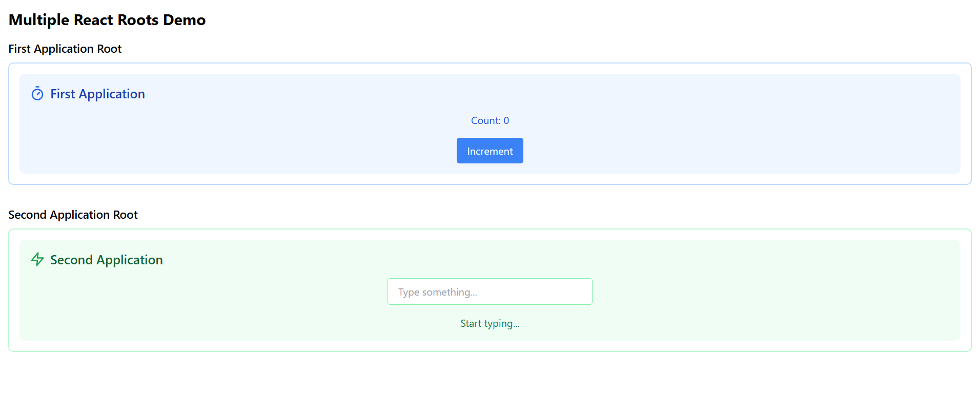
Demo
• First application has a counter with its own state
• Second application has a text input with its own state
• Each has distinct styling and functionality
• They operate completely independently
• This setup shows that multiple roots are not only possible but can be quite practical in certain scenarios. • The performance impact is minimal as long as you don't create an excessive number of roots.

