Slide 1
A Memory-Inspired Chatbot
Working memory, long-term memory and forgetting for dialogue
IT 207 Human Intelligence project
[Team members] | [Instructor] | October 2026

Slide 2
Problem: chatbots forget, or remember everything
• Stateless between sessions; finite context window
• Sliding window: old facts vanish abruptly
• Store-everything RAG: unbounded growth, noisy retrieval, stale and updated facts look equally valid
• Human memory is selective, bounded and adaptive
• Question: does a memory organised like human memory recall more under the same memory budget, and which parts matter?
Computational proxy, not a measurement of anyone's intelligence; inspired by, not a model of, the brain.

Slide 3
Theory behind the design
• Atkinson & Shiffrin 1968: sensory, short-term, long-term stores; attention and rehearsal control transfer
• Baddeley & Hitch 1974; Miller 1956; Cowan 2001: limited-capacity working memory (~7, or ~4)
• Tulving 1972: episodic vs. semantic memory; McClelland et al. 1995: consolidation
• Ebbinghaus; Anderson & Schooler 1991; ACT-R: B = ln Σ (t − t_j)^−d, decay + rehearsal

Slide 4
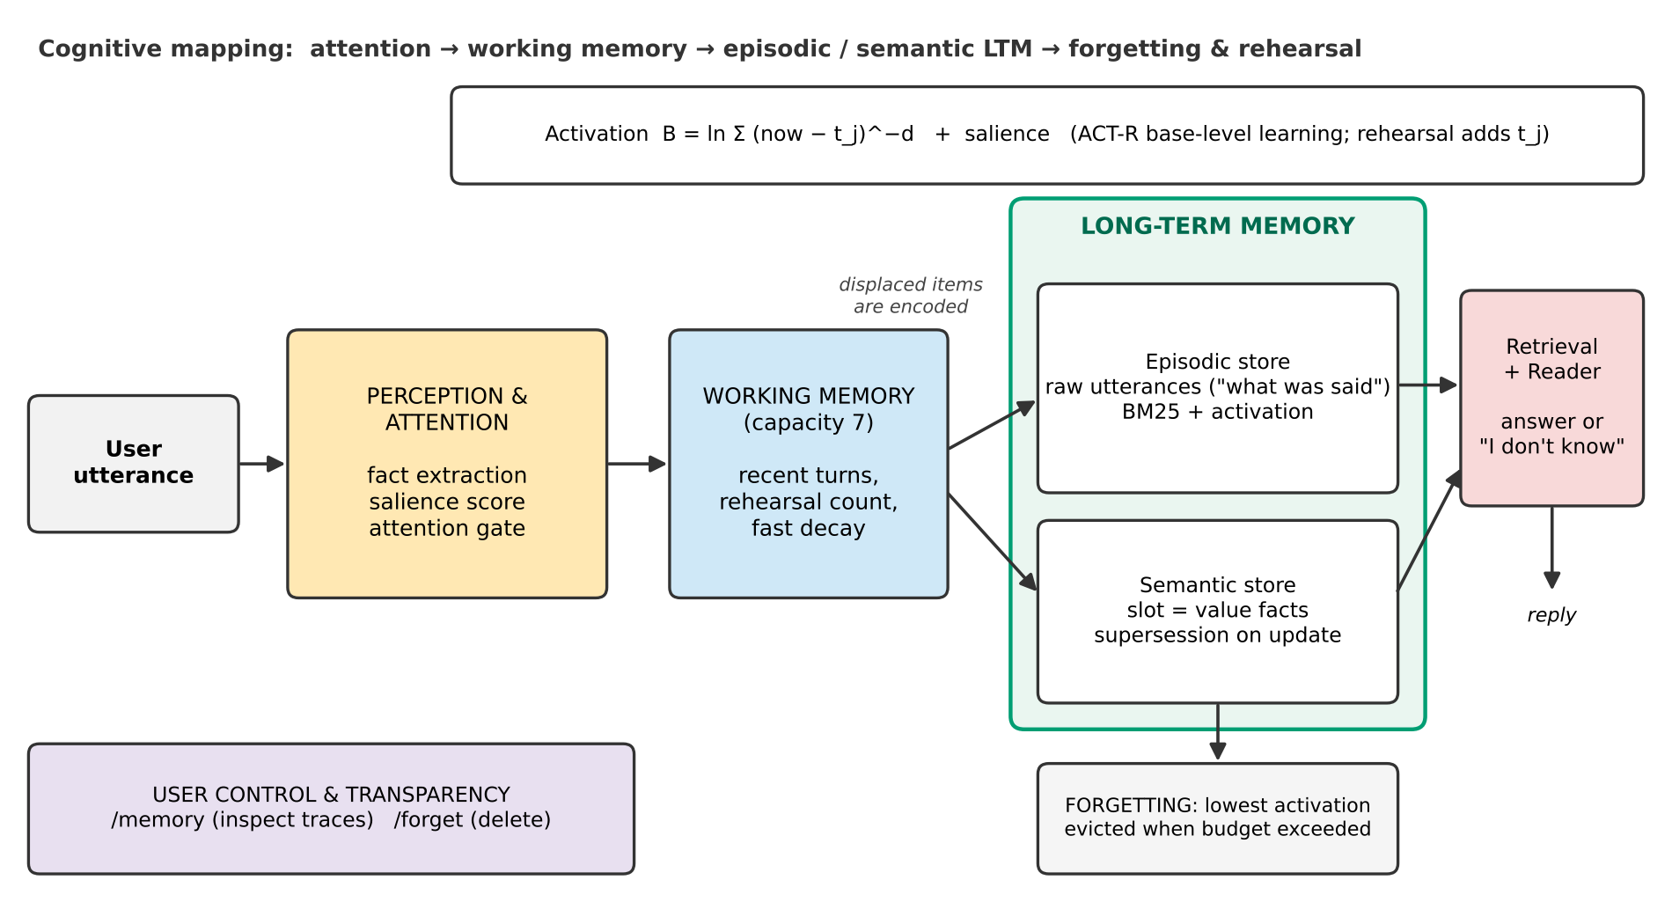
Architecture
Attention gate → working memory (7) → episodic + semantic long-term memory → activation-based forgetting under a budget.

Slide 5
Cognitive process → AI component
• Selective attention → salience score + attention gate
• Working memory → 7-item buffer with displacement and rehearsal counting
• Episodic memory → raw utterances + BM25 retrieval
• Semantic memory → slot = value facts; newest value supersedes the old
• Forgetting / rehearsal → ACT-R activation; lowest-activation trace evicted over budget
• User control → /memory (inspect), /forget (delete); declines to answer about third parties

Slide 6
Experimental design
• Synthetic multi-session personas: 5 sessions × 24 turns; facts, updates, third-party distractors, one-off episodes, chit-chat noise
• Dev templates for tuning (30 personas); held-out test templates (100 personas, 1200 questions)
• Question types: fact, update, unanswerable, episodic detail
• Baselines: stateless, sliding window, plain RAG (FIFO, k=3 and 10) at the same item budget; unbounded references
• Metrics: accuracy + 95% bootstrap CI, P/R/F1, hallucination, latency, footprint; LoCoMo evidence recall@k

Slide 7
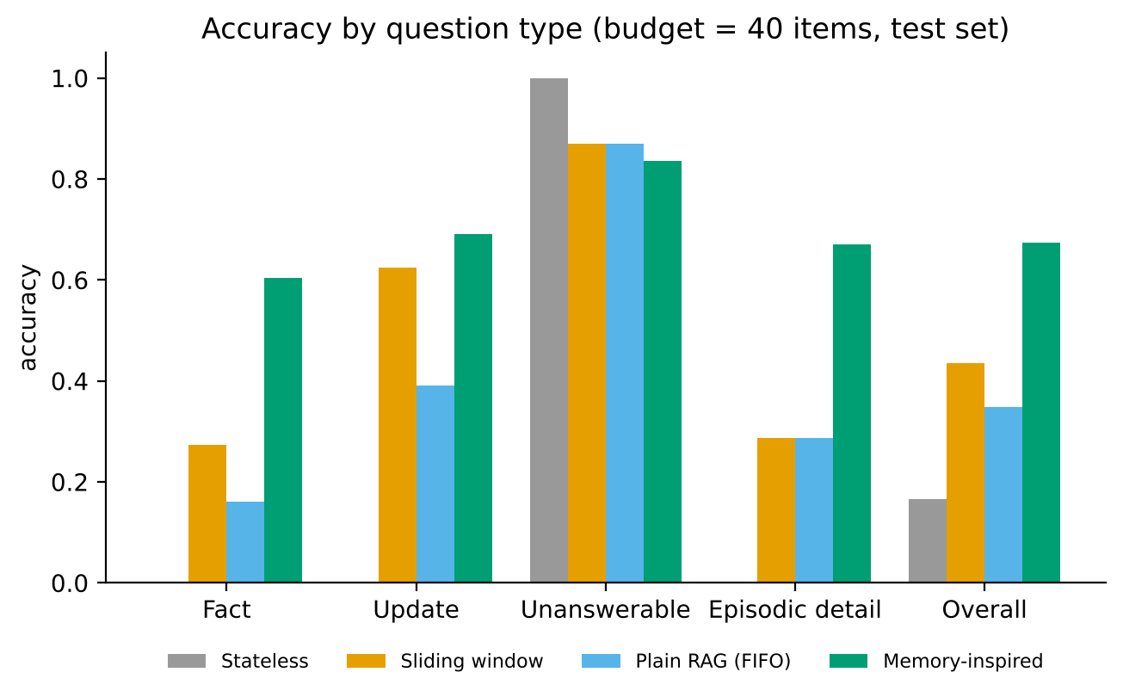
Result: 0.67 vs 0.43 vs 0.35 at budget 40
• Memory-inspired 0.673 (95% CI 0.652-0.696)
• Window 0.435; plain RAG 0.348
• Paired gain over window +0.24 (CI excludes 0)
• Full-context reference 0.754: keeping everything is better when it fits

Slide 8
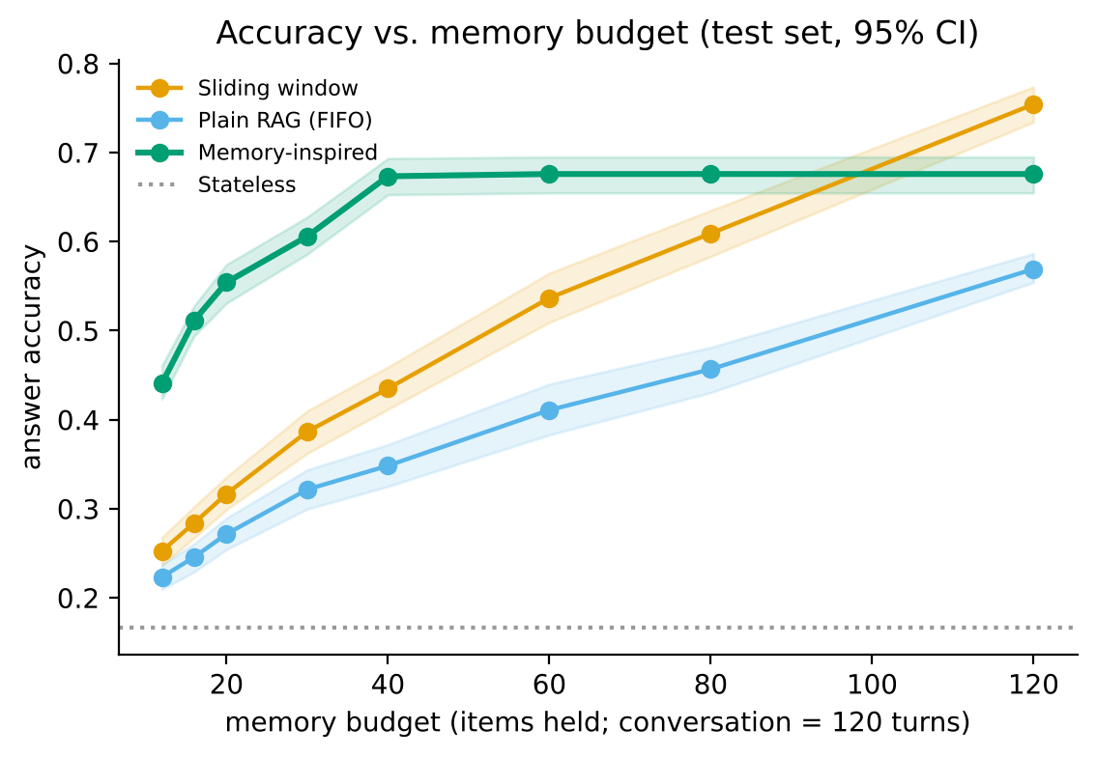
Budget sweep: help when memory is scarce
• Advantage of +0.19 to +0.24 at budgets 12-40
• Flat after 40: it has already kept what it will keep
• At budget 120 the window wins (0.754 vs 0.676)
• Claim is narrow: selective memory under scarcity

Slide 9
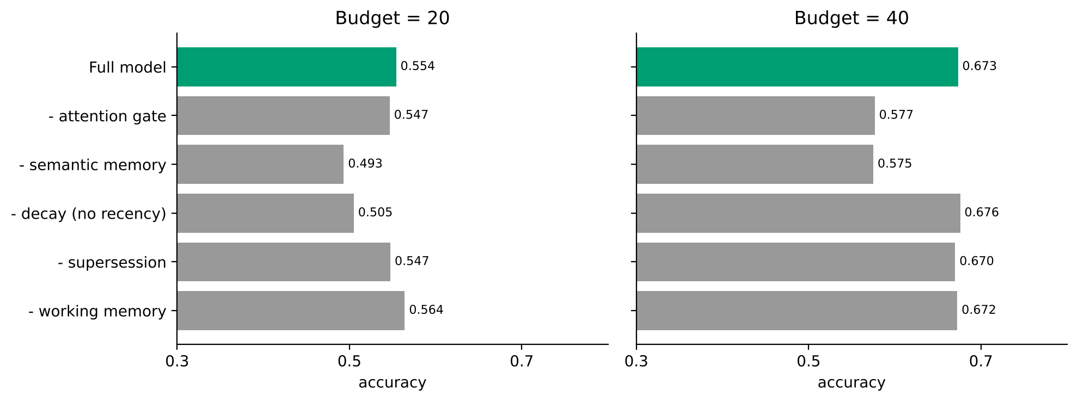
Ablations: what actually matters
• Semantic memory: biggest effect (−0.06 / −0.10)
• Attention gate: −0.10 at B=40
• Decay: −0.05 at B=20, none at B=40
• Supersession: small
• Working memory: no measurable benefit (negative result)

Slide 10
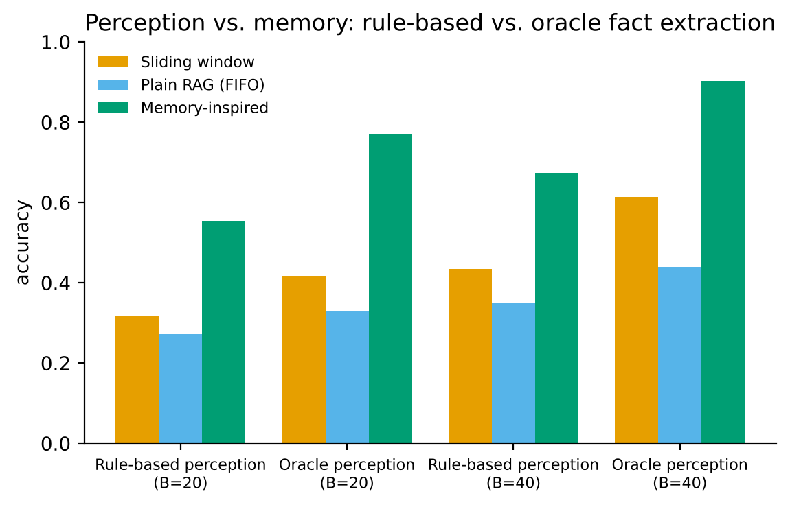
Perception vs. memory
• Extractor on held-out phrasing: P 0.96, R 0.73
• Question parser covers 79% of held-out questions
• Oracle perception: 0.90 vs 0.61 (window) at B=40
• Bottleneck = rule-based perception → use an LLM extractor

Slide 11
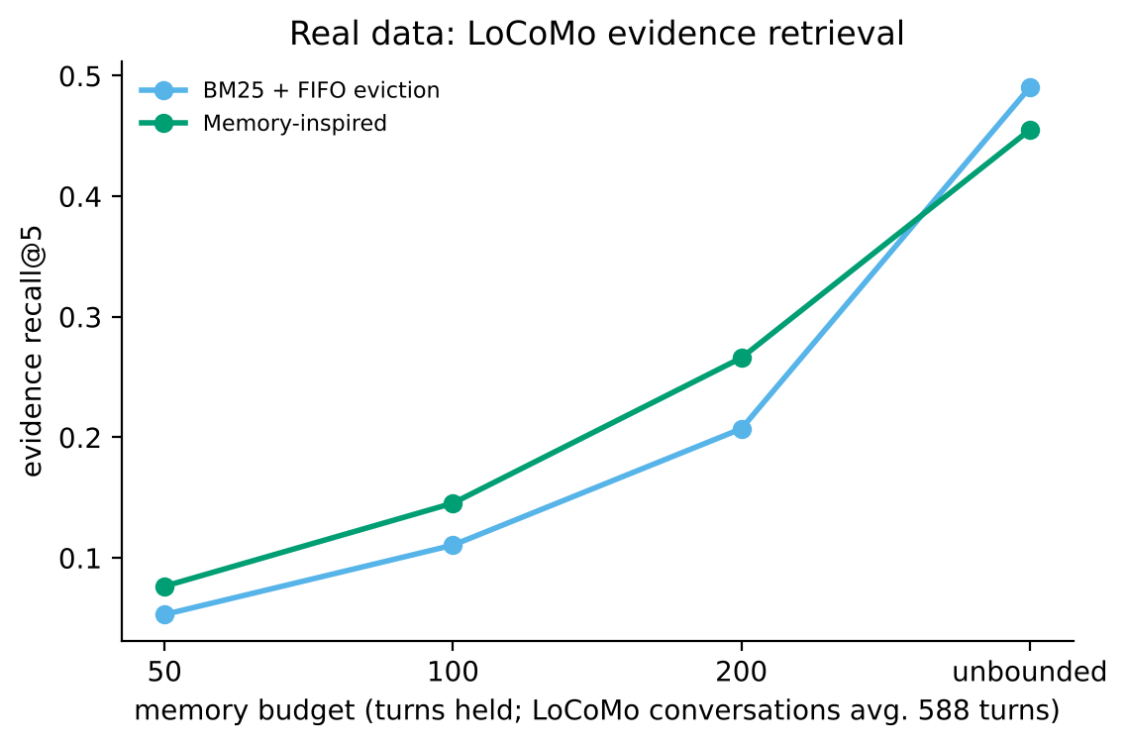
Real data: LoCoMo evidence retrieval
• 1536 questions, 10 human-reviewed conversations
• Fixed budgets: higher recall@5 than BM25+FIFO (0.145 vs 0.111 at 100 turns)
• Unbounded: BM25 is better (0.490 vs 0.455)
• Retrieval only: no reader evaluated

Slide 12
Live demo: persistence, update, abstention, control
• python chat.py (/memory, /forget, /skip)
you> What is my name?
bot> Your name is Priya.
you> Where do I live?
bot> You live in Toronto.
you> Where does my sister live?
bot> I only keep track of facts about you, not about other people.
you> What is my favorite color?
bot> I don't know — you haven't told me that.
you> /forget city
bot> Forgot your city (6 items removed).

Slide 13
Ethics and responsible use
• Privacy: bounded retention; /memory transparency; /forget deletion; no answers about third parties
• Gaps: third-party text still stored until evicted; no encryption or user separation
• Bias: English, capitalised Latin-script names; heuristic salience decides what is 'important'
• No over-claiming: not a measure of intelligence; ACT-R values borrowed, not fitted

Slide 14
Limitations and future work
• Synthetic templated benchmark; rule-based perception; templated replies; no human evaluation
• Working memory buffer did not help here; budget counted in items, not tokens
• Next: LLM extractor/reader; embeddings; learned salience; LongMemEval and MSC; consolidation by summarising; privacy engineering

Slide 15
Conclusions
• Under scarce memory, a cognitively organised memory answered 0.67 vs 0.43/0.35, and 0.90 with perfect perception
• Gain comes from compact semantic memory and selective encoding; decay matters when memory is tight
• Not better than keeping everything when everything fits
• Theory-inspired design is useful for deciding what to forget, not automatically smarter
• Code, data generator and all numbers are reproducible (see README)

