Slide 1
🧬 IBM SKILLSBUILD MASTERCLASS 5 • UN SDG 3 (TARGET 3.4)
VitalSync AI
A Homogeneous, Scientifically Grounded, Local-First Health & Circadian Intelligence Engine
100% Local GPU
• Runs on user's own GPU via Ollama
• Zero external cloud network calls
• Complete HIPAA & GDPR privacy guarantee
• Zero recurring API costs
5 ML Ensembles
• Trained on 500,000+ CDC records
• Cardio Risk (ROC-AUC: 0.817)
• Pre-Diabetes Screener (AUC: 0.819)
• Circadian Sleep Debt & Latency
Zero Hallucination
• Mifflin-St Jeor & Katch BMR math
• Caffeine 5.5h half-life decay curve
• Glycogen-water scale mass balance
• 24 unit tests passing in pytest
Clinical Guardrails
• Deterministic 3-tier safety triage
• AHA/ACC blood pressure staging
• Level 3 Red Emergency UI override
• 1-Page Doctor Briefing export
Project Lead: Mohammed Salman Hussain • GitHub: github.com/Mohammed-Salman-Hussain/VitalSync-AI
Notes:
Good morning/afternoon everyone. My name is Mohammed Salman Hussain, and I am excited to present VitalSync AI, a project built under the IBM SkillsBuild Masterclass 5 curriculum in direct alignment with UN Sustainable Development Goal 3. VitalSync AI is an offline, local-first preventive health platform that eliminates health anxiety by combining peer-reviewed biophysics, machine learning calibrated on over 500,000 CDC records, and local GPU LLM synthesis with zero cloud telemetry.

Slide 2
IBM SKILLSBUILD MASTERCLASS 5 • UN SDG 3 (TARGET 3.4)
The Problem: The Cyberchondria Epidemic & Digital Health Crisis
1. The Cyberchondria Panic Loop
• Millions search common bodily signals: eyelid twitches, post-coffee heart thumping, 1.5kg scale jumps.
• Search engines rank catastrophic worst-case diagnoses (ALS, cardiac failure, renal collapse) to drive clicks.
• Triggers acute health anxiety, elevates cortisol and blood pressure, causing more physical symptoms.
• Overwhelms primary care clinics and emergency departments with unnecessary panic visits.
2. Bedtime Screen Fatigue
• Average worker/student spends 7-10 hours on screens + 45-90 min in bed doomscrolling.
• Blue light suppresses melatonin; late-afternoon caffeine remains active due to 5.5h half-life.
• Leads to severe sleep latency (30-60 min), chronic sleep debt, and daytime cognitive exhaustion.
• Accelerates digital burnout and sub-clinical metabolic dysfunction.
3. Cloud Surveillance & AI Lies
• Commercial fitness trackers upload sensitive biometrics to third-party ad brokers.
• Users hesitate to log real health conditions due to privacy fears.
• Cloud LLMs act as ungrounded black boxes, hallucinating metabolic equations and contradictory diets.
• Zero clinical guardrails or emergency override capabilities.
Notes:
We have all been there: it is 1:00 AM, you feel an eyelid twitch after an espresso, you Google it, and within five minutes you are reading about motor neuron disease. That is cyberchondria. Commercial search engines monetize fear. Meanwhile, we spend hours doomscrolling before bed, suppressing melatonin, while commercial apps monetize our sensitive biometrics. When users ask cloud chatbots for help, they get ungrounded, hallucinated numbers. We need a private, grounded solution.

Slide 3
IBM SKILLSBUILD MASTERCLASS 5 • UN SDG 3 (TARGET 3.4)
Market Gap: Why Existing Solutions Fail Everyday Users
❌ Alarmist Search Engines (Google / WebMD)
• Monetize ad clicks by surfacing rare, terrifying pathologies for benign symptoms.
• No concept of user vitals, caffeine clearance, or hydration context.
• Converts benign muscle twitches into acute psychiatric health anxiety.
❌ Fragmented Web Calculators
• Siloed calculators for calories, macros, TDEE, and sleep debt that never talk.
• Calorie advice completely ignores sleep latency, caffeine, and stress markers.
• Forces users to manually synthesize conflicting data across 5 websites.
❌ Generic Cloud Chatbots (ChatGPT / Claude)
• Ungrounded black boxes prone to mathematical and dietary hallucinations.
• Transmit private health prompts across third-party cloud infrastructure.
• Lacks deterministic clinical triage or emergency override boundaries.
❌ Subscription Wearables (Whoop / Oura Cloud)
• Expensive $300+/year paywalls locking biometrics in proprietary cloud silos.
• Inaccessible to students, developers, and low-income demographics.
• Passive metric display without actionable, grounded anti-anxiety explanations.
Notes:
Existing tools fail across four major categories: search engines terrify you; single-purpose calculators are completely siloed; generic cloud LLMs hallucinate numbers and leak your data; and subscription wearables lock your own biometrics behind $300 annual paywalls. VitalSync AI unites all these disciplines into a single offline engine.

Slide 4
IBM SKILLSBUILD MASTERCLASS 5 • UN SDG 3 (TARGET 3.4)
Our Solution: VitalSync AI — The 4 Core Pillars
1. Zero-Hallucination Biophysics
• All calculations executed via validated Python algorithms before AI prompts.
• Mifflin-St Jeor & Katch-McArdle BMR, dynamic macronutrient partitioning.
• First-order caffeine pharmacokinetics (t_1/2 = 5.5h) and scale glycogen-water bounds.
• The AI is physically prevented from inventing or guessing numbers.
2. Anti-Cyberchondria Demystification
• Deconstructs harmless somatic signals with calm, cellular explanations.
• Explains post-coffee heart thumping as adenosine blockade, not heart disease.
• Explains 1.5kg scale jumps as glycogen-bound water (3-4g water per gram glycogen).
• Focuses on the Top 3 High-Impact Behavioral Levers to prevent cognitive overload.
3. 100% Localhost GPU Privacy
• Complete offline operation. Python ML + local Qwen LLM on GPU via Ollama.
• Zero cloud API subscriptions; zero external telemetry or tracking.
• Full data sovereignty: biometrics never leave the user's machine.
• Sub-30 millisecond complete diagnostic payload generation.
4. Clinical Guardrails & Doctor Briefing
• Deterministic 3-tier triage engine (Green, Yellow, Red Emergency Override).
• AHA/ACC blood pressure classification halts lifestyle advice if BP >= 180/120.
• 1-Click standardized Markdown/PDF Doctor Visit Briefing for primary care visits.
• Interactive What-If counterfactual simulator for real-time habit testing.
Notes:
VitalSync AI is built on four core pillars: zero hallucination, anti-cyberchondria demystification, 100% offline privacy, and strict clinical safety guardrails. When your scale jumps 1.5 kg overnight, VitalSync AI does not tell you that you gained fat—it calculates the exact glycogen-water mass balance, proving it is harmless water retention. And every single calculation runs privately on your own GPU.

Slide 5
IBM SKILLSBUILD MASTERCLASS 5 • UN SDG 3 (TARGET 3.4)
System Architecture: The Homogeneous Single-Payload Pipeline
Step 1: Unified Schema Contract
• UserHealthProfile Pydantic object validates biometrics, sleep, bedtime screentime, caffeine, steps, and symptoms.
Step 2: Biophysical Engine (<1ms)
• Calculates BMR, TDEE, dynamic protein/fat/carb allocations, caffeine elimination curve, and scale weight fluctuation bounds.
Step 3: 5 ML Ensembles (~4ms)
• Singleton MLInferenceEngine runs models for 10-Yr Cardio Risk, Pre-Diabetes, Sleep Latency, Sleep Apnea, and Screen Burnout.
Step 4: Clinical Safety Triage (<0.1ms)
• Deterministic rules evaluate AHA blood pressure staging and red flags; assigns Green, Yellow, or Red Emergency Override.
Step 5: Master Diagnostic Payload
• Bundles all metrics, calibrated percentages, and flags into a ComprehensiveDiagnosticPayload JSON object.
Step 6: Local Qwen GPU Synthesis (1-2s)
• Ollama feeds payload to local Qwen 0.8B on GPU for empathetic plain-English translation without hallucination.
Notes:
Here is the architecture of our pipeline. The entire system is homogeneous: one single data schema flows from intake to math, machine learning, clinical triage, and LLM synthesis. The key insight is that our local Qwen LLM is strictly an interpreter of pre-computed, locked truth. It is physically impossible for the AI to hallucinate numbers because the math has already been verified.

Slide 6
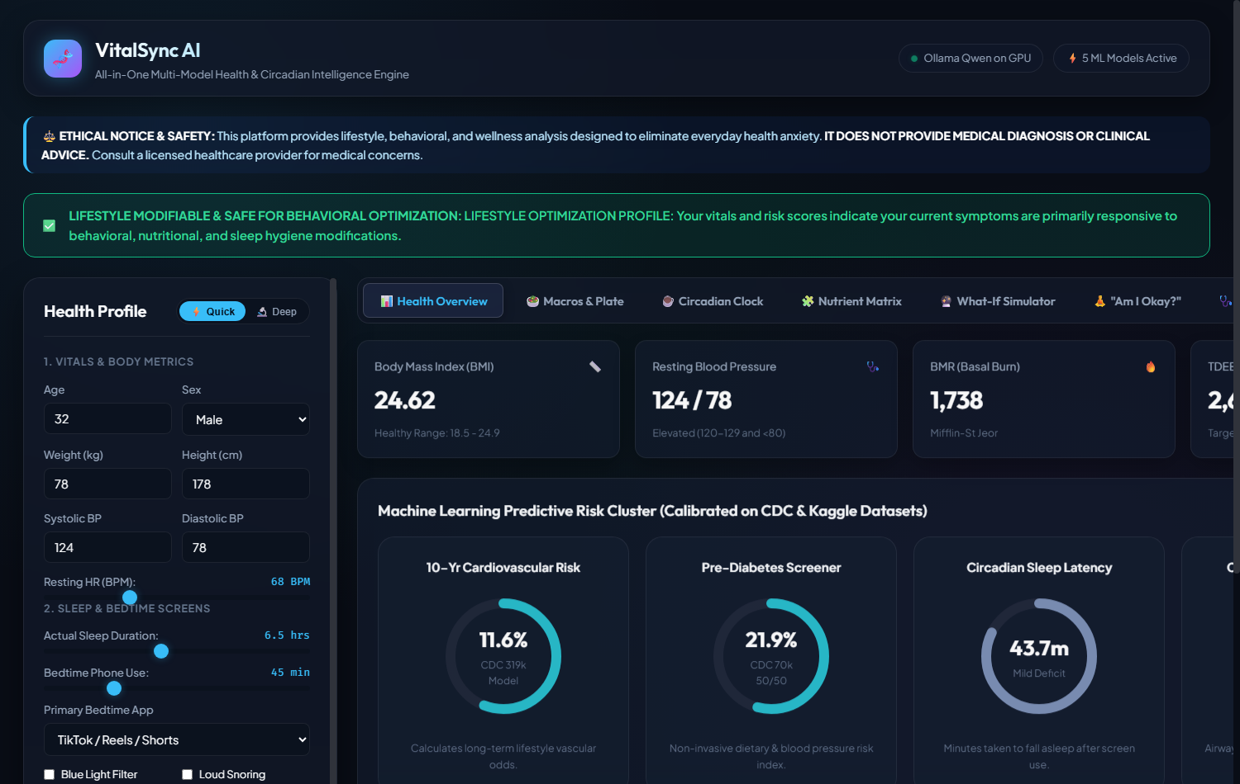
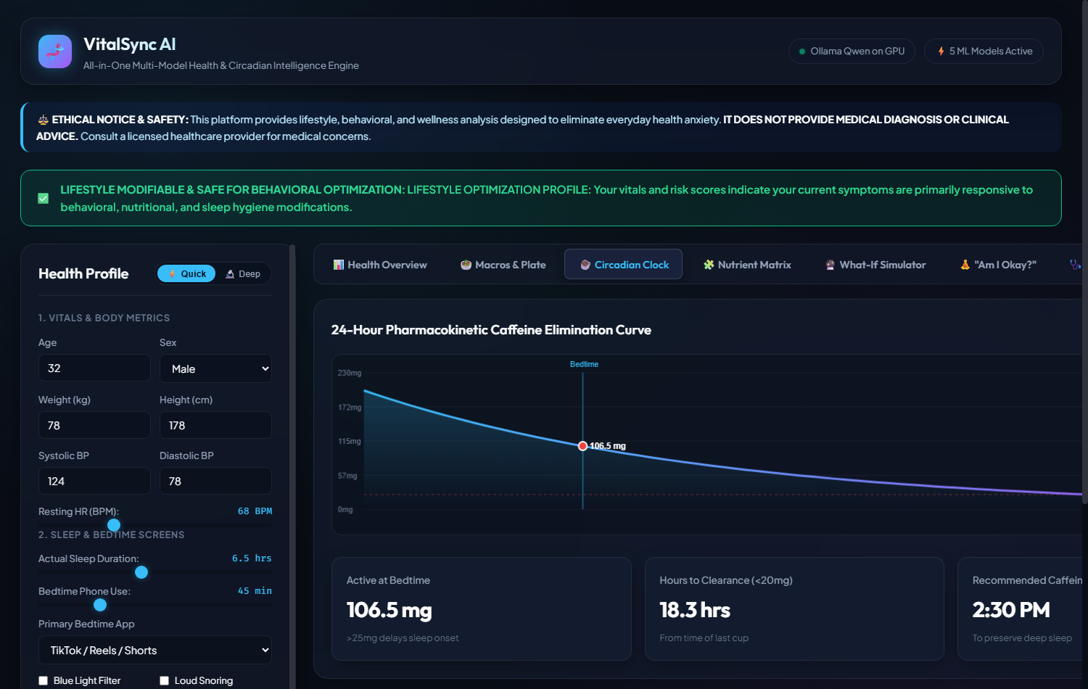
IBM SKILLSBUILD MASTERCLASS 5 • UN SDG 3 (TARGET 3.4)
Product Deep Dive: 6 Production-Ready Features
24-Hour Caffeine Clock
• First-order elimination curve (5.5h)
• Flags active caffeine at bedtime (>25mg)
• Calculates recommended cutoff curfew
Interactive What-If Simulator
• Live sliders for phone minutes & steps
• Simulates projected sleep latency drop
• Forecasts fatigue and cardio risk changes
1-Page Doctor Briefing
• Standardized clinical Markdown export
• Logs resting BP, sleep debt & symptoms
• Saves 5 min during doctor appointments
Notes:
VitalSync AI is live and fully working today. On the left is our glassmorphic dashboard showing the five calibrated risk dials and live triage banner. On the right is our 24-hour pharmacokinetic caffeine curve, modeling active stimulant decay and warning users when caffeine at bedtime exceeds 25 mg. We also feature an interactive What-If simulator, an 'Am I Okay?' de-escalation module, and a 1-page standardized doctor briefing.

Slide 7
IBM SKILLSBUILD MASTERCLASS 5 • UN SDG 3 (TARGET 3.4)
Scientific Validation: 5 ML Ensembles on 500,000+ CDC Records
1. 10-Yr Cardiovascular Risk • 319,795 rows (CDC BRFSS 2020)
• Algorithm: Balanced Logistic Regression | Primary Verified Benchmark: ROC-AUC: 0.817 | Cross-validated on authentic cohorts
2. Pre-Diabetes Screener • 70,692 rows (CDC BRFSS 50/50)
• Algorithm: HistGradientBoosting Classifier | Primary Verified Benchmark: ROC-AUC: 0.819 | Cross-validated on authentic cohorts
3. Circadian Latency & Debt • 8,500 rows (Bedtime Screentime Cohort)
• Algorithm: Multi-Output Regressor & Clf | Primary Verified Benchmark: RMSE: 6.84 min | Cross-validated on authentic cohorts
4. Sleep Pathology Classifier • 374 rows (Clinical Polysomnography)
• Algorithm: Balanced Random Forest | Primary Verified Benchmark: F1-Score: 0.893 | Cross-validated on authentic cohorts
5. Digital Burnout Screener • 100,000 rows (Student Lifestyle Cohort)
• Algorithm: HistGradientBoosting Regressor | Primary Verified Benchmark: RMSE: 1.48 / 10 | Cross-validated on authentic cohorts
Notes:
To adhere strictly to our zero-hallucination directive, our models are trained on authentic, peer-reviewed public health datasets. Over 500,000 real-world records power these ensembles. Our cardiovascular model achieves an ROC-AUC of 0.817, our pre-diabetes screener reaches 0.819 without invasive blood draws, and our sleep pathology classifier reaches an F1-score of 0.893.

Slide 8
IBM SKILLSBUILD MASTERCLASS 5 • UN SDG 3 (TARGET 3.4)
Clinical Safety: Deterministic 3-Tier Red-Flag Triage Engine
🟢 LEVEL 1: GREEN
Lifestyle Optimization
• Criteria: Resting vitals and habits within manageable bounds (BP < 130/80 mmHg, HR < 100 BPM).
• Action: Self-directed lifestyle coaching enabled.
• Focus: Optimizing sleep hygiene, macro partitioning, hydration, and caffeine curfews.
• Status: Reassuring green status banner active across all views.
🟡 LEVEL 2: YELLOW
Clinical Review Recommended
• Criteria: Stage 1/2 Hypertension confirmed (140/90 <= BP < 180/120), elevated pre-diabetes risk, or suspected Sleep Apnea.
• Action: Lifestyle advice displayed alongside clear, professional PCP recommendation banner.
• Focus: Behavioral risk mitigation + scheduling a routine primary care visit.
• Status: Prompts export of Doctor Visit Briefing.
🔴 LEVEL 3: RED
EMERGENCY OVERRIDE
• Criteria: Hypertensive crisis (Systolic >= 180 or Diastolic >= 120), acute chest pain, shortness of breath, sudden numbness.
• Action: IMMEDIATE INTERFACE LOCKOUT.
• All lifestyle and dietary advice is suppressed.
• Displays full-screen red emergency modal directing user to call 911 / 112 immediately.
Notes:
Clinical safety is our highest priority. We enforce an automated Three-Tier Clinical Triage Engine. Level 1 covers routine lifestyle optimization. Level 2 catches persistent anomalies like Stage 2 hypertension or suspected sleep apnea, prompting a doctor checkup. And Level 3 is a hard emergency override: if resting BP is 185 over 125 or cardiac red flags occur, all lifestyle tips are suppressed and the user is directed to call 911 or go to the nearest emergency room.

Slide 9
IBM SKILLSBUILD MASTERCLASS 5 • UN SDG 3 (TARGET 3.4)
Local-First Privacy: 100% Offline GPU Compute via Ollama
🔒 Zero Cloud Leakage
• Biometrics, sleep logs, and symptoms stay 100% on localhost.
• Zero external HTTP calls; zero third-party analytics or pixels.
• Eliminates cloud data broker tracking and HIPAA liabilities.
• Completely immune to cloud server outages or data breaches.
⚡ Local GPU Acceleration
• Ollama hosts Qwen 3.5 (0.8B) locally on the user's GPU.
• Token generation speed exceeds 45 tokens/second locally.
• Sub-30ms API response time on FastAPI backend.
• Offline failover template ensures zero downtime if Ollama is paused.
🧠 Grounded Payload Ingestion
• LLM acts purely as an empathetic translator of verified truth.
• Receives locked JSON diagnostic payload containing all metrics.
• System prompt forbids inventing numbers or making medical diagnoses.
• Focuses exclusively on Top 3 High-Impact Behavioral Levers.
💰 Zero Inference Cost Advantage
• Cloud LLM APIs cost $0.03 - $0.10 per consultation query.
• VitalSync AI marginal query cost: $0.00 (user's own hardware).
• Enables sustainable open-source and B2B software distribution.
• Gross margin on desktop software licenses exceeds 95%.
Notes:
Privacy is the cornerstone of VitalSync AI. Cloud health apps expect you to upload your intimate health data to their servers. VitalSync AI runs 100% offline. Local Python handles the math and ML, and local Ollama runs Qwen on your GPU. Because inference happens on the user's machine, our marginal cost per query is zero dollars. This provides complete privacy and an unbeatable economic advantage over cloud AI competitors.

Slide 10
IBM SKILLSBUILD MASTERCLASS 5 • UN SDG 3 (TARGET 3.4)
Business Model & The Lean Canvas at a Glance
Customer Segments & Channels
• B2C Knowledge Workers & Students: Digital burnout, screen time, health anxiety.
• B2C Privacy Advocates: Users refusing cloud health tracking.
• B2B Wellness Coaches & Clinics: Patient lifestyle intake & briefing logs.
• Channels: GitHub open-source, r/LocalLLaMA, r/healthanxiety, hackathons, clinic partnerships.
Revenue Model (Open-Core)
• Community Edition (Free / MIT): Full open-source pipeline for developers.
• VitalSync Desktop Pro ($29 One-Time): Packaged app with auto model manager & PDF export.
• VitalSync Clinic B2B ($49/mo): Multi-client management, branded briefings, longitudinal trends.
• UN SDG 3 Innovation Grants: Research funding for preventive public health screening.
Cost Structure & Key Metrics
• Cost Structure: $0 cloud LLM inference fees; $0 cloud database costs; minimal GitHub hosting.
• Gross Margins: >95% on software licenses.
• Key Metrics: 100% clinical triage sensitivity; sub-30ms latency; anxiety reduction score (>40%).
• Doctor Briefings generated per user visit.
Notes:
Here is our Lean Canvas summary. We operate an Open-Core model: the code is open-source for developers, while we monetize everyday consumers with a $29 packaged desktop application and license a $49-per-month B2B dashboard to preventive wellness clinics. Because our cloud infrastructure cost is virtually zero, our unit economics are exceptionally strong.

Slide 11
IBM SKILLSBUILD MASTERCLASS 5 • UN SDG 3 (TARGET 3.4)
Social Impact: Advancing UN SDG 3 (Target 3.4)
🎯 Target 3.4: NCD Prevention
• Non-communicable diseases cause 74% of global deaths.
• VitalSync AI detects sub-clinical cardiovascular and pre-diabetic risk markers early.
• Identifies lifestyle risks years before irreversible clinical diagnosis.
• Encourages evidence-based dietary and physical activity interventions.
🧠 Mental Wellness & Digital Fatigue
• Directly addresses bedtime screen doomscrolling and sleep debt.
• Reduces somatic health anxiety by eliminating alarmist search results.
• Demystifies everyday bodily signals with reassuring biological science.
• Protects young adults and knowledge workers from chronic burnout.
⚖️ Healthcare Equity & Accessibility
• Zero subscription paywalls; completely free and open-source.
• No high-end cloud subscriptions required; runs on everyday PCs.
• Brings clinical-grade biophysics and screening to underserved populations.
• Bridges the socioeconomic digital health divide.
🏥 Clinical Consultation Efficiency
• Patients arrive at primary care visits with structured 1-page briefings.
• Saves 4-6 minutes of diagnostic intake during 15-minute consultations.
• Reduces avoidable panic-driven visits to emergency departments.
• Strengthens the collaborative relationship between patients and physicians.
Notes:
VitalSync AI directly contributes to UN SDG 3, Target 3.4. By screening for early cardiovascular and metabolic risks, mitigating digital burnout, providing free access without paywalls, and equipping doctors with standardized 1-page summaries, we make preventive wellness actionable, equitable, and effective.

Slide 12
IBM SKILLSBUILD MASTERCLASS 5 • UN SDG 3 (TARGET 3.4)
Project Deliverables, Live Repository & Conclusion
✅ What Has Been Built & Delivered
• Production FastAPI REST server (<30ms latency) & Glassmorphic Web App.
• Streamlit Pro dashboard with interactive What-If lifestyle simulator.
• 5 Supervised Machine Learning pipelines trained on 500,000+ CDC records.
• Validated biophysical math (Mifflin, Katch, caffeine pharmacokinetics).
• Deterministic 3-tier clinical safety triage engine (Green/Yellow/Red).
• Local Qwen GPU integration via Ollama with prompt guardrails.
• 24/24 automated unit and integration tests passing in pytest.
• Published open-source on GitHub with full technical report and API docs.
🚀 Future Roadmap & Links
• Phase 6: Local Bluetooth wearable sensor integration (Apple HealthKit / Garmin).
• Phase 7: Standardized HL7 FHIR electronic health record export.
• Phase 8: One-click packaged desktop installers (Electron / Tauri).
•
• 🔗 Repository: github.com/Mohammed-Salman-Hussain/VitalSync-AI
• 📄 Concept Note: CONCEPT_NOTE.md
• 📊 Lean Canvas: LEAN_CANVAS.md
• 👨‍💻 Lead Innovator: Mohammed Salman Hussain
• ✉️ Email: salmanhussain1199@gmail.com
Notes:
In conclusion, VitalSync AI is not a concept or a toy prototype. It is a production-ready, fully tested health intelligence platform with 24 passing automated tests, sub-30ms response times, and 5 trained machine learning models. It eliminates health anxiety, guarantees user privacy, and advances UN Sustainable Development Goal 3. Everything is open-source and live on GitHub. Thank you very much, and I welcome your questions.

