Slide 1
Module 5
Index Structures For Files

Slide 2
Indexing in Database
Indexing improves database performance by minimizing
the number of disc visits required to fulfill a query.
It is a data structure technique used to locate and quickly
access data in databases. Several database fields are used to
generate indexes.
The main key or candidate key of the table is duplicated in
the first column, which is the Search key.
To speed up data retrieval, the values are also kept in sorted order. It
should be highlighted that sorting the data is not required.
The second column is the Data Reference or Pointer which contains a
set of pointers holding the address of the disk block where that
particular key value can be found.

Slide 3
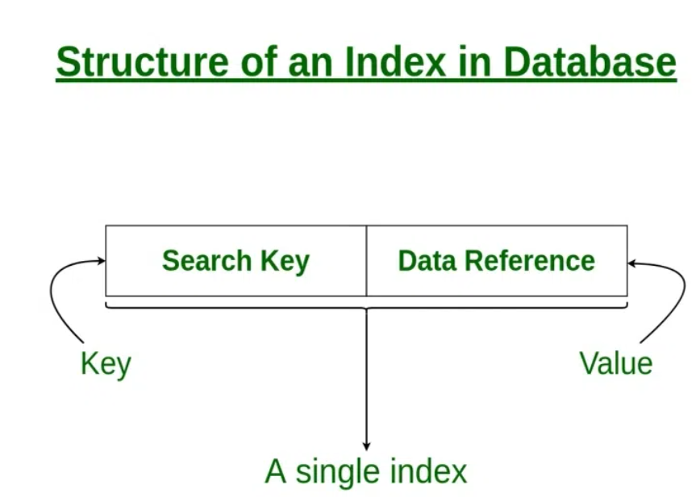

Slide 4
Attributes of Indexing
Access Types: This refers to the type of access such as
value-based search, range access, etc.
Access Time: It refers to the time needed to find a
particular data element or set of elements.
Insertion Time: It refers to the time taken to find the
appropriate space and insert new data.
Deletion Time: Time taken to find an item and delete it as
well as update the index structure.
Space Overhead: It refers to the additional space required by the index.

Slide 5
Sequential File Organization or Ordered Index File
In this, the indices are based on a sorted ordering of
the values. These are generally fast and a more
traditional type of storing mechanism.
These Ordered or Sequential file organizations might
store the data in a dense or sparse format.

Slide 6
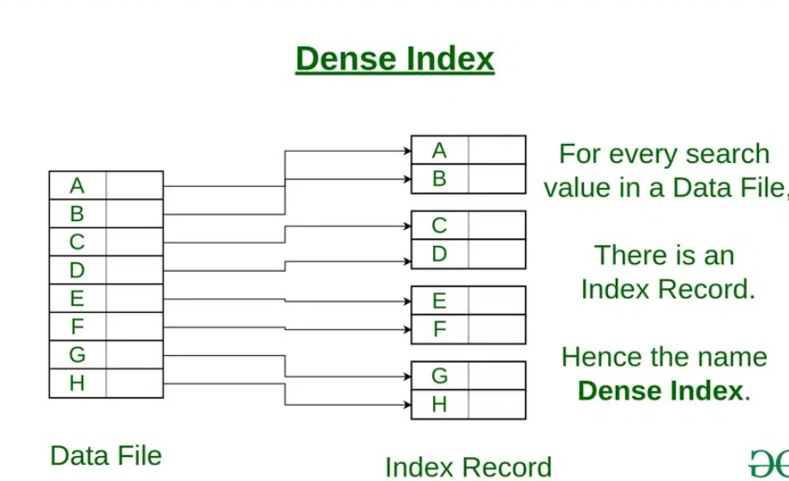
Dense Index:
For every search key value in the data file, there is an index record.
This record contains the search key and also a reference to the first data record with that search key value.

Slide 7
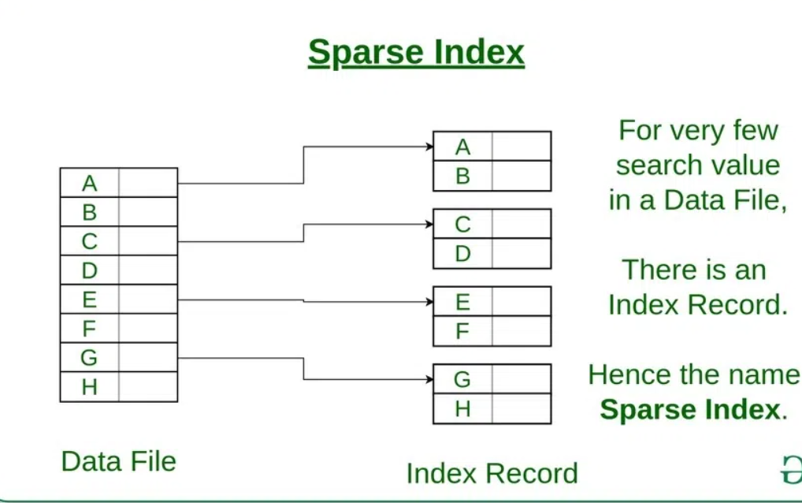
Sparse Index:
The index record appears only for a few items in the data file. Each item points to a block as shown.
To locate a record, we find the index record with the largest search key value less than or equal to the search key value we are looking for.
We start at that record pointed to by the index record, and proceed along with the pointers in the file (that is, sequentially) until we find the desired record.
Number of Accesses required=log₂(n)+1, (here n=number of blocks acquired by index file)

Slide 8
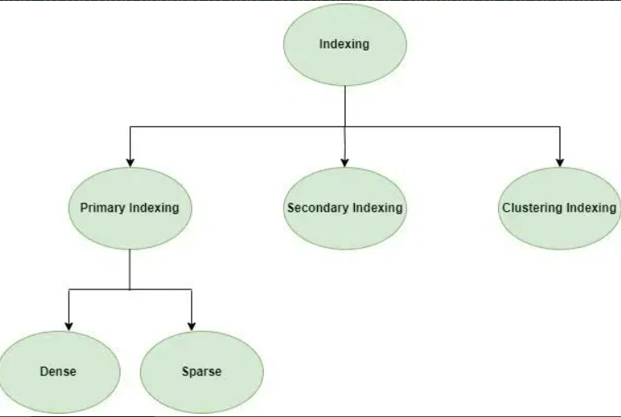
In general, there are two types of file organization mechanisms that are followed by the indexing methods to store the data.
Single Level Ordered Indexes – Primary indexes, clustering indexes and Secondary indexes
Multi-level indexes- Dynamic Multilevel indexes using B-trees

Slide 9
Single Level Ordered Indexes:
Primary Indexing:
A primary index is an ordered file whose records are of fixed length with two fields:
The first field is the same as the primary key of data file.
The second field is a pointer to the data block where the primary key is available.
Types of Primary Indexing
Dense Indexing: In Dense Index has an index entry for every search key value in the data file. This approach ensures efficient data retrieval but requires more storage space.
No of Index Entry = No of DB Record
Sparse Indexing: Sparse indexing involves having fewer index entries than records. The index entries point to blocks of records rather than individual records. While it reduces storage overhead, it may require additional disk accesses during retrieval.
No of Index Entry = No of Block

Slide 10
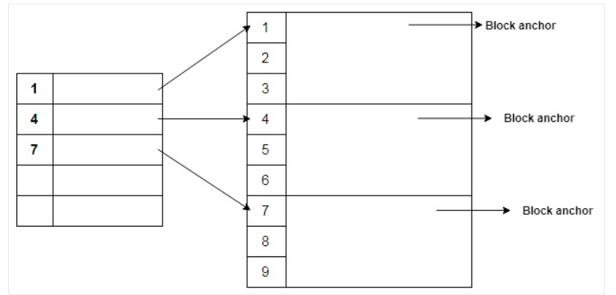
Index created for the first record of each block is called block anchors. In primary indexing, the number of index entries = the number of original data blocks. The average number of block accesses using primary index is:
$\log_{2}B_i + 1$ ,
where $B_i$ is the number of blocks in the indexed records
The rightmost figure refers to the original data records divided into several blocks. Note that column containing the numbers 1,2,3,...,9 are the primary keys. The leftmost figure refers to the indexed entries where each entry consists of:
The first entry of each data block (block anchor)
The second entry denotes the block pointer.

Slide 11
Clustering Index
A clustered index can be defined as an ordered data
file. Sometimes the index is created on non-primary
key columns which may not be unique for each record.
In this case, to identify the record faster, we will group
two or more columns to get the unique value and
create index out of them. This method is called a
clustering index.
The records which have similar characteristics are
grouped, and indexes are created for these group.

Slide 12
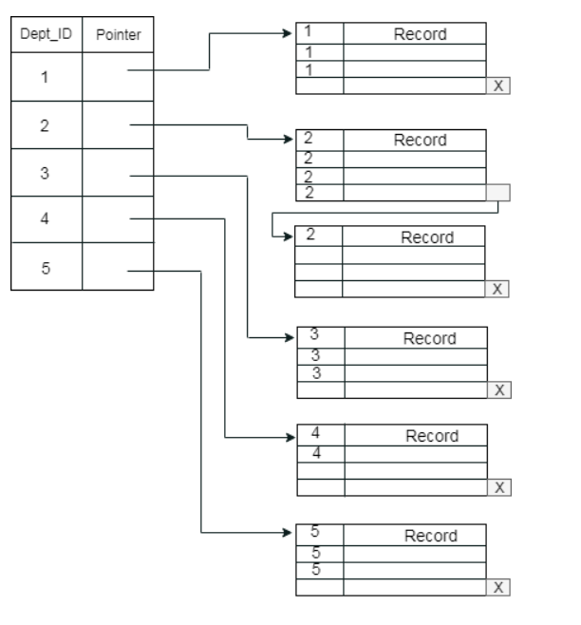
Example: suppose a company contains several
employees in each department. Suppose we use a
clustering index, where all employees which belong to
the same Dept_ID are considered within a single cluster,
and index pointers point to the cluster as a whole. Here
Dept_Id is a non-unique key.

Slide 13
Secondary Indexing
In secondary indexing, to reduce the size of mapping,
another level of indexing is introduced.
In this method, the huge range for the columns is
selected initially so that the mapping size of the first
level becomes small.
Then each range is further divided into smaller ranges.
The mapping of the first level is stored in the primary
memory, so that address fetch is faster.
The mapping of the second level and actual data are
stored in the secondary memory (hard disk).

Slide 14
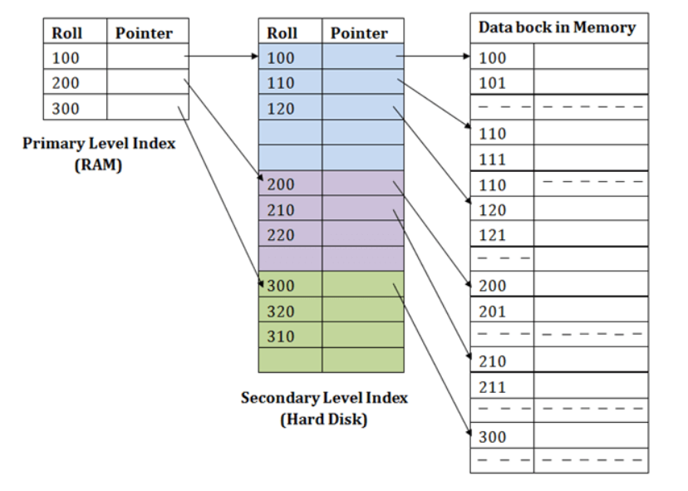
For example:
If you want to find the record of roll 111 in the diagram, then it
will search the highest entry which is smaller than or equal to 111 in
the first level index. It will get 100 at this level.
Then in the second index level, again it does max (111) <= 111 and gets 110. Now using the address 110, it goes to the data block and
starts searching each record till it gets 111.
This is how a search is performed in this method. Inserting, updating or deleting is also done in the same manner.

Slide 15
Multi Level Indexing
As the size of the database increases, the size of the index also increases. But, storing a single- level index in main memory may not be practical due to its large size, which requires multiple disk accesses.
To solve this problem multilevel indexing is used. This technique breaks down the main block into smaller blocks. Each smaller block can be stored in a single block. The outer block is further divided into inner blocks, each of which is associated with a data block. This approach reduces overhead and makes it easier to store the index in main memory.

Slide 16
Multilevel indexes refer to a hierarchical structure of indexes. Here, each level of the index provides a more detailed reference to the data. It allows faster data retrieval, reduces disk access, and improves query performance. Multilevel indexes are essential in large databases where traditional indexes are not efficient.
A multi-level index can be created for any first-level index (primary, secondary, or clustering) that has more than one disk block. It's like a search tree, but adding or removing new index entries is challenging because every level of the index is an ordered file.

Slide 17
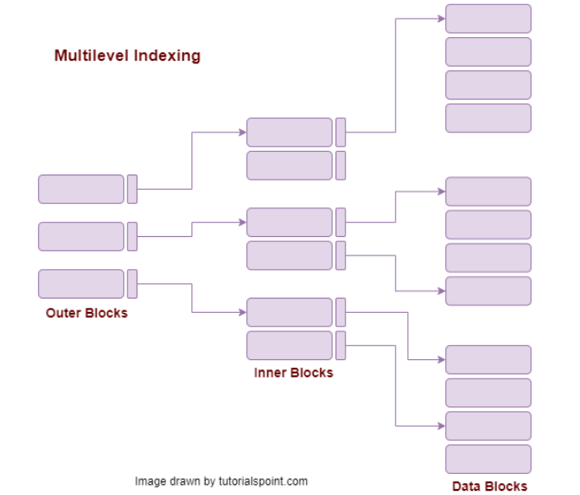

Slide 18
Dynamic Multilevel Indexing
To retain the benefits of using multilevel indexing while reducing index insertion and deletion problems, designers adopted a multilevel index called a dynamic multilevel index that leaves some space in each of its blocks for inserting new entries and uses appropriate insertion/deletion algorithms for creating and deleting new index blocks when the data file grows and shrinks.
B-trees and B⁺-trees are special cases of the well-known search data structure known as a tree.

Slide 19
B-Tree
B Tree is a specialized m-way tree that can be widely used for disk access.
B-Tree of order m can have at most m-1 keys and m children. One of the
main reason of using B tree is its capability to store large number of keys in
a single node and large key values by keeping the height of the tree
relatively small.
B tree of order m contains all the properties of an M way tree. In addition, it contains the following properties.
Every node in a B-Tree contains at most m children.
Every node in a B-Tree except the root node and the leaf node contain at least m/2 children.
The root nodes must have at least 2 nodes.
All leaf nodes must be at the same level.
It is not necessary that, all the nodes contain the same number of children but, each node must have m/2 number of nodes.

Slide 20
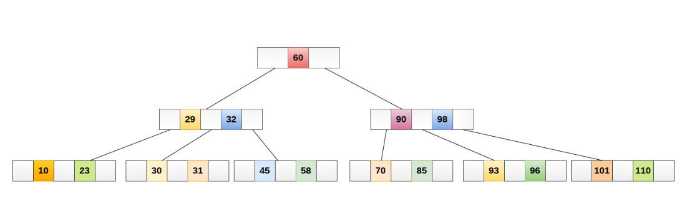
B tree of order 4 is shown in the following image.

Slide 21
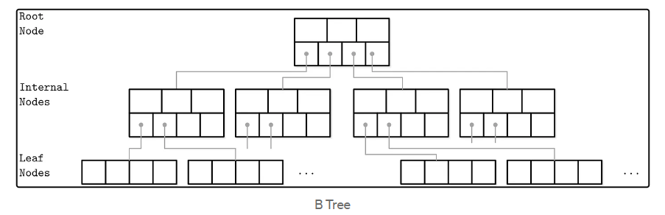
B-Tree
B-Tree is a self-balancing tree data structure that
maintains sorted data and allows searches, but it
generalizes the binary search tree, allowing for nodes
with more than two children.
More formally, each node has between k to 2k key-
value pairs and k+1 to 2k+1 child pointers except the
root node with as few as 2 children even when k is a
high number.

Slide 22
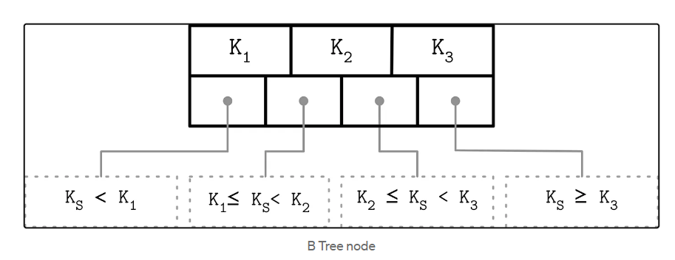
Searching, Inserting, and Deleting
Searching
Searching a B-Tree is done using a binary search. The
algorithm starts with the root node and traverses all
the keys until it finds the first key greater than the
searched value. Then, we descend toward the relevant
subtree using the corresponding child pointer and
repeat the process until the value is found.

Slide 23
Range scans are also possible by finding the starting
key of the scan and following sibling pointers until the last
node is found. This is not optimal as values are spread across
many nodes. A better approach is using a B+ tree, a modification of B-Tree.
Insertion
Insertion is done by performing a search and inserting the value at the
correct index. Insertion might cause the tree to get out of balance if a node
has too many values (n>2k).
In that case, the tree will be balanced using node split. Splitting is done by
allocating a new node, transferring half of the key-value pairs there, and
adding its first key and a pointer to that node to the parent node. If it’s a
non-leaf node, then all the child pointers after the splitting point will be moved as well.

Slide 24
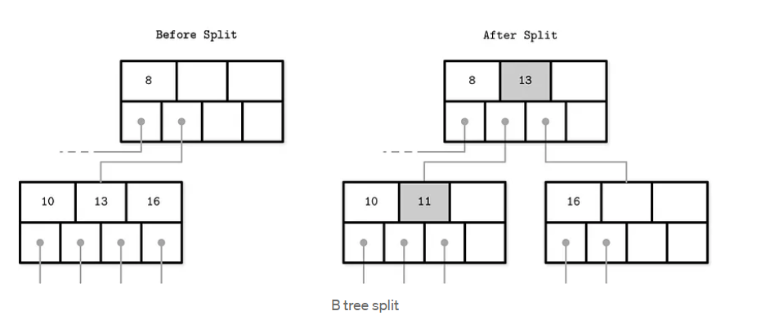
The first key and a corresponding pointer are moved to the parent, thus
increasing its occupancy. This might result in overflow again, so rebalancing
has to be repeated recursively all the way up the tree.
The first key and a corresponding pointer are moved to the parent, thus
increasing its occupancy. This might result in overflow again, so rebalancing
has to be repeated recursively all the way up the tree.

Slide 25
Deleting
When deleting, the target node and the deletion index
are located. After removing, a node can get out of
balance by having too few values (n<k). It can be solved
either by merging nodes or by rotating.
Rotation can be done to the right or the left,
depending on which node has an item to spare. A right
rotation, for example, is done by copying the separator
key from the parent to the start of the underflow node
and replacing the separator key with the last element
of its left sibling. When rotating a non-leaf node, the
last child pointer of the left sibling is moved to the start of
the unbalanced one. A similar approach is made when
performing a left rotation.

Slide 26
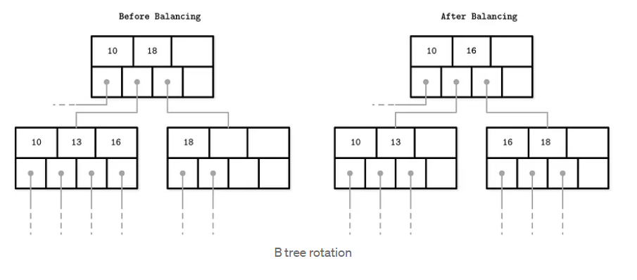
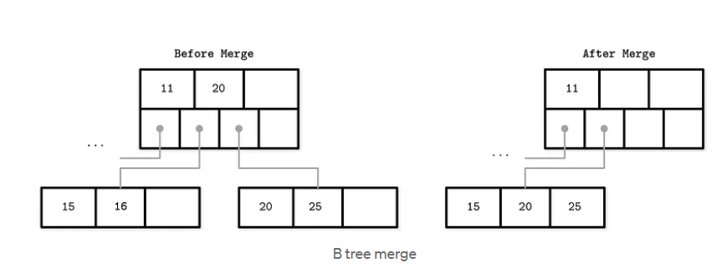
If no sibling can spare an element (has k elements), the deficient node must be merged with a sibling. The merge causes the parent to lose a separator element, so the parent may become deficient and need rebalancing. Rebalancing may continue all the way to the root.

Slide 27
Hashing:
Hashing technique is used to calculate the direct location of a data record on the
disk without using index structure.
The hashing technique utilizes an auxiliary hash table to store the data records
using a hash function.
There are 3 key components in hashing:
Hash Table: A hash table is an array or data structure and its size is determined by
the total volume of data records present in the database. Each memory location in a hash table is
called a ‘bucket‘ or hash in dice and stores a data record’s exact location and can be accessed
through a hash function.
Bucket: A bucket is a memory location (index) in the hash table that stores the data record. These
buckets generally store a disk block which further stores multiple records. It is also known as the
hash index.
Hash Function: A hash function is a mathematical equation or algorithm that takes one data
record’s primary key as input and computes the hash index as output.

Slide 28
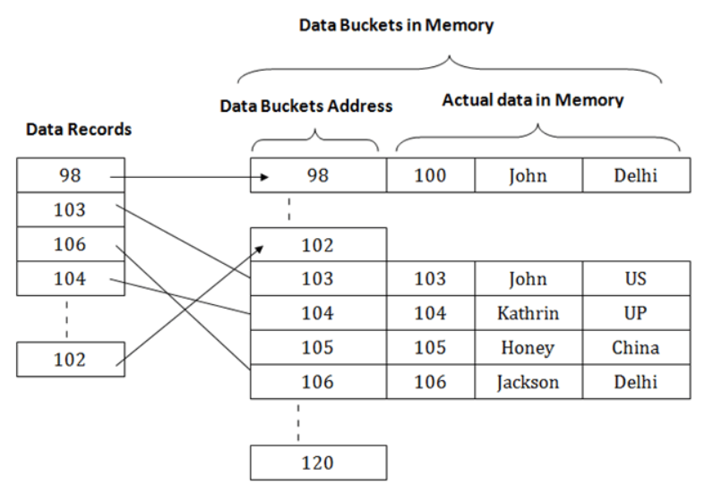
The above diagram shows data block addresses same as primary key value.

Slide 29
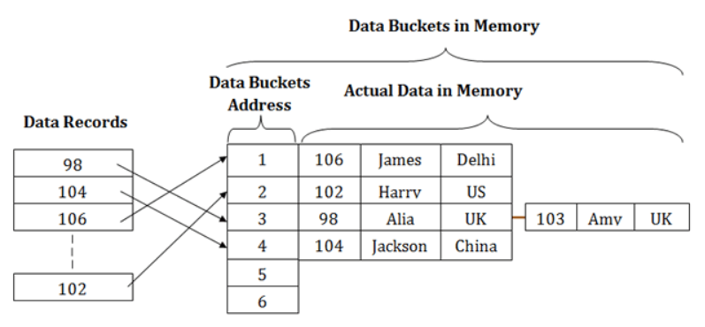
Hash function can also be a simple mathematical function like exponential, mod, cos, sin, etc. Suppose
we have mod (5) hash function to determine the
address of the data block.
Let us apply mod (5) hash function on the primary
keys and it generates 3, 3, 1, 4 and 2 respectively, and records are stored in those data block addresses.

Slide 30
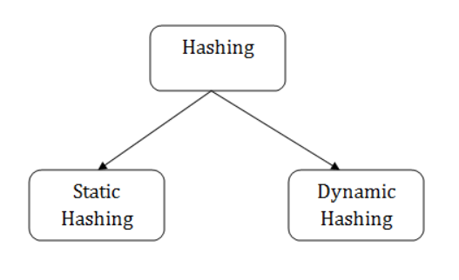
Types of Hashing:

Slide 31
Static Hashing:
In static hashing, the resultant data bucket address will
always be the same. That means if we generate an
address for EMP_ID =103 using the hash function mod
(5) then it will always result in same bucket address 3.
Here, there will be no change in the bucket address.
Hence in this static hashing, the number of data
buckets in memory remains constant throughout. In
this example, we will have five data buckets in the
memory used to store the data.

Slide 32
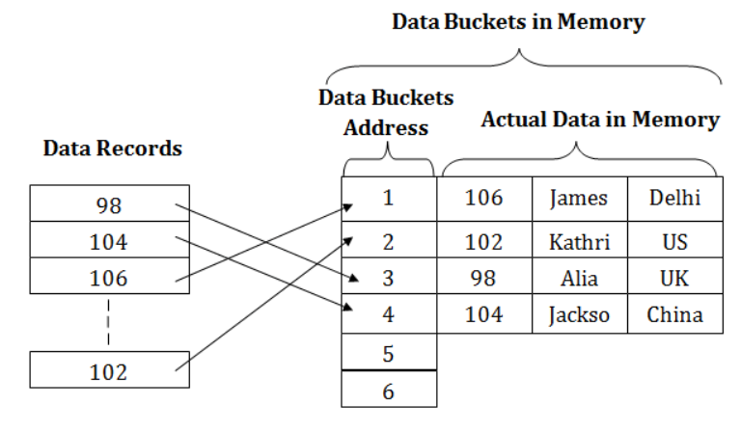
Operations of Static Hashing
Searching a record
When a record needs to be searched, then the same hash
function retrieves the address of the bucket where the data is
stored.
Insert a Record
When a new record is inserted into the table, then we will
generate an address for a new record based on the hash key
and record is stored in that location.

Slide 33
Delete a Record
To delete a record, we will first fetch the record which is supposed to be deleted. Then we will delete the records for that address in memory.
Update a Record
To update a record, we will first search it using a hash function, and then the data record is updated.
If we want to insert some new record into the file but the address of a data bucket generated by the hash function is not empty, or data already exists in that address. This situation in the static hashing is known as bucket overflow. This is a critical situation in this method.
To overcome this situation, there are various methods. Some commonly used methods are as follows:
1. Open Hashing
When a hash function generates an address at which data is already stored, then the next bucket will be allocated to it. This mechanism is called as Linear Probing.

Slide 34
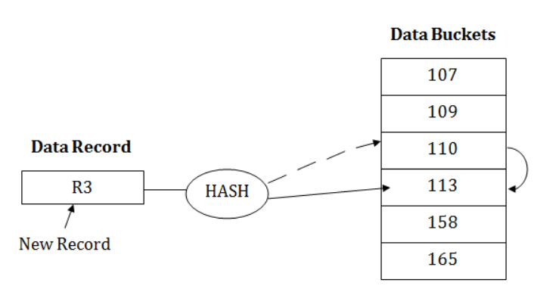
For example: suppose R3 is a new address which needs to be inserted, the hash function generates address as 112 for R3. But the generated address is already full. So the system searches next available data bucket, 113 and assigns R3 to it

Slide 35
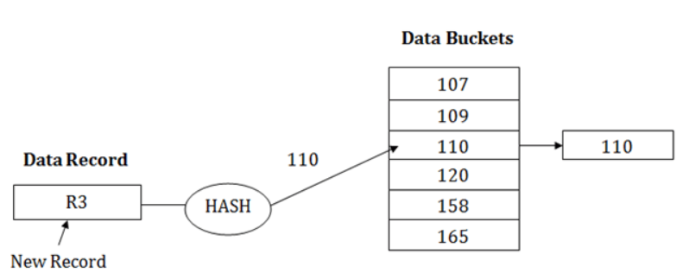
2. Close Hashing
When buckets are full, then a new data bucket is allocated for the same hash result and is linked after the previous one. This mechanism is known as Overflow chaining.
For example: Suppose R3 is a new address which needs to be inserted into the table, the hash function generates address as 110 for it. But this bucket is full to store the new data. In this case, a new bucket is inserted at the end of 110 buckets and is linked to it.

Slide 36
Dynamic Hashing
The dynamic hashing method is used to overcome the
problems of static hashing like bucket overflow.
In this method, data buckets grow or shrink as the
records increases or decreases. This method is also
known as Extendable hashing method.
This method makes hashing dynamic, i.e., it allows
insertion or deletion without resulting in poor
performance.

Slide 37
To search a key:
First, calculate the hash address of the key.
Check how many bits are used in the directory, and these bits are called as i.
Take the least significant i bits of the hash address. This gives an index of the directory.
Now using the index, go to the directory and find bucket address where the
record might be.
To insert a new record
Firstly, you have to follow the same procedure for retrieval, ending up in
some bucket.
If there is still space in that bucket, then place the record in it.
If the bucket is full, then we will split the bucket and redistribute the records

Slide 38
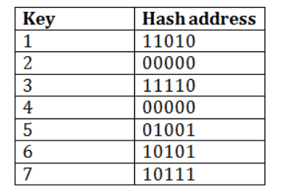
For example:
Consider the following grouping of keys into buckets,
depending on the prefix of their hash address

Slide 39
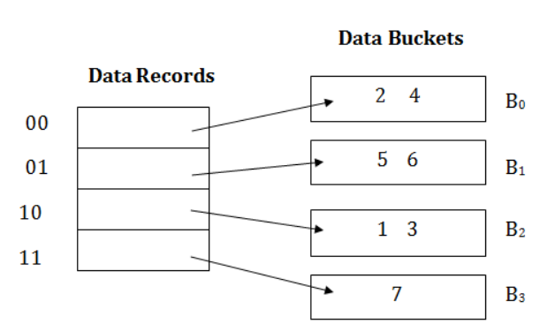
The last two bits of 2 and 4 are 00. So it will go into
bucket B0. The last two bits of 5 and 6 are 01, so it
will go into bucket B1. The last two bits of 1 and 3 are
10, so it will go into bucket B2. The last two bits of 7
are 11, so it will go into B3.

Slide 40
Insert key 9 with hash address 10001 into the above structure:
Since key 9 has hash address 10001, it must go into the first bucket. But bucket B1 is full,
so it will get split.
The splitting will separate 5, 9 from 6 since last three bits of 5, 9 are 001, so it will go
into bucket B1, and the last three bits of 6 are 101, so it will go into bucket B5.
Keys 2 and 4 are still in B0. The record in B0 pointed by the 000 and 100
entry because last two bits of both the entry are 00.
Keys 1 and 3 are still in B2. The record in B2 pointed
by the 010 and 110 entry because last two bits of both the entry are 10.
Key 7 are still in B3. The record in B3 pointed by the 111 and 011 entry because last two bits of both the entry are 11.

Slide 41
