Slide 1
Module 4
Normalization
Functional Dependencies - Concepts
1 NF
2 NF
3 NF
BCNF
4 NF
5 NF
Problems Solving ( Candidate Key , Prime attributes, Non Prime Attributes)

Slide 2
Normalization
Normalization is the process of organizing the data in the database.
Normalization is used to minimize the redundancy from a relation or set of relations. It is also used to eliminate the undesirable characteristics like Insertion, Update and Deletion Anomalies.
Normalization divides the larger table into the smaller table and links them using relationship.
The normal form is used to reduce redundancy from the database table.

Slide 3
Example
Student
S_ID | S_name | C_ID | C_name | F_ID | F_Name | Salary
1 | Ram | C1 | DBMS | F1 | John | 3000
2 | Ravi | C2 | JAVA | F2 | Bob | 4000
3 | Nitin | C1 | DBMS | F1 | John | 3000
4 | Amrit | C1 | DBMS | F1 | John | 3000
S_ID | S_name | S_age
1 | Ram | 20
2 | Shyam | 21
1 | Ram | 20
Row Level
Column Level
To Remove Row Level Redundancy, we use Primary Key (Unique + Not Null) concept.
To Remove Column Level Redundancy, We use Normalization.

Slide 4
Anomalies
If a database design is not perfect, it may contain anomalies, which are like a bad dream for any database administrator. Managing a database with anomalies is next to impossible.
Update anomalies − If data items are scattered and are not linked to each other properly, then it could lead to strange situations. For example, when we try to update one data item having its copies scattered over several places, a few instances get updated properly while a few others are left with old values. Such instances leave the database in an inconsistent state.(Eg:Update Salary of F1 from 30K to 40k, updation happens in 3 rows but there is only 1 faculty F1whose salary needs to be changed)
Deletion anomalies − We tried to delete a record, but parts of it was left undeleted because of unawareness, the data is also saved somewhere else.(Eg: Delete SID=1, but data of faculty details will vanish if faculty handles only for 1 student)
Insert anomalies − We tried to insert data in a record that does not exist at all.
Eg: Introduce New course ID / Course Name (MBBS) without adding Student.
Solution to Problem – Different tables as Students, Course and Faculties.

Slide 5
1st Normal Form
If a relation contains a composite or multi-valued attribute, it violates the first normal form, or the relation is in first normal form if it does not contain any composite or multi-valued attribute. A relation is in first normal form if every attribute in that relation is singled valued attribute.
A table is in 1 NF if:
There are only Single Valued Attributes.
Attribute Domain does not change.
There is a unique name for every Attribute/Column.
The order in which data is stored does not matter.

Slide 6
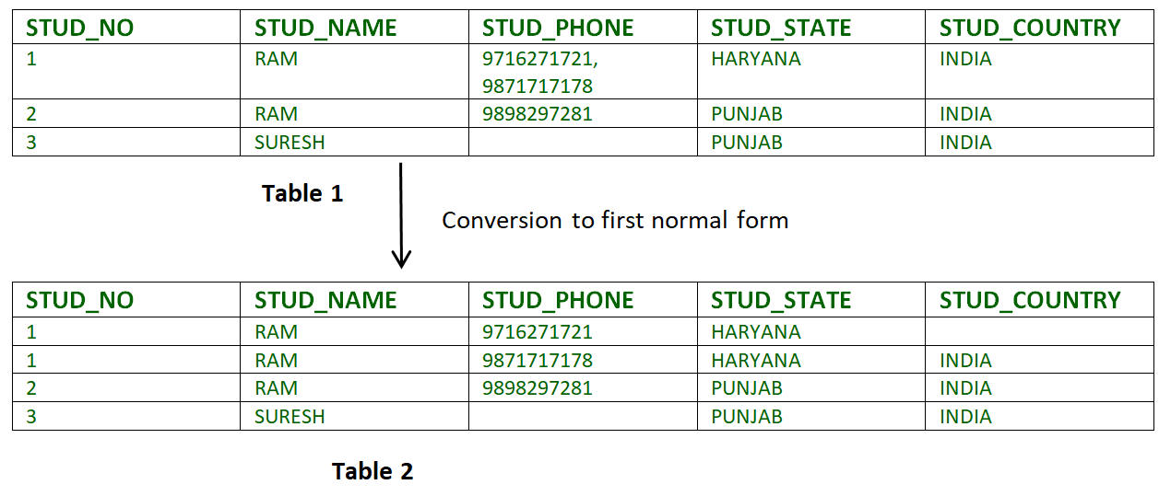
Ex.
where stud_name=Ram
Example-1:
Relation STUDENT in table 1 is not in 1NF because of multi-valued attribute STUD_PHONE. Its decomposition into 1NF has been shown in table 2.

Slide 7

1st Normal Form
1. Primary key= Roll No and Course=composite key
Roll No | Name | Course
1 | sai | c/c++
2 | Ram | Java
3 | Omkar | C/DBMS
Roll NO | Name | Course
1 | sai | C
1 | sai | c++
2 | Ram | java
3 | Omkar | C
3 | Omkar | DBMS
Not in 1st Normal Form
3. Base Table Referencing Table
Primary Key = Roll No + Course
Primary Key
Foreign Key
2.
Roll No | Name
1 | sai
2 | ram
3 | omkar
Roll No | Course
1 | c
1 | c++
2 | java
3 | C
3 | DBMS
Roll_no | Name | Course1 | Course 2
1 | Sai | c | C++
2 | Ram | Java | Null …….
3 | Omkar | c | DBMS

Slide 8
2nd Normal Form
1.The Table must be present in 1st normal form
2.All the non Prime attributes should fully functional dependant on candidate key
3 .There should be No Partial Dependency .
Non Prime Attribute
Customer:
Customer _ID | Store_ID | Location
1 | 1 | Delhi
1 | 3 | Mumbai
2 | 1 | Delhi
3 | 2 | Banglore
4 | 3 | Mumbai
Customer_ID | Store_ID
1 | 1
1 | 3
2 | 1
3 | 2
4 | 3
Store_ID | Location
1 | Delhi
3 | Mumbai
2 | Banglore
Prime or Key Attributes:
Attributes of the relation which exist in at least one of the possible candidate keys, are called prime or key attributes.
Non Prime or Non Key Attributes:
Attributes of the relation which does not exist in any of the possible candidate keys of the relation, such attributes are called non prime or non key attributes
Candidate key={Customer_ID, Store_ID}

Slide 9
3rd Normal Form
1.A relation will be in 3NF if it is in 2NF and not contain any transitive partial dependency.
2.3NF is used to reduce the data duplication. It is also used to achieve the data integrity.
3.If there is no transitive dependency for non-prime attributes, then the relation must be in third normal form.
A relation is in third normal form if it holds atleast one of the following conditions for every non-trivial function dependency X → Y.
1.X is a super key.
2.Y is a prime attribute, i.e., each element of Y is part of some candidate key.

Slide 10
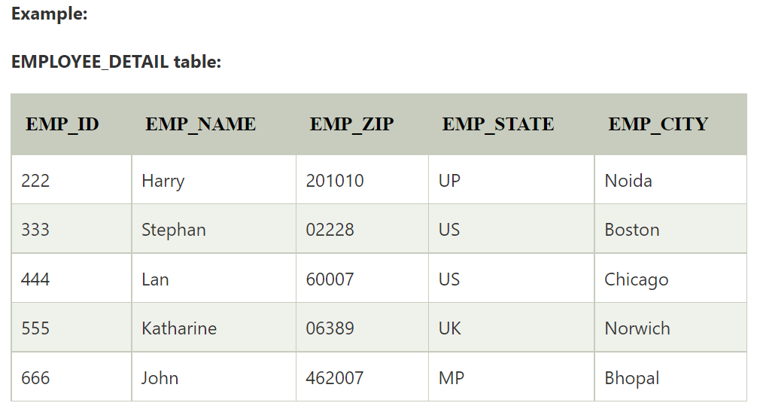

Slide 11
Super key in the table above:
{EMP_ID} , {EMP_ID, EMP_NAME} , {EMP_ID, EMP_NAME, EMP_ZIP}....so on
Candidate key: {EMP_ID}
Non-prime attributes: In the given table, all attributes except EMP_ID are non-prime.
Here, EMP_STATE & EMP_CITY dependent on EMP_ZIP and EMP_ZIP dependent on EMP_ID. The non-prime attributes (EMP_STATE, EMP_CITY) transitively dependent on super key(EMP_ID). It violates the rule of third normal form.
That's why we need to move the EMP_CITY and EMP_STATE to the new <EMPLOYEE_ZIP> table, with EMP_ZIP as a Primary key.

Slide 12
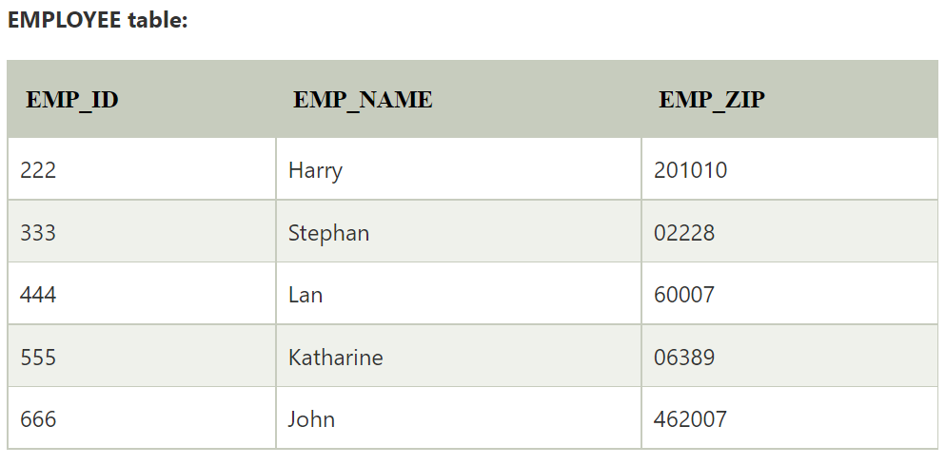
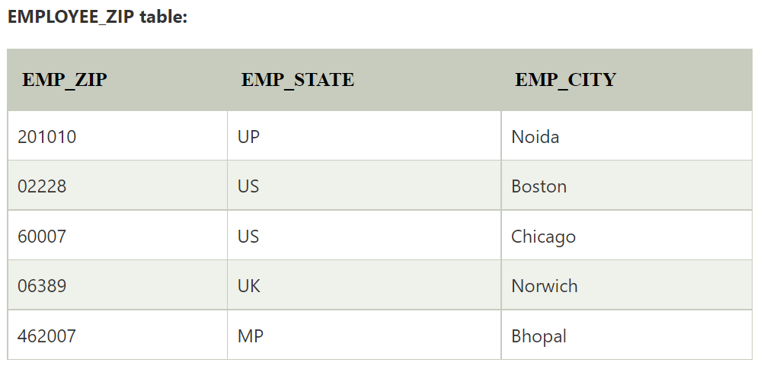
Solution

Slide 13
Boyce Codd normal form (BCNF)
BCNF is the advance version of 3NF. It is stricter than 3NF.
A table is in BCNF if every functional dependency X → Y, X is the super key of the table.
For BCNF, the table should be in 3NF, and for every Functional Dependency, Left Hand Side is super key.
Example: Let's assume there is a company where employees work in more than one department.

Slide 14
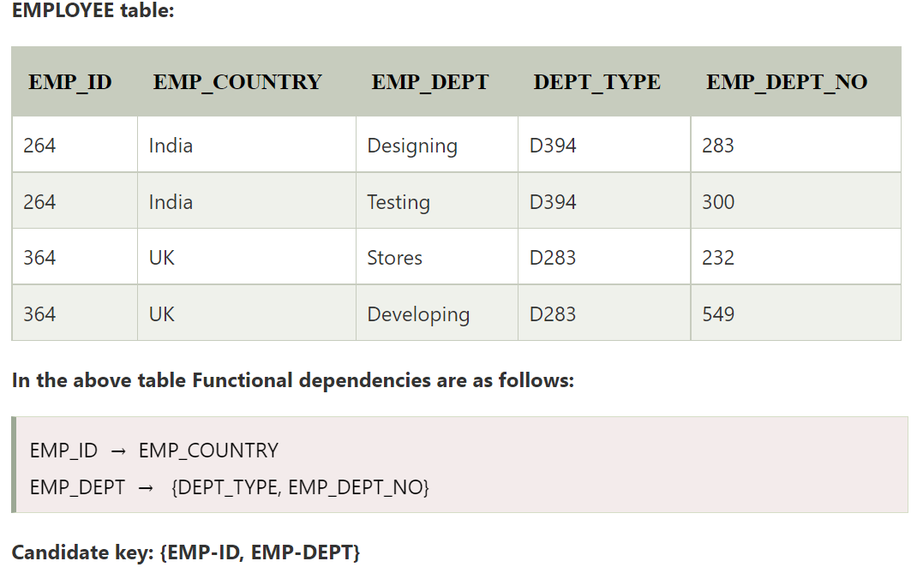

Slide 15
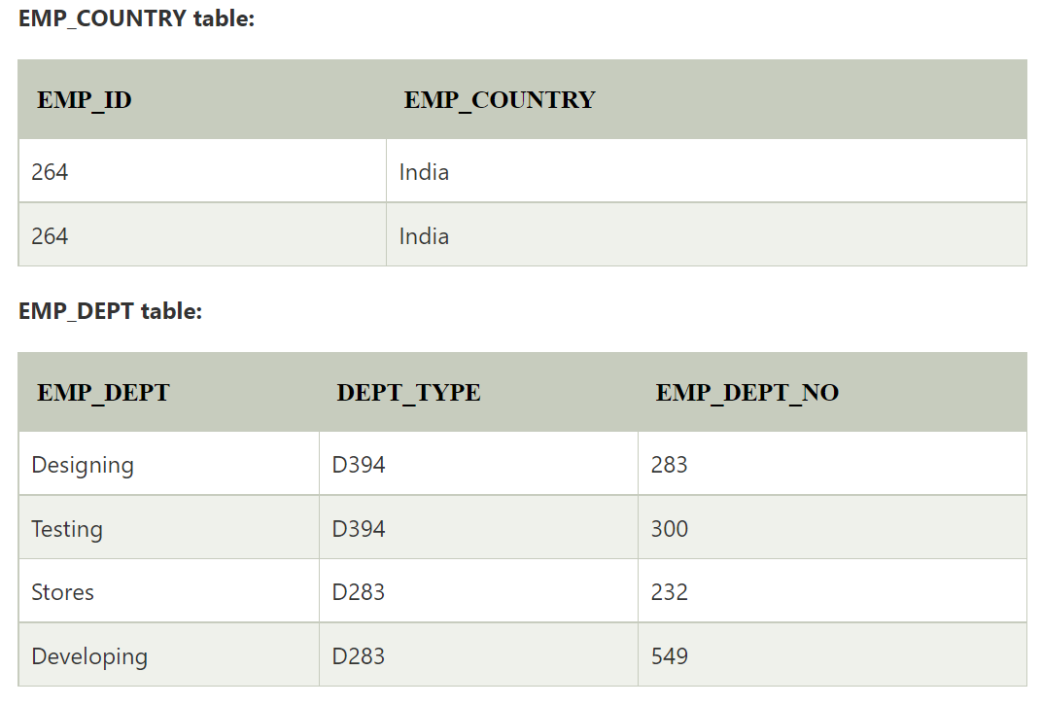
The table is not in BCNF because neither EMP_DEPT nor EMP_ID alone are keys.
To convert the given table into BCNF, we decompose it into three tables:

Slide 16
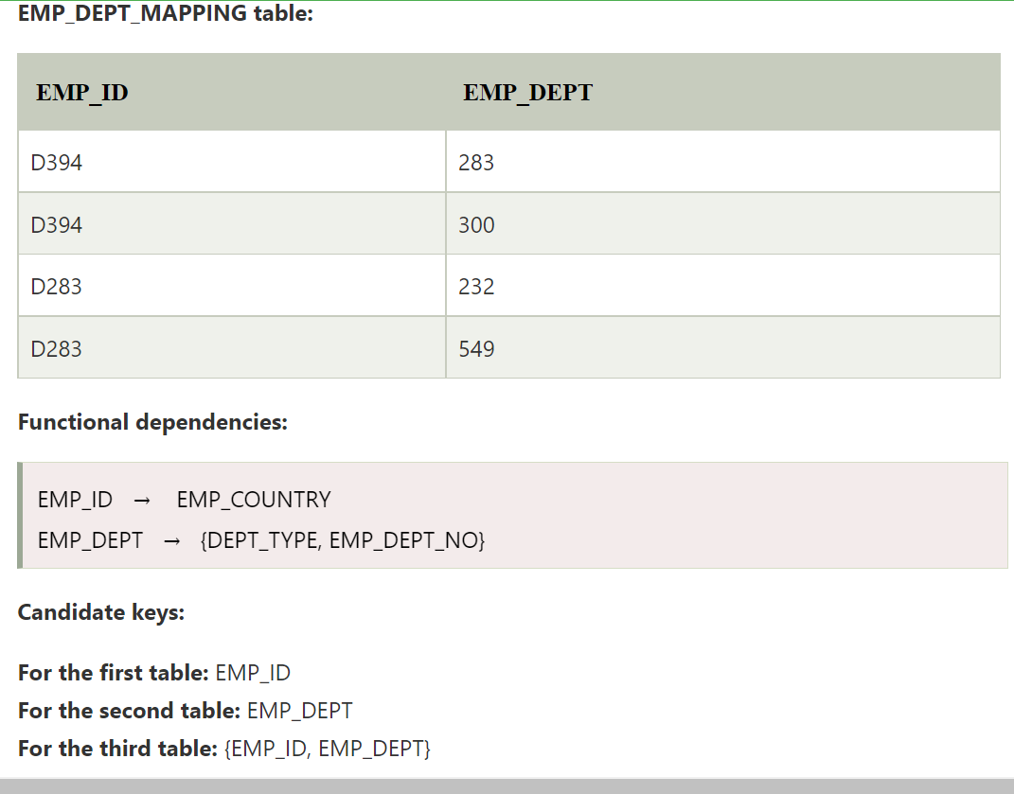

Slide 17
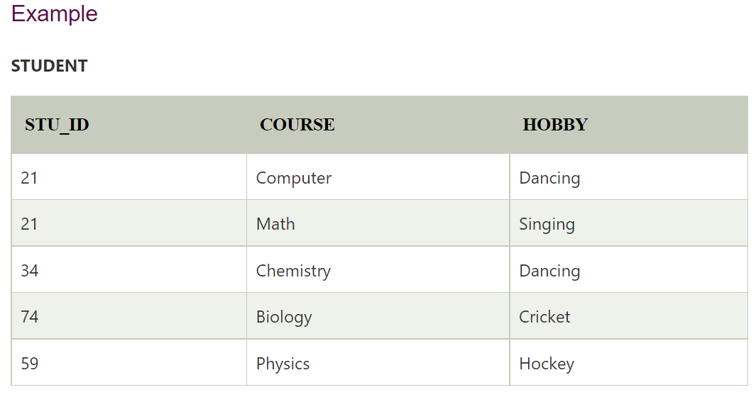
Fourth normal form (4NF)
A relation will be in 4NF if it is in Boyce Codd normal form and has no multi-valued dependency.
For a dependency A → B, if for a single value of A, multiple values of B exists, then the relation will be a multi-valued dependency.

Slide 18
The given STUDENT table is in 3NF, but the COURSE and HOBBY are two independent entity. Hence, there is no relationship between COURSE and HOBBY.
In the STUDENT relation, a student with STU_ID, 21 contains two courses, Computer and Math and two hobbies, Dancing and Singing. So there is a Multi-valued dependency on STU_ID, which leads to unnecessary repetition of data.

Slide 19

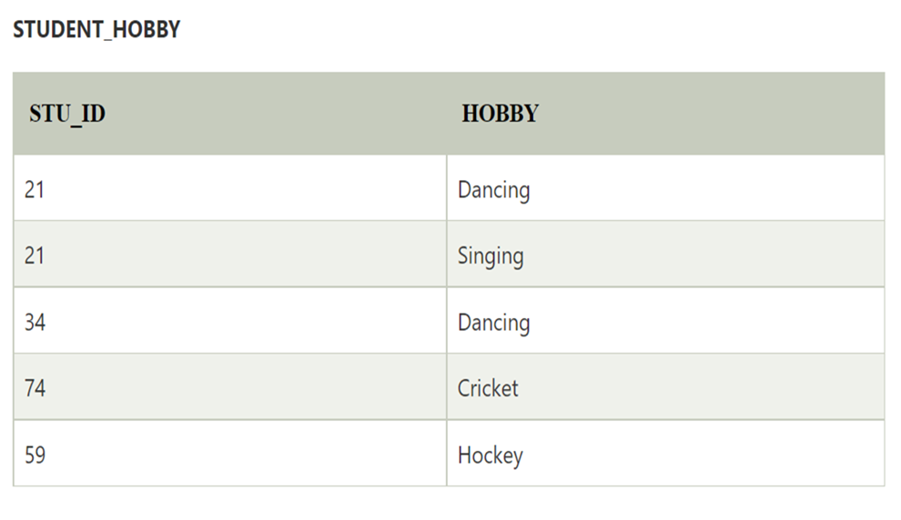
So to make the above table into 4NF, we can decompose it into two tables:

Slide 20
Fifth normal form (5NF)
A relation R is in 5NF if it is in 4NF and there is no join dependency. No join dependency means lossless-join decomposition.
Decomposition is lossless-join decomposition if it preserves all the data in original Relation R or Whenever we can recreate a table by simply joining various tables where each of these tables consists of a subset of the table's attribute, then this table is known as a Join Dependency.
Relation R - A relation R satisfies join dependency if R is equal to the join of R1,R2,.....Rn where Ri are a subset of the set of attributes of R.

Slide 21
dept ->-> subject
dept->-> name
The above relation is in 4NF. Anomalies can occur in relation in 4NF if the primary key has three or more fields. The primary key is (dept, subject, name). Sometimes decomposition of a relation into two smaller relations does not remove redundancy. In such cases it may be possible to decompose the relation in three or more relations using 5NF.
The above relation says that dept offers many elective subjects which are taken by a variety of students. Students have the opinion to choose subjects. Therefore, all three fields are needed to represent the information.
The above relation does not show non-trivial MVDs since the attributes subject and name are dependent; they are related to each other (A FD subject->name exists). The relation cannot be decomposed in two relations (dept, subject) and (dept, sname).
Therefore the relation can be decomposed into following three relations −
R1(dept, subject)
R2(dept, name) and
R3(subject, name) and it can be shown that decomposition is lossless.

Slide 22
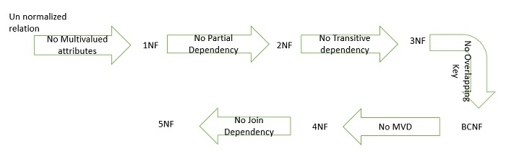
Given: R R1 R2 R3
All Normal forms can be understood in single picture as shown below

