Slide 1
Car Sales Dashboard Design
Dashboard Design | Power BI

Slide 2
KPI Overview
Key KPIs selected for the Dashboard:
Total Sales (Total Selling Price)
Top Performing Car Makes
Monthly Sales Trends
Growth Over Time

Slide 3
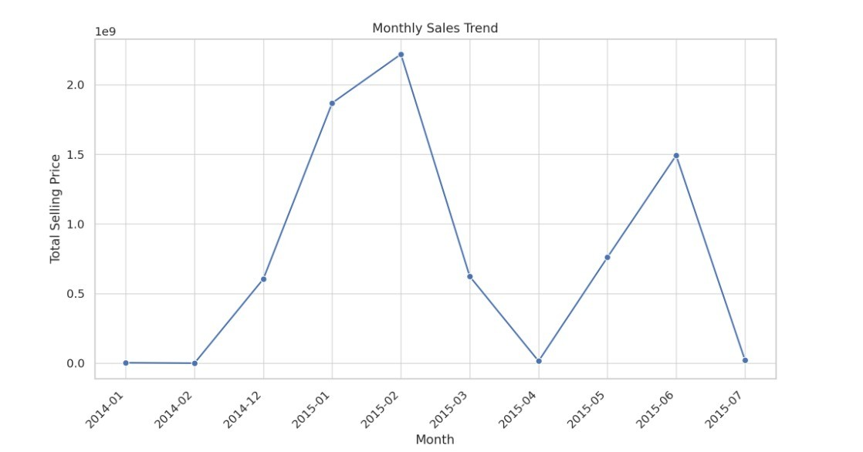
Dashboard Visualizations

Slide 4
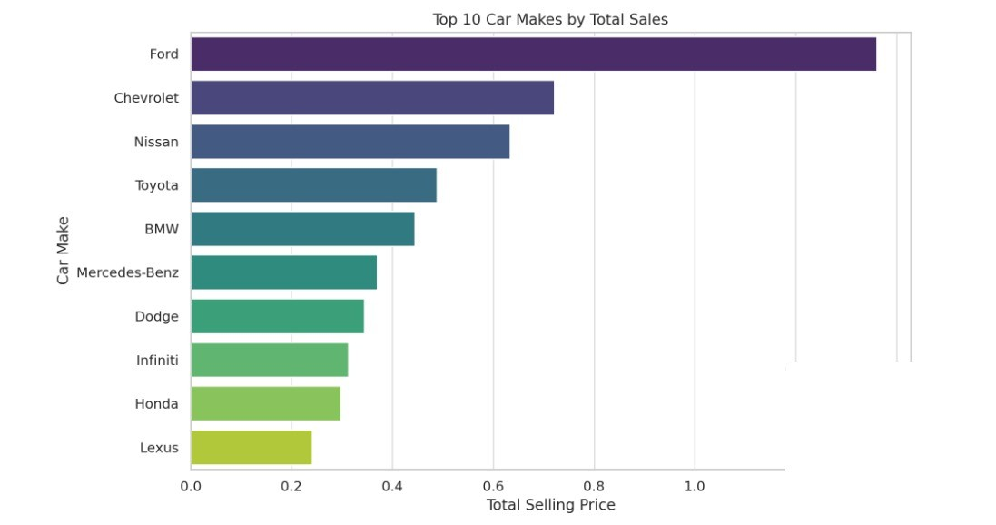
Dashboard Visualizations

