Slide 1


Bapuji Institute of Engineering and Technology, Davangere.
Online Complaint Box
UNDER GUIDANCE :
Dr. NIRMALA C.R
Professor & HOD,CSE
BIET ,Davangere
TEAM NAME : hexagon
TEAM MEMBERS :
HANUMANTAPPA BUDIHAL
MOHAMMED ABRAR M B
IBM Bluemix
The Digital Innovation Platform

Slide 2

ABSTRACT
“The main aim of this project is to develop an application, which used to inform and send immediate complaint to the police station for crimes which are happening to their nearby locations. With this system, users have to just identify the type of crime such as robbery, theft, bank robbery etc. and just they have to enter their name, email or Mobile number and details about complaint.”

Slide 3
INTRODUCTION
Existing system does not have any such application by which users can place their complaint from any location. They have to visit their nearest police station and take a copy of the complaint for future reference.
Many citizens hesitate to visit police station and thus informer’s information cannot be confidential.
This application help to inform and send immediate complaint to the police station for crimes which are happening to their nearby locations by online.
Users information will be kept confidential and if any help needed by police in future, then they will use their mobile number as a medium of contact and communication.

Slide 4
EXISTING SYSTEM
Existing system does not have such medium by users can place their complaint from any location. They have to visit their nearest police location and take a copy of the complaint for future reference.
Many citizens hesitate to visit any police station and thus informer’s information cannot be kept confidential.
Sometimes conflicts occurs between police station regarding area, means which area comes under their police station and the person get frustrated before placing their complaints.
User not able get updates about their complaints at a particular instance.

Slide 5
PROPOSED SYSTEM
This application is used to inform and send immediate complaint to the police station for crimes which are happening to their nearby locations. With this system, users have to just identify the type of crime such as robbery, theft, bank robbery etc. and just they have to enter their name, email or mobile number and details about complaint.
This message will be forwarded to police station.
After forwarding message, users have option to get status by login in to application. User’s information will be kept confidential and if any help needed by police in future, then they will use their mobile number or email as a medium of contact and communication.
User have option to check the complaint status.
Admin have option to update status about every complaint.

Slide 6
OBJECTIVES
To develop an application which helps to register the complaint by Online.
To provide easy to access the application through web app.
To provide facility for common people to register complaint and get update about their complaints.
To implement an application with scalability features like updates the status of complaint.
To implement a solution for Police station to maintain complaints.
To create a responsive user interface using new technologies like bootstrap, IBM Bluemix service.

Slide 7
TOOLS :
HTML5
Bootstrap 3
JavaScript
php
SERVICES :
ClearDB MySQL Database
Twilio message service
Monitoring and Analytics
Access Trail
Embeddable Reporting

Slide 8
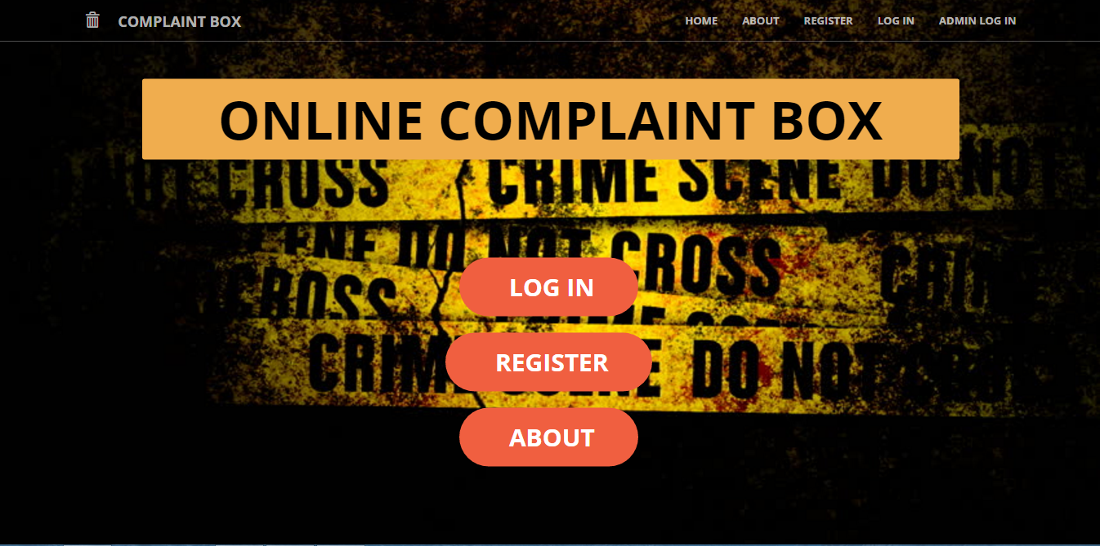
SCREEN SHOTS
1.Home Page

Slide 9
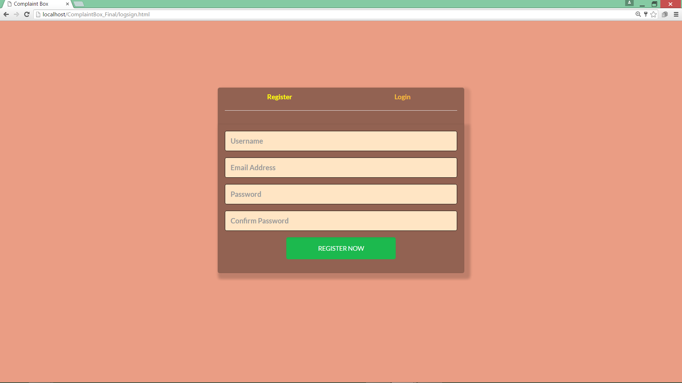
2.Login and Signup page

Slide 10

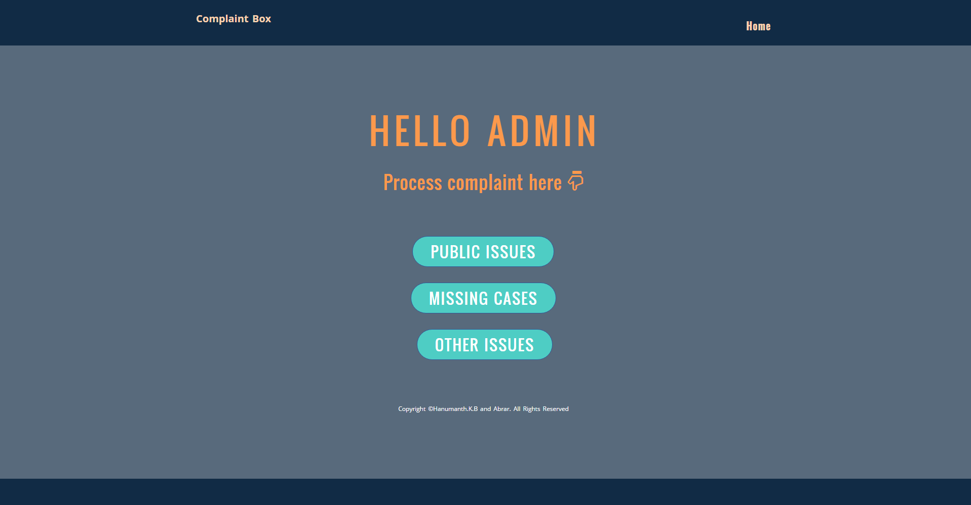
3.Admin login and Admin page

Slide 11
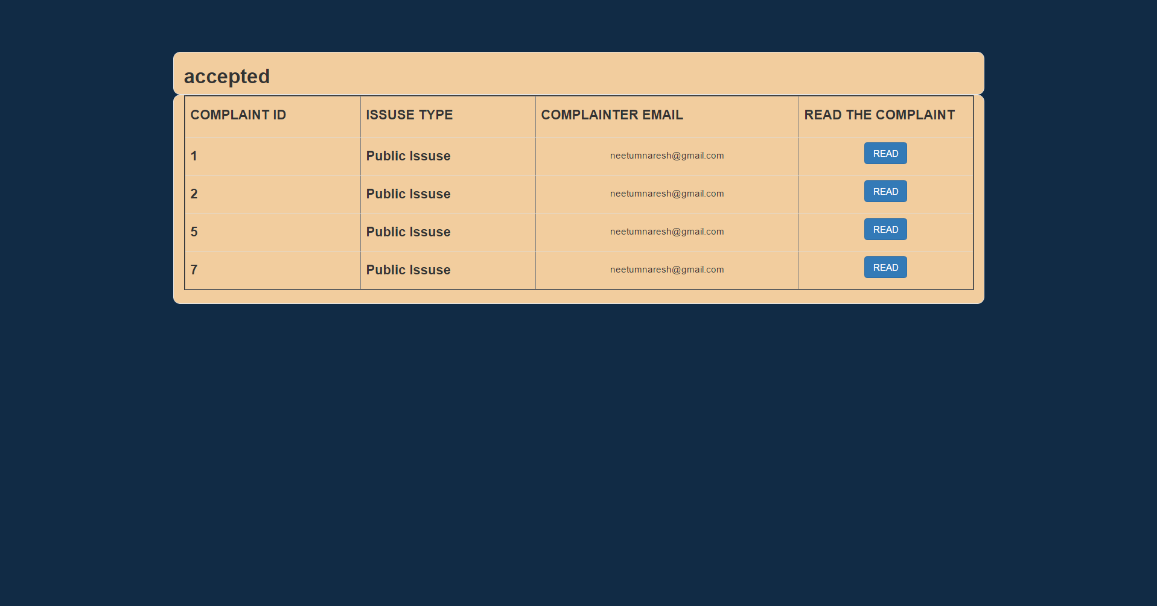
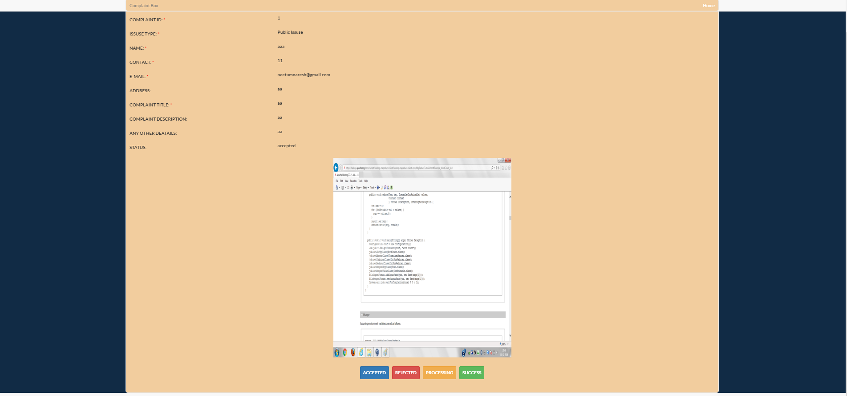
4.Complaint List

Slide 12
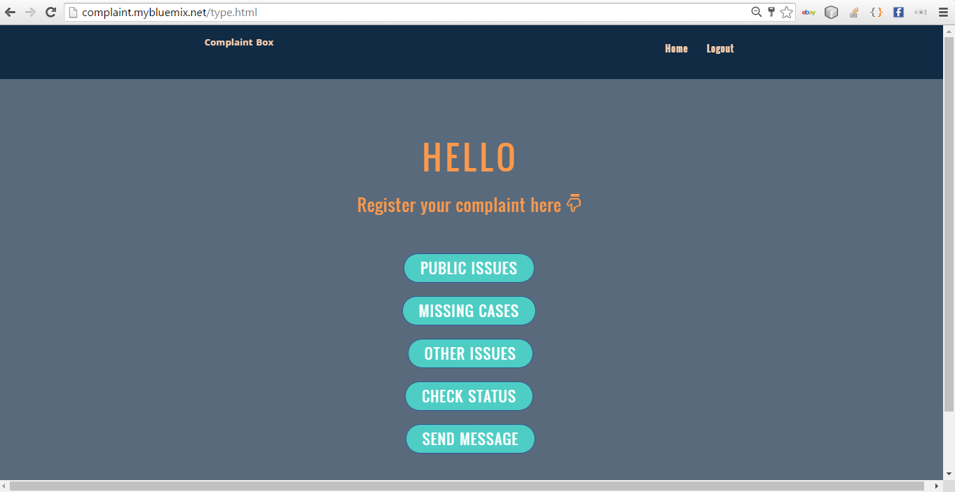
5.User page

Slide 13
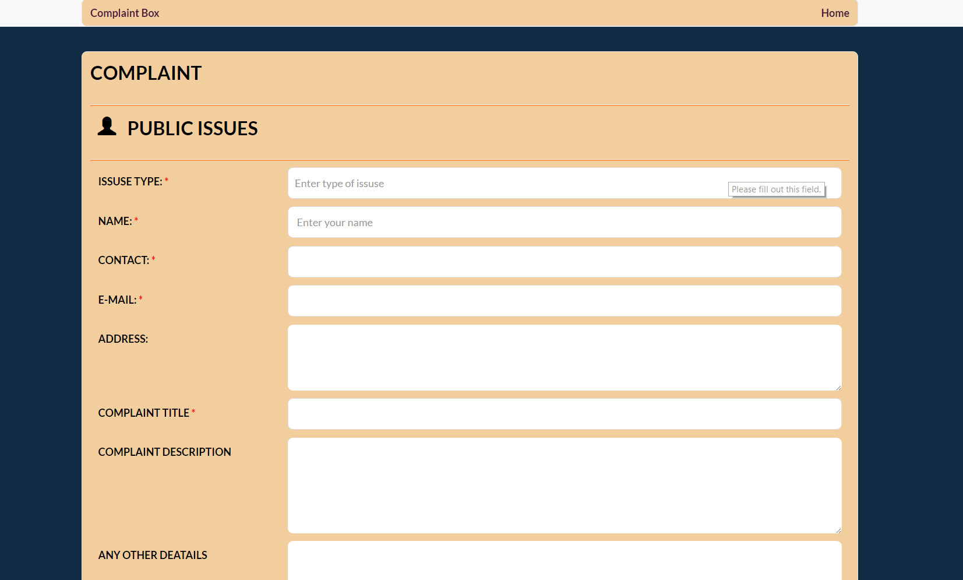
6.Complaint Register page

Slide 14
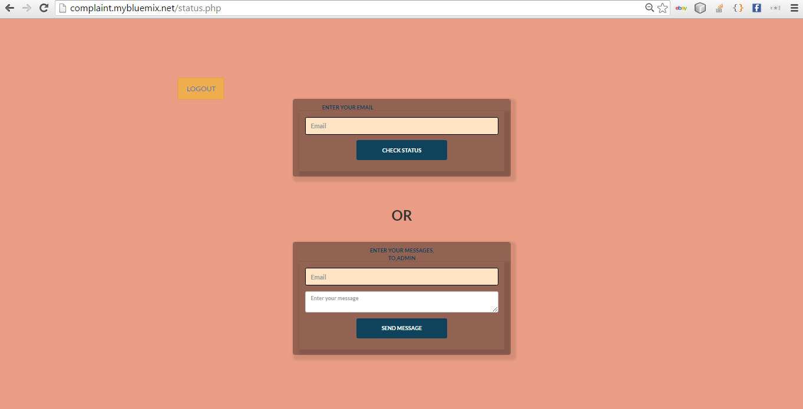
6.User complaint status

Slide 15

Thank you . . .

