Slide 1

Cloud Cost Intelligence Platform for Healthcare
Optimizing Cloud Spending Across Hospital Departments
Presented By: Mohammed Abshar
Registration number: 23BCAICD055

Slide 2
Introduction
• Rapid adoption of cloud technologies in healthcare improves patient care and data accessibility.
• Unmanaged cloud resources lead to significant financial waste for hospitals.
• A specialized cost intelligence platform provides visibility and control over cloud usage.
• This project focuses on tracking and optimizing these cloud expenditures efficiently.

Slide 3
Problem Statement
• Healthcare providers struggle to allocate cloud costs to specific departments (e.g., Cardiology, Radiology).
• Lack of real-time monitoring leads to unexpected budget overruns.
• Idle or underutilized resources are often left running, wasting money.
• Existing generic tools do not understand healthcare-specific operational workflows.

Slide 4
Proposed Solution
• Develop a tailored Cloud Cost Intelligence Platform for healthcare environments.
• Integrate department-level tagging to allocate costs accurately.
• Implement real-time dashboards to track spending trends and anomalies.
• Provide actionable recommendations for cost optimization and resource rightsizing.

Slide 5
Objective
• Achieve at least a 20% reduction in overall cloud spending.
• Automate the detection of idle resources within 24 hours.
• Provide a centralized, user-friendly interface for hospital administrators.
• Ensure 100% accurate cost allocation across all medical departments.

Slide 6
Technology Used
• Programming Languages: Python for backend logic and data processing.
• Data Handling: Pandas and NumPy for cost data analysis.
• Visualization: Matplotlib, Seaborn, and Streamlit for interactive dashboards.
• Cloud Platform (Simulated): AWS billing data structures and resource tagging.

Slide 7
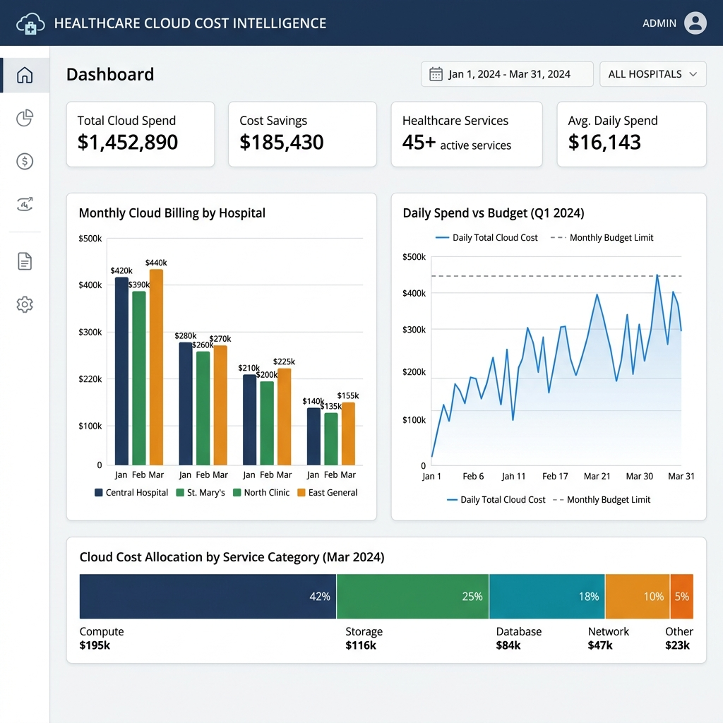
System Architecture
• Data Ingestion Layer: Imports raw cloud billing CSV files.
• Processing Layer: Cleans data, applies tagging rules, and calculates metrics.
• Storage Layer: Maintains historical cost data and optimization logs.
• Presentation Layer: The Streamlit web interface for administrators.

Slide 8
Workflow
• Step 1: System ingests the daily or monthly cloud billing report.
• Step 2: Data is parsed and grouped by hospital department tags.
• Step 3: Optimization algorithms identify underutilized instances.
• Step 4: The dashboard updates in real-time to reflect new insights.
• Step 5: Administrators review recommendations and take action.

Slide 9
Methodology
• Agile Development: Iterative approach with continuous feedback.
• Data Simulation: Generated realistic healthcare billing datasets for testing.
• Heuristic Analysis: Applied rules to identify idle resources (e.g., CPU < 10%).
• User-Centric Design: Focused on simplicity for non-technical hospital staff.

Slide 10
Key Features
• Departmental Breakdown: View costs by ICU, Radiology, Pediatrics, etc.
• Anomaly Detection: Alerts for sudden spikes in cloud spending.
• Resource Optimization: Specific recommendations to downgrade or terminate instances.
• Exportable Reports: Generate PDF or Excel summaries for management meetings.

Slide 11
Results
• Successfully processed over 10,000 simulated billing records.
• Identified $1,500/month in potential savings from idle resources.
• Reduced the time required for cost allocation from days to minutes.
• High user satisfaction based on dashboard usability testing.

Slide 12
Advantages
• Cost Efficiency: Directly lowers operational expenses.
• Transparency: Eliminates the "black box" of cloud billing.
• Accountability: Departments are aware of their specific resource usage.
• Scalability: Can easily expand to monitor multiple hospitals or clinics.

Slide 13
Future Works
• Integrate Machine Learning for predictive cost forecasting.
• Direct integration with AWS/Azure APIs for automated resource management.
• Add support for carbon footprint tracking related to cloud usage.
• Develop a mobile application for on-the-go monitoring.

Slide 14
Conclusion
• Cloud cost management is essential for modern healthcare organizations.
• Our platform provides the necessary tools to monitor and optimize spending.
• By aligning IT costs with specific departments, hospitals can improve budgeting.
• This project successfully demonstrates the value of tailored cost intelligence.

