Slide 1
AWS Web App using a Three-Tier Architecture
Supervised By: Eng. Ayman Ali

Slide 2
Contents
Contents
Intro
Services
Deployment
Architecture
WA Framework

Slide 3
Introduction to 3-Tier Architecture
The 3-Tier Architecture consists of:
Presentation Tier (Web Layer) > EC2 + ALB
Application Tier (Logic Layer) > EC2
Data Tier (Database Layer) > RDS
This architecture provides:
Easier maintenance due to simple components of the architecture.
Possible scalability in the future
Improved security due to isolation between layers.
Intro

Slide 4
AWS Services Used
Key AWS services in our 3-Tier Architecture:
Amazon EC2: Application servers.
Amazon RDS: Relational Database Service.
Elastic Load Balancer (ALB).
Amazon VPC with Public/Private Subnets.
AWS CloudFormation for deployment.
Services

Slide 5
Architecture Overview
Availability Zone Structure:
Public subnet: Web servers
ALB distributing traffic to EC2 instances
Private subnet: EC2 application servers
Private subnet: RDS database
Architecture

Slide 6
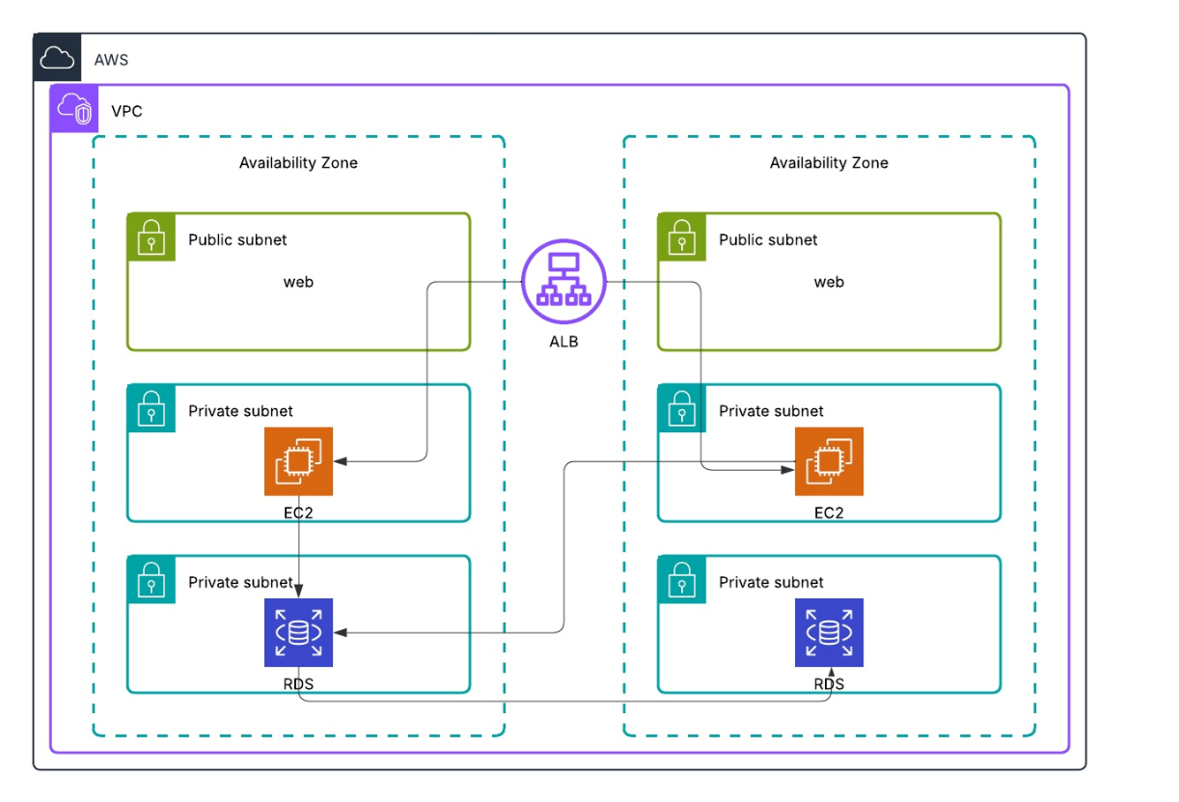
Architecture Diagram
Architecture

Slide 7
Deployment
So we met multiple challenges in free-tier during deployment:
We couldn’t use multiple AZs.
We also couldn’t use multiple EC2 & RDS instances.
We couldn't place the EC2 instance that was deployed in a private subnet, due to limitations on NAT Gateways.
We were not able to use an ALB due to the limitation of AZs allowed (1), therefore we used a CLB instead.
Deployment

Slide 8
Deployment
DEMONSTRATION OF WHAT WAS DEPLOYED AND THE YAML TEMPLATE USED TO ACHIEVE THE LIMITED ARCHITECTURE
Deployment

Slide 9
Well-Architected Framework Recommendations
Security:
Add Network ACLs and security group audits.
Reliability:
Enable Multi-AZ RDS and backups.
Operational Excellence:
Implement monitoring with CloudWatch.
WA Framework

Slide 10
Cont. on Well Architected Framework
Performance Efficiency: Use Auto Scaling for EC2 instances.
Cost Optimization: Use spot instances or savings plans for EC2 and RDS instances.
Sustainability: Enable CloudWatch with EC2 Auto Stop feature to deal with idle periods. Also, consider switching to t4g.graviton instances because they are more energy efficient.
WA Framework

Slide 11
Project Done By:
Ahmed TakeyEldeen
Amal Yasser
Ibrahim AbdelShafy
Maged Al Shaarawy
Mohammed Medhat Khater

Slide 12
THANK YOU !

