Slide 1
MediCare Outpatient Visits
Mini-Project 2 · Naresh IT · Python for Full Stack Data Science with AI & Generative AI
The question
Where are patients waiting longest, which departments earn what, is the clinic getting busier, and what should change in 2026?
The data
2,423 raw rows · 13 columns · Jan–Dec 2025
After deduplication and age validation: 2,397 rows · 16 analysis columns
MediCare Outpatient Visits · 2025 analysis · 1/5

Slide 2
Data & cleaning
Seven documented decisions · original export preserved for comparison
Issue | Rows | Decision
Exact duplicates | 23 | Drop exact row matches
Department labels | 60 | Trim/case-standardise; preserve ENT
Mixed date formats | 2,400 unique | Parse 3 formats explicitly
Impossible ages | 3 | Reject; retain visit IDs
Negative waits | 5 | Correct sign with abs()
IQR fee outliers | 13 | Keep ₹50,000; provisional procedure flag
Missing fees | 118 | Department median imputation
Proudest decision: an IQR flag is not automatic deletion — keep plausible procedure charges, but verify billing codes.
MediCare Outpatient Visits · 2025 analysis · 2/5

Slide 3
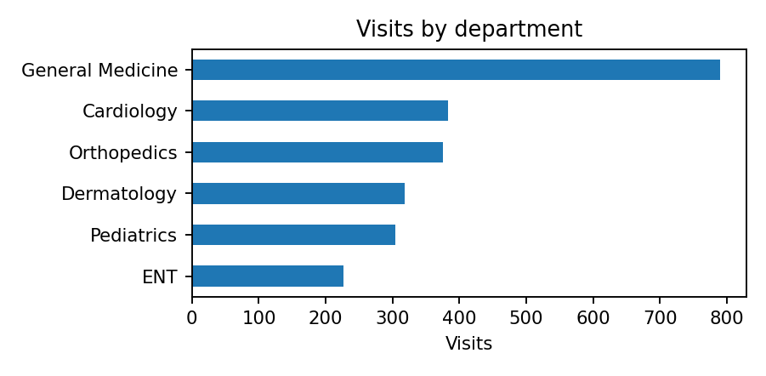
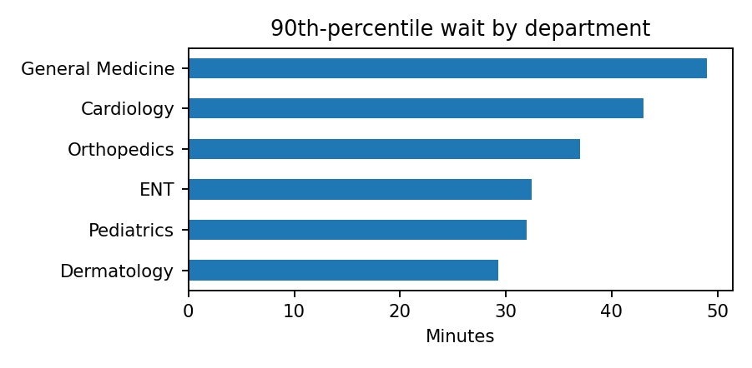
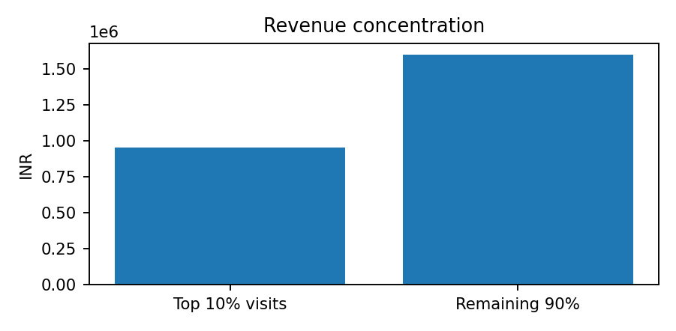
Three findings
Workload · waiting · revenue concentration
General Medicine: 790 visits. Monday is busiest (495).
General Medicine has the highest p90 wait: 49 minutes.
Top 10% of visits contribute 37.4% of recorded revenue; top 2 departments contribute 59.3%.
MediCare Outpatient Visits · 2025 analysis · 3/5

Slide 4
Recommendation
Act on queue pressure first; validate revenue interpretation in parallel
2026 actions
• Review Monday coverage and arrival patterns in General Medicine; pilot queue changes before making permanent staffing decisions.
• Track median and 90th-percentile waits weekly alongside visits per staffed hour; escalate repeated p90 breaches.
• Verify the 13 ₹50,000 charges against billing/procedure codes and report consultation revenue separately from procedure revenue.
The number that proves it
49 min
General Medicine 90th-percentile wait
MediCare Outpatient Visits · 2025 analysis · 4/5

Slide 5
What I’d do next
Make the next analysis more operationally reliable
With more data, I would check
Appointment arrival and service timestamps · staffing rosters by shift · verified procedure/billing codes · reasons for missing fees · monthly visit counts alongside revenue
One thing I’d change
Replace the fee-based procedure proxy with a verified procedure code and re-run the revenue comparisons.
Next: predict consult time from age + department + doctor
That is the next module; this project intentionally uses descriptive analysis only.
MediCare Outpatient Visits · 2025 analysis · 5/5

