Slide 1
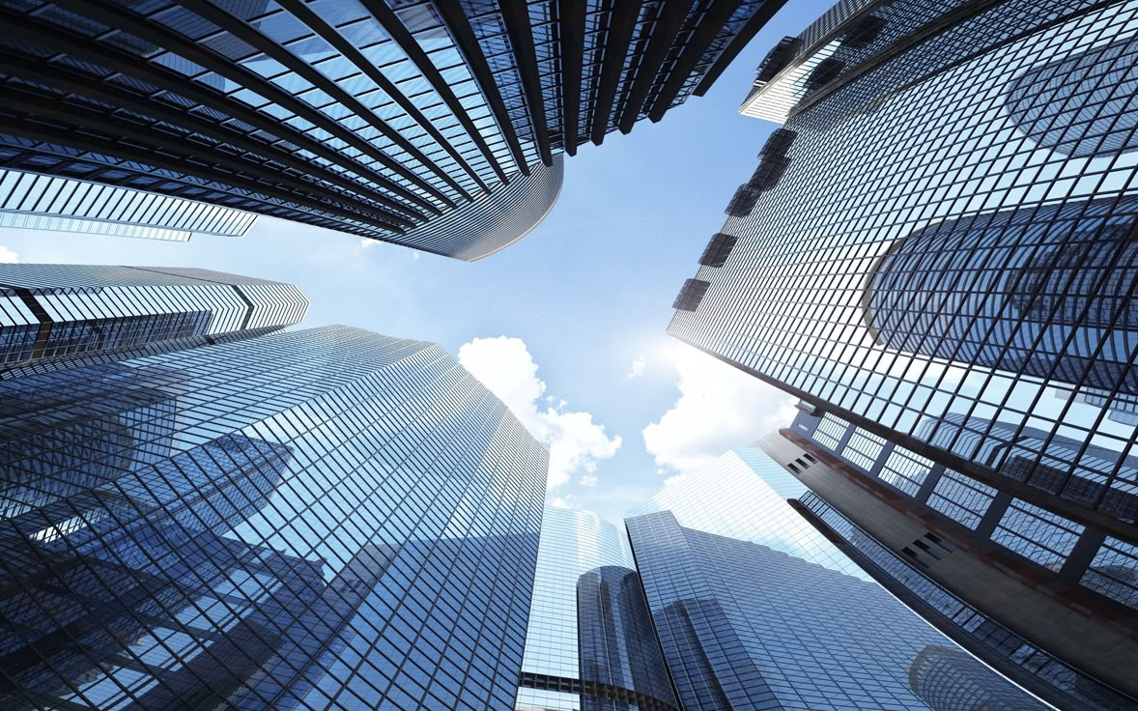
Web Scraping & Emploi : Quand l’IA décrypte les opportunités cachées
Réalisé par :
Encadrée par :
Osama Akeskous
Ikram Elkarfi
Dechraoui Mohammed
Boulguant Yassine
Notes:
Good morning, everyone. Today, I’m excited to present one the very interesting topic that is shaping the future of urban living. This subject brings together cutting-edge technologies like data-driven solutions, the Internet of Things (IoT), machine learning,deep lerning, and big data. software solutions to make cities more efficient, sustainable, and connected. : Smart Citie, Let’s dive into how these innovations are transforming the way we live in cities.
1

Slide 2
Plan
1
Introduction
3
L’architecture du Projet
4
Interface Web Utilisateur
Notes:
We will start by explaining what smart cities are and why they matter. Then, we’ll look at the main parts that make a city "smart,".
Next, we’ll talk about how IoT and AI help improve cities and the benefits they bring.
But smart cities also have problems, like high costs and cybersecurity risks, which we’ll discuss.
To see real examples, we’ll look at smart cities like Singapore and Barcelona and explore future trends.
Let’s begin!
2

Slide 3

Introduction
Introduction
Contexte et Problématique
Importance des offres d'emploi en ligne
Difficulté d'accéder manuellement à plusieurs sites
Besoin d'automatisation pour gagner du temps
L’architecture du projet
Role of IoT and AI in Smart Cities
Benefits of Smart Cities
Challenges in Implementing Smart Cities
Case Studies and Future of Smart Cities
Scraping
Objectifs :
Scraper des offres d'emploi depuis plusieurs sites web
Automatiser le processus de scraping avec Airflow
Offrir une interface web pour postuler aux emploisnhance efficiency and quality of life.
Notes:
But what is a smart city? A smart city is a modern urban area that uses technology like IoT, AI, and data to improve daily life. These cities focus on making transportation, energy, and public services more efficient.
3

Slide 4

L’architecture du projet
L’architecture du projet
Introduction
Benefits of Smart Cities
Challenges in Implementing Smart Cities
Case Studies and Future of Smart Cities
Introduction
Scraping
Notes:
A smart city is made up of different key parts that work together to improve urban life. Let’s look at some of the most important components
4

Slide 5
L’architecture du projet
Scraping
Automatisation par airflow
Stockage
Introduction
Interface web
Notes:
A smart city is made up of different key parts that work together to improve urban life. Let’s look at some of the most important components
5

Slide 6





Demonstration
Demonstration
Load Data
Extract data
L’architecture du projet
Challenges in Implementing Smart Cities
Case Studies and Future of Smart Cities
Case Studies and Future of Smart Cities
Case Studies and Future of Smart Cities
Demonstration
Scraping
Notes:
Technology is at the heart of smart cities, and two key technologies that make them work are IoT (Internet of Things) and AI (Artificial Intelligence).
6

Slide 7

Interface Web Utilisateur
Demonstration
Case Studies and Future of Smart Cities
Case Studies and Future of Smart Cities
Case Studies and Future of Smart Cities
Case Studies and Future of Smart Cities
Interface Web Utilisateur
Scraping
Notes:
Smart cities are designed to improve the way we live and work by using technology to make urban life more efficient, safe, and sustainable. Let’s explore some of the key benefits they offer
7

Slide 8
Case Studies and Future of Smart Cities
Case Studies and Future of Smart Cities
Merci pour votre attention
Digital Divide

