Slide 1
Over Reduction
Axial reduction should be 0,5 mm in full metal crown ,
1 mm in all ceramic crown and
1,5 in ceramic metal crown(PFM)
Over reduction leads to :
1- lack of retention and lack of the strength of the restoration and that may lead to dislodgment or displacement of the crown.
2- Esthetic failure in all ceramic and PFM restoration(in anterior teeth)
Continuous evaluation of the amount of reduction by fabricating putty index.
Oclusual reduction in posterior teeth following the anatomy of the surface to avoid flat oclusual surface
Oreinting the stone parrallet to the long axis to avoid over tapering

Slide 2
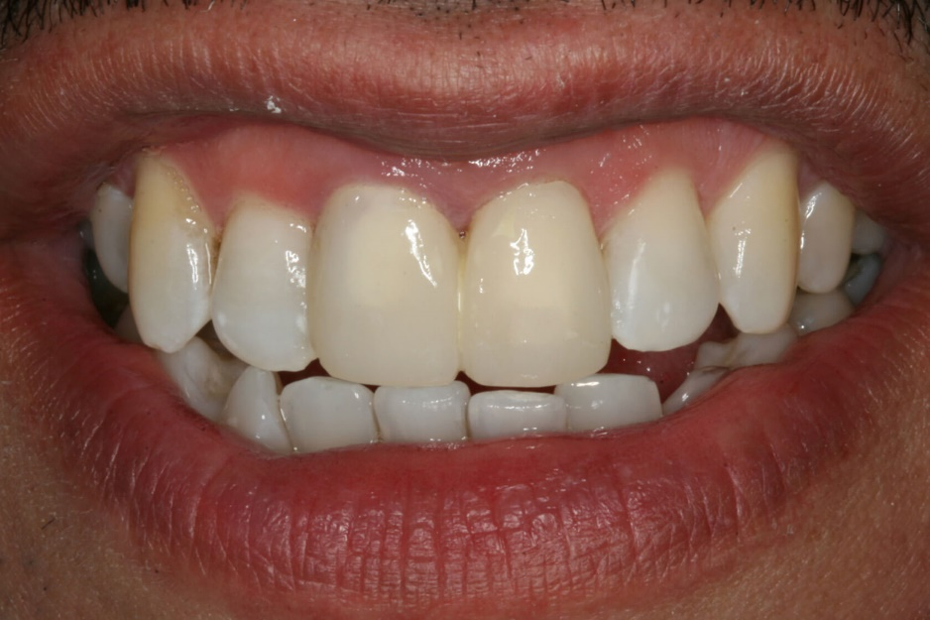
Under reduction
Insufficient reduction(under reduction) results in over contoured restoration that :
1- prevent plaque control resulting in periodontal disease or dental caries.
2- Bad appearance in all ceramic anterior crowns.
Solutions :
1- Increasing the amount of reduction or using larger diameter stones to ensure adequate amount of reduction.
2-Continuous evaluation of the amount of reduction by fabricating putty index or any other measuring procedure.

Slide 3
Undercuts
Undercuts is the portion that is between the gingiva and the height of contour, or in general, a depression under an elevation.
Undercuts can prohibit the restoration's complete seating.
When left unattended technicians have to block them out before making the restoration, causing reduced retention.
ways to prevent undercuts.
Proper and clear vision.
Correct technique and hand positioning.
Reduction parallel to the long axis of the tooth.

Slide 4


Solution :
1- Further wall reduction.
2-Block out the undercuts by the technicians.

