Slide 1

Customer Segmentation using K-Means and Hierarchical Clustering
A Project on Segmenting Online Retail Customers for Marketing Insights
By Manjit Singh & Mohammed Suleman
Date 18-09-2024

Slide 2
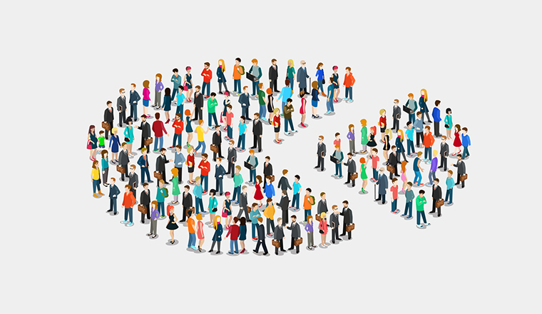
Introduction
Objective:
This project aims to perform customer segmentation for a UK-based online retailer. By segmenting customers based on purchasing behavior, businesses can implement personalized marketing strategies to enhance customer satisfaction and boost revenue.
Why Segmentation:
Customer segmentation allows companies to target different customer groups with tailored marketing strategies, improving retention, and increasing customer lifetime value.

Slide 3
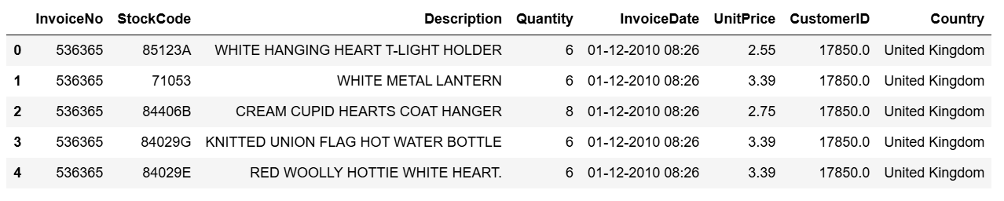
Dataset Overview
Dataset: Online Retail Dataset (Link: UCI Repository)
Key Features:
Transactions from December 1, 2010, to December 9, 2011.
Important columns: InvoiceNo, StockCode, Description, Quantity, InvoiceDate, UnitPrice, CustomerID, Country.
Data Preprocessing:
Removed cancelled transactions (negative quantities).
Handled missing values by removing entries with null CustomerID.
Converted InvoiceDate into proper datetime format and created new features (e.g., Recency).

Slide 4
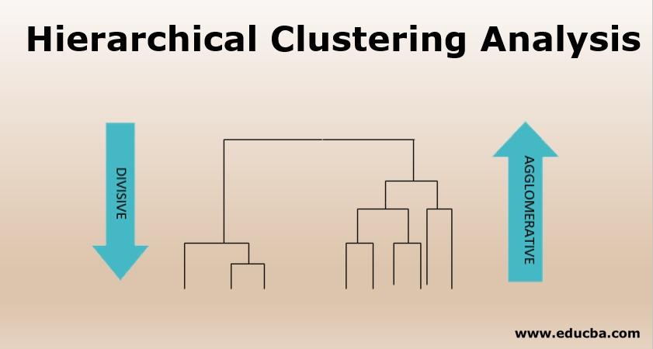
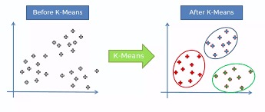
Methodology
K-Means Clustering:
A centroid-based algorithm used to divide customers into k clusters. The optimal number of clusters was determined using the elbow method.
Hierarchical Clustering:
Agglomerative hierarchical clustering builds clusters step by step, combining similar clusters at each stage. We used Ward’s method to minimize the variance within each cluster.

Slide 5
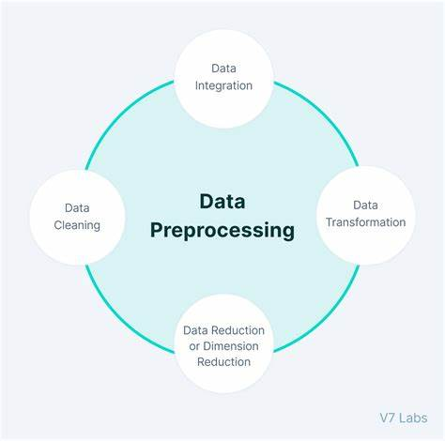
Data Preprocessing
Steps:
Handling Missing Values: "Removed rows with missing CustomerID.
Feature Engineering: Created key features such as:
Recency: Days since the last purchase.
Frequency: Number of transactions.
Monetary Value: Total spent by each customer.
Scaling: "Used MinMaxScaler to scale the features for K-Means clustering."

Slide 6
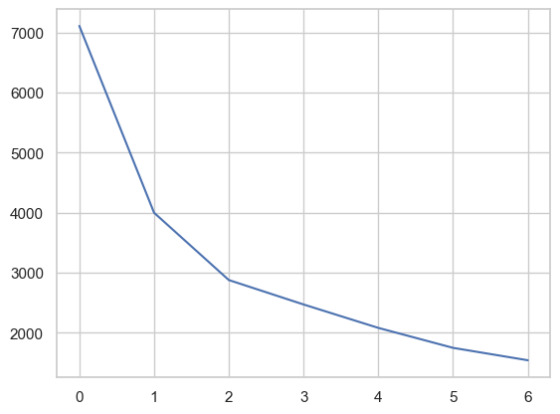
Model Implementation (K-Means)
Elbow Method: To find the optimal number of clusters, we used the elbow method, which plots the within-cluster sum of squares against the number of clusters.
Final K-Means Model: Using the elbow method, we selected 3 clusters for K-Means. These clusters represent different groups of customers based on their purchasing behavior.

Slide 7
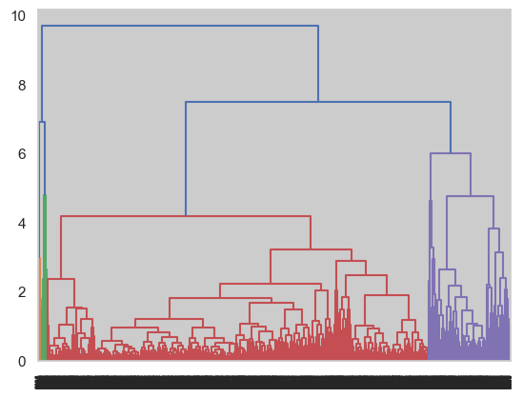
Model Implementation (Hierarchical Clustering)
Dendrogram: Hierarchical Clustering was performed using Ward's method to minimize variance within clusters.

Slide 8
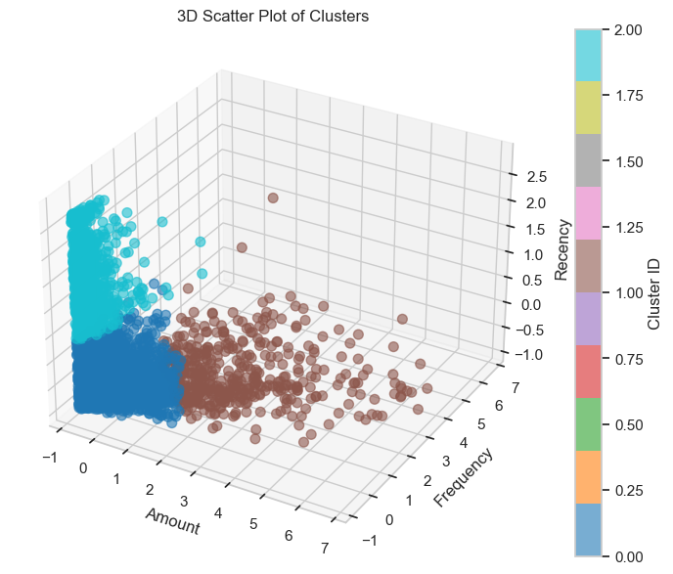
Cluster Visualizations (K-Means)
Visualize the Clusters: Using K-Means, we identified 3 distinct customer segments. The 3D scatter plot reveals distinct clusters in the data based on Recency, Frequency and Amount.

Slide 9
Cluster Interpretation
Cluster Analysis:
Cluster 0: These are high-value customers with occasional but significant purchases. This group should be prioritized with loyalty programs or exclusive offers to increase retention.
Cluster 1: These customers purchase frequently but tend to spend less. Marketing efforts could focus on increasing the average order value through upselling or cross-selling strategies.
Cluster 2: Moderate-frequency buyers with average spending. A balanced approach to retention and upselling may be effective here.

Slide 10
Conclusion
Findings: Customer segmentation revealed 3 distinct groups with varied purchasing behaviors. The high-value customers (Cluster 0) represent a key segment for targeted marketing strategies.
Recommendations:
Implement targeted loyalty programs for high-value customers.
Special discounts for low-frequency customers to increase engagement.
Limitations: The dataset lacks demographic information, which could provide deeper insights. Further segmentation with additional features could improve results.

