Slide 1
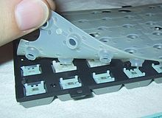
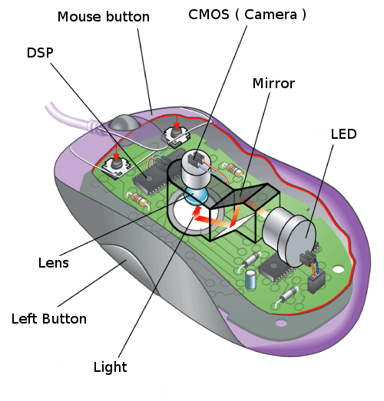
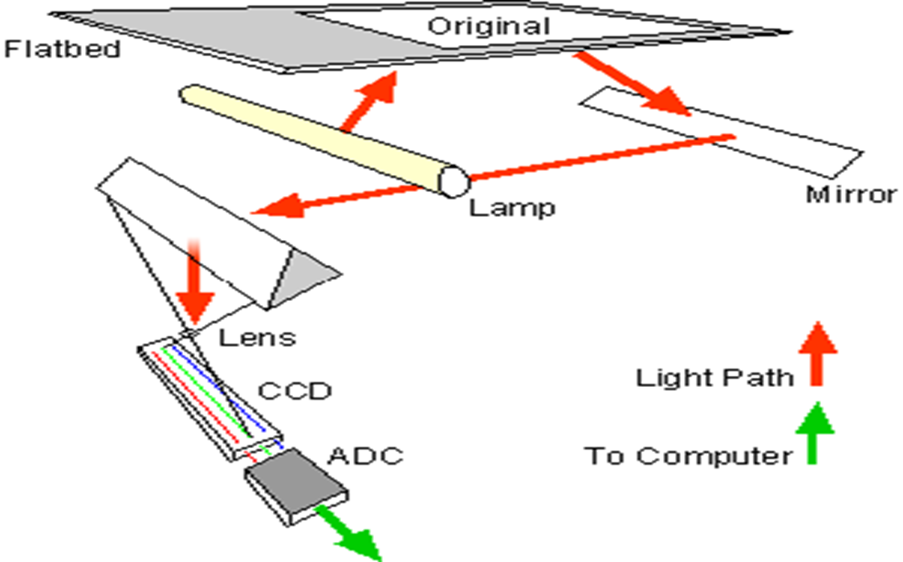
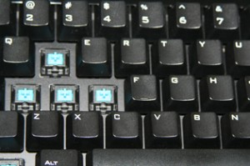
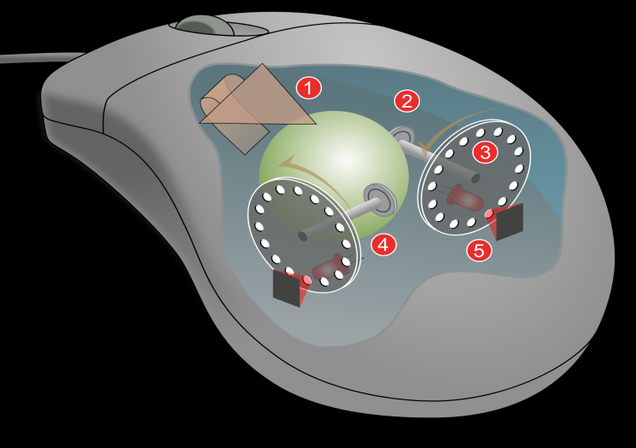
INPUT DEVICES
MEMBRANE KEYBOARD
OPTICAL MOUSE
SCANNER
MECHANICAL KEYBOARD
MECHANICAL MOUSE

Slide 2
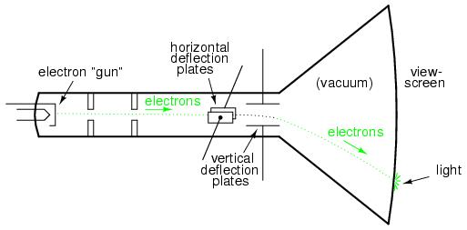
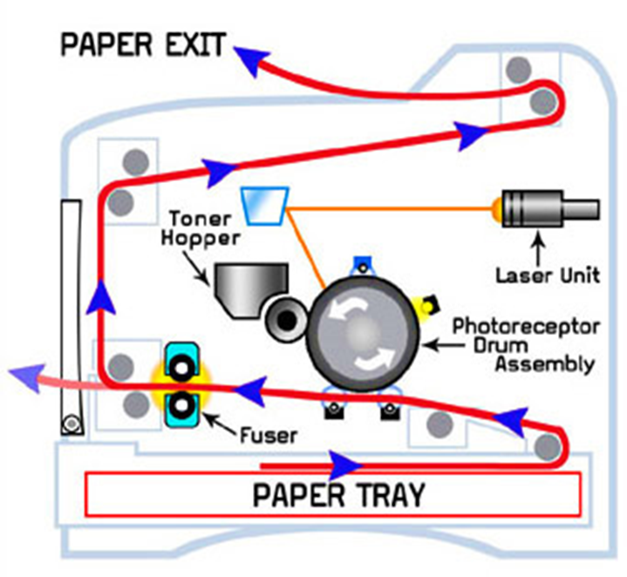
OUTPUT DEVICES:
INKJET PRINTER
MONITOR
LASER PRINTER

Slide 3
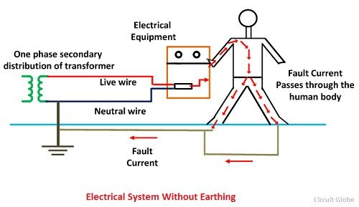
SMPS
AC INPUT
STEP DOWN TRANSFORMER
BRIDGE RECTIFIER
FILTER
VOLTAGE REGULATOR
DC INPUT
FEEDBACK
Earthing:

Slide 4
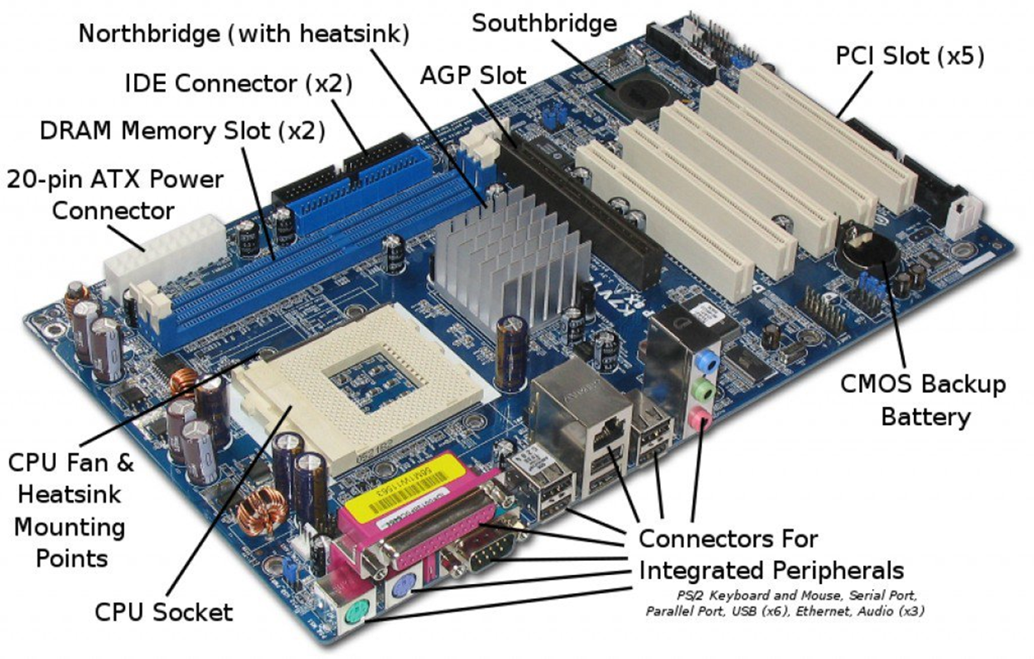
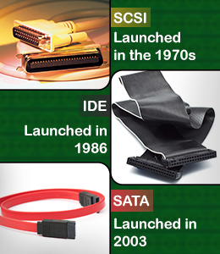
MOTHERBOARD

Slide 5
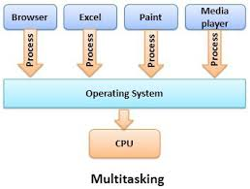
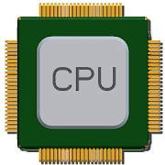
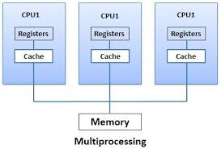
RISC
CISC
Simple
30-40 Instructions
One cycle
Parallel Execution
Multiple Register set
Complexity in compiler
Complex
100-200 Instructions
More cycles
Sequential Execution
Unique Register set
Complexity in CPU(micro-programming)

Slide 6
Memory
Primary Memory
Secondary Memory
Cache Memory
Optical storage
L1
L2
L3
RAM
ROM
Magnetic storage
SRAM
DRAM
PROM
EPROM
EEPROM
Hard disk
Magnetic tapes
CD
DVD

