Slide 1
DIRECTORY SERVICES
LDAP

Slide 2
X.500 Directory Service
The X.500 directory service is a global directory service.
X.500 is a series of computer networking standards covering electronic directory services.
The X.500 series was developed by CCITT, and first approved in 1988.
The directory services were developed in order to support the requirements of X.400 electronic mail exchange and name lookup.
Its components cooperate to manage information about objects such as countries, organizations, people, machines, and so on in a worldwide scope.
It provides the capability to look up information by name and to browse and search for information.

Slide 3
The different types of protocols of X.500:
DAP (Directory Access Protocol)
DSP (Directory System Protocol)
DISP (Directory Information Shadowing Protocol)
DOP (Directory Operational Bindings Management Protocol)
These protocols used in the OSI networking stack.
A number of alternatives to DAP were developed to allow Internet clients to access the X.500 Directory using the TCP/IP networking stack.
The most well-known alternative to DAP is Lightweight Directory Access Protocol (LDAP).

Slide 4
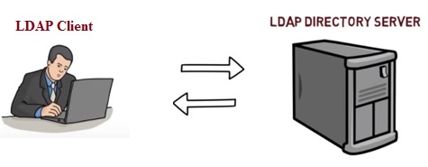
LDAP (Lightweight Directory Access Protocol)
Lightweight Directory Access Protocol uses client-server architecture.
It is used to manage and access distributed directory over IP network.
It is similar to telephone directory containing contact numbers and addresses of the subscribers.
It provides directory service with systematic set of records organized in hierarchical structure.

Slide 5
Clients may be directly controlled by individuals, embedded in applications or "agents".
It is useful when integrating multiple directory services.
To commence LDAP session, client needs to connect with server (called as "Directory System Agent"). By default server is set to use TCP port number 389.
After connection is established, client and server can exchange the information or data.
Various operations can be performed on LDAP such as Add, Bind, Delete, Modify, Unbind etc.
The default TCP port for LDAP is 389

Slide 6
Basic functionality of LDAP
The main benefit of using LDAP is that information for an entire organization can be consolidated into a central repository.
For example, rather than managing user lists for each group within an organization, LDAP can be used as a central directory accessible from anywhere on the network. And because LDAP supports Secure Sockets Layer (SSL) and Transport Layer Security (TLS), sensitive data can be protected from prying eyes.

Slide 7
Advantages of LDAP
Global naming model ensures unique entries.
It allows use of multiple independent directories.
It is extensible to meet future/local requirements.
It runs over TCP/IP and SSL directly.
It has wider support across the industries.
The protocol is based on existing deployed technologies.
LDAP is used by many services like TCP and DNS.
It is open source protocol with very flexible architecture.
LDAP is automated and hence updating of the same is much easier unlike DNS.

Slide 8
Disadvantages of LDAP
It requires directory servers to be LDAP compliant for service to be deployed.
LDAP is difficult but rarely employed unlike DNS which is more easy to use and widely employed.
An LDAP server cannot be its own client.
Setting up and managing an LDAP naming service is more complex and requires careful planning

Slide 9
OPERATION OF LDAP
Add operation:
Used to create a new entry in a directory server.
Bind operation:
Used to authenticate a user and change the identify of the associated connection.
Modify operation:
Used to alter the contents of an entry in a directory server.
Delete operation:
Used to retrieve entries that match a provided set of criteria.
Unbind operation:
Used to close the connection to the directory server.

Slide 10
Abandon operation:
An abandon operation may be used to request that the server stop working on an operation that the client had previously requested.
Compare operation:
Compare operation may be used to determine whether a specified entry has a particular attribute value.
Extended operation:
An extended operation may be used to request some other kind of processing that isn't covered by one of the other operation types.
Search operation:
A search operation may be used to retrieve entries that match a provided set of criteria.
Modify DN operation:
A modify DN operation may be used to change the DN of an entry. This may be used to replace the RDN and/or to move the entry to a different place in the DIT.

Slide 11
Configuring LDAP on windows 2012 server

Slide 12
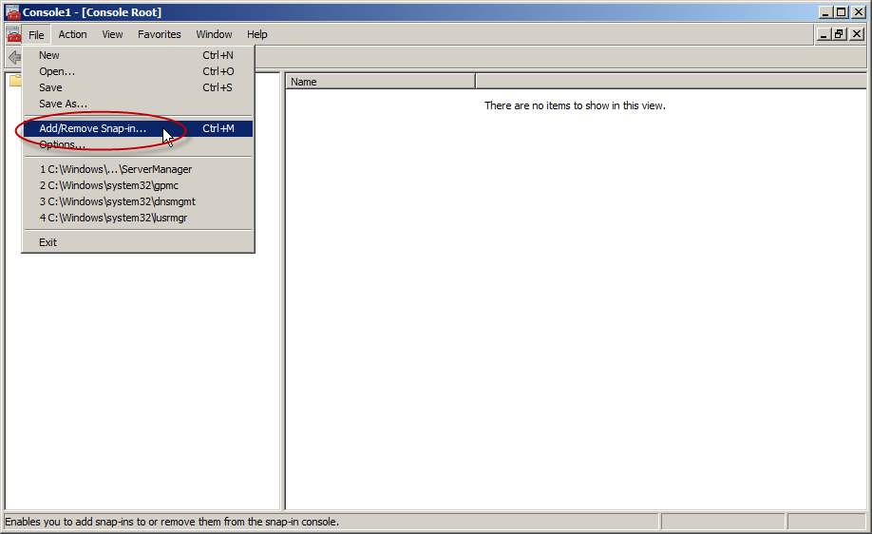

Slide 13
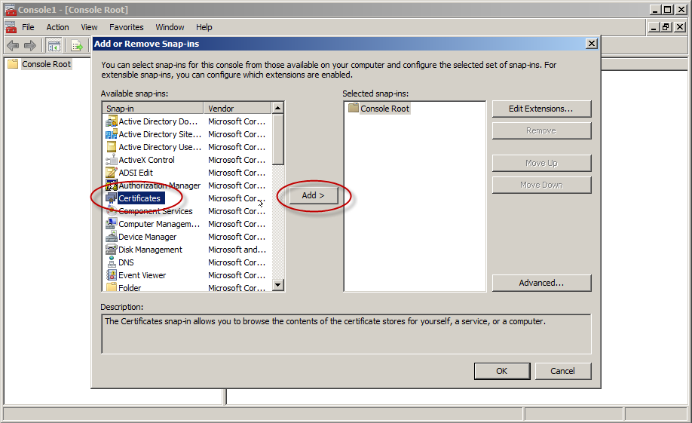

Slide 14
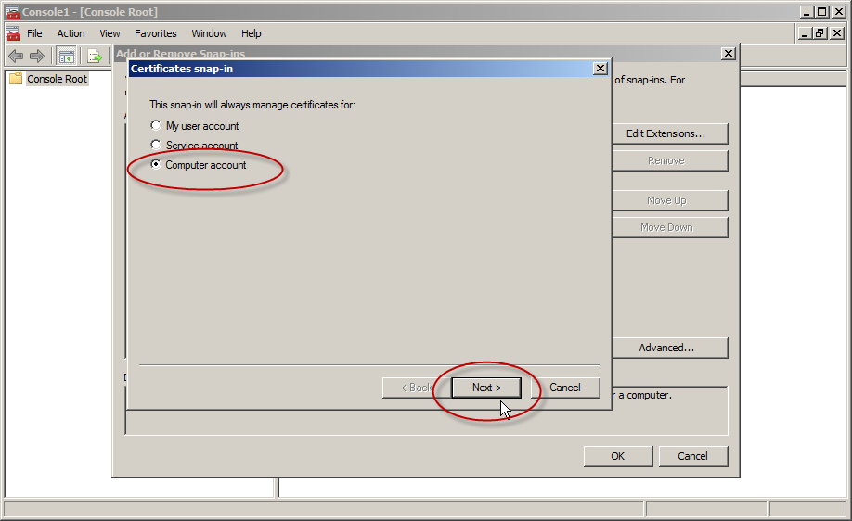

Slide 15
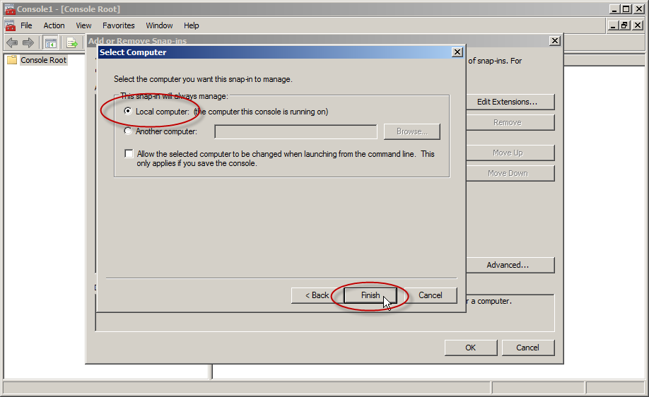

Slide 16
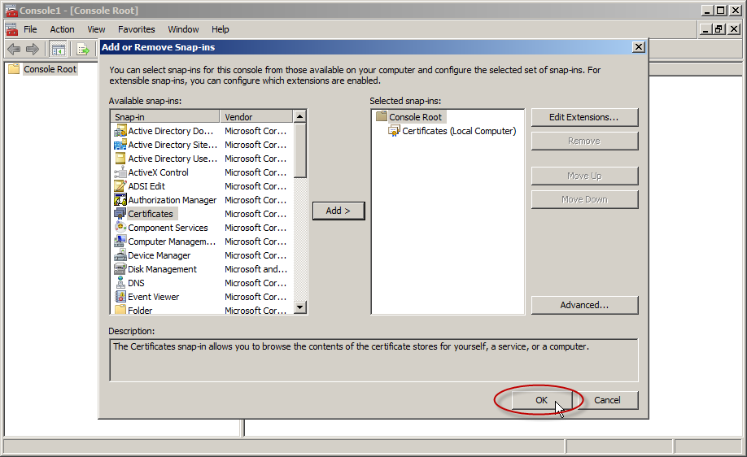

Slide 17
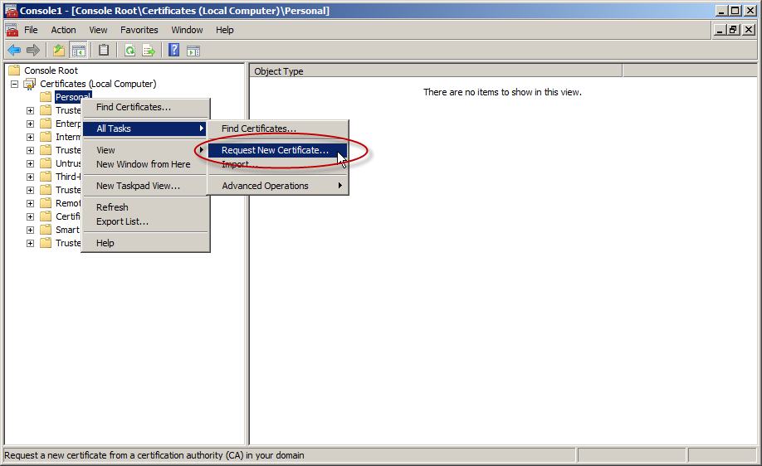

Slide 18
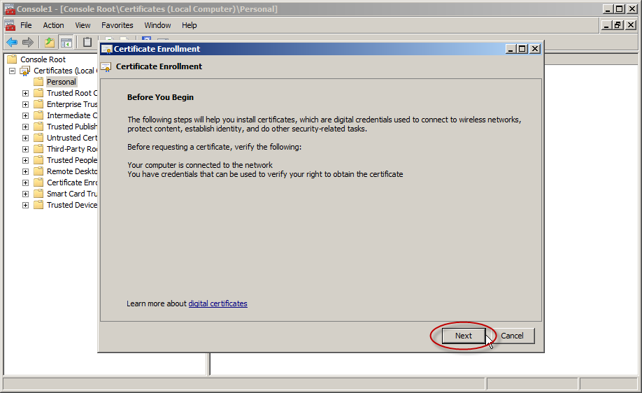

Slide 19
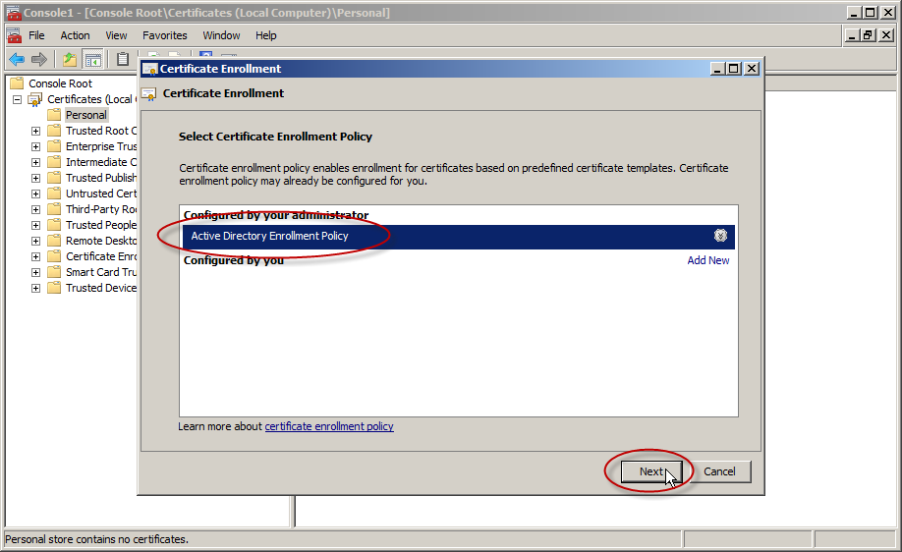

Slide 20
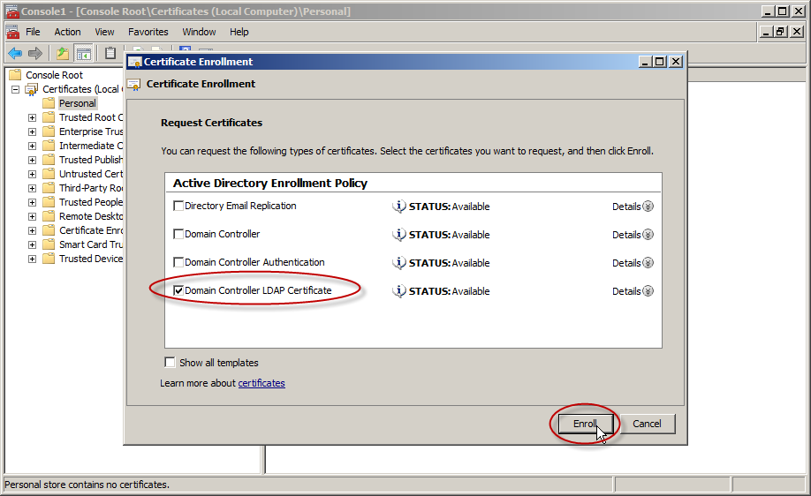

Slide 21
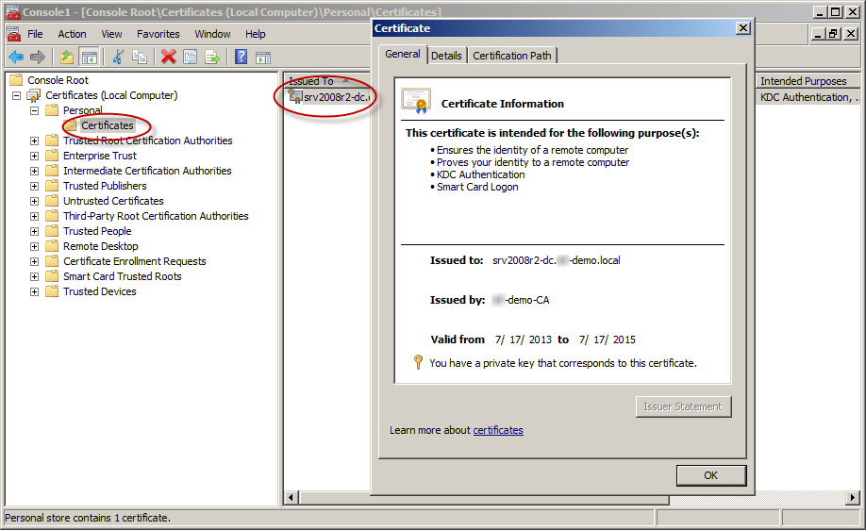

Slide 22
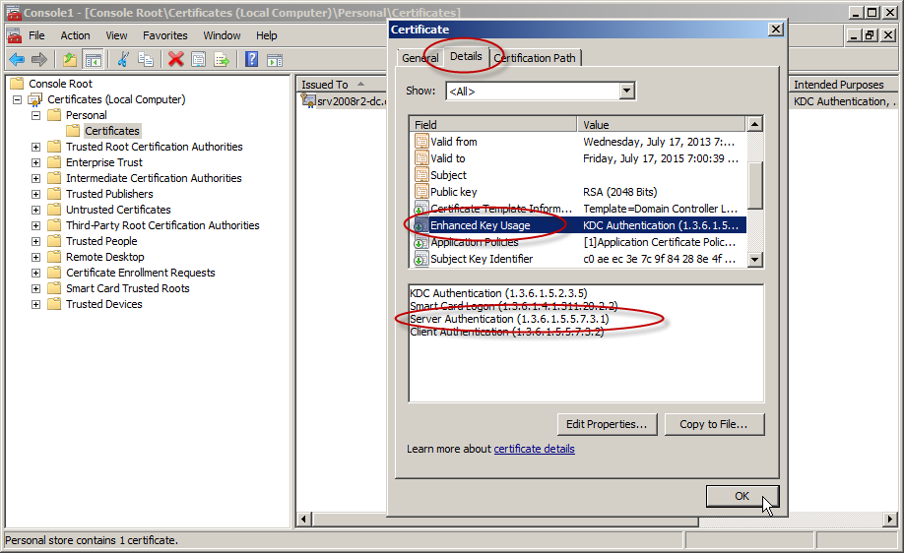

Slide 23
What is LDAP &Why?

Slide 24
PROTOCOLS IN LDAP

Slide 25
LDAP DIRECTORY STRUCTURE

Slide 26
LDAP OPERATIONS

