Slide 1
Group 5
Mohammed Asik 093947
Raavi Vinay Kumar 093992
Madhuri Sanapala 093963
Rohit Hurkadli 094048
Bindu Shree 093941
1

Slide 2
DATA-LINK LAYER

Slide 3
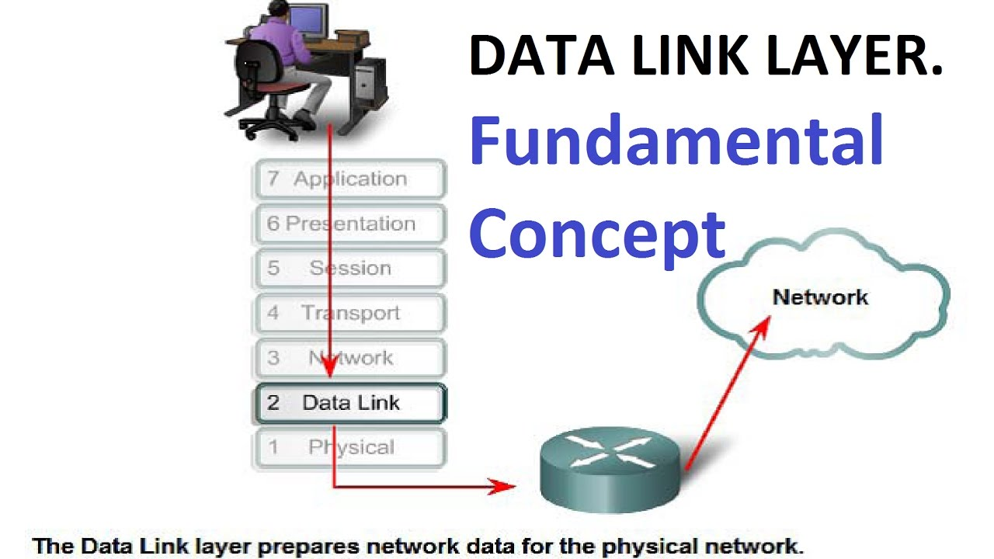

Slide 4
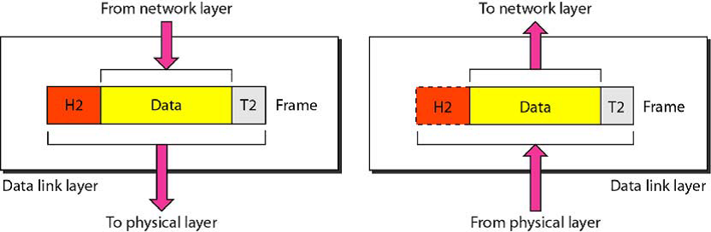
Functionalities
FRAMING ADDRESSING FLOW CONTROL ERROR CONTROL

Slide 5
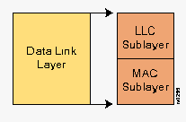
PROTOCOLS
Address Resolution Protocol
Asynchronous transfer mode
PPP
Ethernet

Slide 6
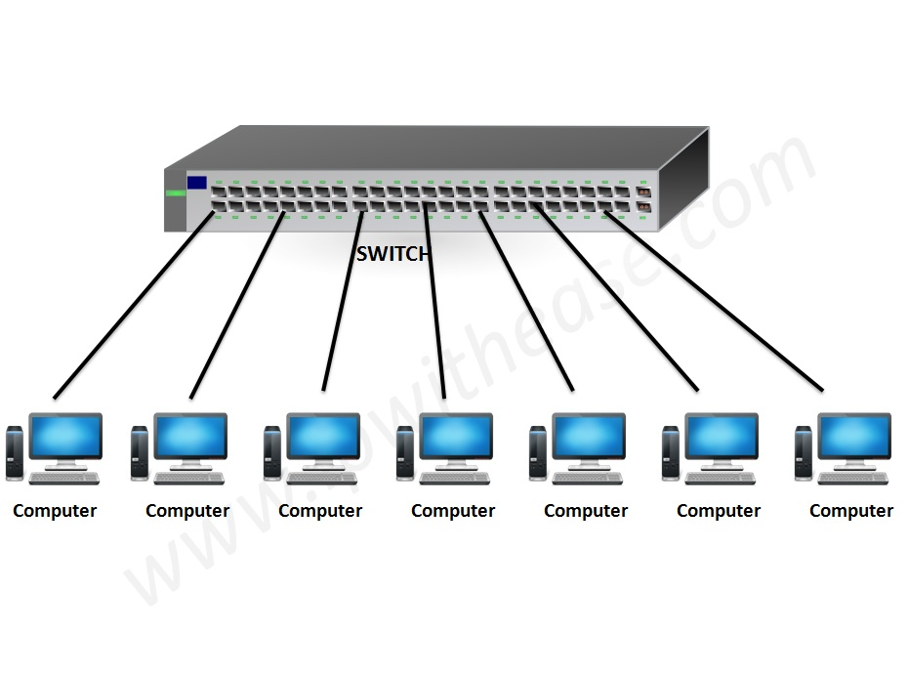
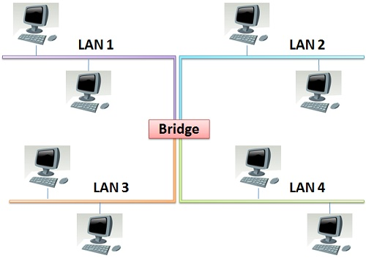
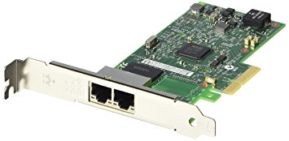

Slide 7
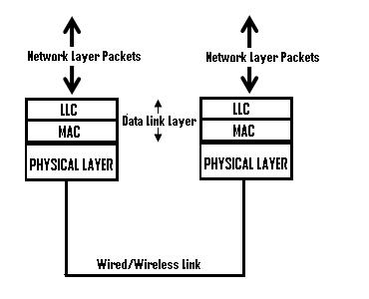
Sublayers of datalink layer
The data link layer functionality is usually split it into 2 logical sub-layers.
LLC
MAC

Slide 8
LLC:
Logical Link Layer.
It interacts with the network layer.
It is responsible for handling multiple Layer protocols (multiplexing/de- multiplexing) and link services like reliability and flow control.
It talks about WAN protocols (PPP, HDLC, Frame-relay).
The primary responsibilities of LLC are:
Network Layer protocol Multiplexing/De-Multiplexing
Logical Link Services
Connectionless Unacknowledged Service
Connectionless Acknowledged Service
Connection oriented service With Acknowledgment
Connection oriented service Without Acknowledgment

Slide 9
MAC:
Media Access Control.
It interacts with the physical layer.
It is responsible for framing and media access control for broadcast media.
It talks about the physical address.
It’s a 48 bit address.
It is responsible for error detection.
MAC addresses are permanent.
The primary responsibilities of MAC are:
Framing/De-Framing
Collision Resolution
MAC Filtering:
It refers to security access control method whereby the 48 bit address assigned to every
NIC is used to determine access to network i.e. it may permit or deny the network access.

Slide 10
Services of Datalink Layer
Network is responsible for transmission of data from one device to another device.
Data can be corrupted during transmission.
Error control is the process of detecting and correcting both the bit level and packet level errors.
Types of Errors:
Single Bit Error
Multiple bits error
Burst Error
Error control mechanism may involve two possible ways:
Error detection
Error correction

Slide 11
Error detection:
Error detection is the process of detecting the error during the transmission between the sender and the receiver.
Types of error detection
Parity checking
Cyclic Redundancy Check (CRC)
Checksum
Parity checking:
Types of Parity Checking
Single bit parity
Two dimension parity

Slide 12

Single bit parity:
One extra bit is sent along with the original bits to make number of 1s either even in case of even parity, or odd in case of odd parity.
Two dimension parity:
Parity check bits are calculated for each row, which is equivalent to a simple parity check bit. Parity check bits are also calculated for all columns, then both are sent along with the data. At the receiving end these are compared with the parity bits calculated on the received data.

Slide 13
Cyclic Redundancy Check (CRC):
CRC is a different approach to detect if the received frame contains valid data.
This technique involves binary division of the data bits being sent.
The divisor is generated using polynomials.
Before sending the actual bits, the sender adds the remainder at the end of the actual bits.
Actual data bits plus the remainder is called a codeword.
Checksum:
In checksum error detection scheme, the data is divided into k segments each of m bits.
In the sender’s end the segments are added using 1’s complement arithmetic to get the sum.
The sum is complemented to get the checksum.
The checksum segment is sent along with the data segments.
At the receiver’s end, all received segments are added using 1’s complement arithmetic to get the sum. The sum is complemented.
If the result is zero, the received data is accepted; otherwise discarded.

Slide 14
Error Correction :
In the digital world, error correction can be done in two ways
Backward Error Correction :
When the receiver detects an error in the data received, it requests back the sender to retransmit the data unit.
Forward Error Correction :
When the receiver detects some error in the data received, it executes error-correcting code, which helps it to auto-recover and to correct some kinds of errors.
Addressing :
Data-link layer provides layer-2 hardware addressing mechanism. Hardware address is assumed to be unique on the link. It is encoded into hardware at the time of manufacturing.

Slide 15
Flow Control :
When a data frame (Layer-2 data) is sent from one host to another over a single medium, it is required that the sender and receiver should work at the same speed.
That is, sender sends at a speed on which the receiver can process and accept the data.
What if the speed (hardware/software) of the sender or receiver differs? If sender is sending too fast the receiver may be overloaded, (swamped) and data may be lost.
Two types of mechanisms can be deployed to control the flow
Stop and Wait:
This flow control mechanism forces the sender after transmitting a data frame to stop and wait until the acknowledgement of the data-frame sent is received.

Slide 16
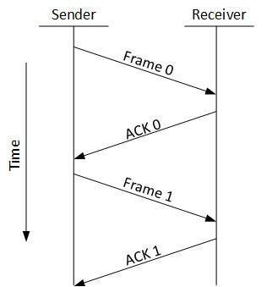
Example for Stop and Wait :
Sliding Window :
In this flow control mechanism, both sender and receiver agree on the number of data-frames after which the acknowledgement should be sent. As we learnt, stop and wait flow control mechanism wastes resources, this protocol tries to make use of underlying resources as much as possible.

Slide 17
PROTOCOLS

Slide 18
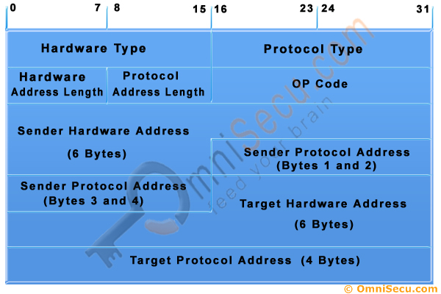
ADDRESS RESOLUTION PROTOCOL
Address Resolution Protocol is a protocol for mapping an Internet Protocol address to a physical machine address that is recognized in the local network.
The purpose of Address Resolution Protocol ARP is to resolve an IPv4 address (32 bit Logical Address to the physical address (48 bit MAC Address).
Address Resolution protocol message format.

Slide 19
ASYNCHRONOUS TRANSFER MODE
Asynchronous transfer mode is a switching technique used by telecommunication networks that uses asynchronous time-division multiplexing to encode data into small, fixed-sized cells.
Use variable packet sizes for data or frames.
ATM services generally have four different bit rate choices:
Available Bit Rate
Constant Bit Rate
Unspecified Bit Rate
Variable Bit Rate (VBR)

Slide 20
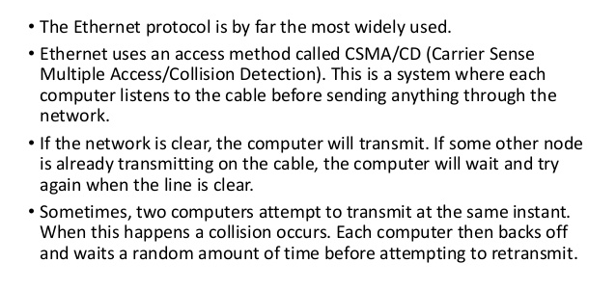
ETHERNET

Slide 21
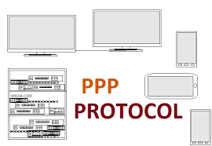
POINT TO POINT PROTOCOL(PPP)
Is a data link-layer protocol used to encapsulate higher network-layer protocols to pass over synchronous and asynchronous communication lines.
PPP uses the High-Level Data-Link Control (HDLC) protocol as the basis to encapsulate its data during transmission.
PPP uses the Link Control Protocol (LCP) to establish, test, and configure the data link connection.
Various network control protocols (NCPs) are used to configure the different communications protocols. This system enables the use of different protocols, such as TCP/IP and IPX, over the same line simultaneously.

