Slide 1
Group 5
Mohammed Asik 093947
Raavi Vinay Kumar 093992
Madhuri Sanapala 093963
Rohit Hurkadli 094048
Bindu Shree 093941
1

Slide 2
DATA-LINK LAYER

Slide 3
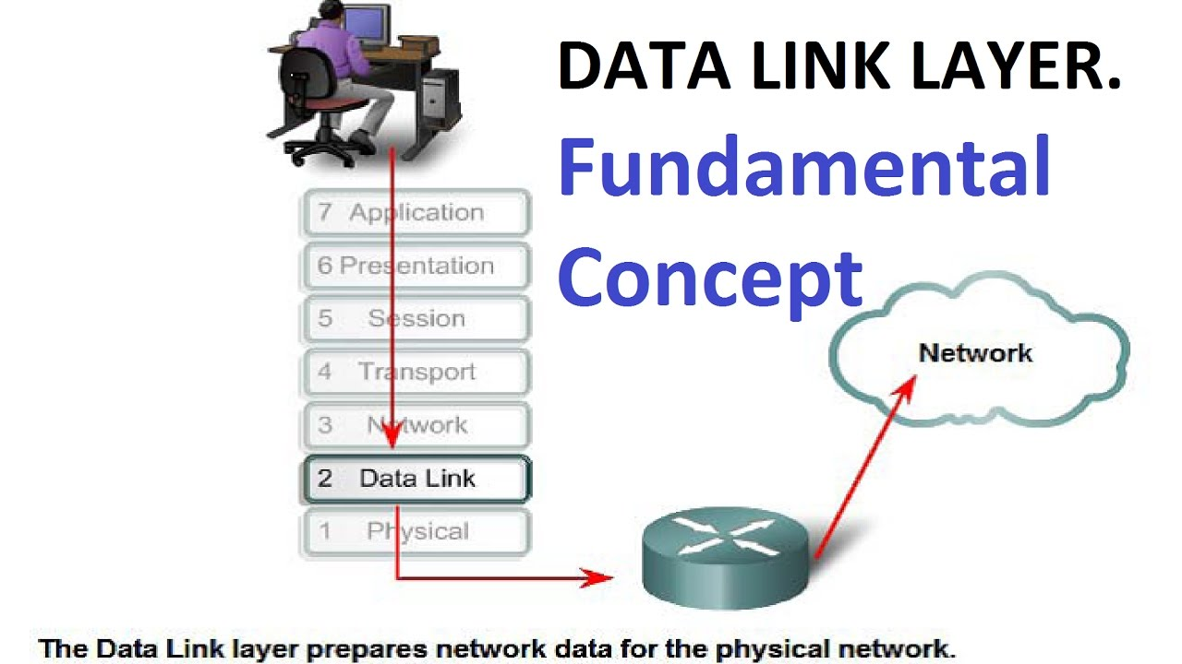

Slide 4
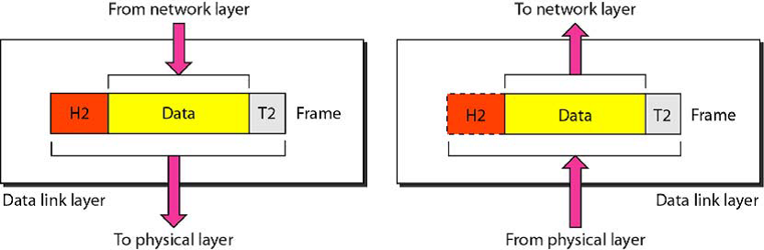
Functionalities
FRAMING ADDRESSING FLOW CONTROL ERROR CONTROL

Slide 5
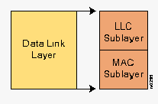
PROTOCOLS
Address Resolution Protocol
Asynchronous transfer mode
PPP
Ethernet
HDLC
FDDI
Frame relay
MPLS

Slide 6
