Slide 1
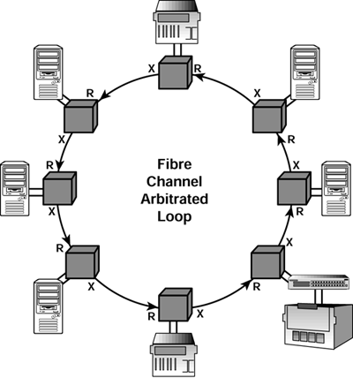
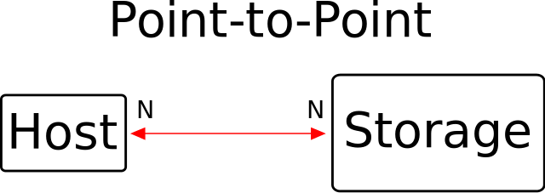
Storage Types
Fibre Channel is a high-speed network technology primarily used to connect computer data storage to servers.
Topologies:

Slide 2
NAS
SAN
DAS
Application
Client
Application
Application
File system
Network
File system
Network
File system
Disk Storage
Disk Storage
Disk Storage
NAS Server
RAID subsystem

Slide 3
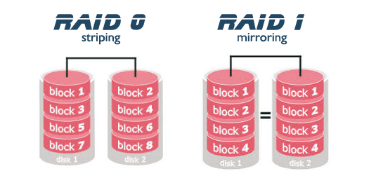
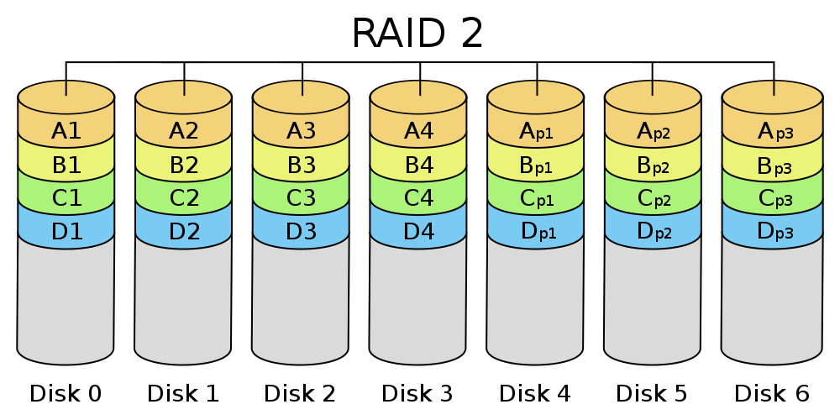
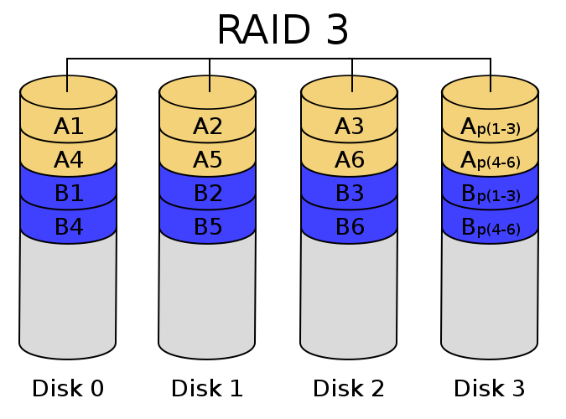
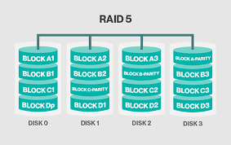
RAID:
RAID storage uses multiple disks in order to provide fault tolerance, to improve overall performance, and to increase storage capacity in a system.

