Slide 1
GRADUATION PROJECT · ECB 3802 · MARINE PORT ENGINEERING
SUEZ PORT CAD
CAD & Masterplan Design AI Engineer
Design-Vessel Port Dimensioning & Automated Masterplan Generation
Presented by Mohamed Abdelshafy
Supervisor Dr. ____________________
Year 2026

Slide 2
OUTLINE
Agenda
01 Introduction & problem statement
02 Project objectives
03 The design vessel
04 Theoretical basis — PIANC / UNCTAD
05 Dimensioning formulas
06 The AI-engineer tool & architecture
07 Automated CAD masterplan generation
08 Worked example & results
09 Validation & limitations
10 Conclusion & future work
SUEZ PORT CAD · MASTERPLAN DESIGN AI ENGINEER
02 / 16

Slide 3
INTRODUCTION
Why Port Dimensioning Matters
▸ The Suez corridor carries ~12% of global trade.
Port & harbour geometry must safely accommodate the largest design vessel.
▸ Vessels keep growing — ULCVs now exceed 400 m LOA.
Channels, basins and berths must be re-checked against the design ship.
▸ Concept dimensioning is repetitive and error-prone by hand.
Dozens of interdependent PIANC / UNCTAD rules per layout.
▸ Need: a fast, standards-based engine that also produces CAD.
Seconds instead of hours — with an AutoCAD-ready masterplan.
SUEZ PORT CAD · MASTERPLAN DESIGN AI ENGINEER
03 / 16

Slide 4
OBJECTIVES
Project Objectives
▸ Compute the principal port dimensions from a single design vessel.
▸ Apply recognised concept methods — PIANC WG121, UNCTAD, Barrass squat.
▸ Generate a to-scale CAD masterplan automatically (DXF / SVG / PNG).
▸ Deliver an interactive, validated AI-engineer web interface.
▸ Keep one source of truth: numbers → geometry → drawing.
SUEZ PORT CAD · MASTERPLAN DESIGN AI ENGINEER
04 / 16

Slide 5
INPUT
The Design Vessel
▸ Definition
the largest vessel the port must routinely serve.
▸ Geometric particulars
LOA, beam B, draft T, deadweight (DWT).
▸ Hydrodynamic
transit speed V and block coefficient Cb (hull fullness).
▸ Operational
exposure, channel type, manoeuvre aids, number of berths.
BLOCK COEFFICIENT Cb
Container 0.65
Tanker 0.82
Bulk 0.85
General 0.70
Cruise 0.62
Lng 0.74
Roro 0.68
SUEZ PORT CAD · MASTERPLAN DESIGN AI ENGINEER
05 / 16

Slide 6
METHOD
Theoretical Basis
▸ PIANC WG121 — Harbour Approach Channels
concept (Class III) design method for depth & width.
▸ UNCTAD & standard port practice
turning basins, quay length, anchorage geometry.
▸ Barrass II — ship squat
speed-dependent dynamic sinkage in shallow water.
▸ Under-keel clearance (UKC) philosophy
manoeuvrability margin + wave allowance by exposure.
Scope: planning / concept level — to be confirmed by detailed study.
SUEZ PORT CAD · MASTERPLAN DESIGN AI ENGINEER
06 / 16

Slide 7
FORMULAS · 1 OF 3
Channel Depth & Squat
SHIP SQUAT (Barrass II)
NET UNDER-KEEL CLEARANCE
S = Cb · V² / 100
UKC = max(0.05 · T, 0.5)
maximum bow squat in open water [m]
manoeuvrability & bottom margin [m]
APPROACH CHANNEL DEPTH
BERTH POCKET DEPTH
D = T + UKC + S + Hw
Db = T + max(0.07 · T, 0.5)
Hw = wave allowance by exposure
alongside, reduced-speed squat
SUEZ PORT CAD · MASTERPLAN DESIGN AI ENGINEER
07 / 16

Slide 8
FORMULAS · 2 OF 3
Approach Channel Width — PIANC
TWO-WAY CHANNEL
W = 2(1.5B) + 2(a·B) + 1.6B + 2(0.5B)
two manoeuvring lanes + passing distance + bank clearances
ONE-WAY CHANNEL
W = 1.5B + a·B + 2(0.5B)
single lane + additional widths + bank clearances
a = exposure width factor sheltered 0.6 · moderate 1.3 · exposed 2.2
SUEZ PORT CAD · MASTERPLAN DESIGN AI ENGINEER
08 / 16

Slide 9
FORMULAS · 3 OF 3
Turning, Quay, Stopping & Anchorage
TURNING CIRCLE
TOTAL QUAY LENGTH
Dt = k · LOA
Lq = n·LOA + (n+1)·c
k: none 2.0 · tugs 1.6 · thrusters 1.5
c = max(0.10·LOA, 15) m clearance
DESIGN STOPPING DISTANCE
ANCHORAGE SWING RADIUS
Ls ≈ 7 · LOA
R = LOA + 6·D + 30
loaded, emergency astern
single-point swing mooring; A = π·R²
SUEZ PORT CAD · MASTERPLAN DESIGN AI ENGINEER
09 / 16

Slide 10
IMPLEMENTATION
The AI-Engineer Tool
▸ FastAPI calculation engine (Python)
dimensioning formulas + plan geometry.
▸ Interactive browser interface
presets, live validation, instant results.
▸ ezdxf CAD exporter
AutoCAD-ready DXF, plus SVG / PNG / JSON.
▸ Single source of truth
the same numbers drive screen and drawing.
PIPELINE
1 Design vessel input
↓
2 PIANC / UNCTAD engine
↓
3 Port dimensions
↓
4 Plan geometry
↓
5 DXF · SVG · PNG · JSON
SUEZ PORT CAD · MASTERPLAN DESIGN AI ENGINEER
10 / 16

Slide 11
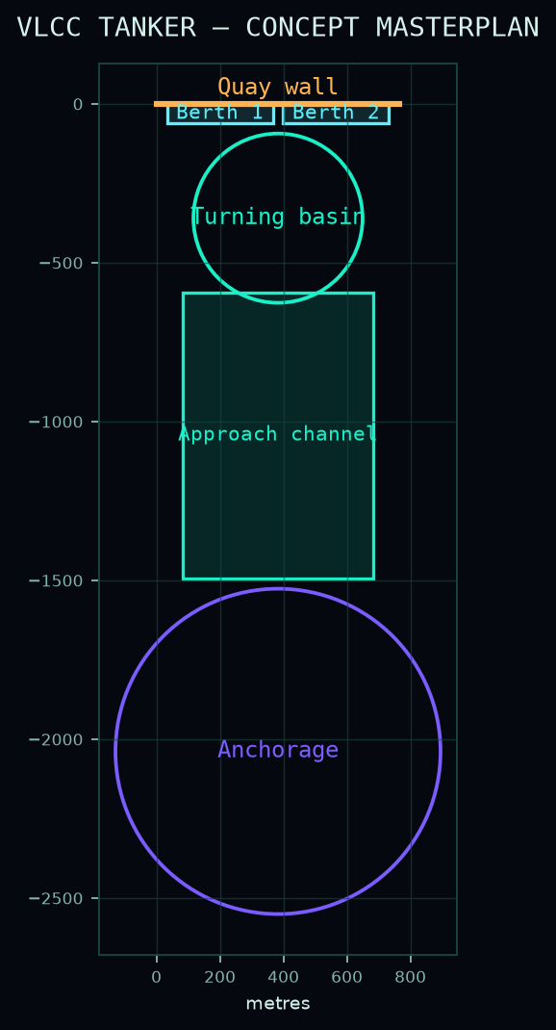
OUTPUT
Automated CAD Masterplan
▸ To-scale schematic
from the computed dimensions, 1 unit = 1 m.
▸ Layered drawing
quay, berths, turning basin, channel, anchorage.
▸ Open formats
DXF (AutoCAD), SVG, PNG, JSON.
▸ Every preset exported
8 design vessels, ready to hand in.
SUEZ PORT CAD · MASTERPLAN DESIGN AI ENGINEER
11 / 16

Slide 12
CASE STUDY · INPUT
Worked Example — Neo-Panamax at Suez
VESSEL TYPE
Container
CLASS
New-Panamax / Neo-Panamax
LOA
366 m
BEAM
49 m
DRAFT
15.2 m
TRANSIT SPEED
6 kn
BLOCK COEFF. CB
0.65
COMPUTED SQUAT
0.23 m
CHANNEL
two-way
EXPOSURE
moderate
MANOEUVRE AIDS
tugs
BERTHS
2
SUEZ PORT CAD · MASTERPLAN DESIGN AI ENGINEER
12 / 16

Slide 13
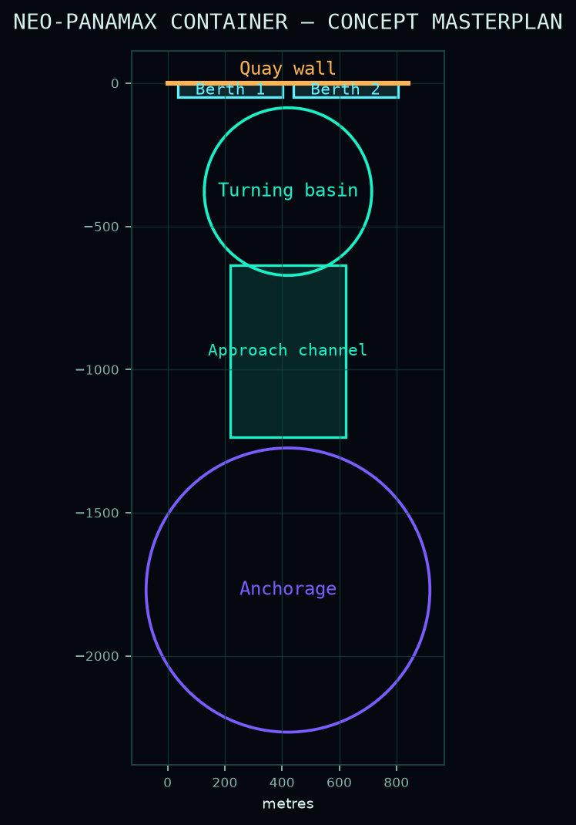
CASE STUDY · RESULTS
Computed Port Dimensions
Approach Channel Depth
16.7 m
Approach Channel Width
401.8 m
Turning Circle Diameter
585.6 m
Turning Basin Area
26.93 ha
Berth Pocket Depth
16.3 m
Total Quay Length
841.8 m
Design Stopping Distance
2,562.0 m
Anchorage Swing Radius
496.2 m
Anchorage Area
77.3 ha
SUEZ PORT CAD · MASTERPLAN DESIGN AI ENGINEER
13 / 16

Slide 14
CRITICAL REVIEW
Validation & Limitations
▸ Planning / concept level only
not a construction-issue design.
▸ Empirical rules give ranges
treat outputs as first-pass envelopes.
▸ Must be confirmed by
real-time manoeuvring simulation.
▸ Site data required
met-ocean, tidal, bathymetric & geotechnical surveys.
▸ Engineer-in-the-loop
a qualified maritime engineer signs off.
SUEZ PORT CAD · MASTERPLAN DESIGN AI ENGINEER
14 / 16

Slide 15
CONCLUSION
Conclusion
▸ A standards-based dimensioning engine
PIANC / UNCTAD concept methods, fully automated.
▸ Seconds, not hours
instant, repeatable, validated computations.
▸ AutoCAD-ready output
to-scale masterplan exported as DXF / SVG / PNG / JSON.
▸ Future work
GIS bathymetry · tidal time-series · layout optimisation · 3D / DWG.
SUEZ PORT CAD · MASTERPLAN DESIGN AI ENGINEER
15 / 16

Slide 16
THANK YOU
Questions & discussion
SUEZ PORT CAD · Masterplan Design AI Engineer · ECB 3802

