Slide 1
Experiences with a
SMP PC Cluster
Antônio Augusto Fröhlich
guto@first.gmd.de
GI Meeting
February, 1998

Slide 2
Outline
The SNOW Project
SNOW Hardware
SNOW Software
SNOW Performance
Conclusions
Alternatives

Slide 3
The SNOW Project
SNOW = Scalable Network of Workstations
Operating Systems Group at GMD-FIRST
Goals
  Investigate and develop solutions to diminish the gap between expensive custom parallel machines and cluster of commodity workstations.

Slide 4
The SNOW Project
Motivation
  Workstations performance is equivalent to MPP nodes.
  Networks are getting closer to MPP interconnection systems.
Challenge
  Reach performance comparable to MPPs.
  Software matter.

Slide 5
The SNOW Project
Current stage
  Evaluation of commodity SMP PC hardware and software to determine the lower edge of this technology.
  How far from HPC systems in SNOW now?
  Would careful software design fulfill the gap?
Notes:
PC => lower edge
if PC = OK then SUCCESS
else MAYBE HAVE TO WAIT

Slide 6
SNOW Hardware
SMP
PC
SMP
PC
SMP
PC
SMP
PC
8 SMP PCs
Myrinet network
Fast Ethernet network
Myrinet
Fast
Ethernet
Internet
SMP
PC
SMP
PC
SMP
PC
SMP
PC

Slide 7
SNOW SMP PCs
2 x Pentium II 266 MHz
512 Kb L2 cache
128 Mbytes 10 ns SDRAM
PCI bus
Myrinet NIC
Fast Ethernet NIC
Pentium II
cache
SDRAM
Pentium II
cache
PCI
Myrinet
Fast
Ethernet
Notes:
3 major aspects IMPACT SOFTWARE
PROCESSOR
MEMORY BANDWIDTH
I/O BANDWIDTH

Slide 8
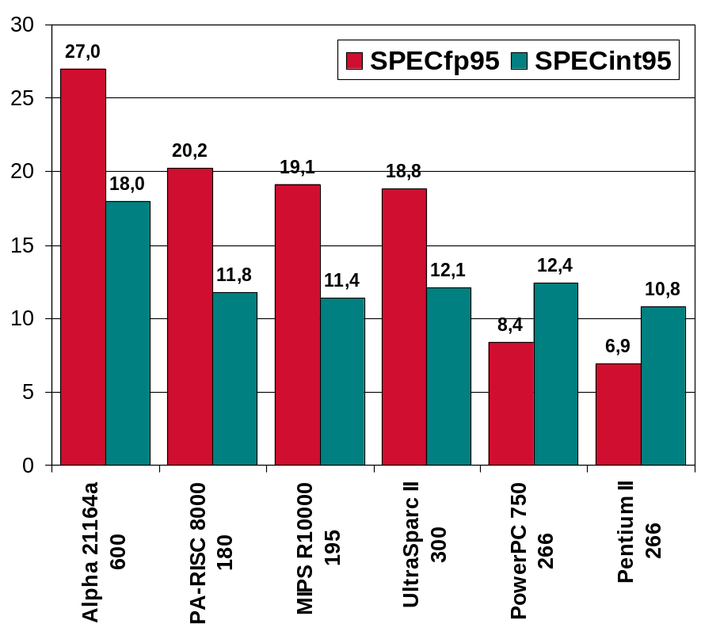
Pentium II
Intel P6 family
  Branch prediction
  Data flow analysis
  Speculative execution
  14 stages pipeline
  2 x IU
  2 x FPU
Max 2-way SMP (Slot1)
ix86 macro-architecture
  CISC
  6 registers
Notes:
1/4 TOP
1/3 MPP

Slide 9
Memory
L1 cache
  16 KB data
  16 KB code
  4256 MB/s
L2 cache
  512 KB
  1064 MB/s
SDRAM
  128 MB / 10 ns
  64 bits / 66 MHz
  422.4 MB/s
Useful bandwidth
  Read => 340 MB/s
  Write => 143 MB/s
  Copy => 140 MB/s
  Stream => 145 MB/s
SMP splits the bandwidth
Notes:
THEORY => USEFULL MUCH WORST
Pentium PRO better L2 cache but 200 MHz => worst!
PEAK AVG
READ 340 340
WRITE 1430 143
COPY 1136 140
SMP!!!

Slide 10
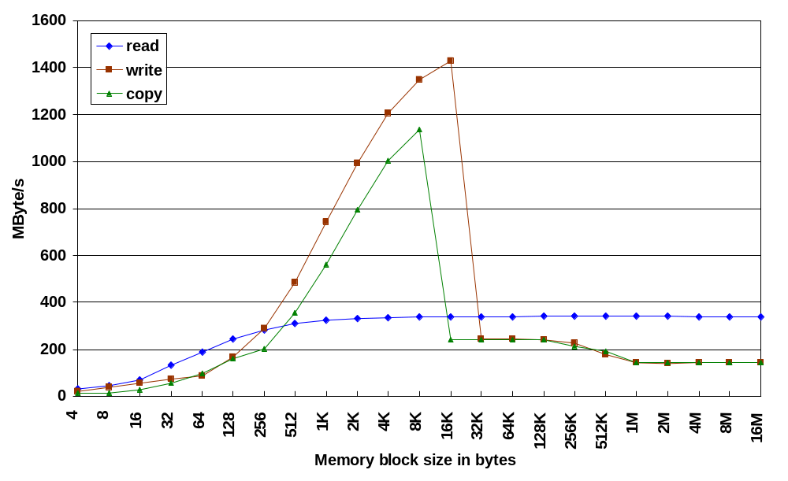
PC Memory Bandwidth
(cache hit)
Notes:
4 8 16 32 64 128 256 512 1K 2K
4K 8K 16K 32K 64K 128K 256K 512K 1M 2M 4M 8M 16M
read
30 44,35 69,16 131,62 189,78 243,59 283,84 309,4 323,99 331,81 335,86 337,93 338,97 339,49 339,75 339,89 339,95 339,98 340 340,01 339,8 339,8 339,79
write
21,25 37,09 54,4 72,86 86,35 165,69 287,59 483,58 741,85 992,9 1207,55 1347,78 1430,86 245,16 242,31 240,84 226,83 179,44 143,28 141,11 142,13 143,12 143,62
copy
12,44 14,68 29,35 55,51 97,73 159,23 202,74 353,84 560,37 793,72 1002,43 1135,98 240,16 240,09 240,05 239,78 213,86 190,06 142,24 141,49 142,86 143,76 144,2

Slide 11
PCI Bus
PCI bus
  32 bits
  33.33 MHz
Bandwidth
  DMA => 127 MB/s
  PIO => 44.4 MB/s
Considerations
  DMA
    Contiguous allocation
    Locked pages
    Physical address
    Copy to buffer?
  PIO
    Logical address

Slide 12
SNOW Networks
Fast Ethernet (100 Mbits/s full-duplex)
  TCP/IP
  File service (NFS)
  Internet
Myrinet (1.28 Gbits/s full-duplex)
  HP applications
  Free protocols and abstractions
Notes:
Why Myrinet?
ATM, SCI Fyberchannel == bandwidth and latency
100 MB/s 10μs
Myrinet NIC => flexible! Software!

Slide 13
Myrinet NIC
Myrinet NIC
  LANai 4.1
    32 bits / 37.5 MHz RISC processor
    3 x DMA engine
    link / packet int.
  1 Mbyte SRAM
  PCI host interface
160 MB/s full-duplex
CRC + flow control
Very flexible
link interface
LANai
packet interface
SRAM
recv DMA
send DMA
processor
host DMA
host interface
Notes:
NIC define solely the link level!

Slide 14
Myrinet Switch
8 x Ports
2 x crossbars
  8 x 8 mesh
  0.5 μs per hop latency
  Worm-hole routing
Flow control
Arbitrary length packages
Free topology
A B
A B
A B
A B
mesh A
mesh B
A B
A B
A B
A B
Notes:
Dual switch => fewer cables for fat three or cube

Slide 15
SNOW Software
HP Applications
MPI
TCP/IP
SMP UNIX
Myrinet
Fast
Ethernet

Slide 16
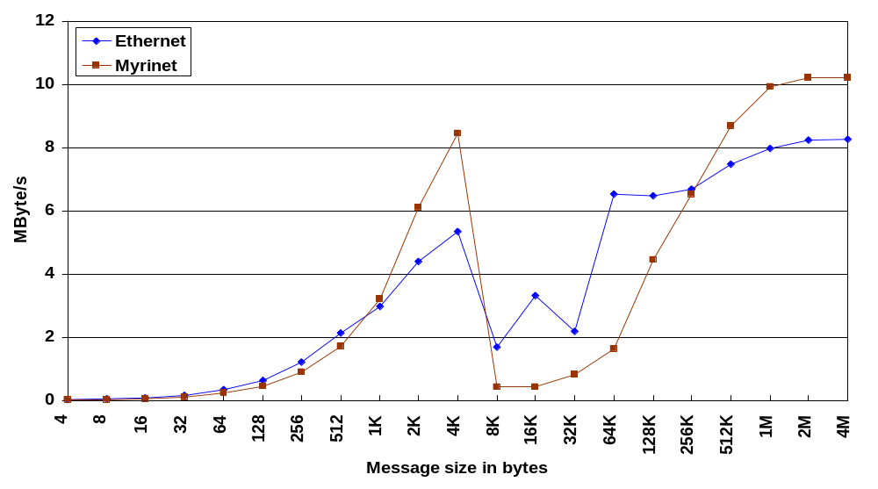
MPI Bandwidth
Notes:
Myrinet = 13 x Fast Ethernet, but == with TCP/IP
4 8 16 32 64 128 256 512 1K 2K 4K 8K 16K 32K 64K 128K 256K 512K 1M 2M 4M
Ethernet
0,020942 0,042039 0,083551 0,166754 0,329557 0,634606 1,214998 2,135113 2,97761 4,392022 5,353549 1,671632 3,304292 2,182816 6,536409 6,469912 6,691939 7,480809 7,963455 8,245814 8,250688
Myrinet
0,014609 0,029155 0,058182 0,115984 0,229803 0,457306 0,888889 1,723325 3,203003 6,111608 8,452332 0,420288 0,409259 0,816662 1,628127 4,439943 6,518433 8,690178 9,918895 10,213688 10,21019

Slide 17
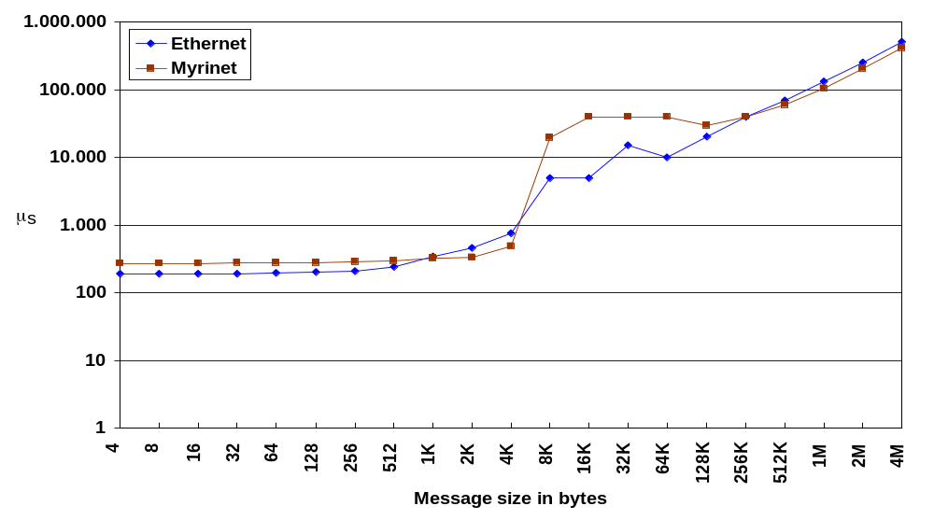
MPI One-way Latency
Notes:
Software overhead >>> network latency
4 8 16 32 64 128 256 512 1K 2K 4K 8K 16K 32K 64K 128K 256K 512K 1M 2M 4M
Ethernet
191 190 192 192 194 202 211 240 344 466 765 4.901 4.958 15.012 10.026 20.259 39.173 70.084 131.674 254.329 508.358
Myrinet
274 274 275 276 279 280 288 297 320 335 485 19.491 40.033 40.124 40.252 29.521 40.216 60.331 105.715 205.328 410.796

Slide 18
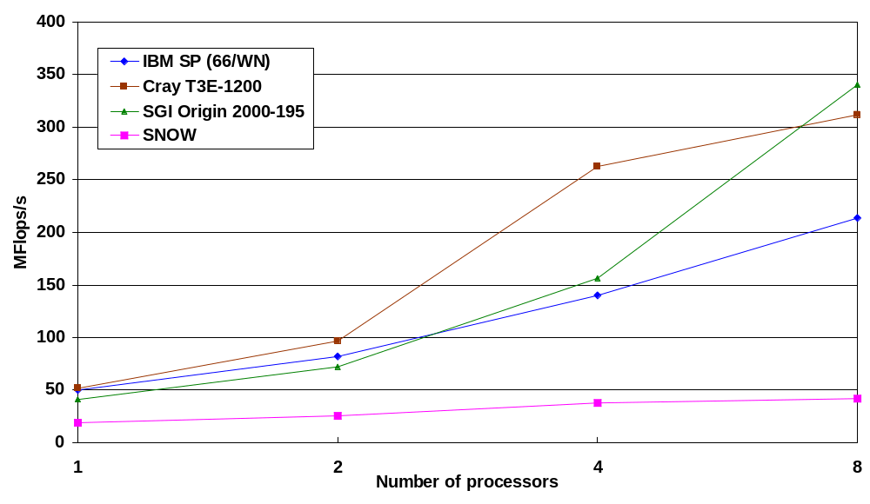
NAS PB 2.3
Conjugate Gradient
Notes:
NPB => widely accepted
C / F77
MPI
SGI => SMP SP/2 and Cray => MPP
1 2 4 8
IBM SP 50 81,4 139,6 213,5
Cray T3E 51,8 96,5 262,5 311,8
SGI Origin 41,1 72,3 155,9 340,1
SNOW 18,6 25,49 37,96 41,88
1 NODE SNOW = 2.5 x BEST
8 NODE => SNOW = 8 x BEST
MEMORY BANDWIDTH + IRREGULAR COMMUNICATION

Slide 19
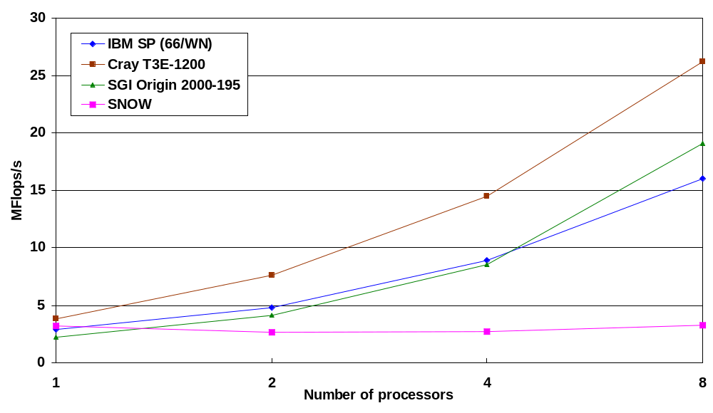
NAS PB 2.3
Integer Sort
Notes:
1 2 4 8
IBM SP 2,9 4,8 8,9 16
Cray T3E 3,8 7,6 14,5 26,2
SGI Origin 2,2 4,1 8,5 19,1
SNOW 3,21 2,65 2,67 3,27
1 S = 0.85 BEST
8 S = 1/8 BEST
SPECint95 PentiumII

Slide 20
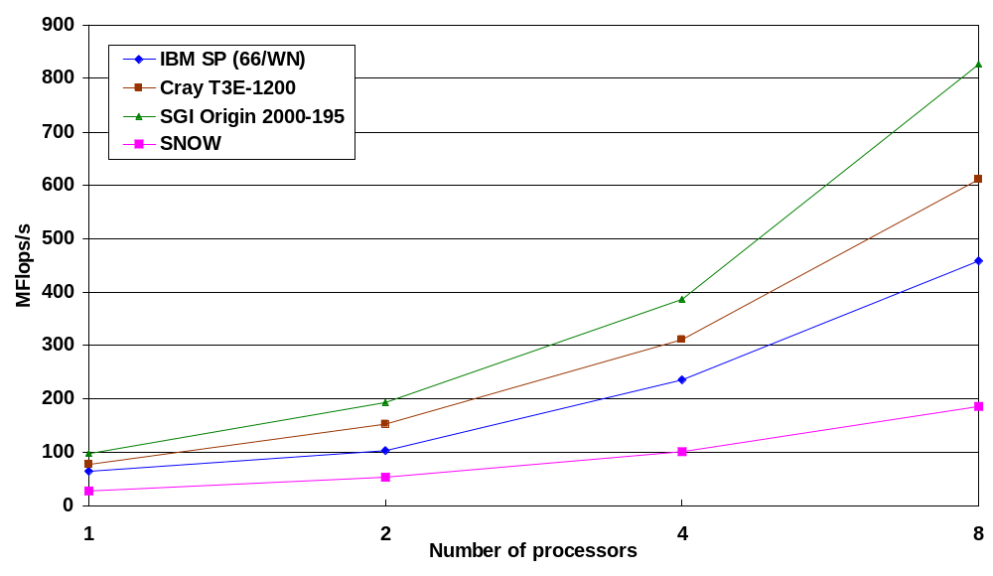
NAS PB 2.3
Laplace Solver
Notes:
1 2 4 8
IBM SP 63,8 102,2 236,2 457,8
Cray T3E 76,6 153,1 310,2 610,8
SGI Origin 96,8 193,6 387,1 826,7
SNOW 27,27 53,12 101,48 185,03
1 S = 1/4 BEST
8 S = 1/4 BEST
TOP SNOW RESULT = 185.3 Mflops/s

Slide 21
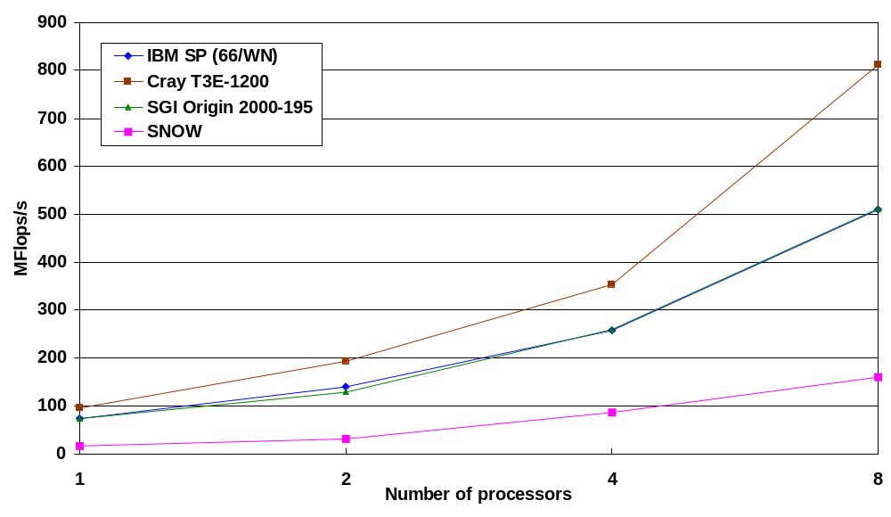
NAS PB 2.3
3D Multigrid
Notes:
1 2 4 8
IBM SP 73 140,2 257,3 510,7
Cray T3E 96,3 192,7 353,9 810,9
SGI Origin 73,9 129,7 259,5 512,1
SNOW 15,65 31,46 86,46 160,3
1 S = 1/6 BEST
8 S = 1/5 BEST

Slide 22
Hardware Conclusions
SUN and SGI opened the way
PCs
  L2 cache at CPU speed or broader path
  100 MHz memory bus => 640 MB/s
  64 bits 66 MHz PCI bus => 528 MB/s
  A matter of months (days)!

Slide 23
Software Conclusions
UNIX is sometimes of big inconvenience
Very high communication overhead
  System calls
  TCP/IP
  Secure multiplexing
Inadequate memory and I/O management
  Paging (physical or virtual)
Poor SMP support
  Lack of control
Notes:
Richar Martin => LogP => OVERHEAD!!!!!

Slide 24
User Level Communication
OS initializes the NIC and exports it to the applications
Communication bypasses the OS
  Lower overhead
  More flexibility
Multiplexing is a problem
HPC Applications
MPI
Myrinet (U.L.C.)
TCP/IP
SMP UNIX
Fast
Ethernet

Slide 25
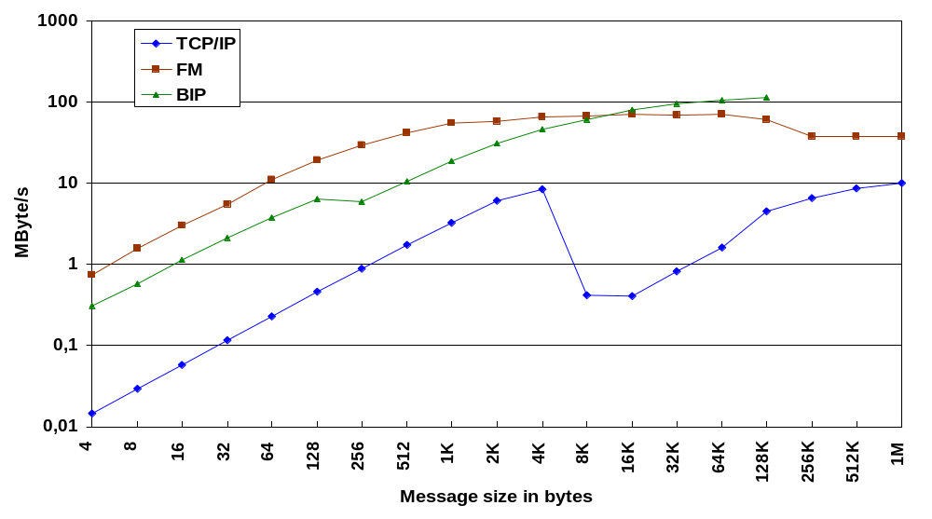
MPI Bandwidth with ULC
Notes:
4 8 16 32 64 128 256 512 1K 2K 4K 8K 16K 32K 64K 128K 256K 512K 1M
TCP/IP
0,014609 0,029155 0,058182 0,115984 0,229803 0,457306 0,888889 1,723325 3,203003 6,111608 8,452332 0,420288 0,409259 0,816662 1,628127 4,439943 6,518433 8,690178 9,918895
Illinois FM
0,747 1,565 2,977 5,503 10,978 18,949 29,571 42,013 55,452 57,76 65,606 66,291 69,736 69,34 69,996 60,585 37,243 37,528 37,826
INRIA BIP
0,307692 0,571429 1,142857 2,133333 3,764706 6,4 5,953488 10,44898 18,618182 31,030303 46,022472 60,235294 79,533981 94,705202 104,8576 113,679098

Slide 26
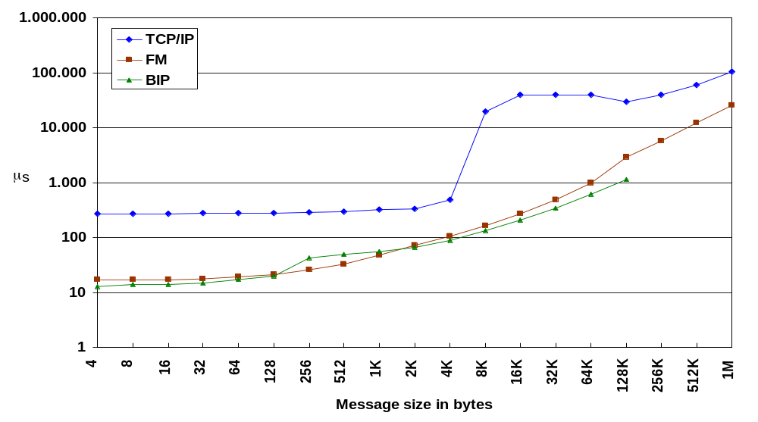
MPI One-way Latency with ULC
Notes:
4 8 16 32 64 128 256 512 1K 2K 4K 8K 16K 32K 64K 128K 256K 512K 1M
TCP/IP
274 274 275 276 279 280 288 297 320 335 485 19.491 40.033 40.124 40.252 29.521 40.216 60.331 105.715
FM
17,192 17,209 16,983 17,641 19,345 20,886 25,975 33,22 48,439 72,05 105,173 162,395 267,879 485,41 991,307 2885,499 5715,554 12355,037 25558,483
BIP
13 14 14 15 17 20 43 49 55 66 89 136 206 346 625 1153

Slide 27
Further Steps
HPC Applications
CPU
COMMUNICATION
FILE
MPI
Myrinet COCO
PURE
NFS
SMP UNIX
TCP/IP
Fast
Ethernet

Slide 28
Berkeley NOW
Microprocessor performance improves 50% per year
  MPPs come 1 to 2 year latter than WS
  MPPs are 1.5 to 2.25 „slower“ than WS
Costs drop 10% when volume doubles
  MPPs can sell 40 x 200 nodes
  WS can sell 100.000
  WS are 1/3 cheaper than MPPs

Slide 29
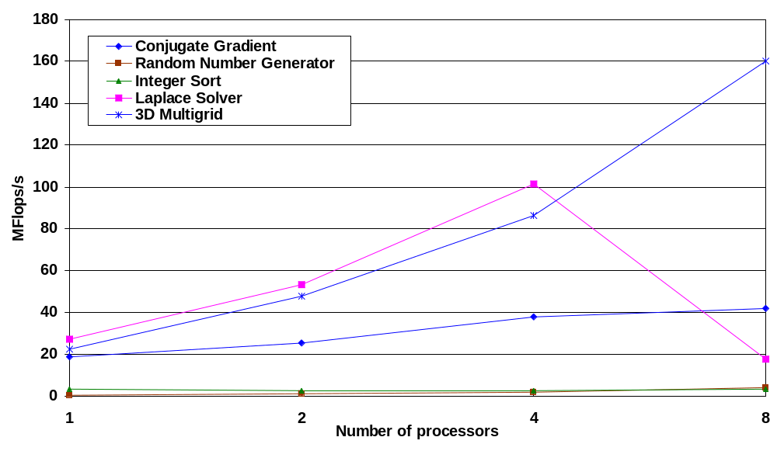
NAS

Slide 30
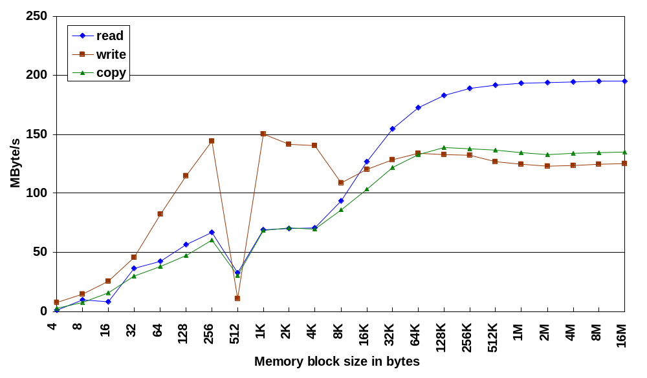
PC Memory Bandwidth
(cache miss)

Slide 31
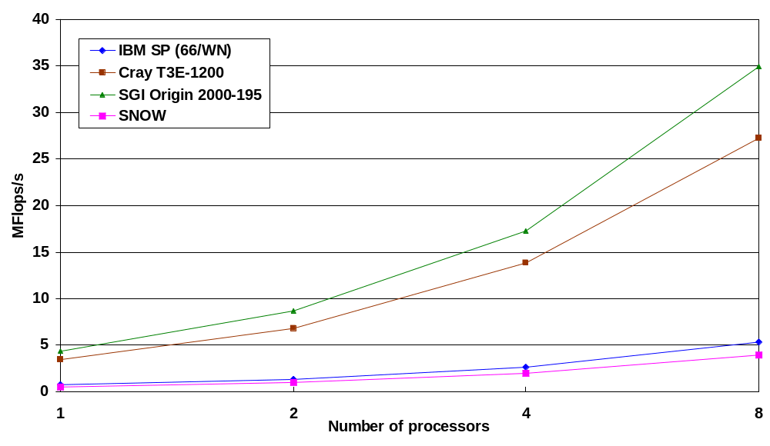
NAS PB 2.3
Random Number Generator
Notes:
1 2 4 8
IBM SP 0,7 1,3 2,6 5,3
Cray T3E 3,4 6,8 13,8 27,2
SGI Origin 4,3 8,7 17,3 34,9
SNOW 0,47 0,95 1,95 3,89
1 S = 9 / BEST
8 S = 9 / BEST

