Slide 1
Tailor-made Operating Systems for Embedded Parallel Applications
Antônio Augusto Fröhlich
Wolfgang Schröder-Preikschat
mailto:guto@first.gmd.de
http://www.first.gmd.de/~guto
April 1999
Notes:
Abstraction exercise
Name EPOS
Relaxed

Slide 2
Outline
Introduction
PURE
EPOS
Automatic operating system generation
Case study on system configuration
Further work
Conclusion

Slide 3
Introduction
Parallel embedded systems are booming
  Cars with more than 60 interconnected μ-controllers
  Demand for high performance
High performance parallel applications
  No all purpose, global or generic solutions
  Each application need it’s on runtime support system
Configurable operating systems

Slide 4
Fundamentals of PURE
Portable
  Native / guest level version
Universal
  Highly reusable and adaptable abstractions
Raw
  Minimal overhead for resource allocation
  No “paraphernalia”
Extensible
  Abstractions can be combined and specialized

Slide 5
The Design of PURE
Incremental system design
  Minimal subset of system functions
  Minimal system extensions
  Abstract machine that extends to applications
  Top down (application) driven
  Bottom-up construction
Revival of program families
  Family-based design
  Object-oriented implementation

Slide 6
The Design of PURE
Program Families
(Parnas 79)
Object Orientation
(Wegner 86)
minimal subset
superclass
incremental design
inheritance
minimal extensions
subclass

Slide 7
Making PURE
Application Ready
While a configurable operating system
  PURE is a complex set of complex objects
  PURE components repository is too complex to be managed manually
PURE doesn’t aim to support end-users
Many of PURE components are not application ready

Slide 8
The Gap to Applications (motivation for EPOS)
There are several strategies to configure system classes:
  The application programmer just needs to express what he wants out of a given ((very) reduced) set of system components!!!
Is a successfully configured collection of successfully configured system components an application-ready OS?
Notes:
Application compilation usually reveals disappointments!

Slide 9
Fundamentals of EPOS
Deep into object orientation
  OS = composition of system abstractions
Application driven configuration
  Each application gets its own OS
Invisibility
  Seems to be, e.g., Unix (standard APIs)
    Posix files, libc, libstdc++, libm, libf2c, MPI
Interaction with the application programmer via visual tools!

Slide 10
The Design of EPOS
(wiping the gap to applications away)
System Abstractions
  Independent from execution scenario aspects
  Bound to specific execution scenarios with the aid of scenario adapters
System Abstraction
system components
(building-blocks)

Slide 11
The Design of EPOS
(wiping the gap to applications away)
Inflated System Abstraction Interfaces
  Well-known to applications
  Comprehensive
  Promote requirement analysis
System Abstraction Interfaces
tasks
mailboxes
threads
tasks
ports
threads
tasks
links
threads
files
monitors
segments
db
locks
pages
persistent obj
semaphor
shared segments

Slide 12
The Design of EPOS
(wiping the gap to applications away)
Scenario Adapters
  Adapt an existing system abstraction to a given scenario
  Adapt system building-blocks to grant the semantics dictated by a given scenario
  Some can be automatic generated
Scenario Adapters

Slide 13
Automatic Operating System Generation
Application designed / coded referring the inflated system abstractions interfaces
Analyze the application and the execution context to draw an OS blueprint, e.g.:
  Single / multi-task?
  Single / multi-thread?
  Local / remote object invocation?
  Trusted / protected environment?
Tailor an OS for this application

Slide 14
Application Requirements
Complex Application Program
code = new Segment(buffer, size);
task = new Task(code, data);
thread = new Thread(task, &entry_func,
priority, SUSPENDED, arguments);
mutex->entry();
Mailbox mailbox;
mailbox >> message;
File file(name);
file << mailbox;
tasks
mailboxes
threads
Application’s
OS Requirements
Analyzer
files
mutex
segments

Slide 15
Application Requirements
Simple Application Program
File file(name) >> matrix;
thread = new Thread(&entry_func);
Channel link(destination);
link << mesage;
threads
Application’s
OS Requirements
Analyzer
files
links
flat memory

Slide 16
Application Requirements
Real Application Program (MPI)
Channel link(destination);
link << mesage;
Application’s
OS Requirements
Analyzer
links
flat memory

Slide 17
Context Information
We need context (user) information
  new Thread(task, &func) => location?
  mailbox << message => protocol?
  Absence of Task => single-task?
Buid up databases
  Scenario dependencies
  Target machine (cluster) description
Notes:
Several aspects can not be inferred by analyzing the application. Only the user know them!

Slide 18

Execution Scenario
tasks
mailboxes
threads
+
=
required
interfaces
Execution Scenario
files
monitors
segments
Notes:
Several aspects can not be inferred by analyzing the application. Only the user know them!

Slide 19
Configuring a Scenario
Why should configuring a scenario from a collection of scenario adapters be easier then configuring an OS from a collection of system components?
  Coarser grain configuration
  Scenario adapters are conceived for configuration
  Configuration information is not spread in the operating system components
  Enables automatic configuration

Slide 20
Application Driven OS
Application
Interfaces
Scenario Adapters
System Components
System Abstractions

Slide 21
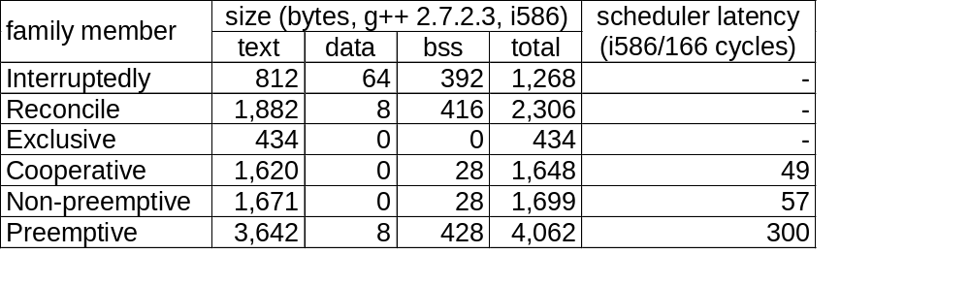
The PURE Nucleus Family
(a case study on system configuration)
PURE nucleus family
Application requiring scheduling every 10 μs
  “preemptive” => 15% slower than “exclusive”
PEACE measured improvements of up to 74% by selecting the proper operating system family member

Slide 22
Further Work
EPOS doesn’t grant the tailored OS to be the optimal
  When several family members fulfill the requirements, the selection is arbitrary
EPOS will include profiling
WABE will use formal description

Slide 23
Conclusion
PURE
  Collection of reusable operating system classes
WABE
  Construction of optimal system abstractions out of PURE classes
EPOS
  Assembly of application specific operating systems by the adaptation and combination of (WABE) system abstractions

Slide 24
Conclusion
High Performance Embedded Parallel Computing calls for Application-Oriented Operating Systems
  Inflated system abstraction interfaces
  Scenario adapters
  Automatic OS generation
PURE + EPOS shall pave the way to Embedded Parallel Applications

