Slide 1
Operating System Support for Handling Heterogeneity in Wireless Sensor Networks
  Lucas Wanner
  Antônio Augusto Fröhlich
  Laboratory for Software/Hardware Integration
  Federal University of Santa Catarina
  guto@lisha.ufsc.br
  http://www.lisha.ufsc.br/
  September 21, 2005

Slide 2
WSN Hardware
Basic recipe
  Microcontroller
  Low-power radio
  Battery
  Just about any sensor you can think of
Result
  Myriad of sensing platforms
  Similar functionality
  Different implementations

Slide 3
Current WSN Hardware “Incarnations”

Slide 4
WSN Sensors
Just about anything!
  Example: Mica sensor boards
    Temperature
      YSI 44006 (analog)
      Panasonic ERT-J1VR103J (analog)
      Sensirion SHT11 (digital)
      Intersema MS55ER (digital)
    Light
      CdSe Photocell (analog)
      TAOS TLS2550 (digital)
    Accelerometer
      Analog Devices ADXL202JE (analog)
    Magnetometer
      Honeywell HMC1002 (analog)

Slide 5
WSN Programming Models
As regards the level of abstraction
  Assembly language
  Programming language with run-time support libraries
  Operating system
  Middleware or virtual machine

Slide 6
Assembly
Myth
  Real men do it in assembly!
  Efficient
  Absolute control over the hardware
  No dependencies (compiler, OS, etc)
  Applications for WSN are usually simple
Reality
  Error-prone
  Little room for code reuse
  Complexity for applications is a limiting factor
  Compilers can generate efficient code

Slide 7
Programming Language
Myth
  Code reuse through simple libraries
  Complete control over the hardware
    Inline assembly?
  Little overhead
Reality
  No context-aware abstraction model
  Portability easily compromised (assembly and run-time support system)
  For complex (real) applications, run-time support libraries get close to fully-fledged operating systems

Slide 8
Operating System
Myth
  Implementation details hidden by API
  Application portability sustained
  Complex programming models
  Excessive overhead
Reality?
  Let’s take a deeper look

Slide 9
A Simple Sensing Application
Continuously check a temperature sensor, forwarding the acquired data through a serial line
On the traditional Mica2 motes
Using two traditional OS for WSN
  TinyOS
    Component-based architecture
    NesC (commands, events, similar to HDLs)
    Task-based scheduling
    Layered hardware abstraction
  Mantis
    POSIX-like API
    Monolithic Hardware Abstraction Layer (device drivers)

Slide 10
Application on TinyOS
configuration SenseToUART {}
implementation {
components Main, SenseToInt, IntToUART,
TimerC, DemoSensorC as Sensor;
Main.StdControl -> SenseToInt;
Main.StdControl -> IntToUART;
SenseToInt.Timer ->
TimerC.Timer[unique("Timer")];
SenseToInt.TimerControl -> TimerC;
SenseToInt.ADC -> Sensor;
SenseToInt.ADCControl -> Sensor;
SenseToInt.IntOutput -> IntToUART;
}

Slide 11
Application on Mantis
static comBuf send_pkt;
void start (void) {
send_pkt.size=1;
while(1) {
dev_read(DEV_MICA2_TEMP,
&send_pkt.data[0],1);
com_send(IFACE_SERIAL, &send_pkt);
}
}

Slide 12
Operating System
Myth
  Implementation details hidden by API
  Application portability sustained
  Complex programming models
  Excessive overhead
Reality
  Exposed implementation details
  Neither OS provides an interface for dealing with sensors
  Neither OS sustains application portability
  Excessive overhead (as we will see soon)

Slide 13
Middleware / Virtual Machine
Myth
  Implementation details and OS hidden by API
    But usually some escape provided
  Application portability sustained
  Adequate programming models (high-level services)
  Acceptable overhead
Reality
  Same design flaws of traditional OS
  Prohibitive cost
    Does anyone have a VM for a 4K RAM -controller?

Slide 14
A Run-time Support System for WSN
Programming model that is adequate for application programmers (and not system programmers)
Effective hardware abstraction mechanisms
  High-level sensing subsystem
Application portability
Little overhead
...
An Application-Oriented Operating System

Slide 15
The EPOS System
Embedded Parallel Operating System
  A collection of software components designed according to AOSD principles
  A meta-programmed framework
  A set of tools to assist the selection, configuration and adaptation of those software components
Portability
  EPOS abstractions interact with hardware components through mediators
  Hardware mediators sustain an interface contract between system abstractions and the machine

Slide 16
EPOS Sensing Subsystem
Sensor hardware mediators
  Uniform interface
  Platform-dependent implementations
  Example
    Panasonic ERT-J1VR103J (temperature)
    Analog Devices ADXL202JE (acceleration)
    Honeywell HMC1002 (magnetic force)
Sentient system abstractions
  User-visible software components
  Platform-independent implementations
  Example
    Thermometer
    Accelerometer
    Magnetometer

Slide 17
EPOS Sentients
A Sentient abstraction can autonomously react to Sensor variations
  Logs
  Alarms
  Actuator invocations
Applications using sentient abstractions can be transparently ported to different sensing platforms
  Distinct Sensors
  Same Hardware Mediator interface

Slide 18
What about the Sensing Application on EPOS?
#include <thermometer.h>
#include <uart.h>
Thermometer thermometer; // Sentient
UART uart(9600,8,0,1); // Mediator
int main()
{
while(1)
uart.put(thermometer.get());
}

Slide 19
Results: System Footprint
Build for Mica2 motes (size in bytes, system + application)
Program Memory
Data Memory

Slide 20
Further Work
Support for different hardware platforms
  Mica2
  Telos
  BT-node
More Sentient abstractions
  Integration with EPOS active object model
Extended evaluation
  Performance
  Energy consumption

Slide 21
Conclusions
We believe we have defined a model for a real WSN run-time support systems
  Application-oriented system design
  Sensors
  Sentients
  OS relieves applications from the dirty work
But it is too early to claim success
  Can we really abstract a considerable set of sensors under a common interface?
    I.e., is there a temperature sensor common interface?
  Will sentients fit in tiny platforms?
    Wireless communication usually demands a lot of resources

Slide 22
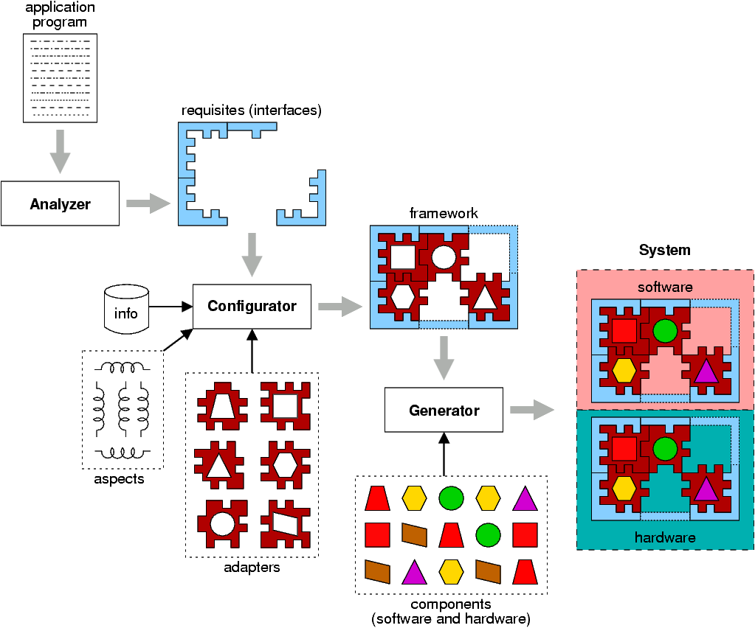
How does it work?

Slide 23
OS Support for Handling Heterogeneity in WSN
Questions and Comments
This work was partially supported by FINEP grant no. 01.04.0903.00

Slide 24
Outline
(We all know the) Hardware for WSN
How do we program a Sensor Network?
  Why should I care?
  The myths of WSN Programming
What could be different?
What's your solution?
Is it any good?
What's next?

Slide 25
What's your solution?
Example: Building a fire-combat system
  Temperature and Humidity Sensors are abstracted by uniform Hardware Mediators
  A Fire Alarm Sentient Abstraction uses Sensor readings to detect whether there is a fire and raise an alarm to the application

Slide 26
What's your solution?
Software engineering!
Dedicated Application Support
  Provide everything the application needs, and only what the application needs
Example: Designing a Sensing Subsystem
  Device drivers must abstract heterogeneous hardware in an uniform fashion
  Applications should not deal directly with Sensor devices, but with high-level, context-aware constructs

