Slide 1
A Hierarchical Approach for
Power Management in Mobile Embedded Systems
  Arliones Stevert Hoeller Jr.
  Lucas Francisco Wanner
  Antônio Augusto Fröhlich
  DIPES 2006

Slide 2
Outline
Power management infrastructure
Power management in deeply embedded systems
Application-driven power management
Implementation in EPOS
First results
Further work

Slide 3
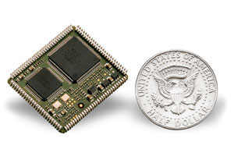
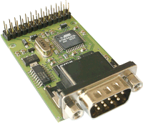
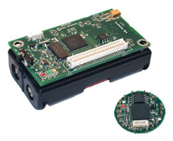
Deeply Embedded Systems (DES)
Application-specific, tiny devices with resource limitations
  8-bit, 3-4 Mhz microcontrollers
  Small data and program memories
  Several peripherals
    Battery = System Lifetime

Slide 4
Power Management Infra-structure
Hardware support for power management
  Operating modes (CPU, UART, ADC, etc)
  Frequency and voltage scaling
  Event counters
Power management standards (e.g. APM, ACPI)
  At the Hardware/Software interface
  Too complex for DES
Deeply embedded systems solutions
  Context-specific
  Partial hardware coverage
  Compromise application portability

Slide 5
Power-awareness in DES
DES “Operating Systems”
  Simplistic HALs
  No or few high-level abstractions
  Power management targeted at the CPU
  Power state transitions implemented by APP
DES Energy-Awareness
  Contestable energy efficiency
    Peripherals often consume more than peripherals
  Compromised portability
    Hardware details exposed to applications

Slide 6
Proposal
Application-Driven Power Management
  Uniform PM API (software and hardware)
    Including high-level abstractions
  Hierarchical state transitions propagation
    Formalized through Petri Nets
  Static-metaprogrammed implementation
    No unnecessary overhead
  Example
    file.power(OFF);
    communicator.power(OFF);
    cout.power(ON);

Slide 7
Power management API
Interface is simple and uniform
  power(Mode s)
  Mode power()
Configurable operating modes
  Components export all operating modes
  Application programmer binds real operating modes to “label” modes
  [FULL | LIGHT | STANDBY | OFF]

Slide 8
Power State Transition Propagation
Components are hierarchically organized
Application programmer sees high-level abstractions (e.g., Thread, File, Alarm, Temperature_Sensor)
Operating mode transition messages are propagated throughout components following a dependency graph

Slide 9
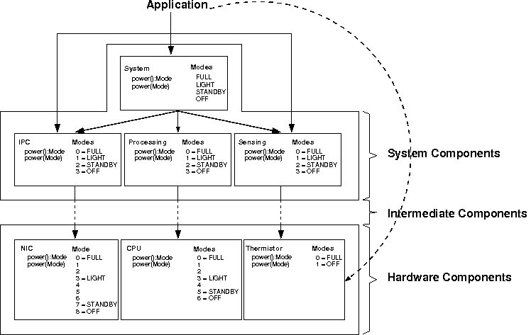
Accessing the API

Slide 10
Operating Mode Transition Nets
Formalized through Petri Nets
Define conditions to transitions
Organized to represent the proposed power state transition mechanism
Generalized transition structure
  OFF, STANDBY, LIGHT, FULL
  Finite reachability graph => state analysis

Slide 11
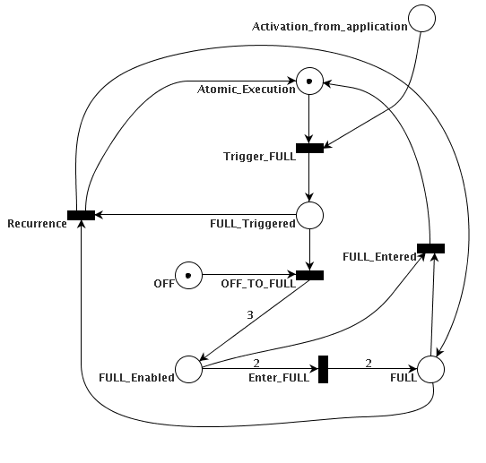
Generalized Transition Net
* the full version covers all operating modes

Slide 12
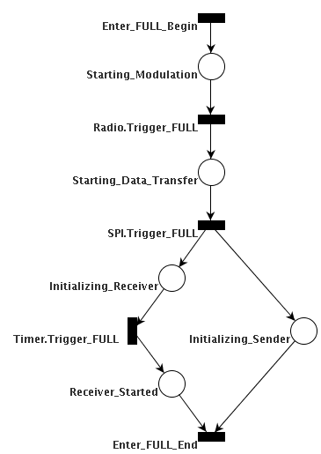
Hierarchical Nets
B-MAC
2
2

Slide 13
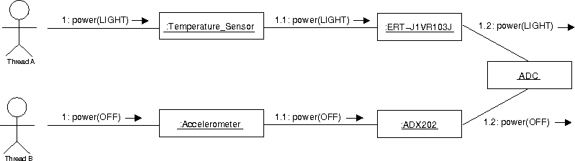
Shared Dependencies
Solution
  Reference counter for each operating mode
  Component stays in the highest operating mode which has “users”
      j is the wanted mode
      opmode is the set of counters
      If Pj = 0 then j is entered

Slide 14
Implementation in EPOS
Application-Oriented System Design
  Domain Engineering methodology
  Components + Aspects + Frameworks
Power Management API
  Power management is a non-functional feature of computing systems
  This interface was modeled as an Aspect Program implemented using C++ meta-programming techniques

Slide 15
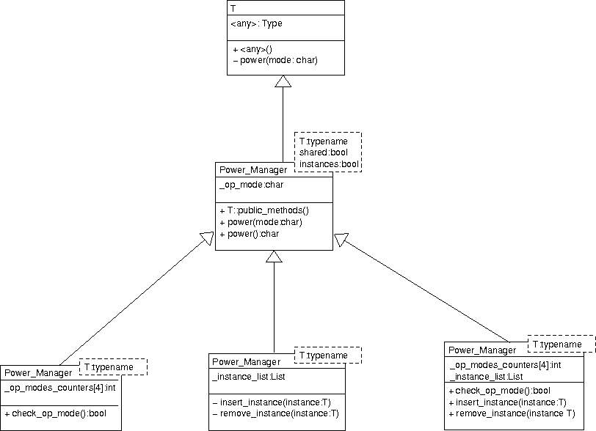
Power Manager Aspect

Slide 16
Sample Application
#include <system.h>
#include <sensor.h>
#include <uart.h>
#include <alarm.h>
using namespace System;
System sys;
Temperature_Sensor sensor;
UART uart;
void alarm_handler() { uart.put(sensor.sample()); }
int main() {
Handler_Function handler(& alarm_handler);
Alarm alarm(1000000,& handler);
while(1) {
sys.power(STANDBY);
}
}

Slide 17
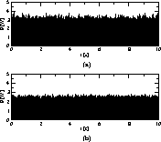
Power Consumption in Example
Hardware
  STK-500, ATMega16, 10 KΩ Thermistor
Software
  EPOS (System, Alarm, UART, Temp_Sensor)
Consumption: 3.96 J
38.1 % less
energy
Consumption: 2.45 J

Slide 18
Summary
Application-Driven power management in deeply embedded systems
  Little overhead
  Platform-independent (application portability)
Uniform API
  Configurable operating modes
  On high-level abstractions
  Easier application programming

Slide 19
On-going Work
Dynamic power manager
  A thread shuts down everything that is not in use at the moment
    Usage/reference counters
    Enabled test on most operations
Static power consumption model
  Enables design space exploration
  Profiling of use cases
    Classify high-level components in regard to power consumption
    Sometimes even estimating battery time

Slide 20
Complex example
MP3_Player player;
Display display;
//...
void main() {
  //...
  char * file_name = select_file();
  display.power(LIGHT);
  play_file(file_name);
  //...
}
//...
void play_file(char * file_name) {
  File file(file_name);
  player.load(file);
  file.power(OFF);
  player.play();
}

